Slide 1
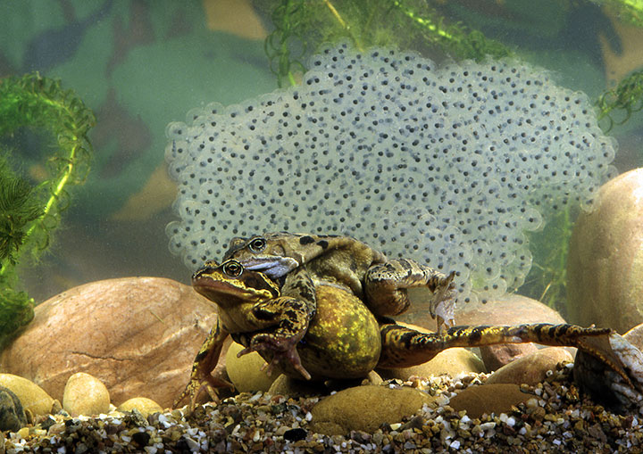
Reproduction in Amphibians

Slide 2
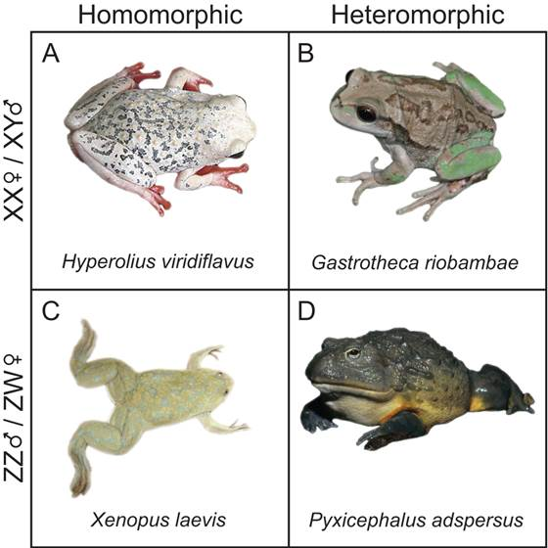
Amphibian reproduction
Most are sexual
XY, ZW

Slide 3
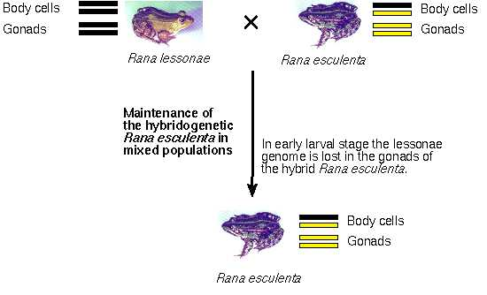
Amphibian reproduction
Most are sexual
XY, ZW
Clonal
hybridogenesis:
Pelophylax (Rana) esculenta

Slide 4
Amphibian reproduction
Most are sexual
XY, ZW
Clonal
gynogenesis:
Ambystoma jeffersonianum complex

Slide 5
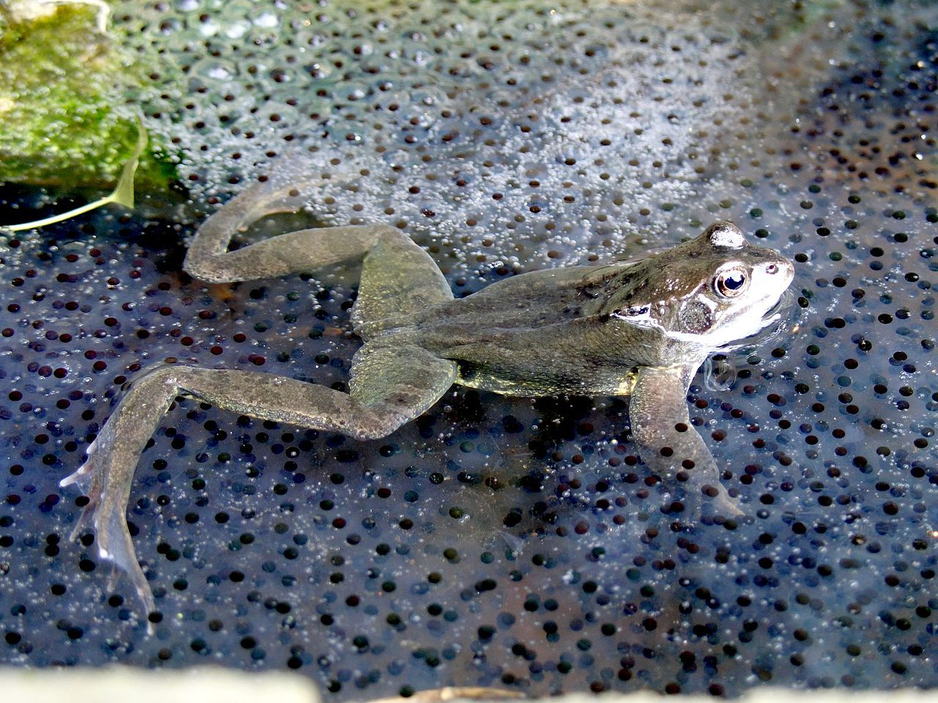
Amphibian reproduction
Temperate
seasonal
rainfall, temperature triggers
ponds and lakes
explosive breeding

Slide 6
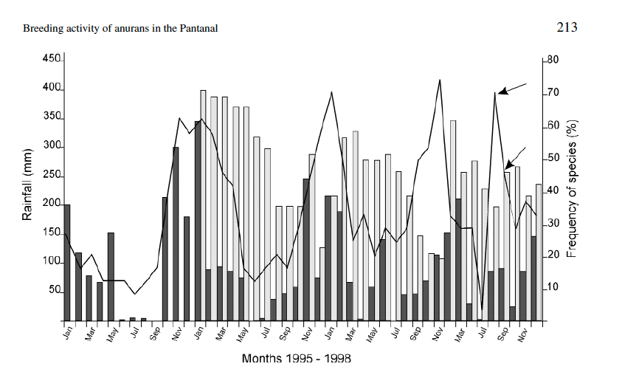
Amphibian reproduction

Slide 7
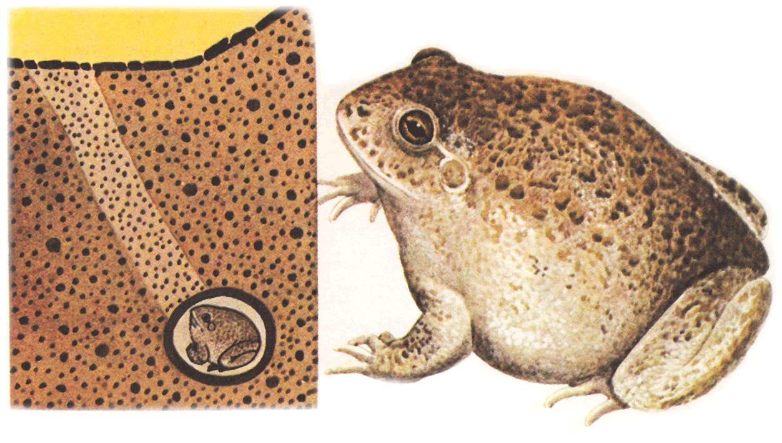
Explosive/ephemeral seasonal breeding

Slide 8
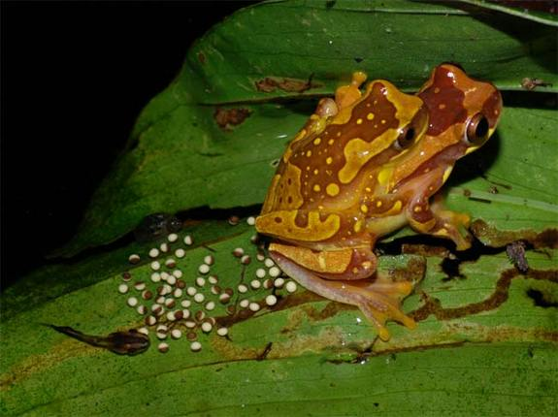
Frog reproduction
Tropical
breeding throughout the year
rainfall may trigger
diversity of reproductive strategies, breeding sites

Slide 9
Tropical frog reproduction
Tropical

Slide 10
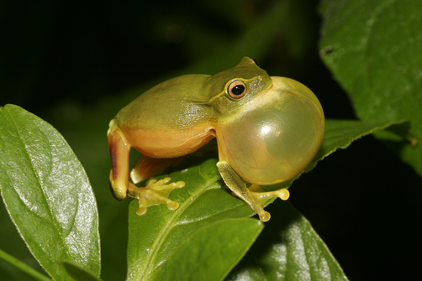
Frog vocalization

Slide 11
Frog vocalization

Slide 14
Amplexus

Slide 15
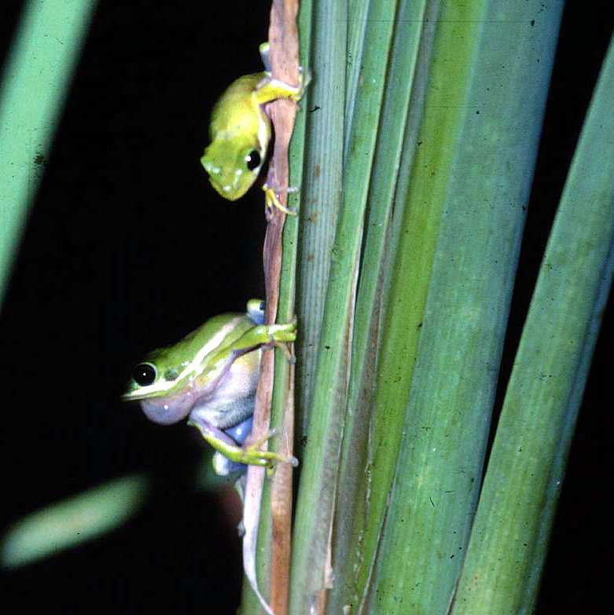
Alternative mating strategies in frogs
satellite males

Slide 16
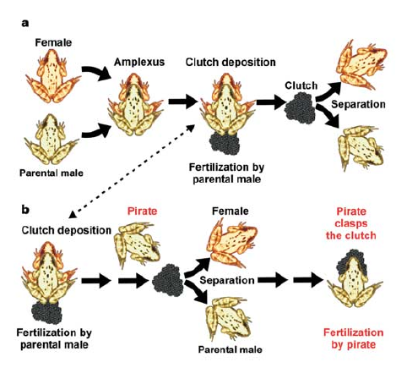
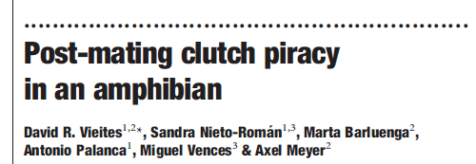
Alternative mating strategies in frogs
satellite males
clutch piracy

Slide 17
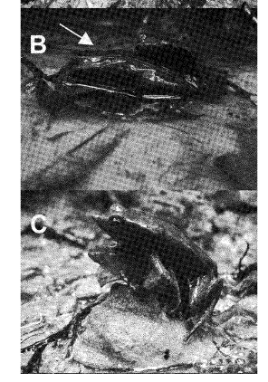
Alternative mating strategies in frogs
satellite males
clutch piracy
functional necrophilia

Slide 18
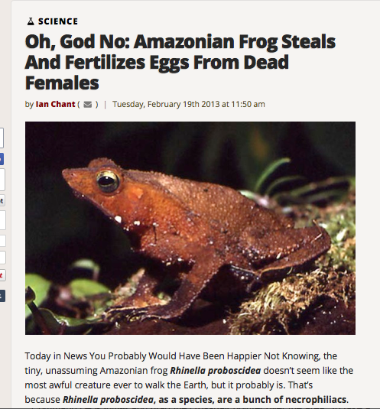

Slide 19
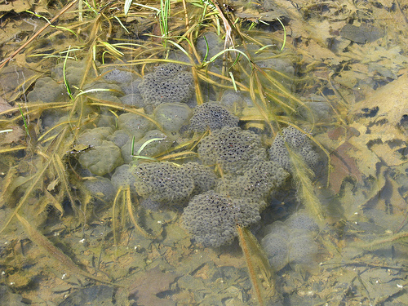
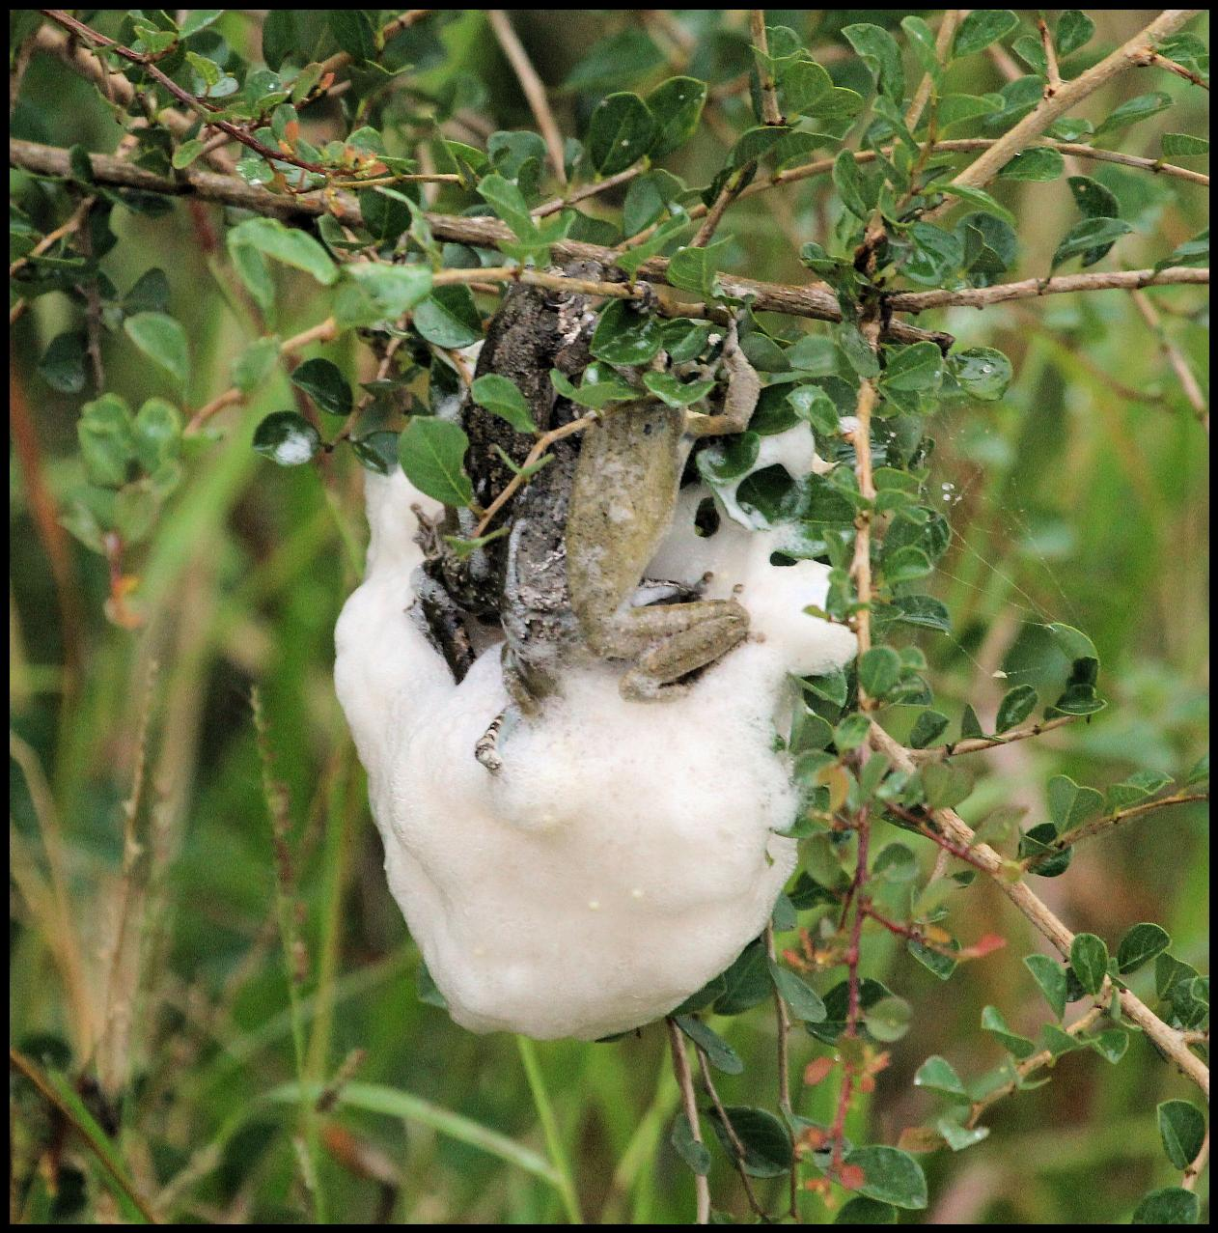
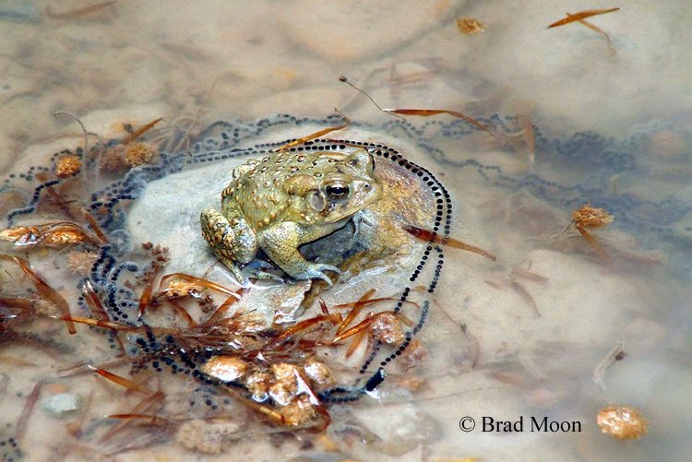
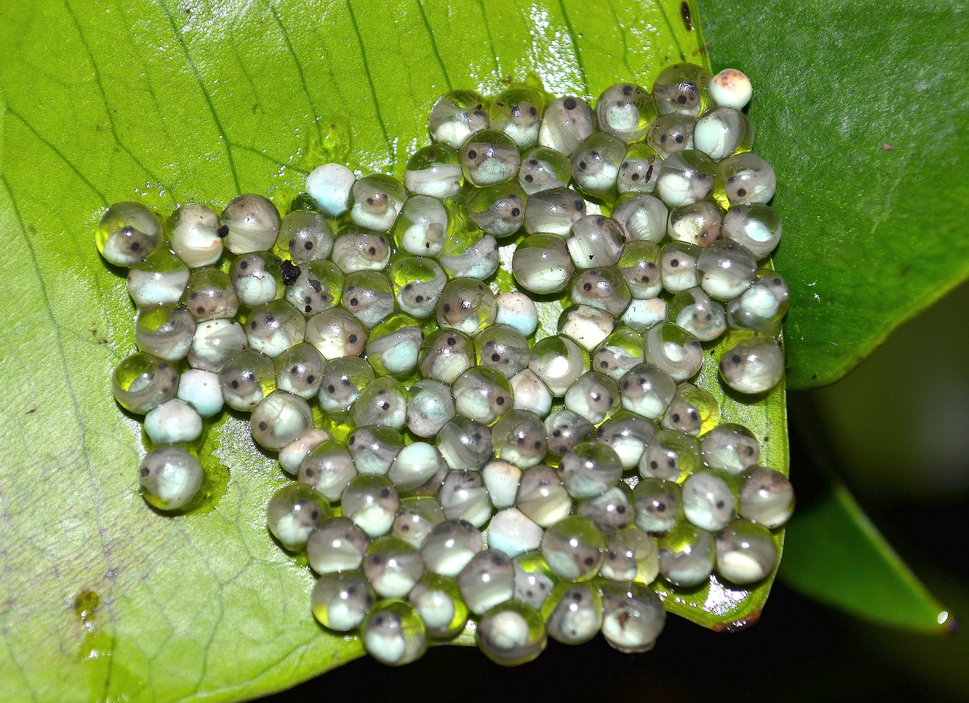

Slide 23
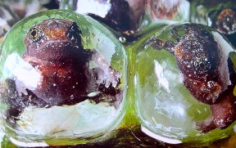

Slide 24
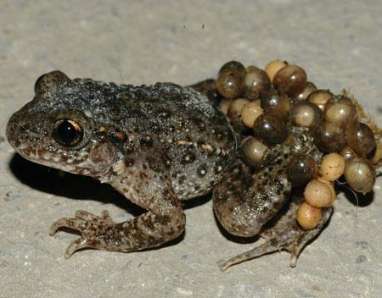
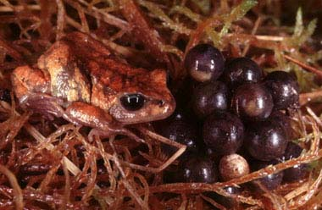
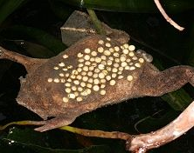
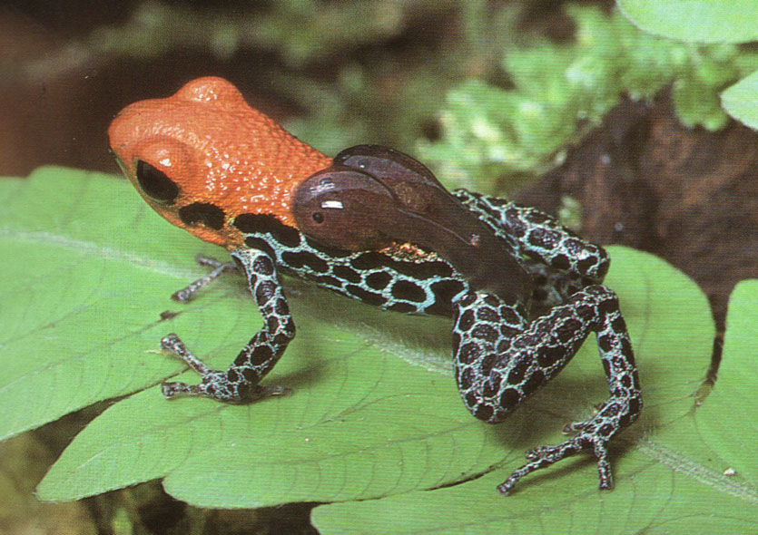
Parental care
Internal Brooding
(♀ → Gastric Brooders)

Slide 25
Parental care: Dendrobates

Slide 26
Parental care: Pipa

Slide 27
Parental care: Rhinoderma

Slide 28
Tadpoles

