Slide 1
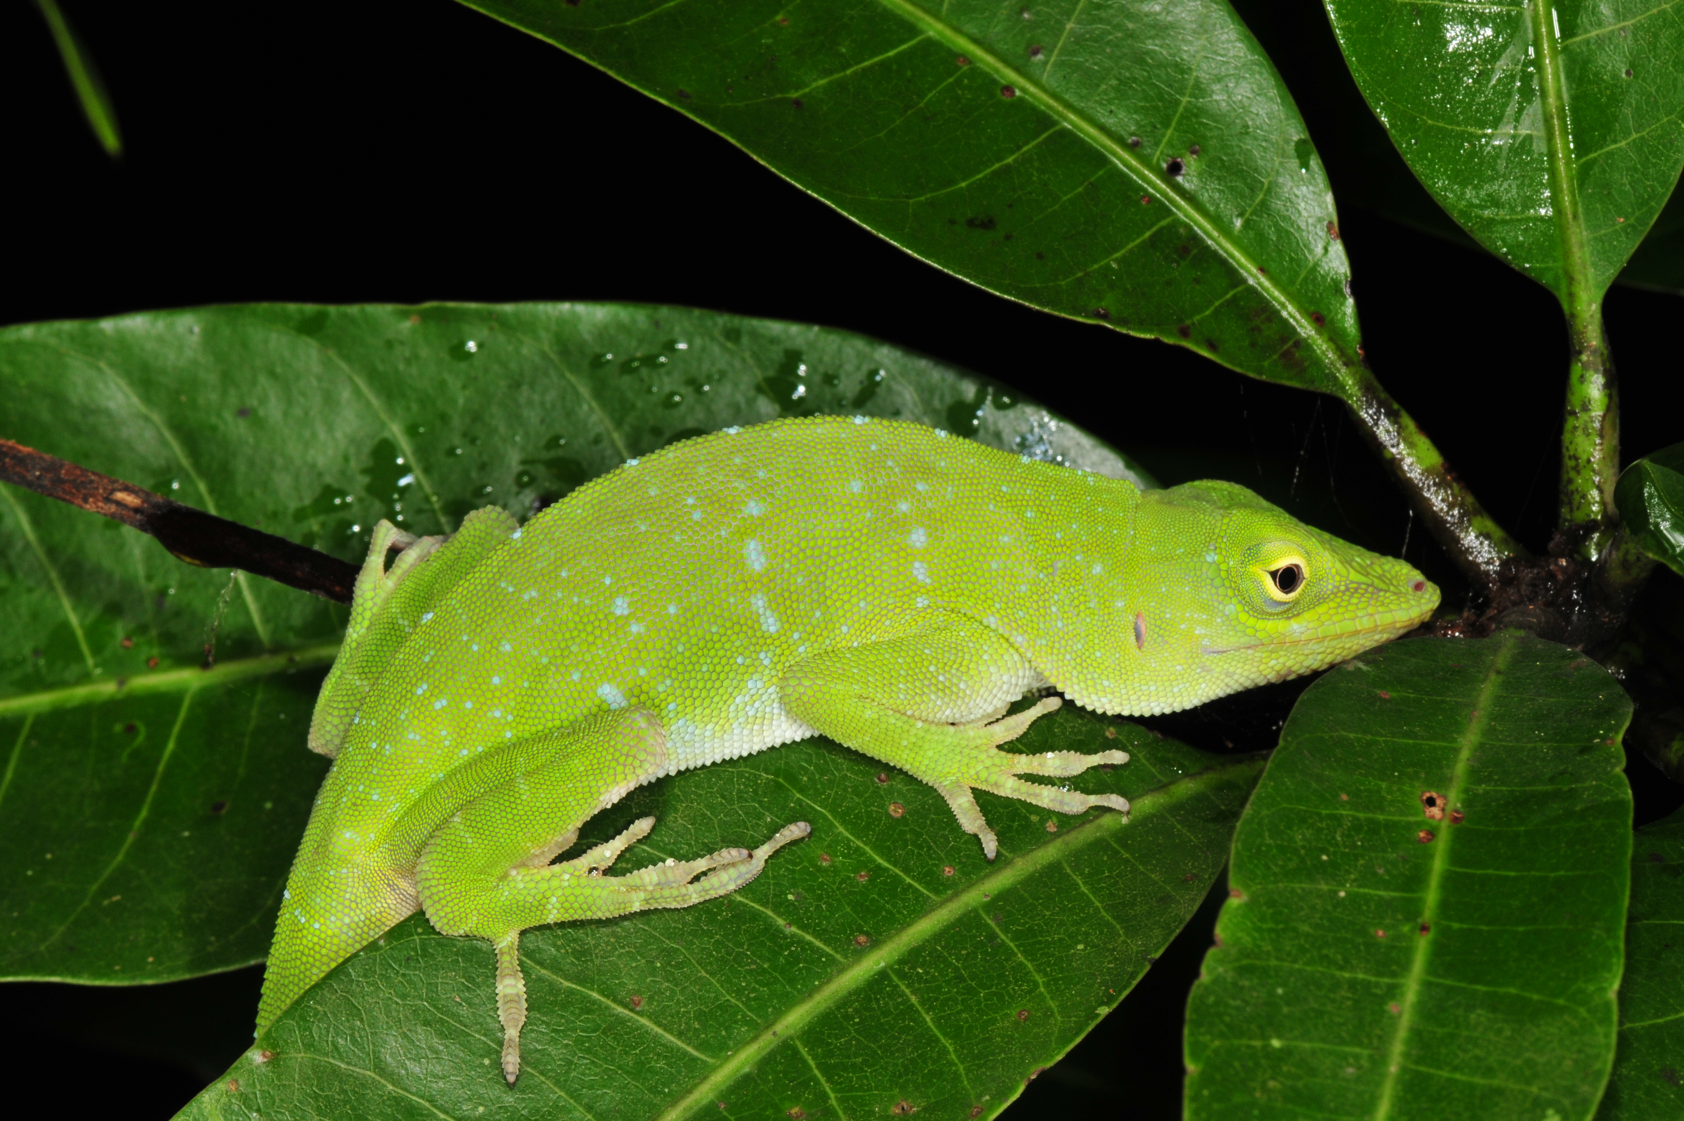
Herpetology 1 September 2022
Species
Species discovery
Species description
Speciation

Slide 2
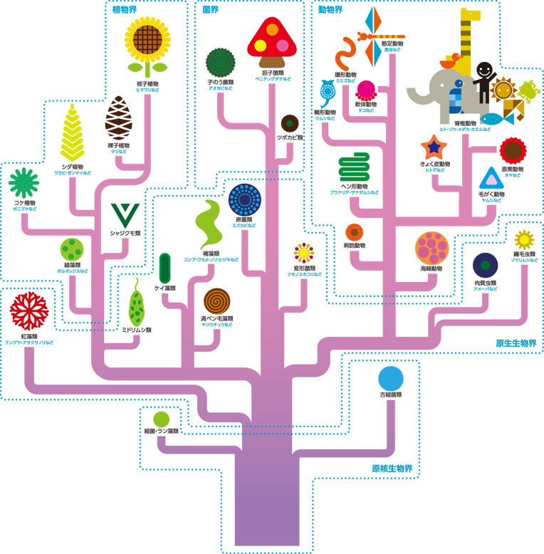
Systematics
Taxonomy
Classification
Nomenclature
Phylogenetics

Slide 3
Species definitions

Slide 4
Species definitions
Phenetic species concept: A species is a set of organisms that are similar to each other and distinct from other sets (Sokal and Crovello 1970).

Slide 5
Species definitions
Phenetic species concept: A species is a set of organisms that are similar to each other and distinct from other sets (Sokal and Crovello 1970).
Ecological species concept: A species is a set of organisms exploiting (or adapted to) a single niche (Van Valen 1976).

Slide 6
Species definitions
Phenetic species concept: A species is a set of organisms that are similar to each other and distinct from other sets (Sokal and Crovello 1970).
Ecological species concept: A species is a set of organisms exploiting (or adapted to) a single niche (Van Valen 1976).
Biological species concept: Species are groups of actually or potentially interbreeding natural populations, which are reproductively isolated from other such groups (Mayr 1942).

Slide 7
Species definitions
Phenetic species concept: A species is a set of organisms that are similar to each other and distinct from other sets (Sokal and Crovello 1970).
Ecological species concept: A species is a set of organisms exploiting (or adapted to) a single niche (Van Valen 1976).
Biological species concept: Species are groups of actually or potentially interbreeding natural populations, which are reproductively isolated from other such groups (Mayr 1942).
Phylogenetic species concept: A species is the smallest diagnosable cluster of individual organisms within which there is a parental pattern of ancestry and descent (Cracraft 1983).

Slide 8
Species definitions
Phenetic species concept: A species is a set of organisms that are similar to each other and distinct from other sets (Sokal and Crovello 1970).
Ecological species concept: A species is a set of organisms exploiting (or adapted to) a single niche (Van Valen 1976).
Biological species concept: Species are groups of actually or potentially interbreeding natural populations, which are reproductively isolated from other such groups (Mayr 1942).
Phylogenetic species concept: A species is the smallest diagnosable cluster of individual organisms within which there is a parental pattern of ancestry and descent (Cracraft 1983).
Evolutionary species concept: A species is a single lineage of ancestor-descendant populations which maintain its identity from other such lineages and which has its own evolutionary tendencies and historical fate (Wiley 1981).

Slide 13
Species (Frost and Kluge 1994; deQueiroz 1998)
Species concept: What is a species?
Species criterion: How can we tell whether two groups of individuals are separate species?

Slide 14
Species (Frost and Kluge 1994; de Queiroz 1998)
Species concept: What is a species?
an evolutionary lineage (ancestors => descendants) of populations (=Evolutionary Species Concept)
Species criterion: How can we tell whether two groups of individuals are separate species?

Slide 15
Species (Frost and Kluge 1994; de Queiroz 1998)
Species concept: What is a species?
an evolutionary lineage (ancestors => descendants) of populations (=Evolutionary Species Concept)
Species criterion: How can we tell whether two groups of individuals are separate species?
Can they interbreed? (Biological Species Concept)
Do they occupy different niches? (Ecological Species Concept)
Does some trait(s) differentiate them (Phenetic Species Concept)
Does a phylogenetic analysis indicate they are distinguishable by synapomorphies? (Phylogenetic Species Concept)

Slide 16
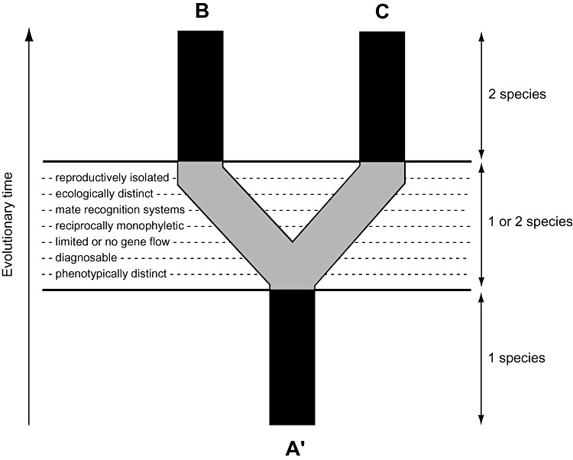

Slide 17
Summary/important aspects of species
Species are evolutionarily independent lineages of populations (EVSC)
Most species "concepts" (BSC, PHYSC, ECSC, PHENSC) capture operational elements of the EVSC
Species are "natural" entities, not human constructs
Subspecies are operational pattern classes
Interbreeding is (very) important, but it is just one aspect of species and speciation

Slide 18
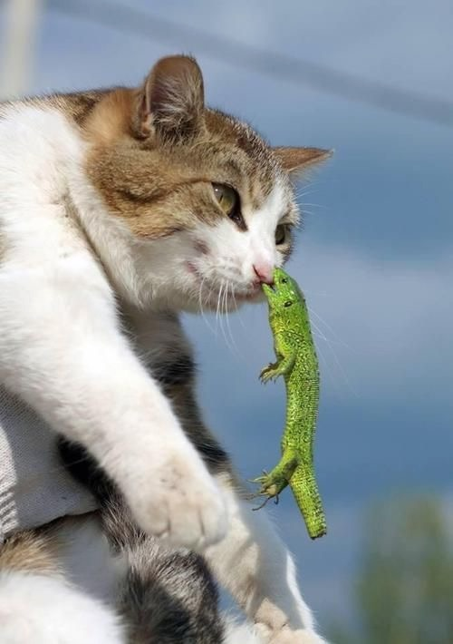

Slide 19
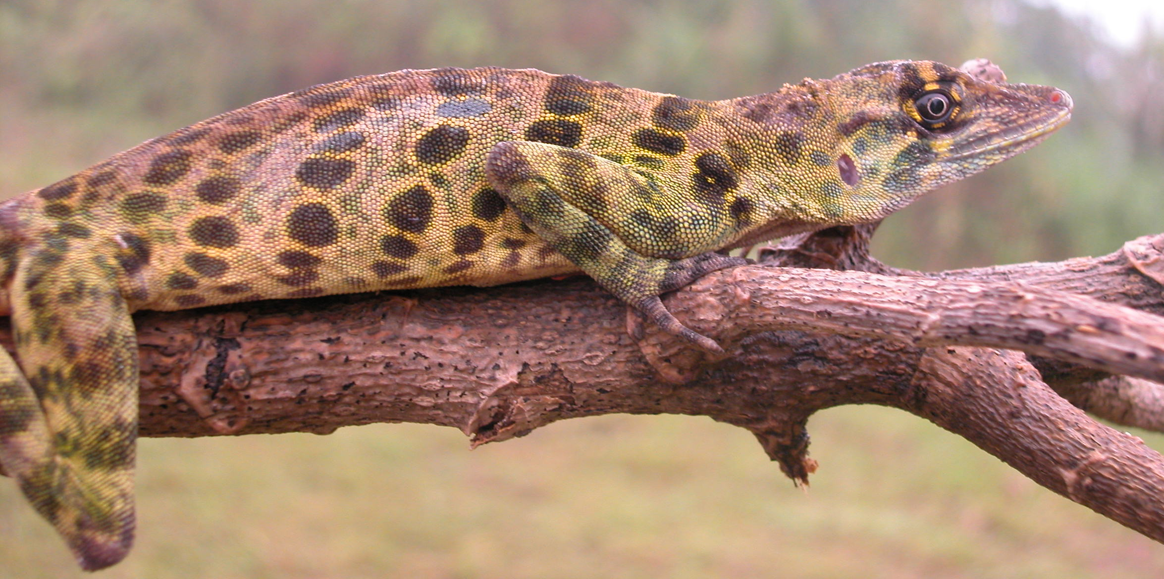
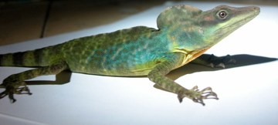
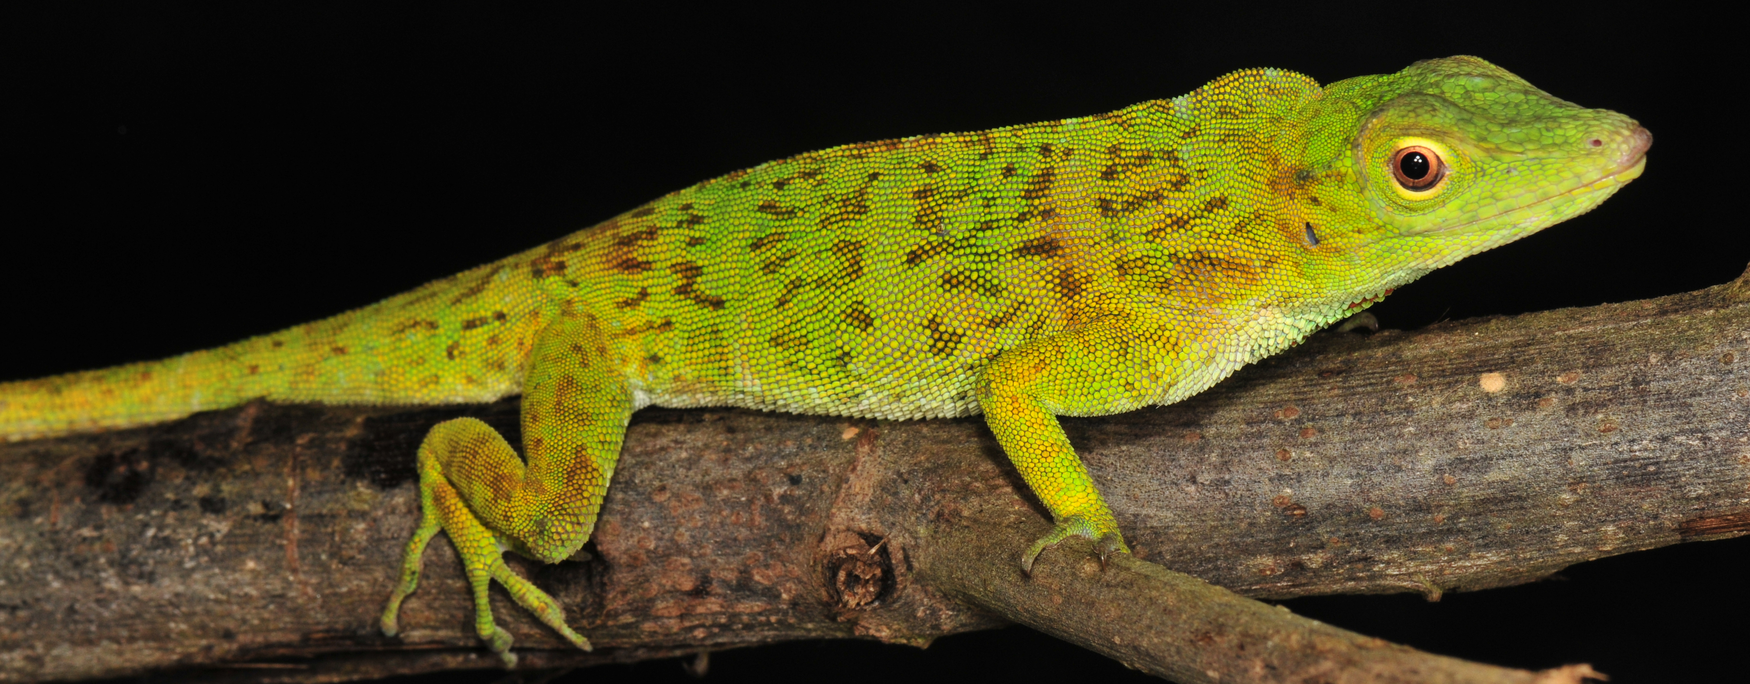
Species discovery
Phenetic
Find an individual or population in nature that appears different from other known populations
Compare individuals of purported new species to individuals of known species; search for diagnostic differences

Slide 20
Species discovery
Phenetic
Find an individual or population in nature that appears different from other known populations
Compare individuals of purported new species to individuals of known species; search for diagnostic differences
Phylogenetic
Obtain DNA sequences for multiple individuals from throughout the range of a species
Perform phylogentic analysis
Recognize separate clades with some degree of genetic divergence as separate species

Slide 21
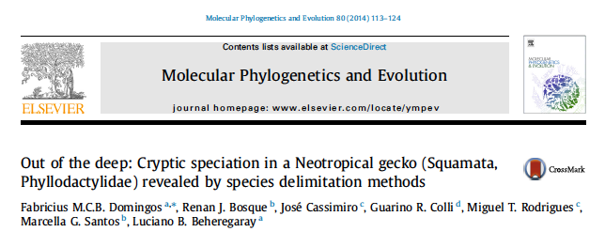
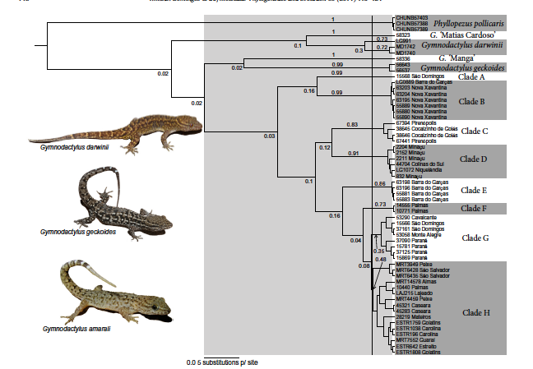
Species discovery

Slide 22
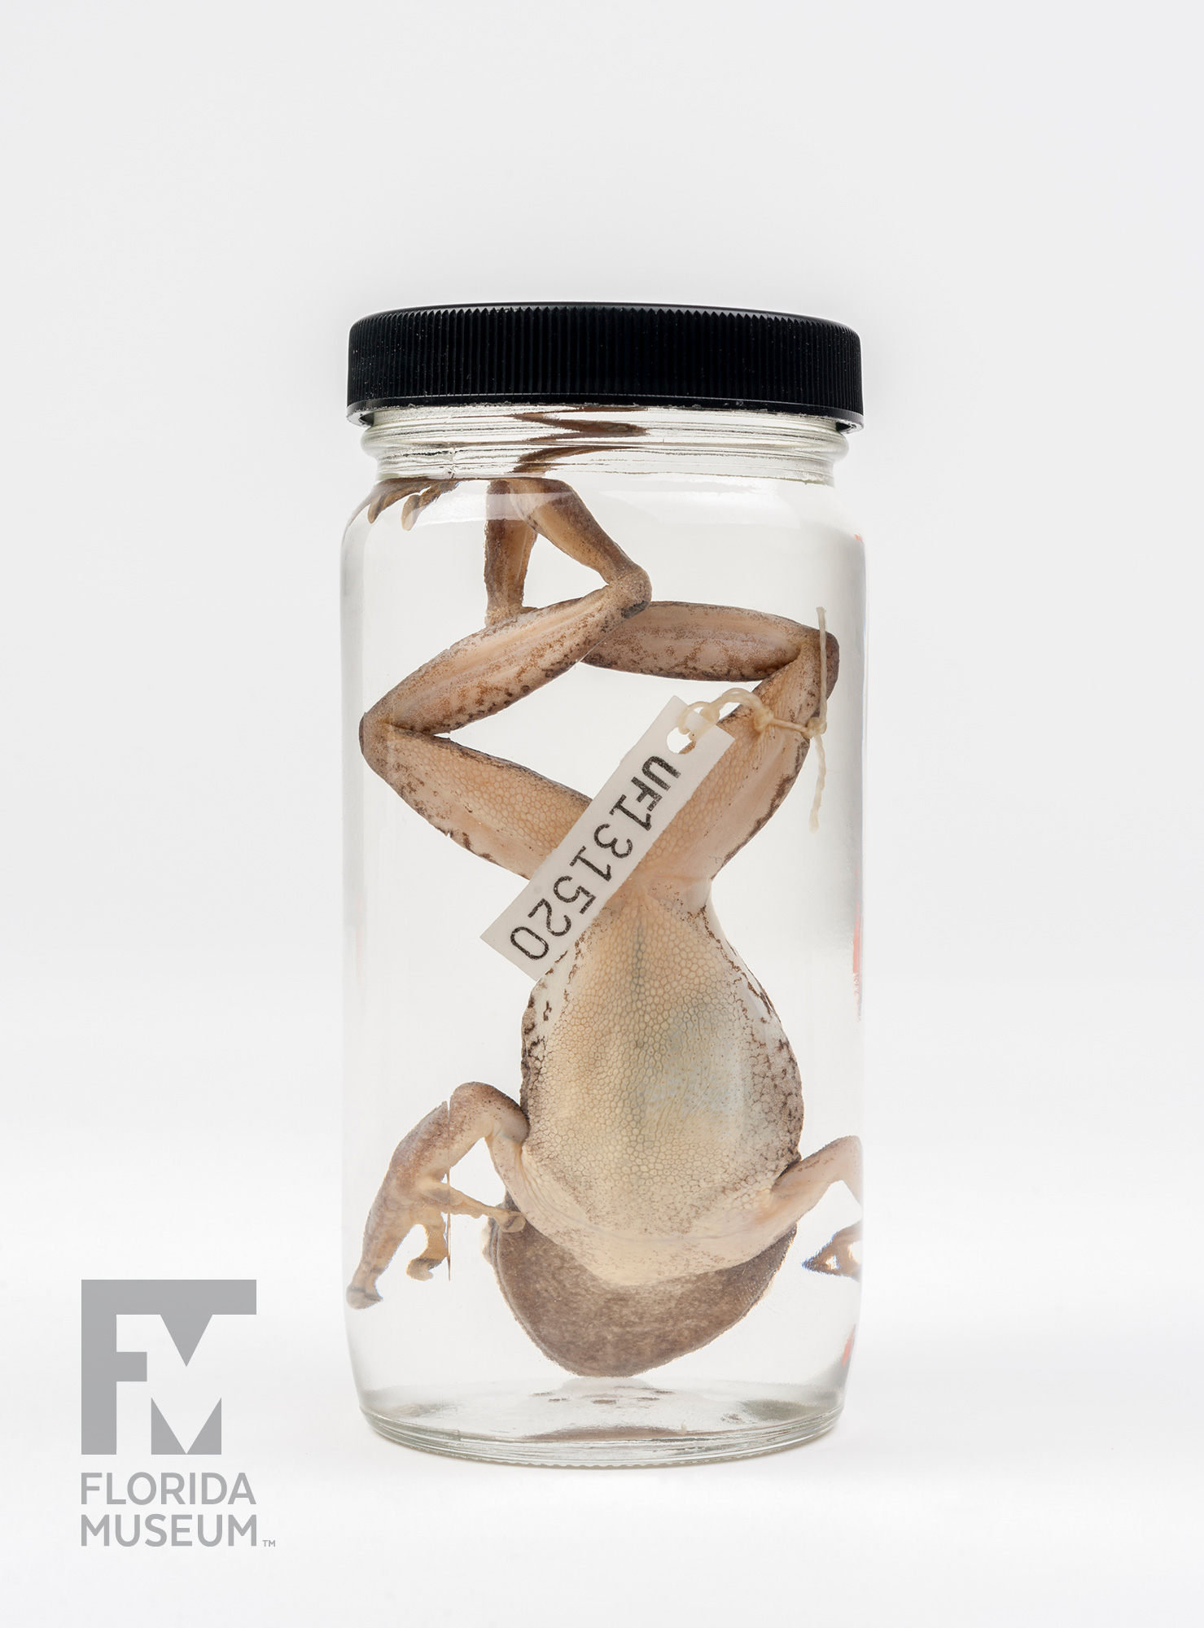
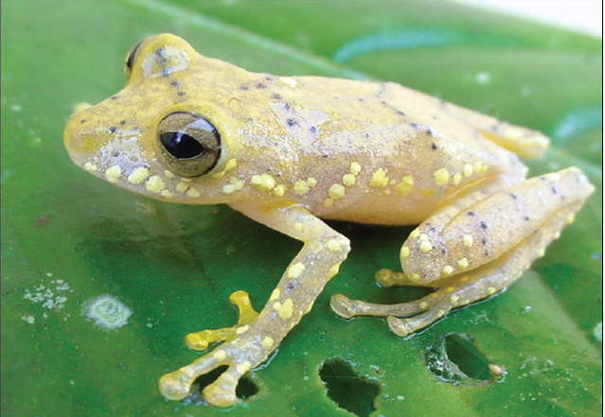
Species description
Name the species
Designate a Holotype
Diagnose the species
Describe the Holotype and variation among paratypes
Other data
illustrations, range map, ecology, phylogeny

Slide 23
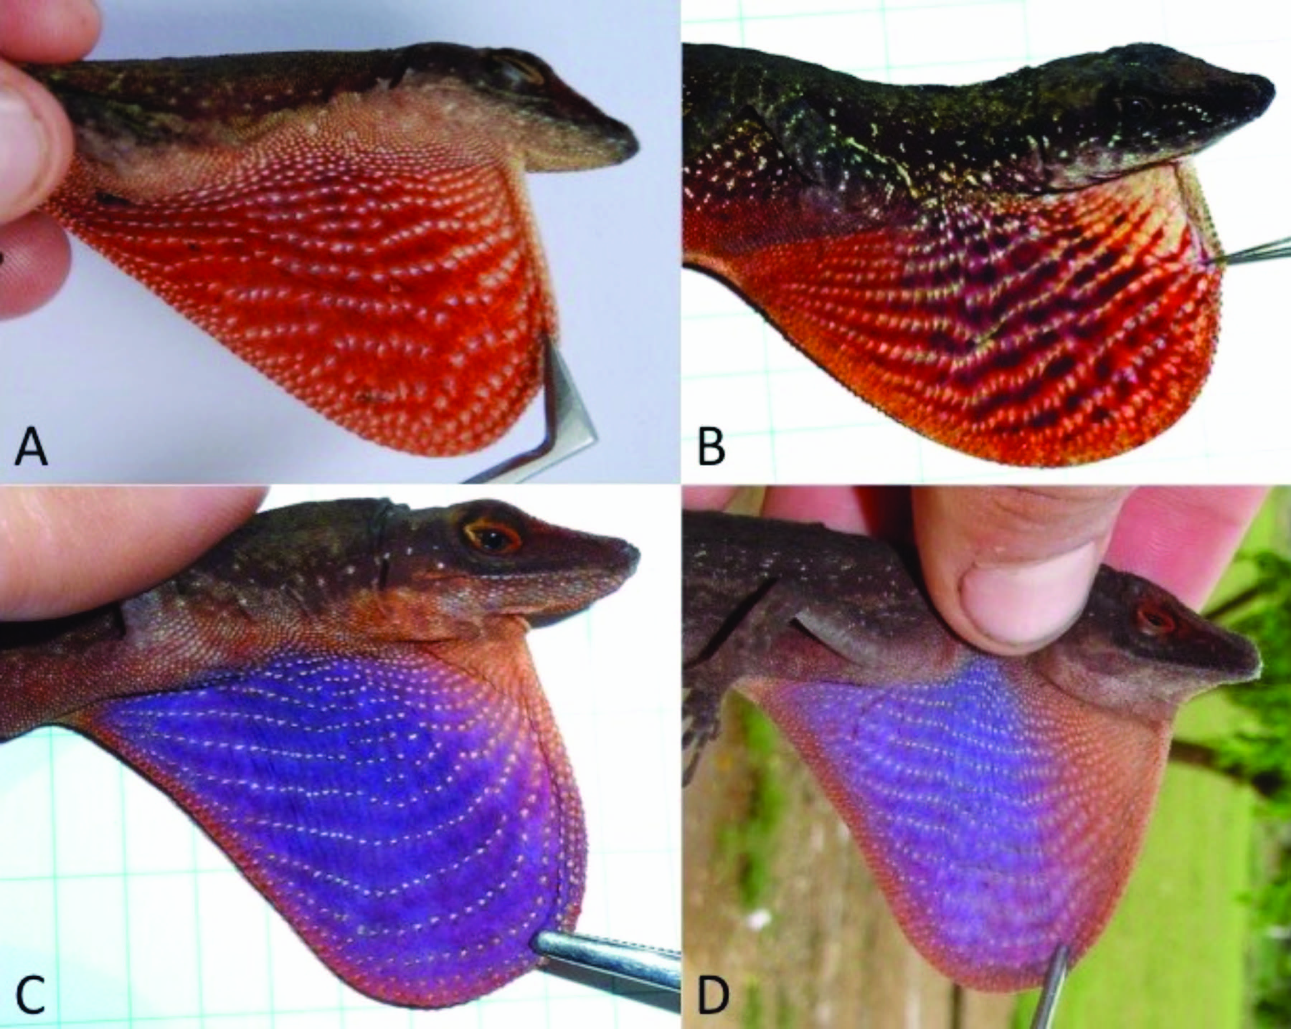
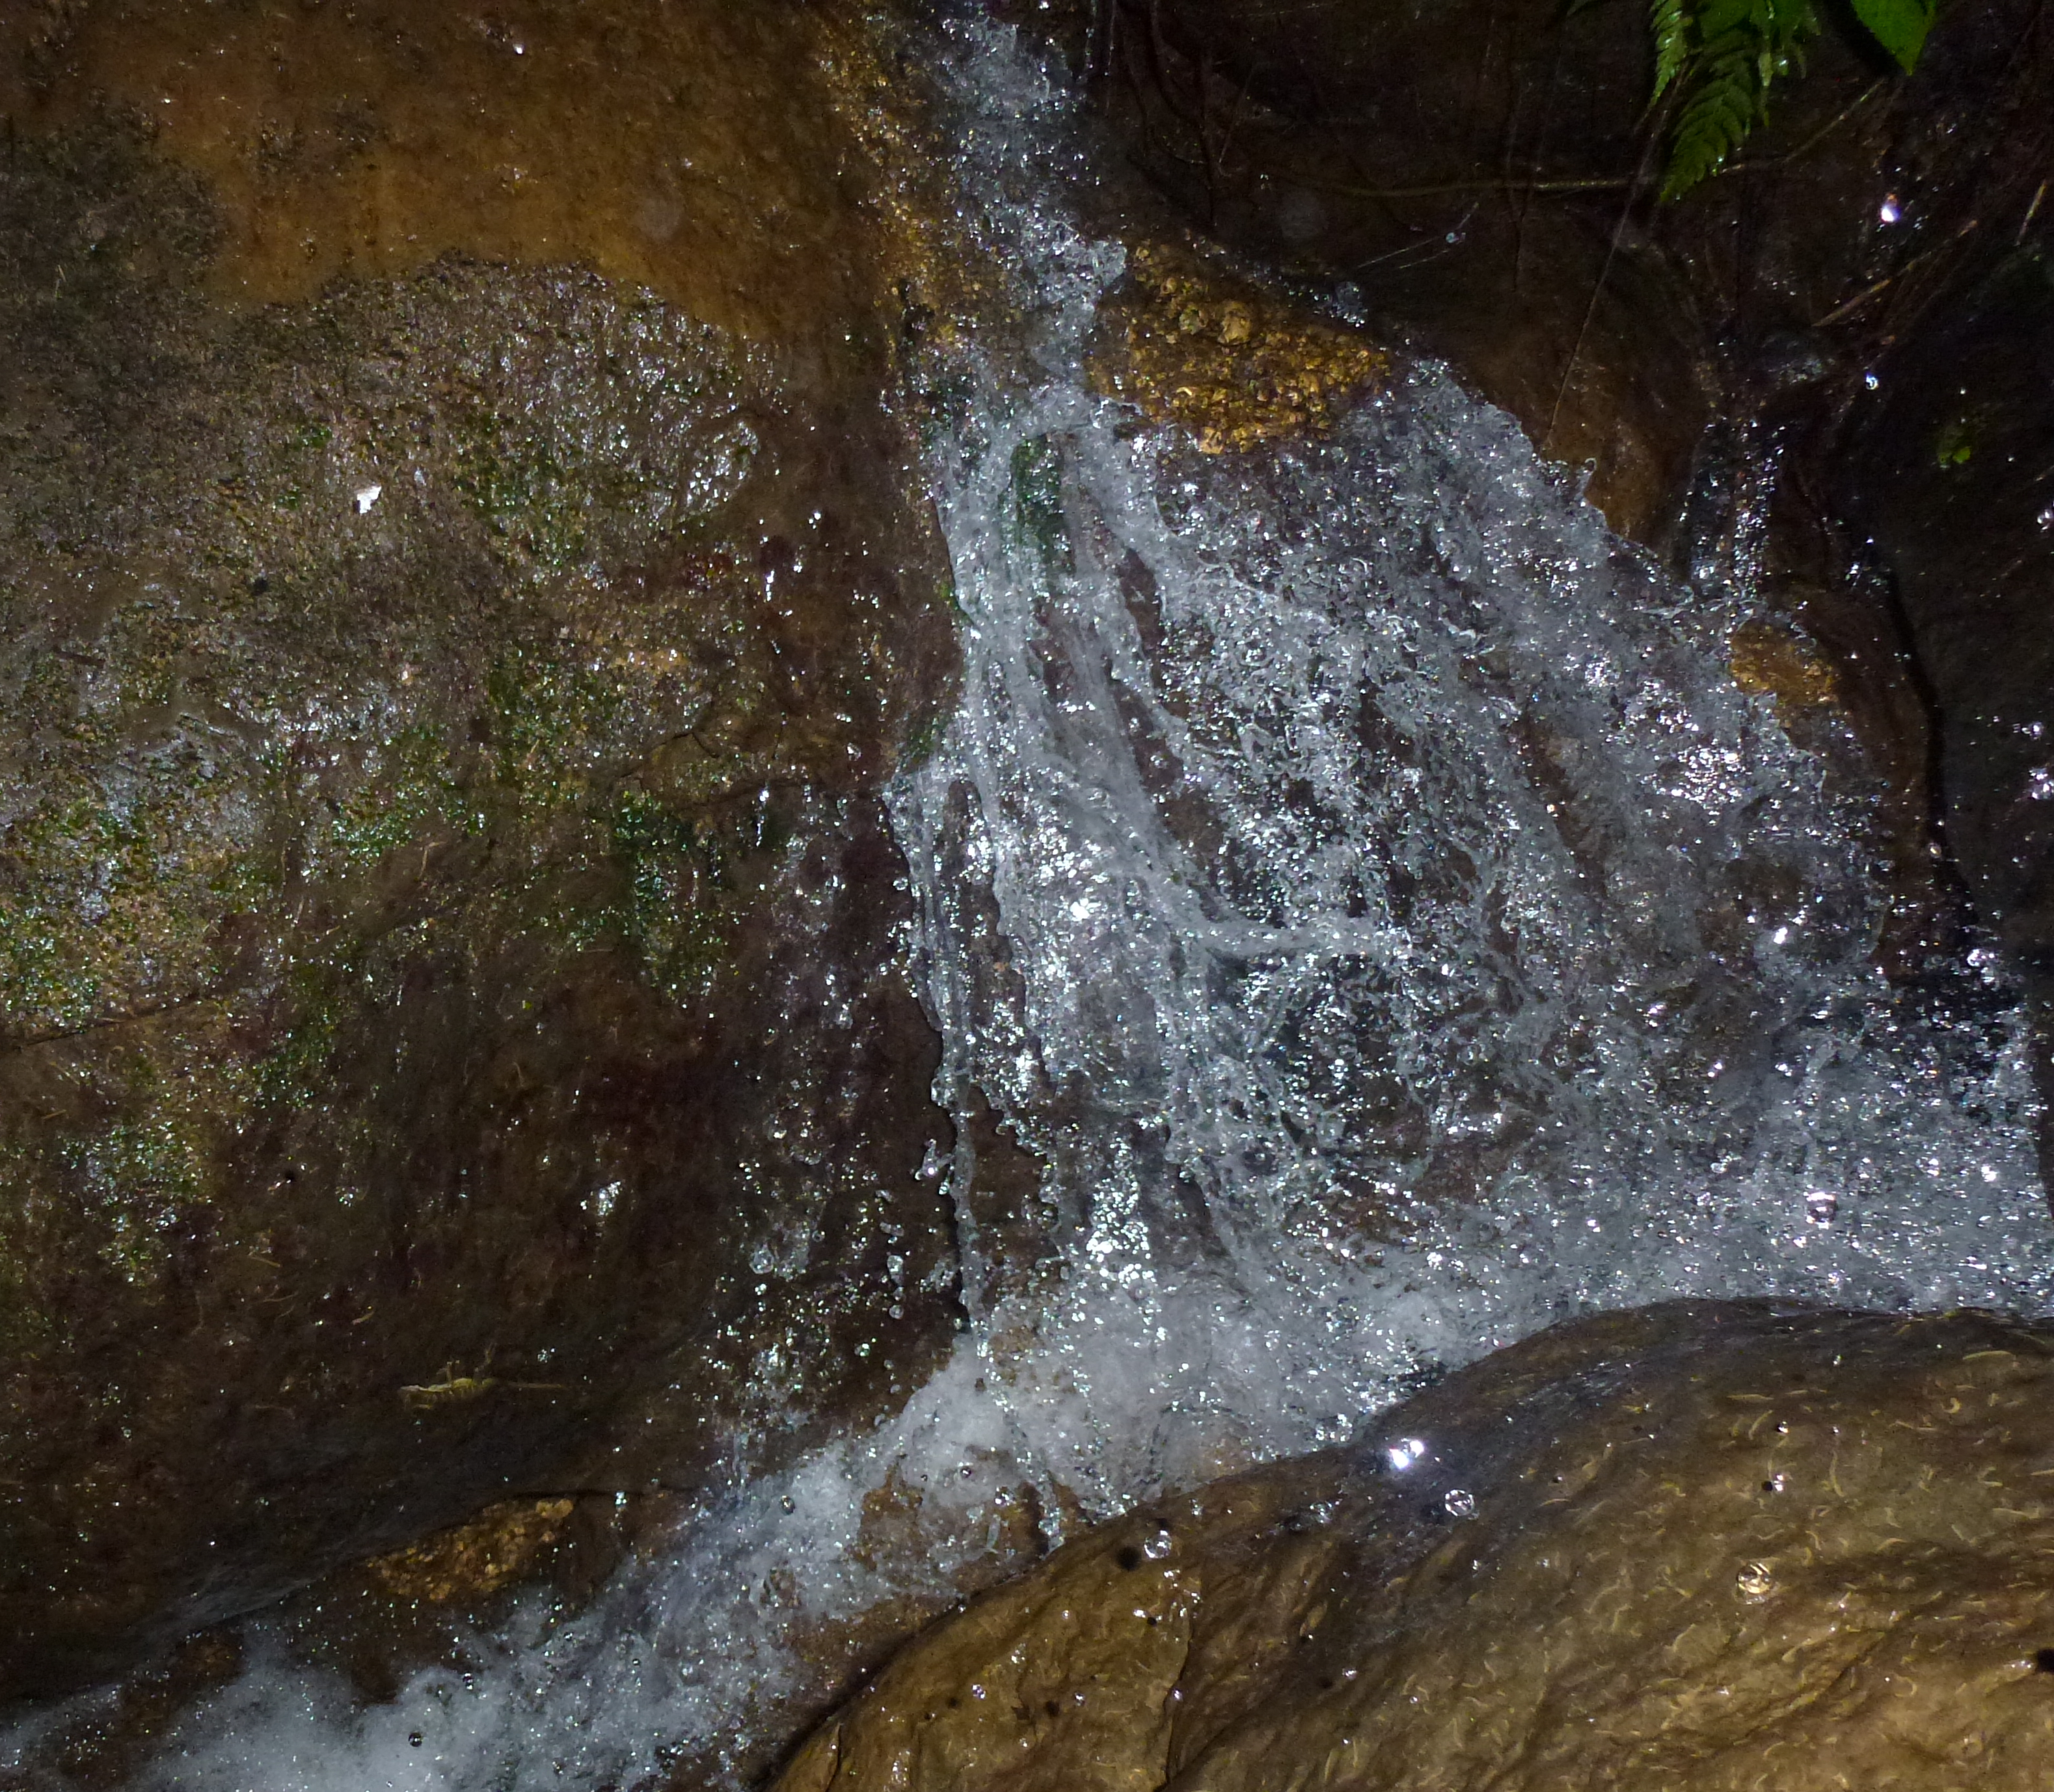
Species description
Name the species
Anolis purpuronectes
Anolis elcopeensis
Anolis taylori
Anolis cochranae
Anolis williamsmittermeierorum

Slide 27
