Slide 1
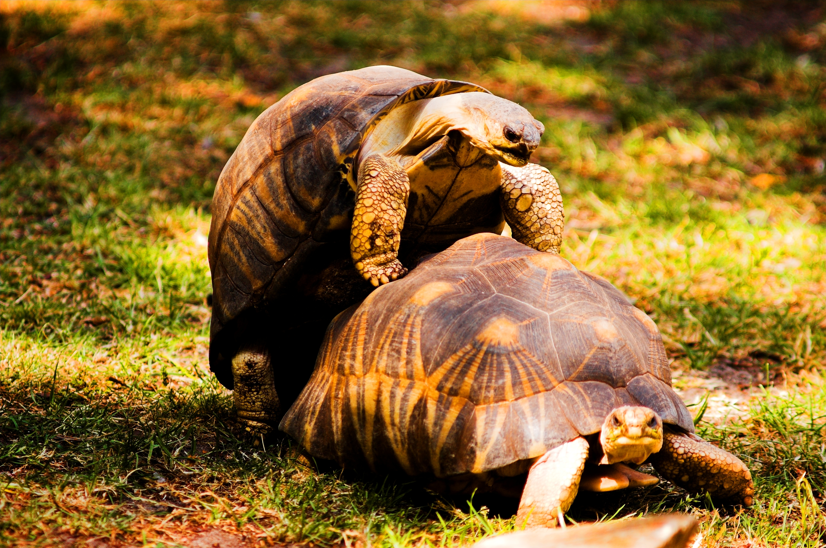

Slide 2
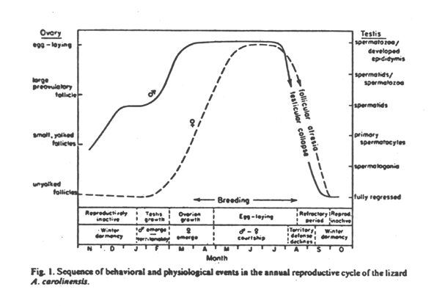
Reptile reproduction
Reproductive cycles
Seasonal (temperate), continuous (tropical)

Slide 3
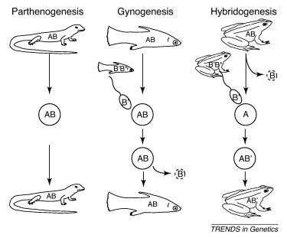
Reptile reproduction
Reproductive cycles
Seasonal (temperate), continuous (tropical)
Sexual, asexual

Slide 4
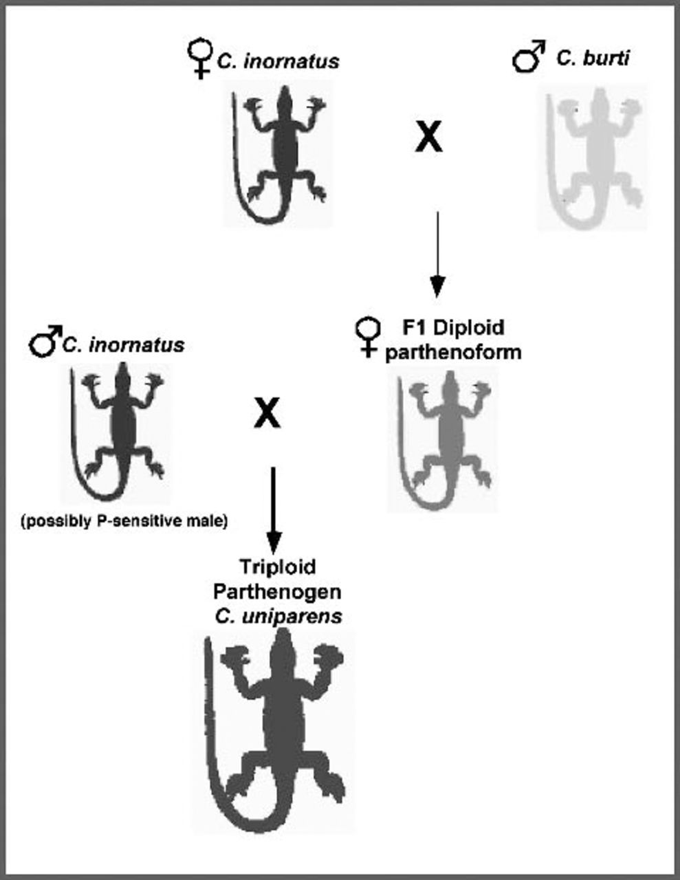
Reptile reproduction
Reproductive cycles
Seasonal (temperate), continuous (tropical)
Sexual, asexual

Slide 5
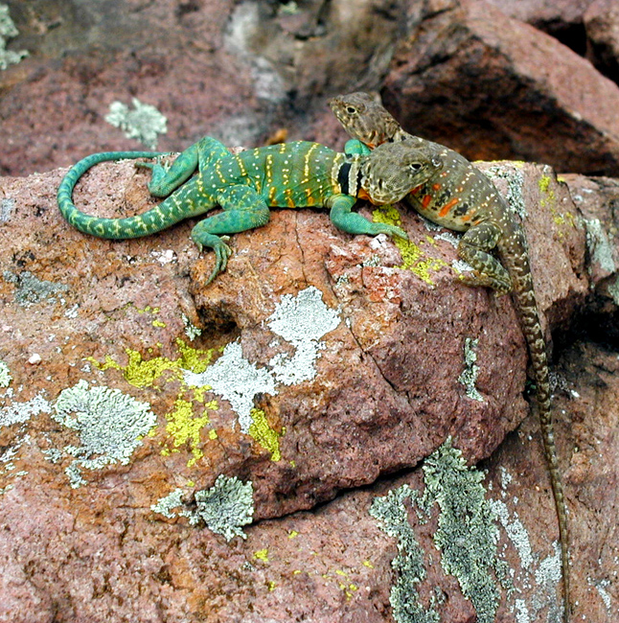
Reptile reproduction
Reproductive cycles
Seasonal (temperate), continuous (tropical)
Sexual, asexual
Mate encounter
scramble, mate-searching, territoriality, leks

Slide 6
scramble mating

Slide 7
mate searching

Slide 8
mate searching

Slide 9
territoriality

Slide 10
territoriality

Slide 11
lek mating

Slide 12
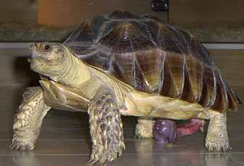
Reptile reproduction
Mating
Internal
Crocodylia, Testudines: penis
Squamata: hemipenes
Sphenodon: "cloacal kiss"

Slide 15
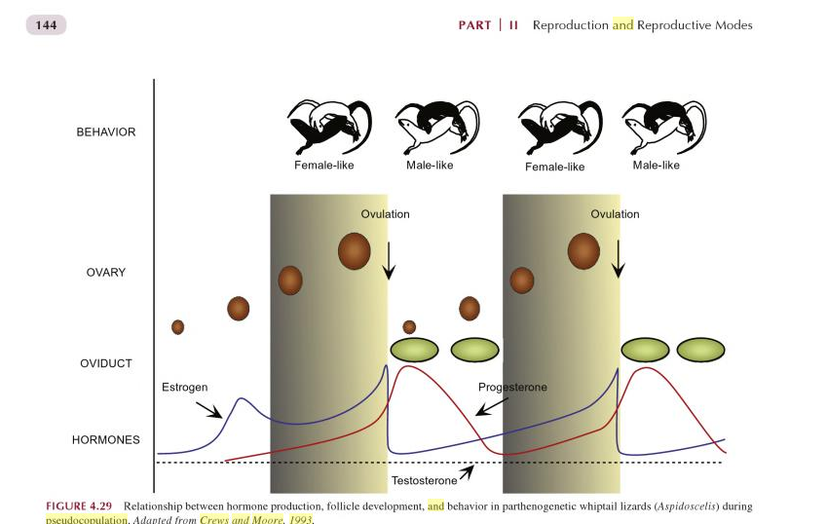

Slide 18
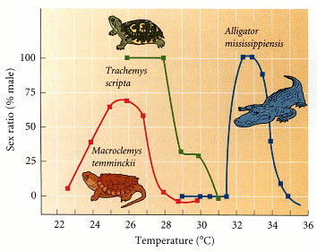
Reptile reproduction
Genetic or Temperature-dependent Sex Determination
Testudines: XY, ZW; TSD
Crocodylia: TSD
Lepidosauria: XY, ZW; TSD

Slide 19
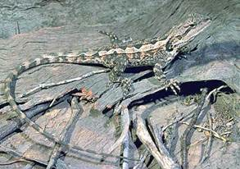
Why would TSD evolve?

Slide 20
Why would TSD evolve?
Charnov and Bull (1987): TSD favored when different temperature environments confer different fitness advantages for each sex.
"if an individual finds itself in an environment where it can become a below average female or an above average male, selection will favor its becoming male because it can pass on more of its genes than if it were female"

Slide 21
Test of the Charnov-Bull hypothesis (Warner and Shine 2008)
Incubate Amphibolurus muricatus eggs at low, medium, high temperatures
Treat some eggs of each clutch temperature with chemicals such that some males, some females are produced
*in nature, Amphibolurus produces females at warmer and colder temps, males at intermediate temps
Release young in an outdoor enclosure, allow them to grow, live, mate
Document parentage

Slide 22
Test of the Charnov-Bull hypothesis (Warner and Shine 2008)
Incubate Amphibolurus muricatus eggs at low, medium, high temperatures
Treat some eggs of each clutch temperature with chemicals such that some males, some females are produced
*in nature, Amphibolurus produces females at warmer and colder temps, males at intermediate temps
Release young in an outdoor enclosure, allow them to grow, live, mate
Document parentage
Result:
females from warmer clutches produced more offspring than females from other temperatures
Males from intermediate-temp clutches produced more offspring than males from other temperatures

Slide 23
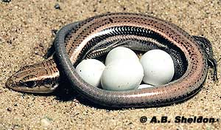
Reptile reproduction
Genetic or Temperature-dependent Sex Determination
Testudines: XY, ZW; TSD
Crocodylia: TSD
Lepidosauria: XY, ZW; TSD
Birth
Testudines: Oviparous
Crocodylia: Oviparous
Lepidosauria: Ovip, Vivip

Slide 24
Reptile reproduction
Genetic or Temperature-dependent Sex Determination
Testudines: XY, ZW; TSD
Crocodylia: TSD
Lepidosauria: XY, ZW; TSD
Birth
Testudines: Oviparous
Crocodylia: Oviparous
Lepidosauria: Ovip, Vivip
Parental care
Testudines: None
Crocodylia: All
Lepidosauria: Few

