Slide 2
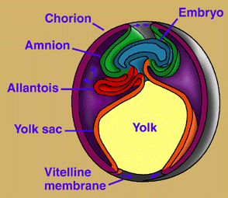

Slide 3
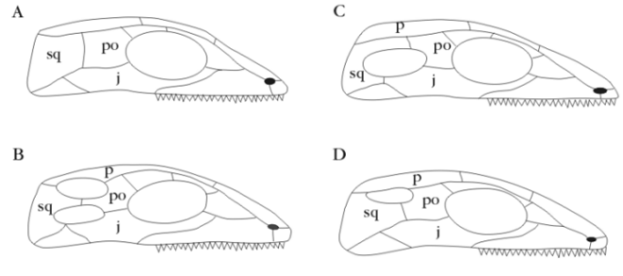
Patterns of fenestration in amniote skulls
Anapsid Synapsid
Diapsid Euryapsid

Slide 4
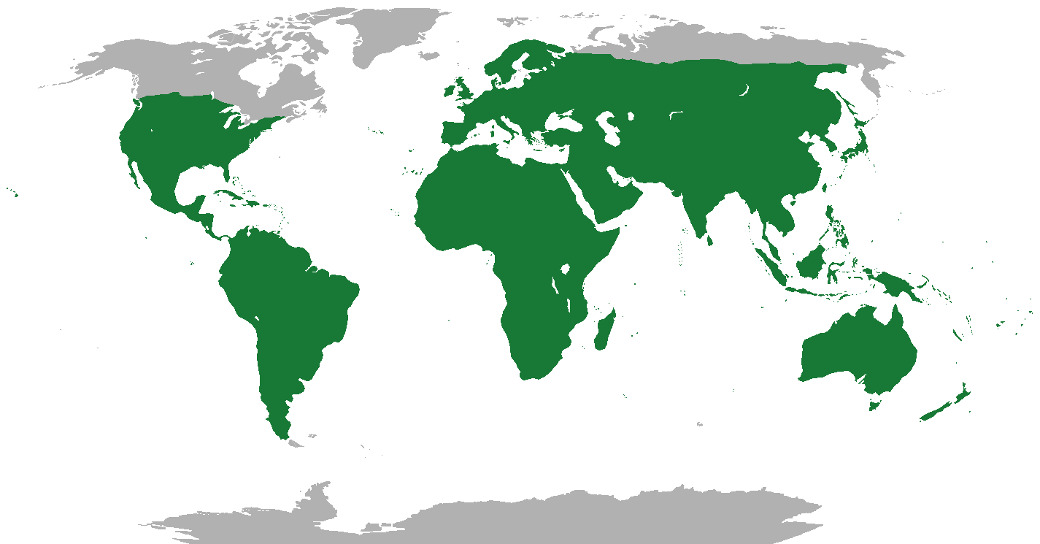
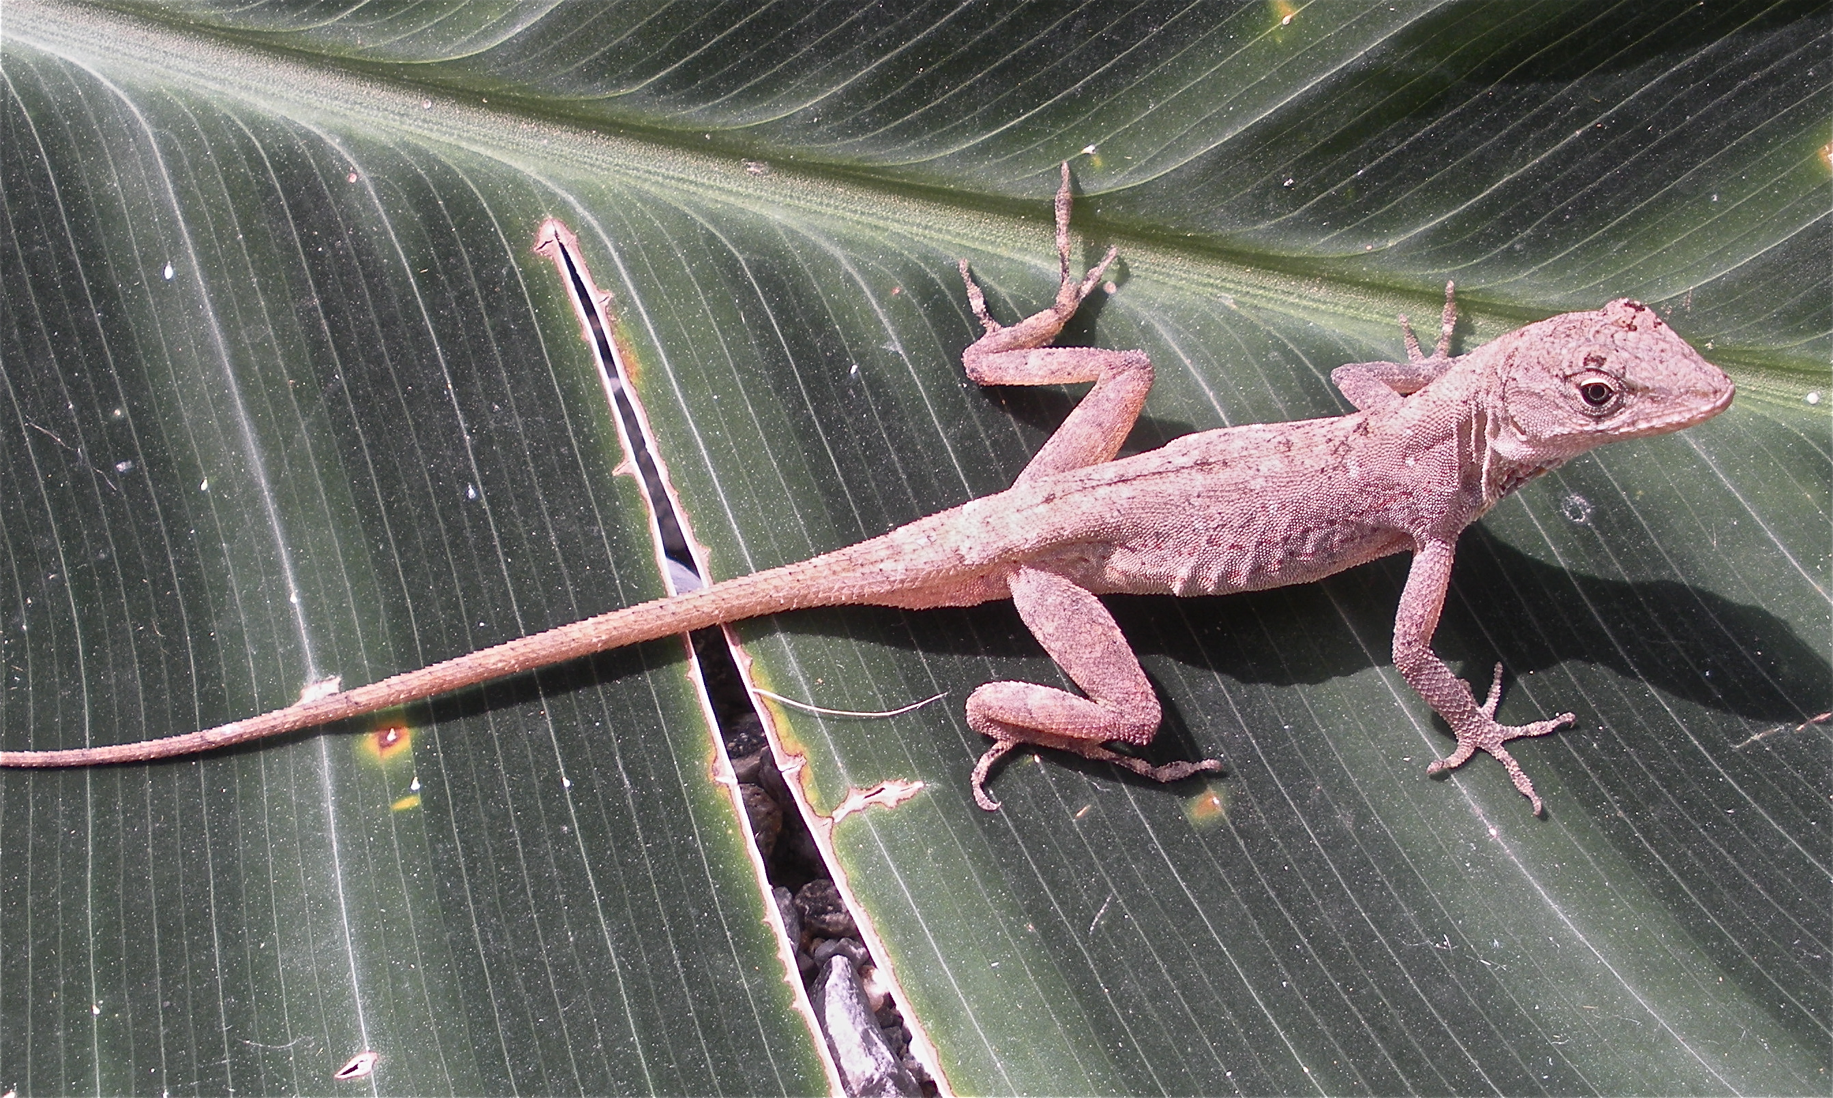
Lepidosauria

Slide 5
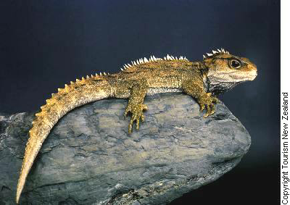
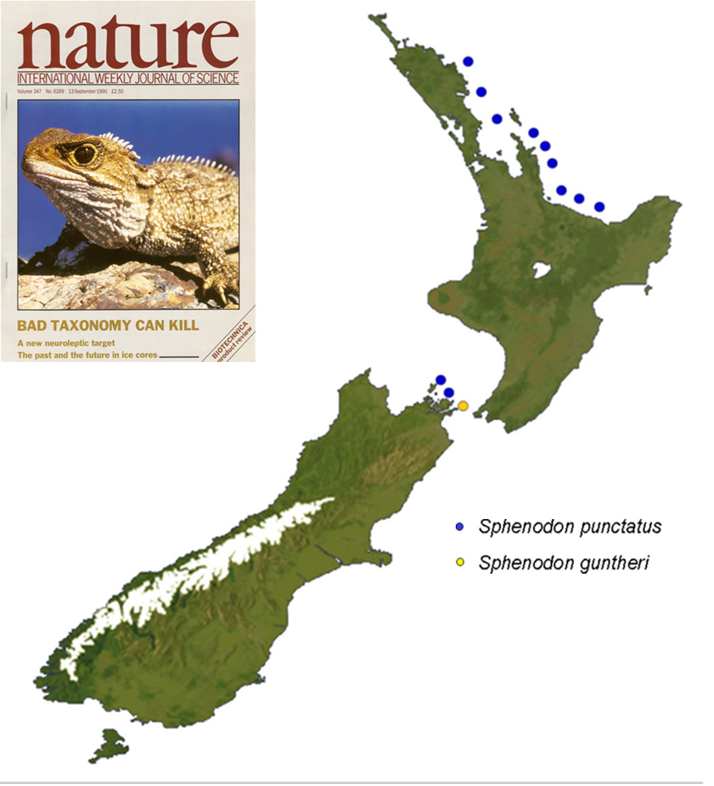
Rhynchocephalia: Spenodon punctatus

Slide 6
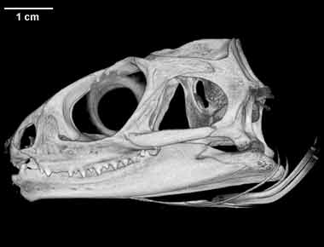
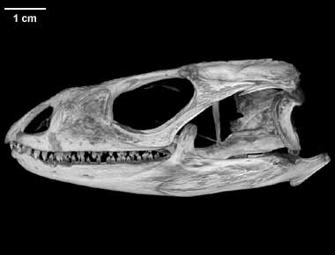
Sphenodon punctatus:
Rhyncocephalia
Diapsid skull
Ctenosaura pectinata:
Squamata
Modified diapsid skull
Lower temporal bar

Slide 7
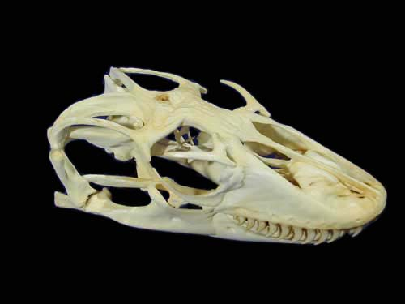
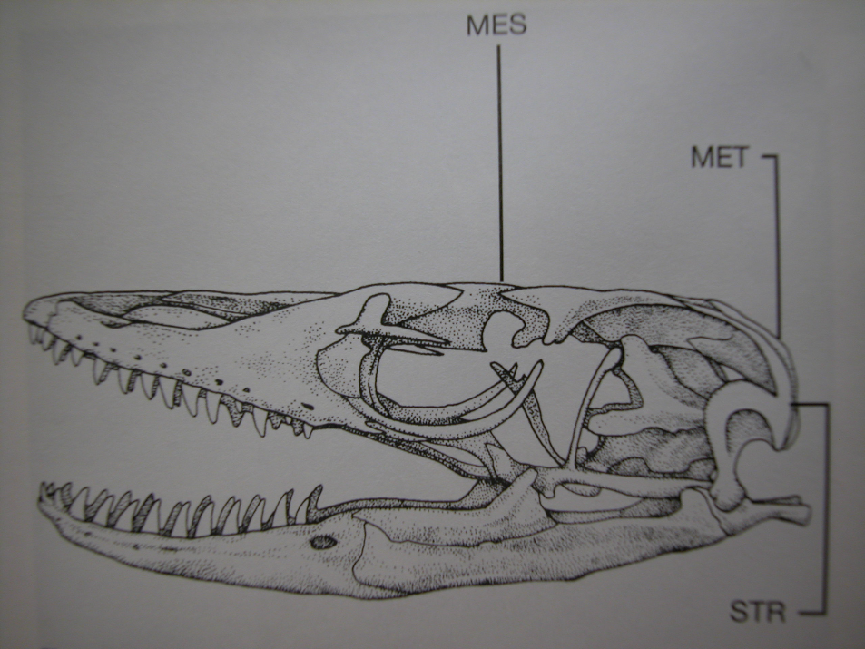
Cranial kinesis in lizard skulls:
Streptostylic, mesokinetic, metakinetic
quadrate

Slide 8
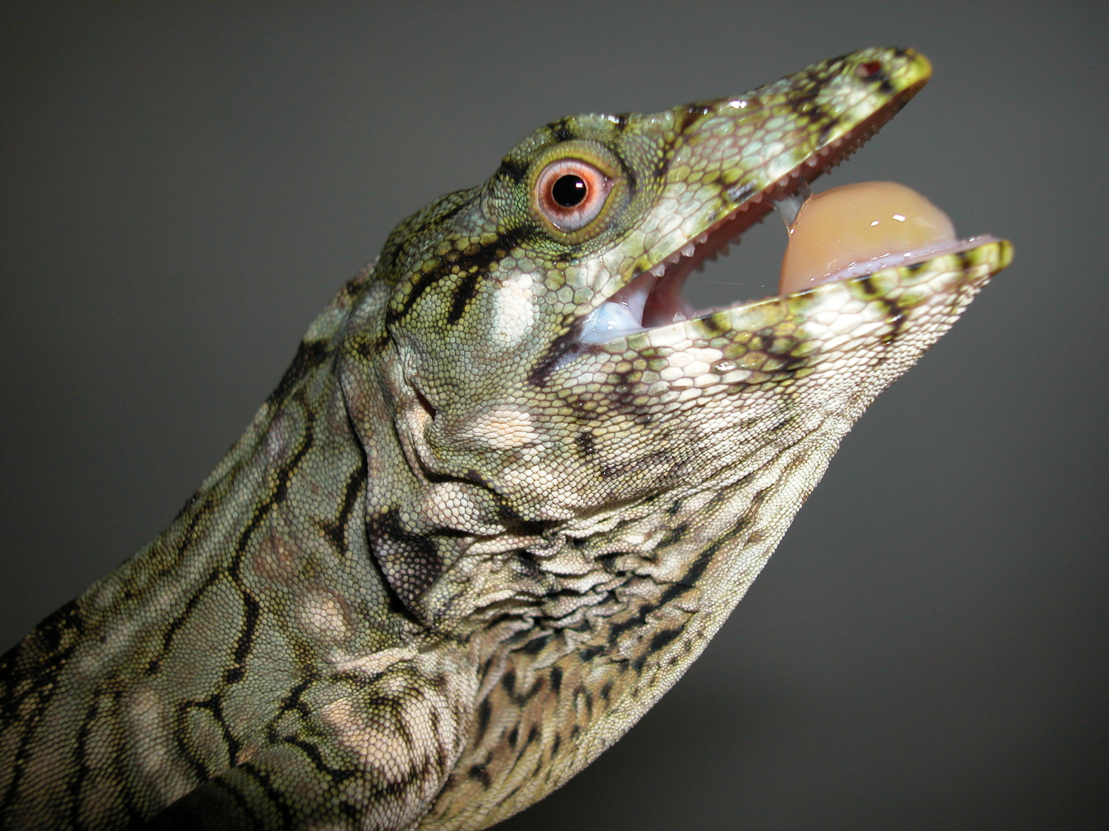
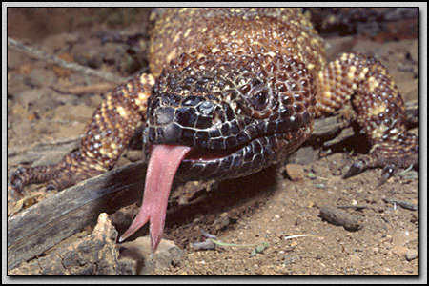
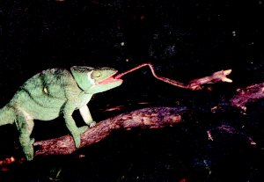
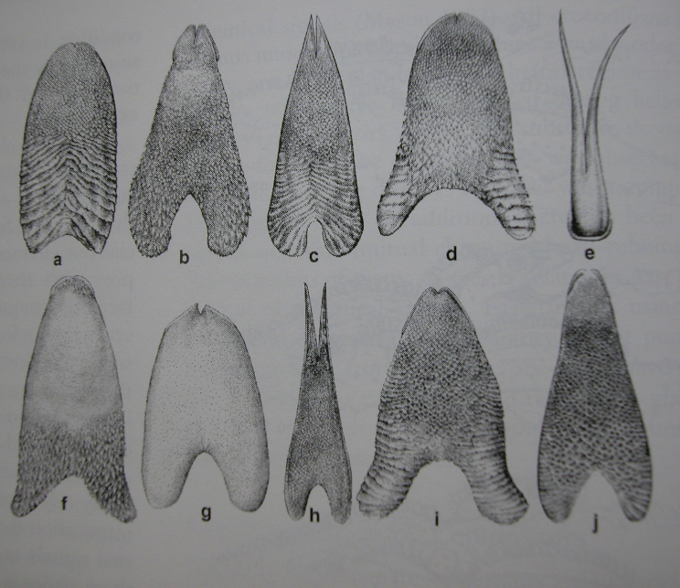
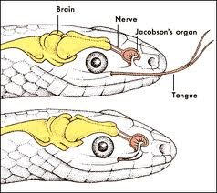
Lizard tongues

Slide 9
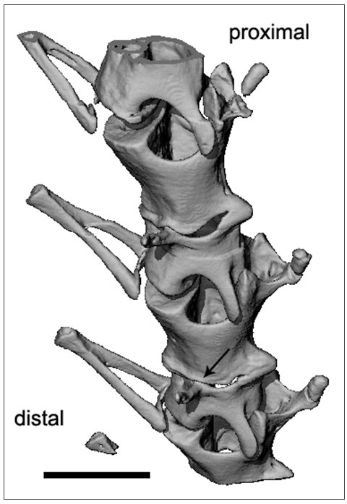
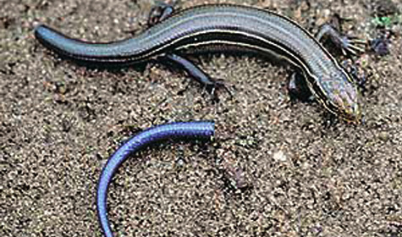
Caudal autotomy

Slide 10
Reproduction in squamates
Oviparous or viviparous
Usually sexual, some parthenogenetic
GSD or TSD
Some parental care
Territorial

Slide 11
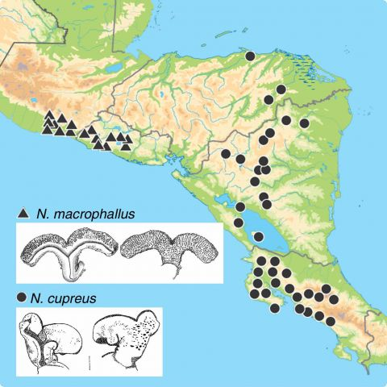
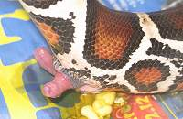
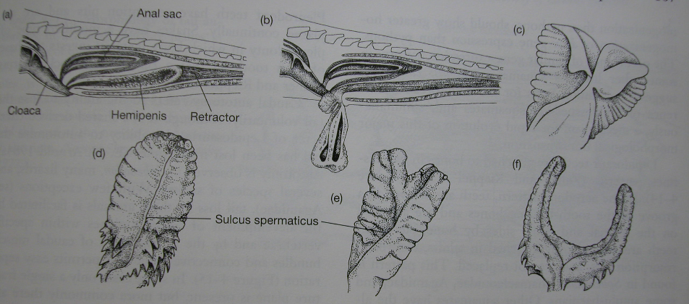
A. macrophallus
Hemipenes diversity in Squamates
A. cupreus

Slide 12
Temperature-dependent sex determination
Sex determined by temperature during critical period of development
All crocodylians, Sphenodon, most turtles, some lizards
Small range of temperatures (1-2C) at which both sexes produced
Differences in sex ratios within nests, between nests, between seasons

Slide 13
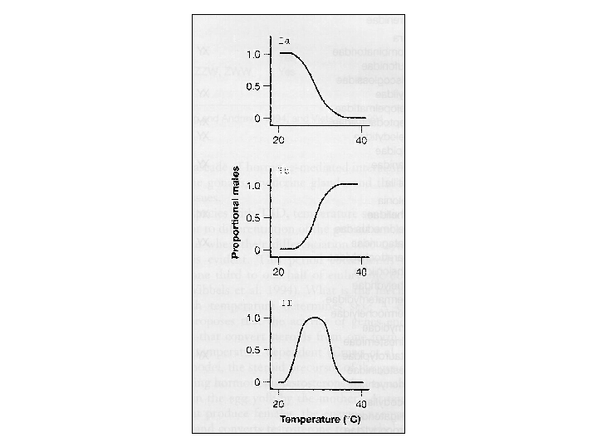
Three patterns of TSD
Most turtles
Many lizards
All crocs, some
Lizards, few turtles
Proportion of males

Slide 14
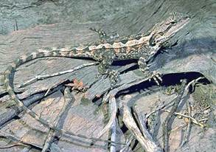
Why would TSD evolve?
Charnov and Bull (1987): TSD favored when different temperature environments confer different fitness advantages for each sex.
"if an individual finds itself in an environment where it can become a below average female or an above average male, selection will favor its becoming male because it can pass on more of its genes than if it were female"

Slide 15
Test of the Charnov-Bull hypothesis (Warner and Shine 2008)
Incubate Amphibolurus muricatus eggs at low, medium, high temperatures
Treat some eggs of each clutch temperature with chemicals such that some males, some females are produced
*in nature, Amphibolurus produces females at warmer and colder temps, males at intermediate temps
Release young in an outdoor enclosure, allow them to grow, live, mate
Document parentage

Slide 16
Test of the Charnov-Bull hypothesis (Warner and Shine 2008)
Incubate Amphibolurus muricatus eggs at low, medium, high temperatures
Treat some eggs of each clutch temperature with chemicals such that some males, some females are produced
*in nature, Amphibolurus produces females at warmer and colder temps, males at intermediate temps
Release young in an outdoor enclosure, allow them to grow, live, mate
Document parentage
Result:
females from warmer clutches produced more offspring than females from other temperatures
Males from intermediate-temp clutches produced more offspring than males from other temperatures

Slide 17
TSD: conservation implications
Many conservation programs for turtles involve collecting eggs, incubating them in the lab, and releasing juveniles back to the wild
Egg collection and incubation could screw up the sex ratio in nature (e.g., too many males)
(expensive) studies needed to
Discern details of TSD (which pattern? what temperatures?)
Determine sex ratios in nature
Global warming

Slide 18
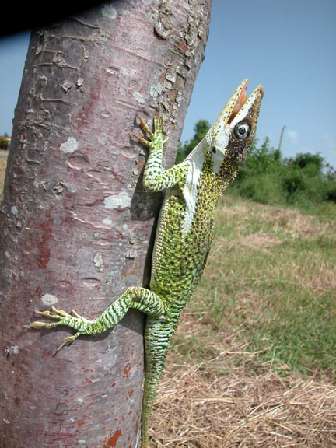
Lizard diversity

Slide 19
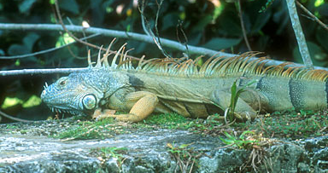
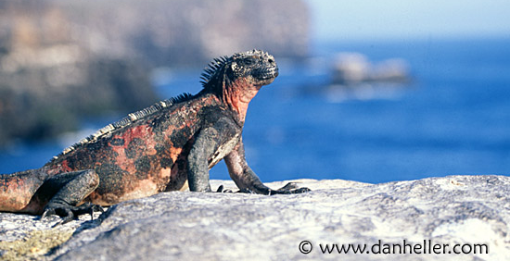
Iguaninae: Iguana iguana
Iguaninae: Amblyrhynchus cristatus

Slide 20
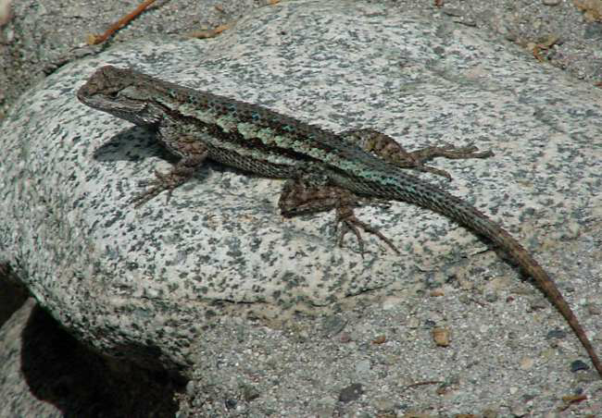
Phyrnosomatinae: Sceloporus magister

Slide 21
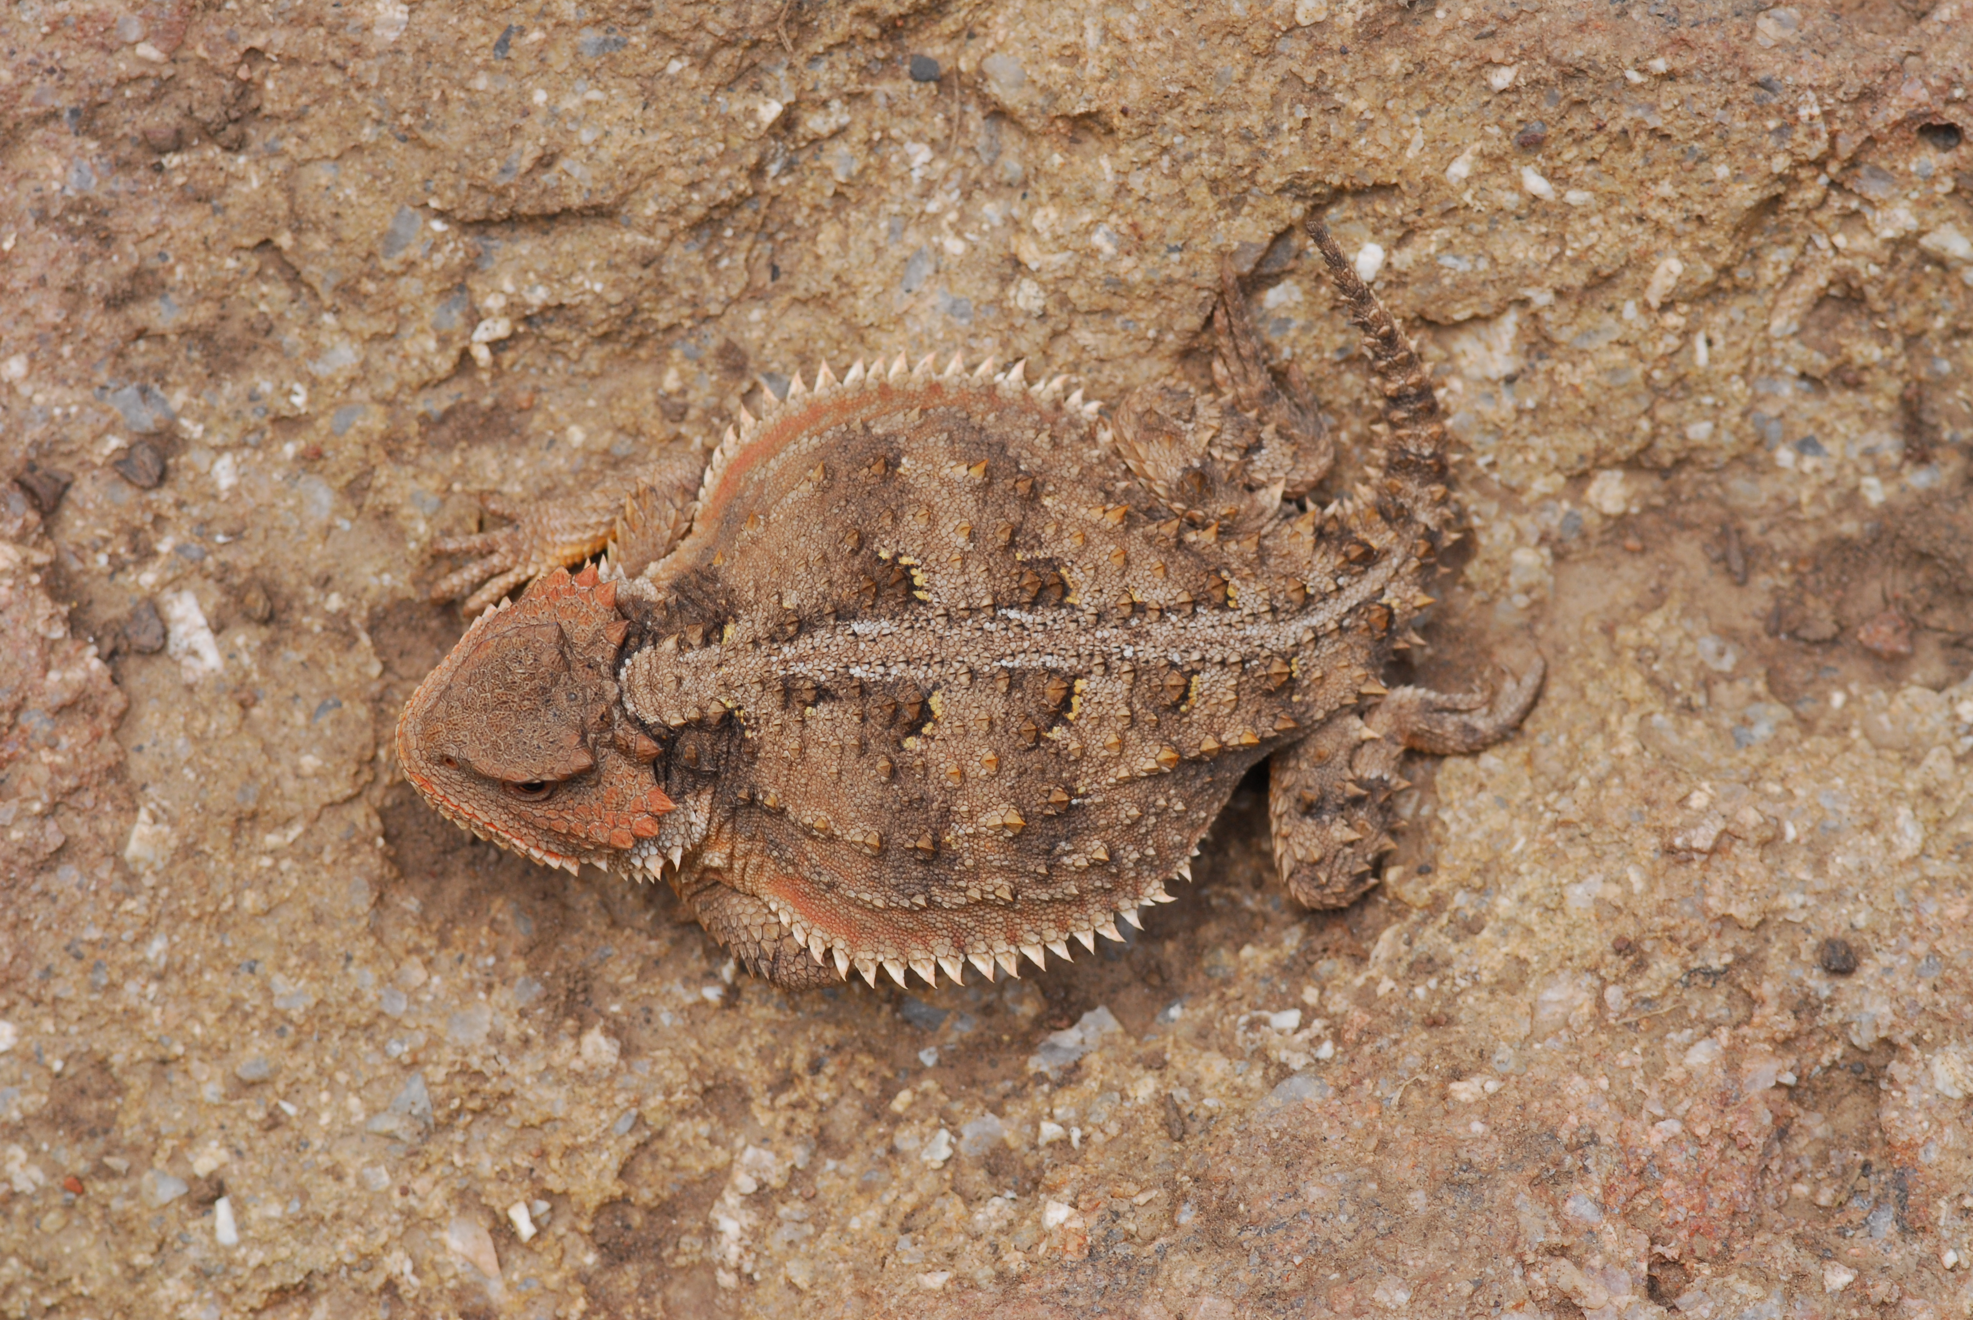
Phrynosomatinae: Phrynosoma douglasi

Slide 22
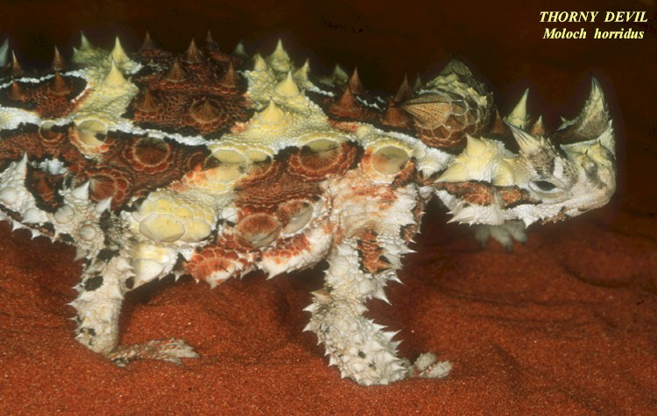
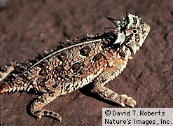
Agamidae: Moloch horridus

Slide 23
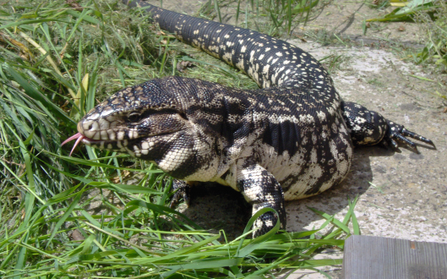
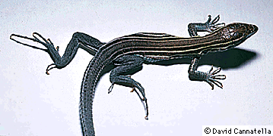
Teidae:
Tupinambis merianae
Teidae:
Aspidoscelis sexlineatus

Slide 24
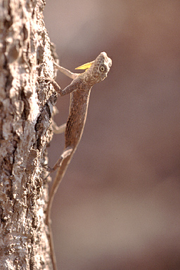
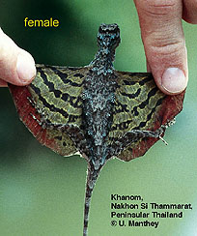
Agamidae: Draco

Slide 25
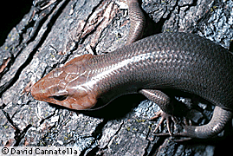
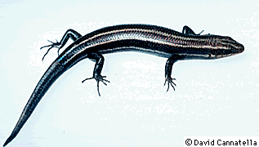
Scincidae
Eumeces laticeps
Eumeces fasciatus

Slide 26
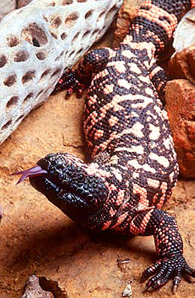
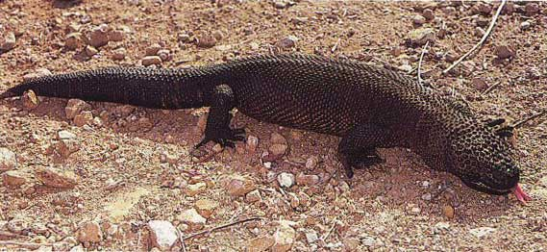
Helodermatidae:
Heloderma suspectum
Heloderma horridum

Slide 27
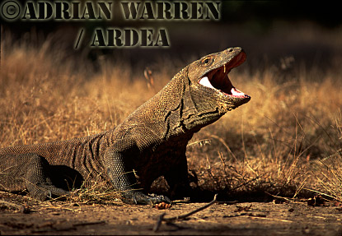
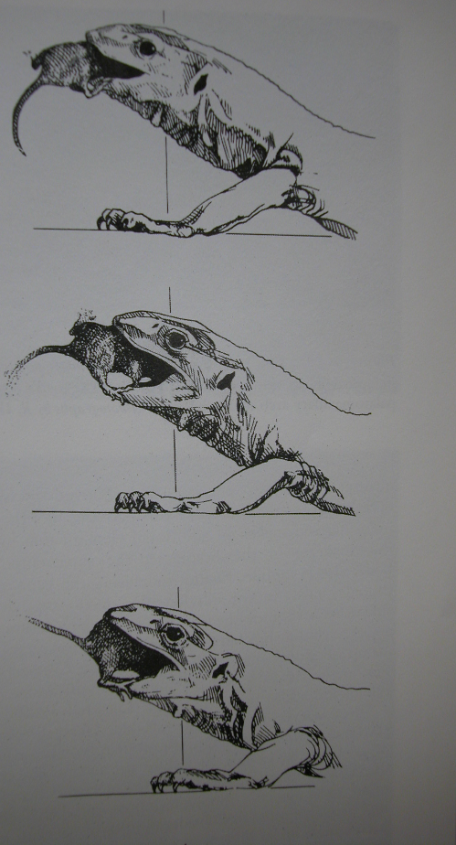
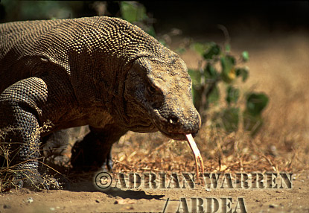
Varanidae: Varanus komodoensis

Slide 28
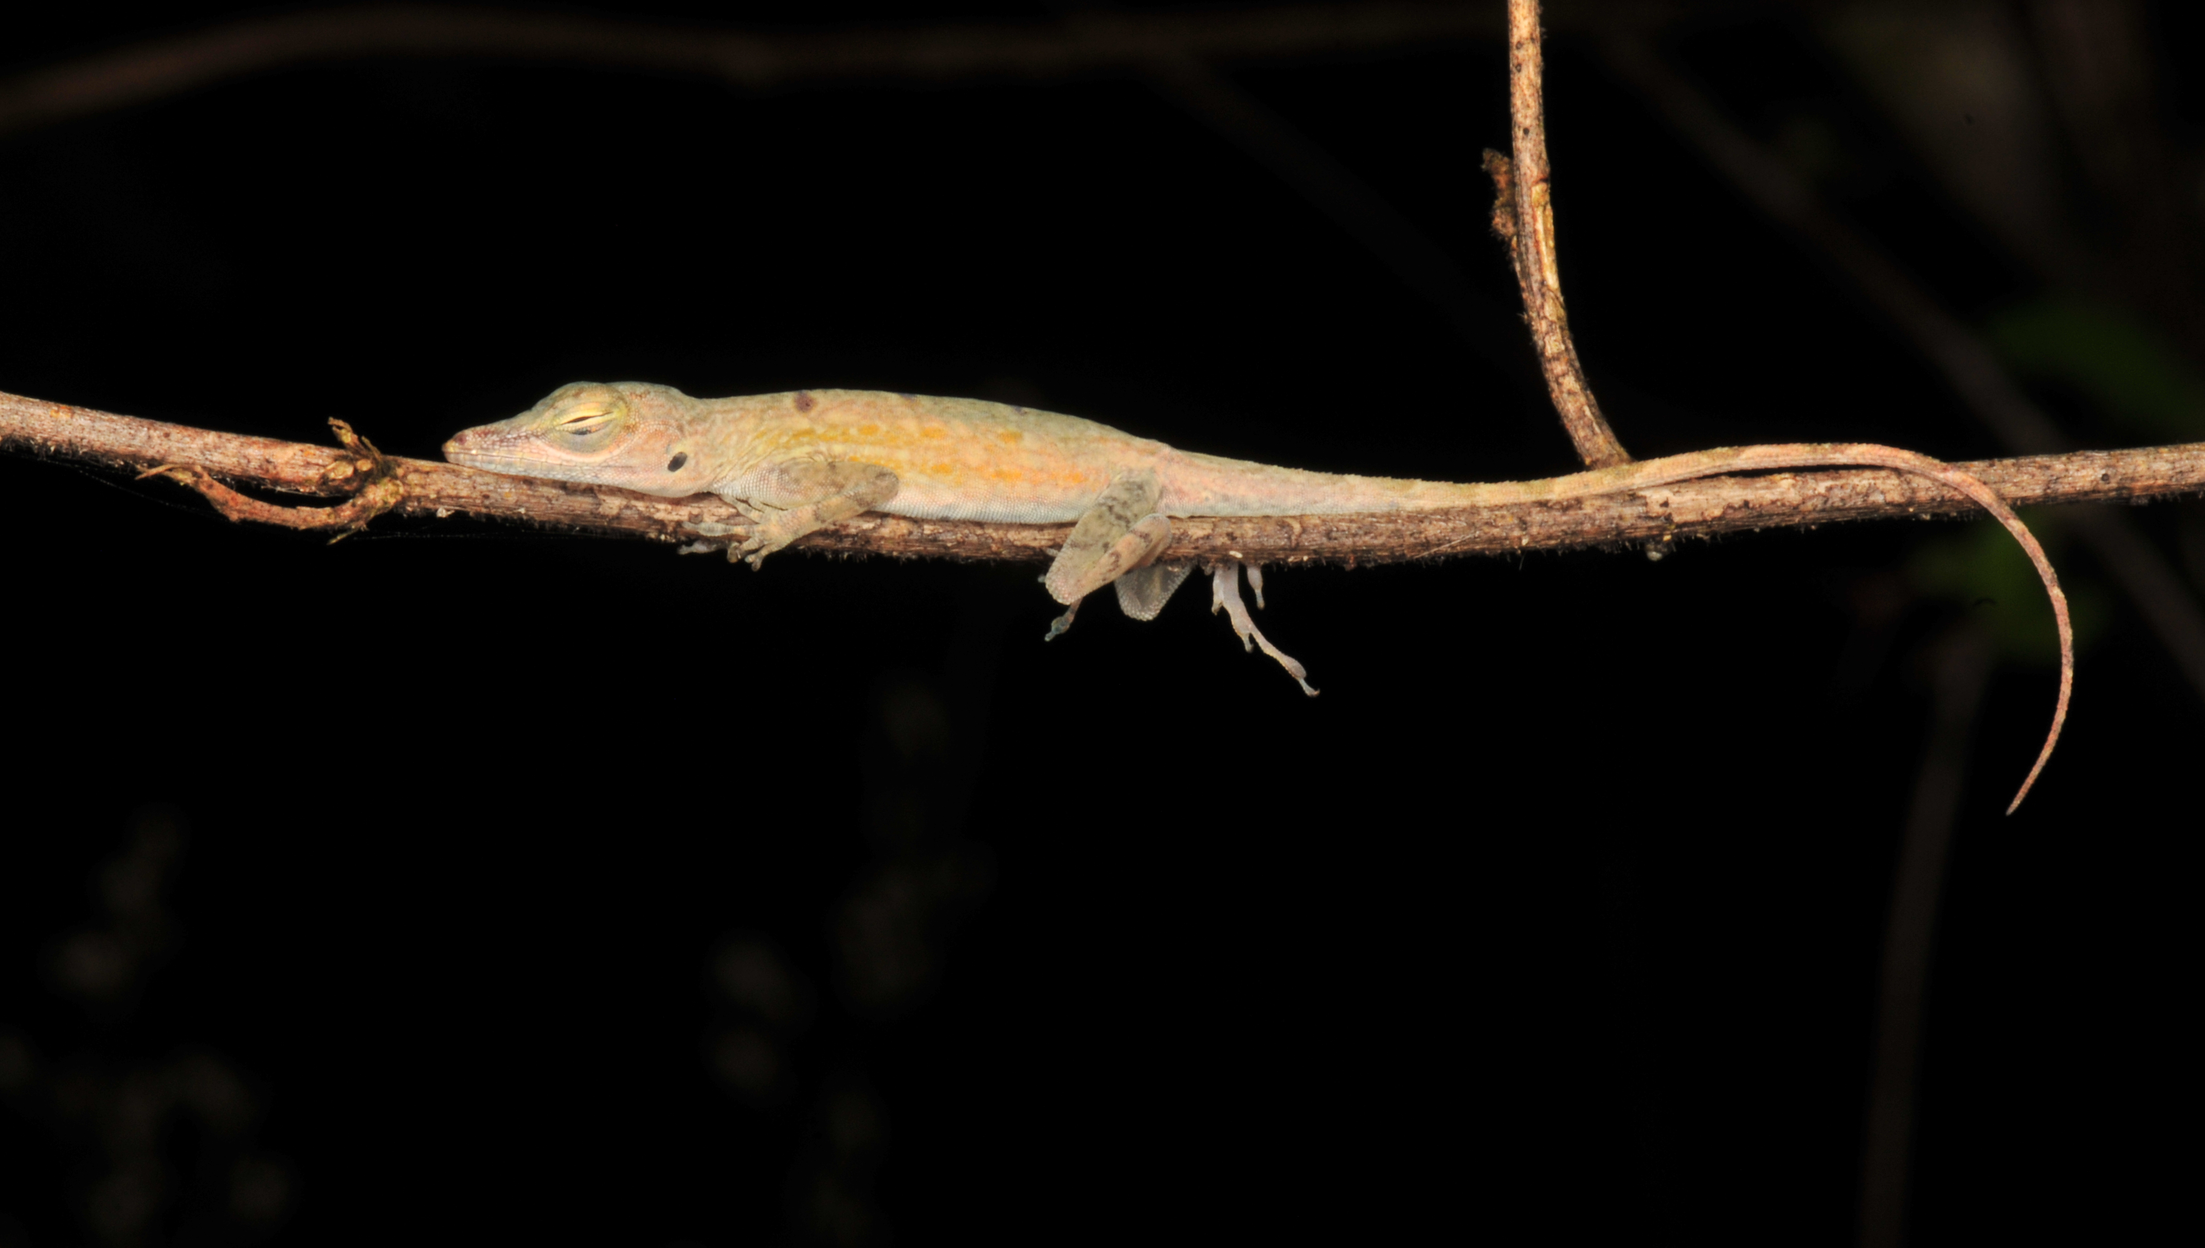
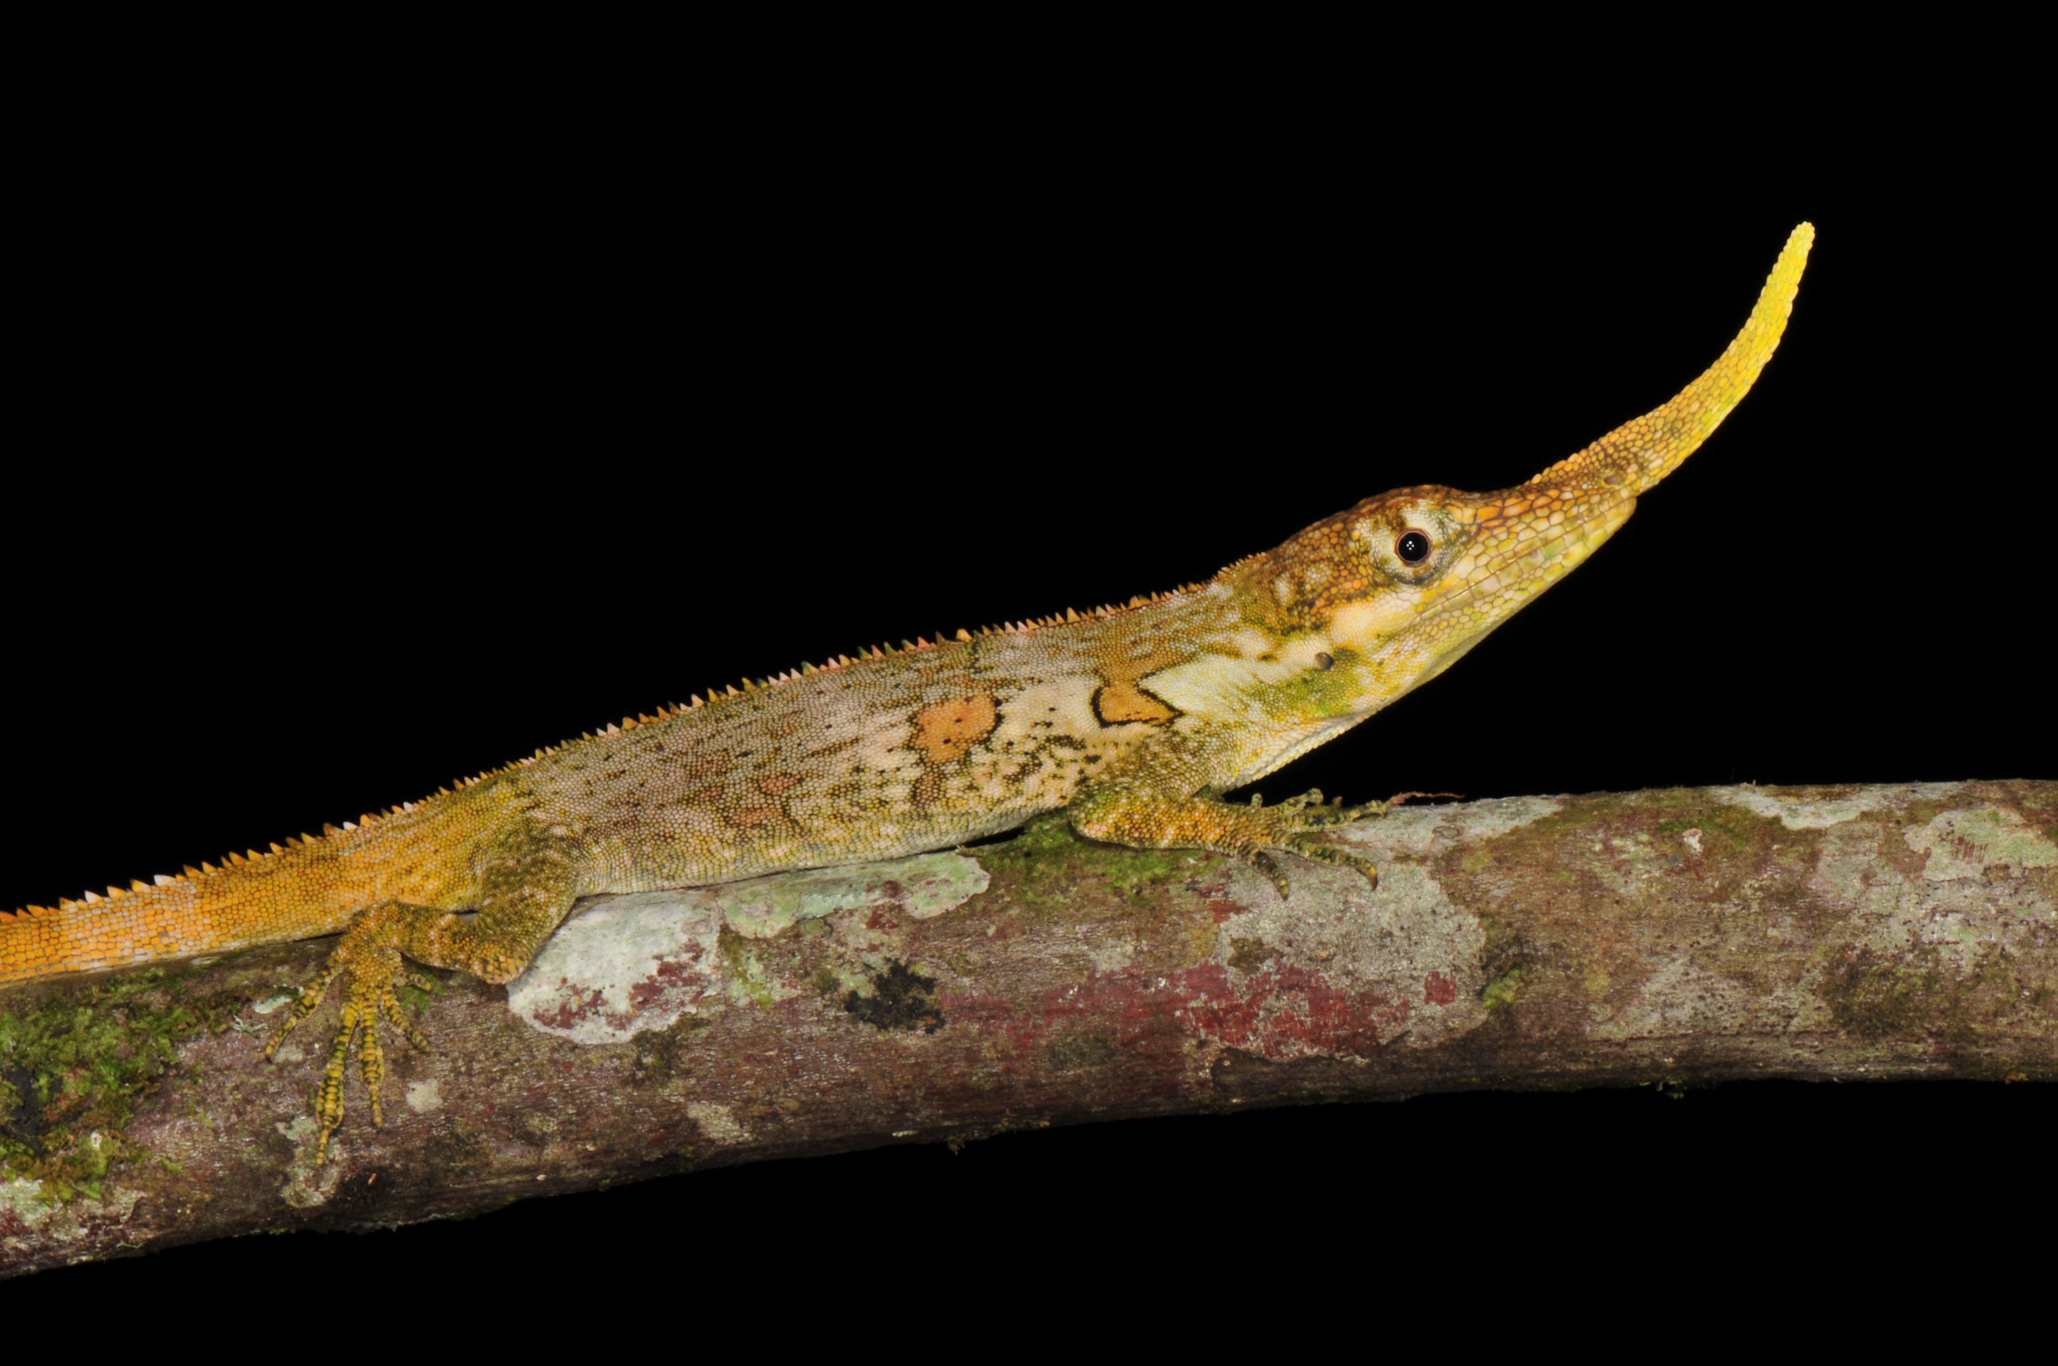
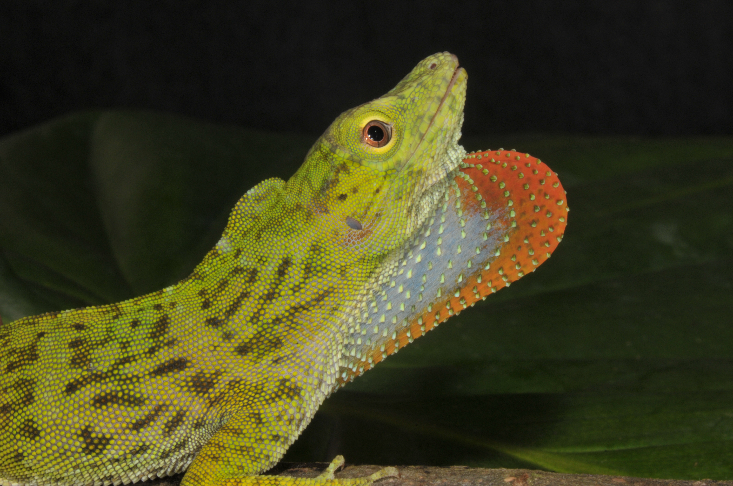
Dactyloidae:
Anolis proboscis
Anolis stratulus Anolis stratulus
Anolis biporcatus

Slide 29
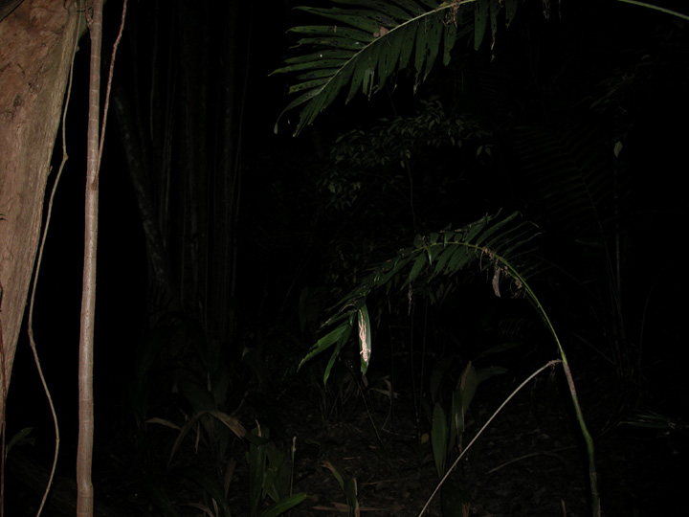
Notes:
29

Slide 30
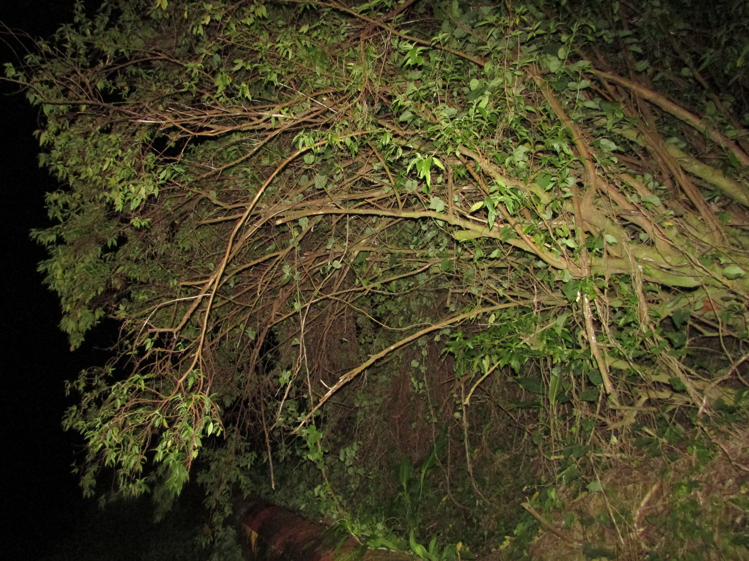

Slide 31
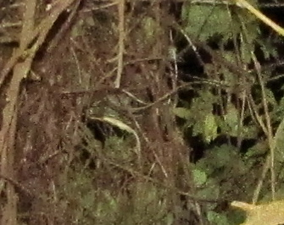

Slide 32
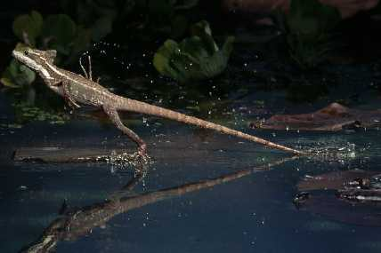
Corytophaninae: Basiliscus vittatus

Slide 33
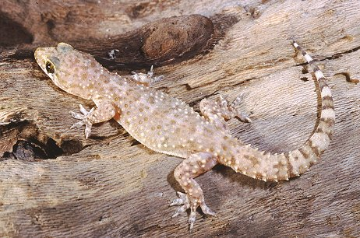
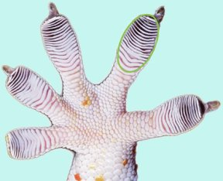
Gekkonidae:
Hemidactylus turcicus

Slide 34
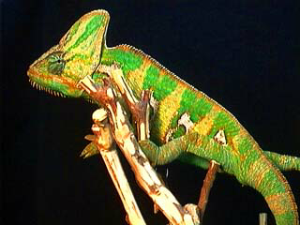
Chamaeleonidae

