Slide 1
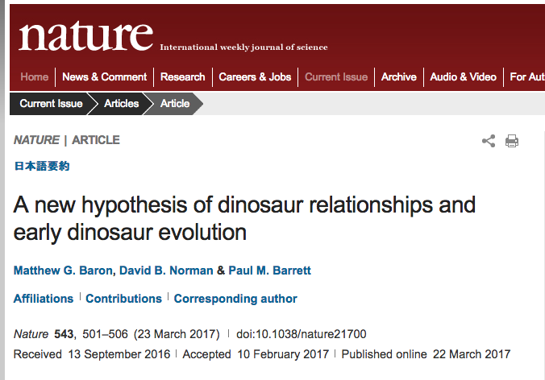
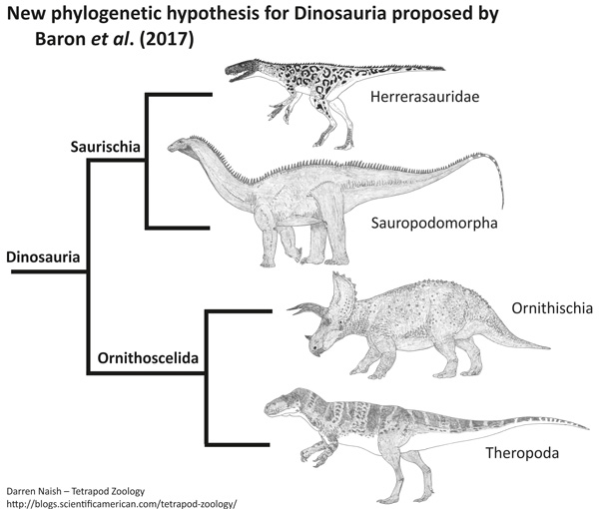
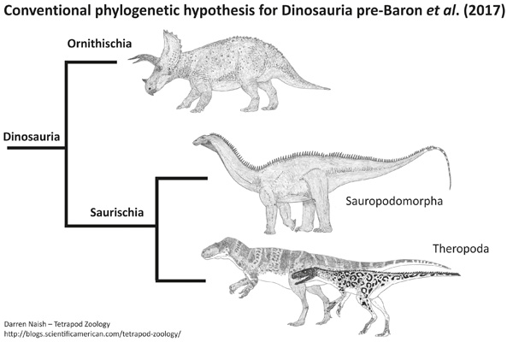

Slide 2
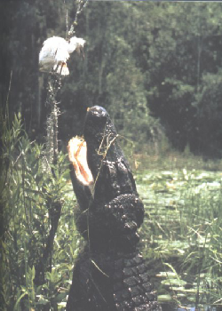
Archosauria: Crocodylians

Slide 3
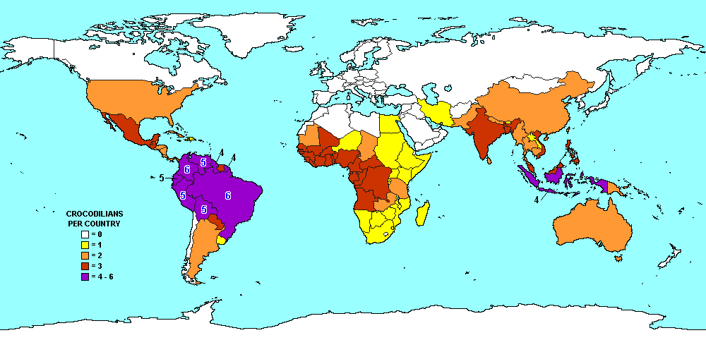

Slide 4
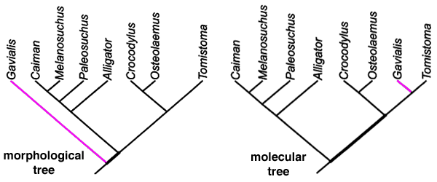

Slide 5
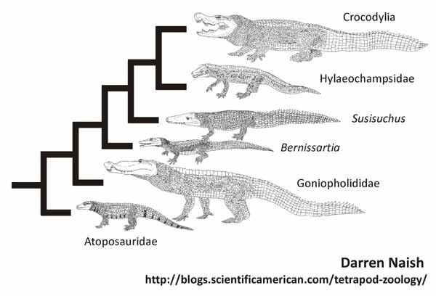

Slide 6
Crocodylian characteristics
Large body size
Semiaquatic
Dorsal scales heavily ossified
Apex predators, Keystone species
Share skeletal/ecological characteristics with birds, dinosaurs (Archosauria)
Internal fertilization, TSD
Complex social behaviors
Locomotion: belly crawl, high walk, gallop, swim, leap

Slide 7
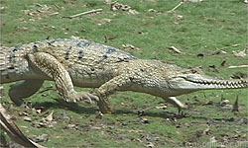

Slide 8
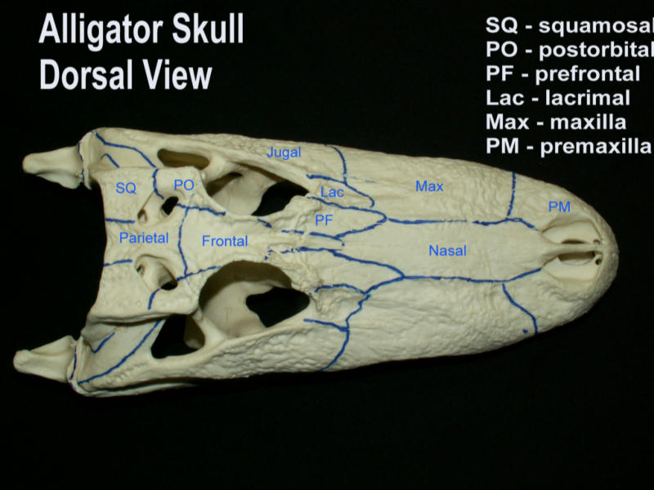
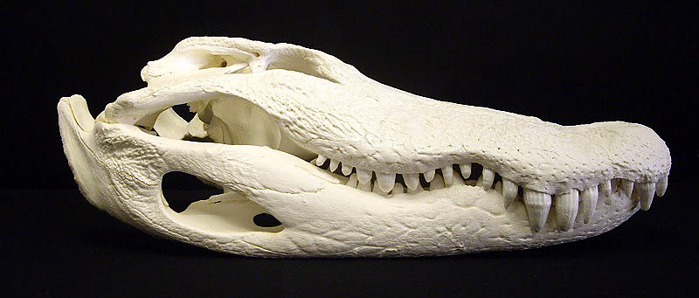
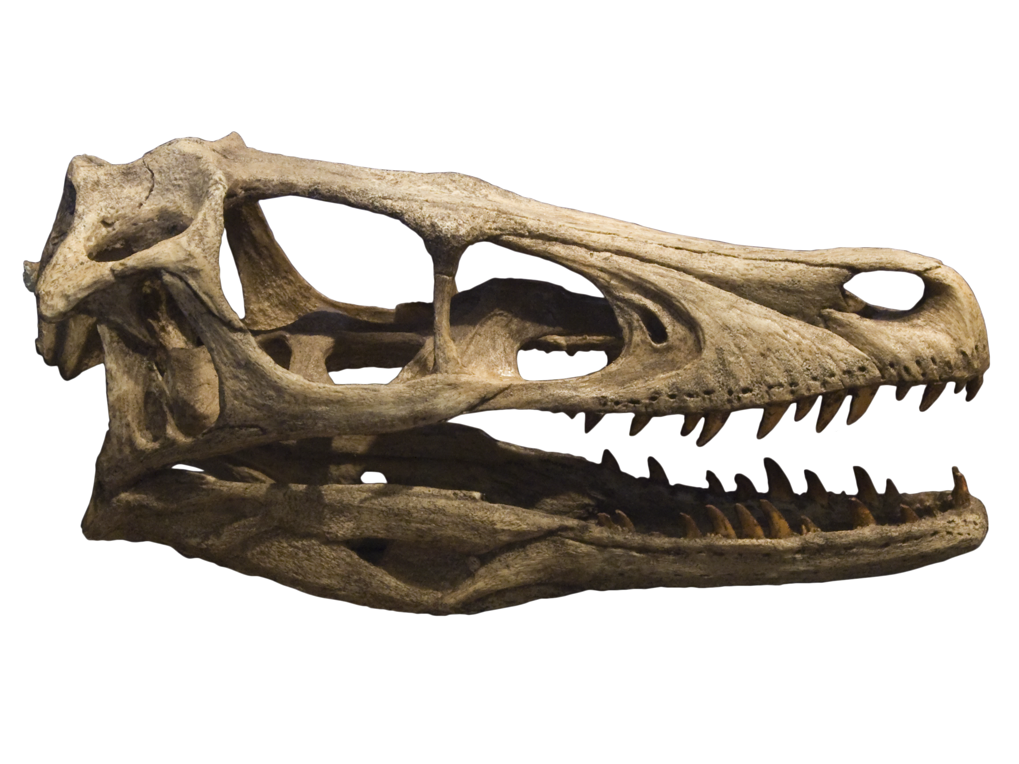
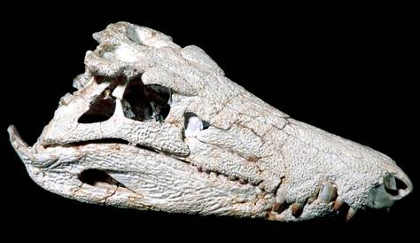

Slide 9
Variation within Crocodylia
Body size
Head shape
Nuchal scales
Teeth pattern
Aquatic habitat
Dirt/veg nest
Structure of parental care

Slide 10
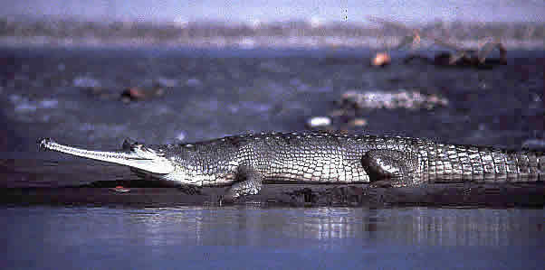
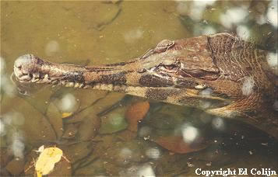
Gavialis gangeticus
Tomistoma schlegelii

Slide 11
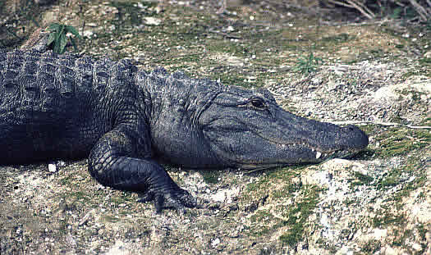
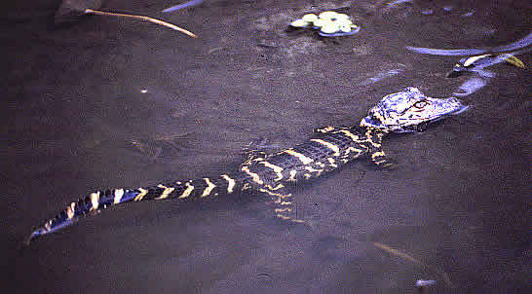
Alligator mississippiensis

Slide 12
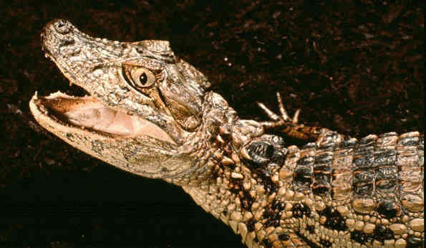
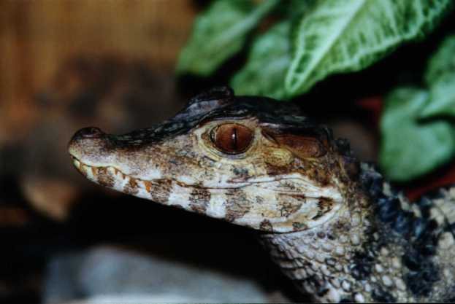
Caiman latirostris
Paleosuchus palpebrosus

Slide 13
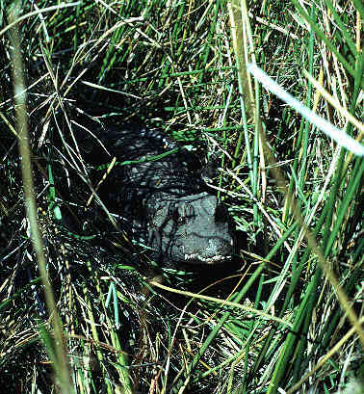
Osteolaemus tetraspis

Slide 14
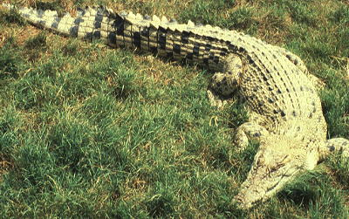
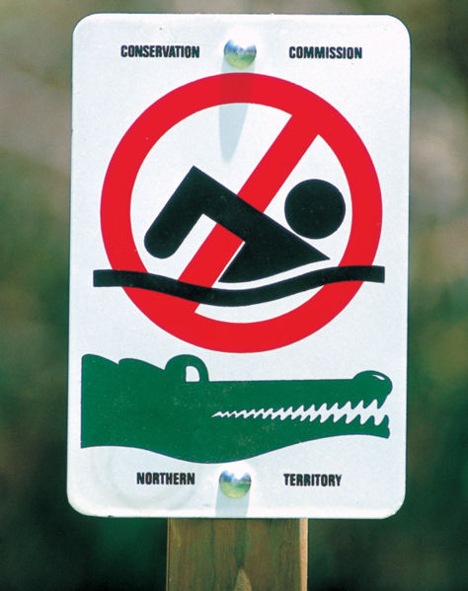
Crocodylus porosus

Slide 15
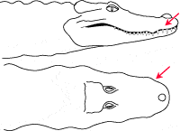
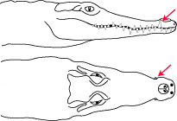
Distinguishing Alligator (+ caimans) and Crocodylus (+ Osteolaemus)
4th lower tooth fits in
socket in upper jaw
(Alligator)
4th lower tooth visible
(Crocodylus)

Slide 16
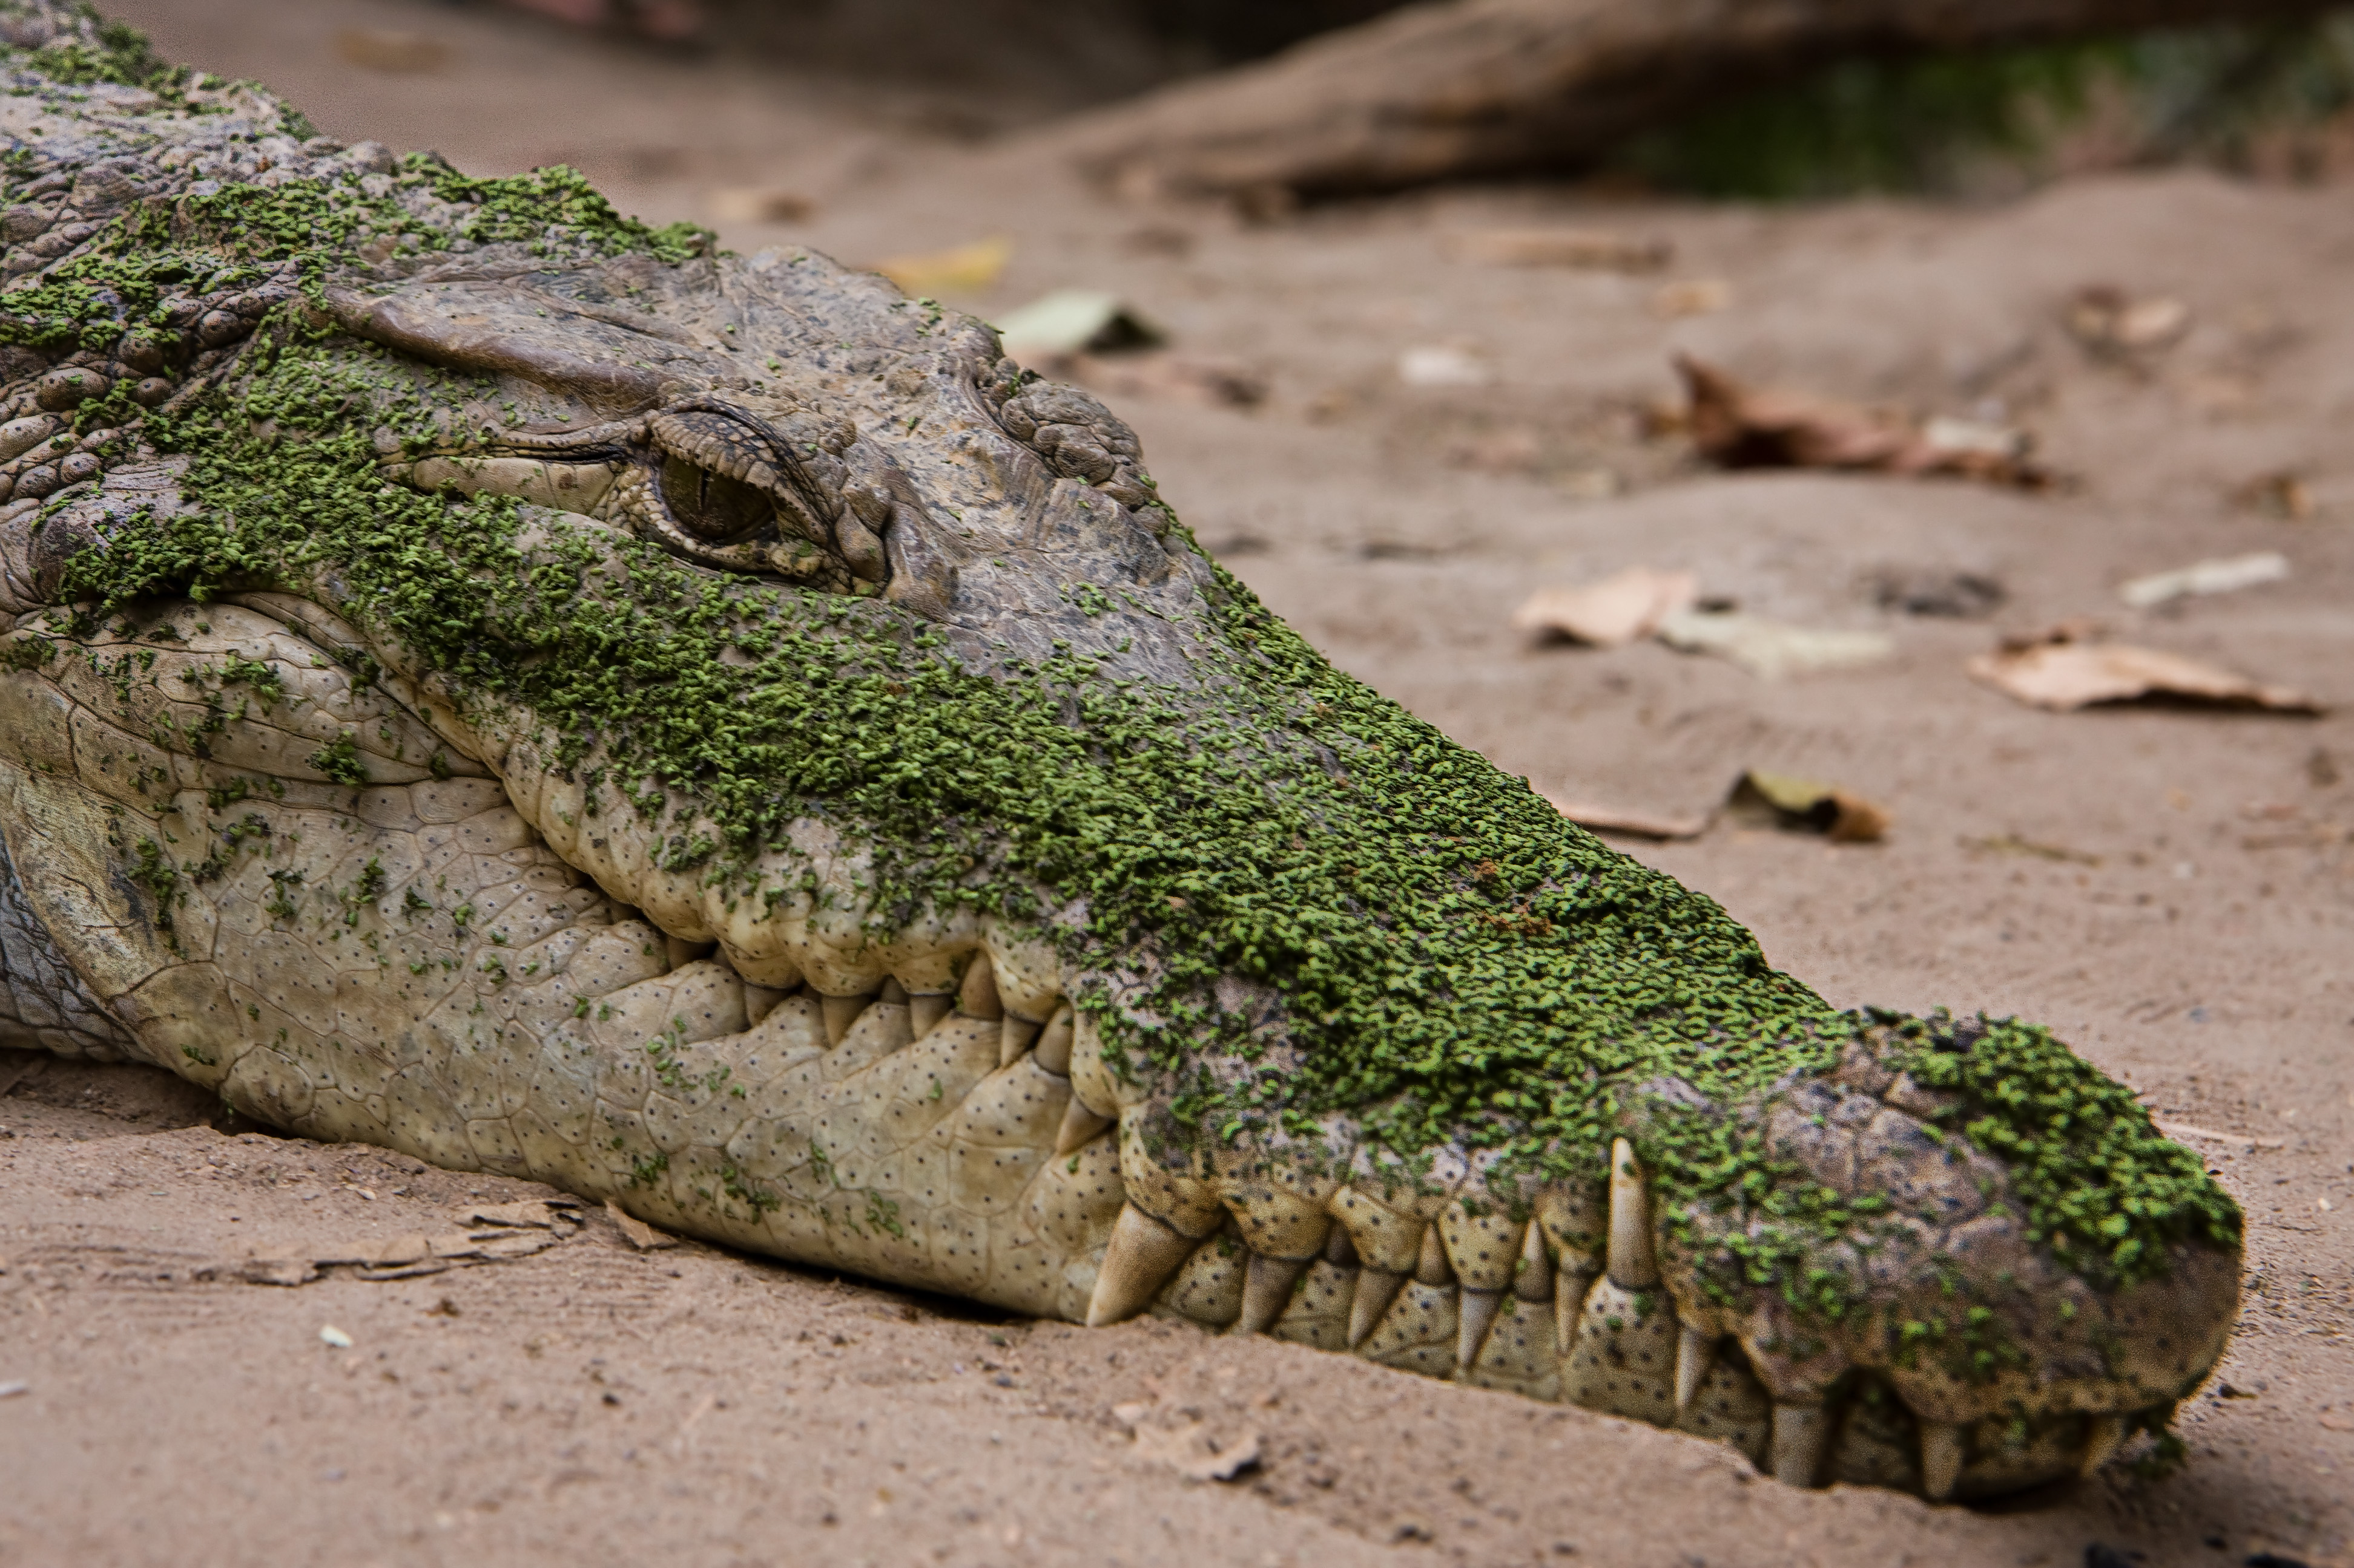

Slide 17
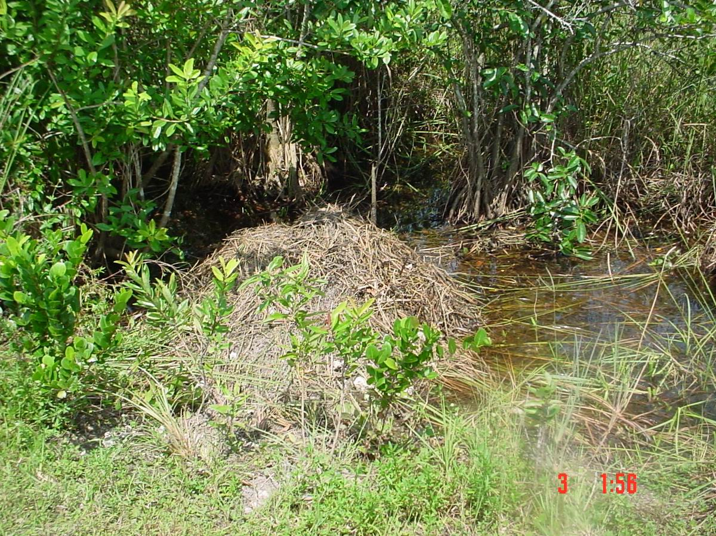
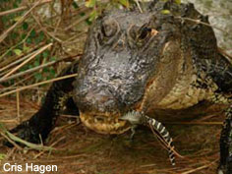
Crocodylian reproduction
Internal fertilization
Oviparous
Temperature dependent sex determination
Complex sexual behavior

Slide 18
Complex social behavior I: vocalization
Vocalize during
Courtship displays
Territorial displays
Distress calls
Types of vocalization
Head slap
Tail slap
Bellow
Hiss
Body muscle contraction
Squeak

Slide 19
Complex social behavior II: parental care

Slide 20
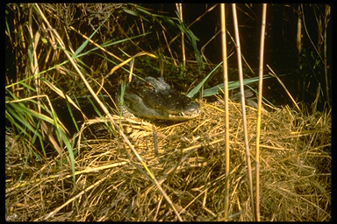
Nest guarding

Slide 21
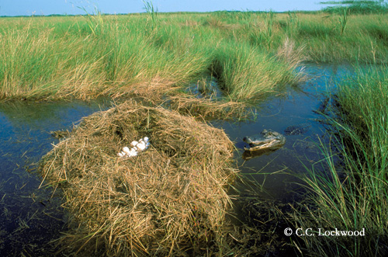
Nest opening

Slide 22
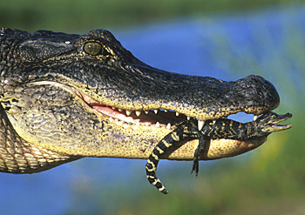
Transport of young

Slide 23
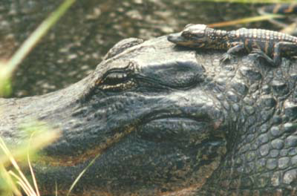
Protect young from predators

Slide 24
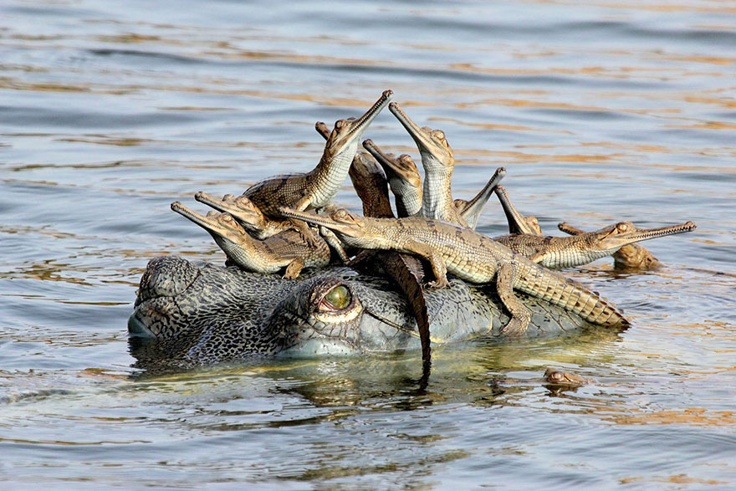

Slide 25
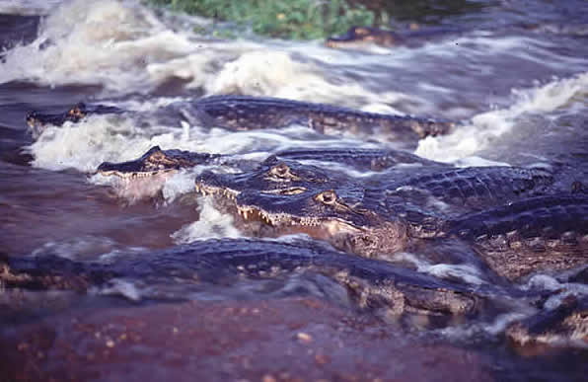
Complex social behavior III: cooperative feeding

Slide 26
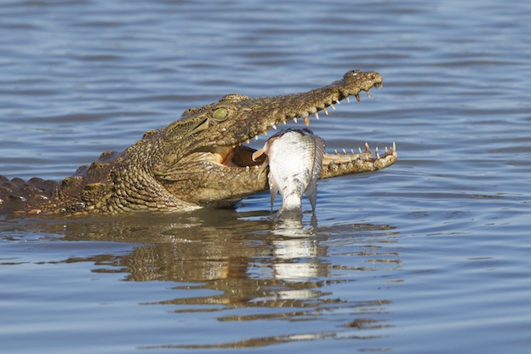

Slide 27
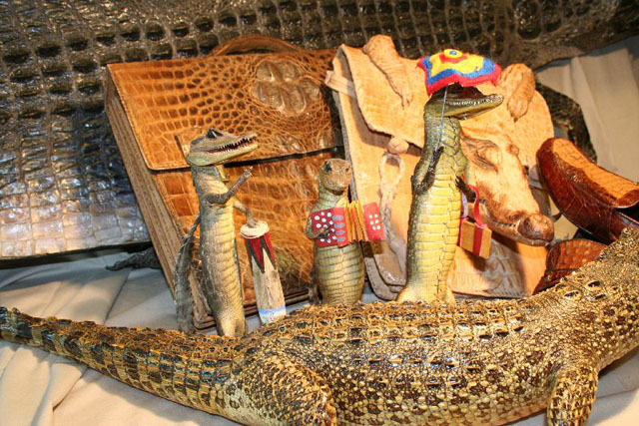
Crocodylian conservation: A success story?
1971: all 23 species considered endangered

Slide 28
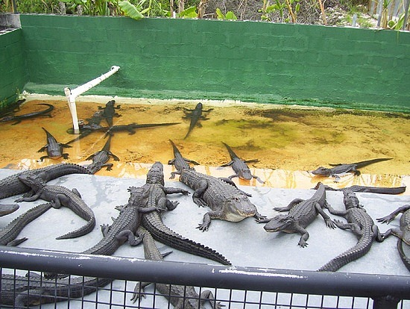
Sustainable use: removing individuals from a population in such a way that the resource is renewable (the population will continue indefinitely).
Provides economic
benefit to local
people
Maintains habitat

Slide 29
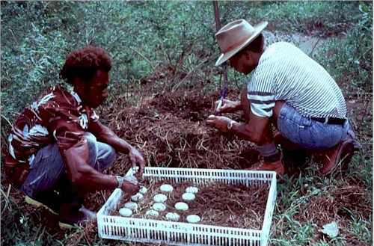
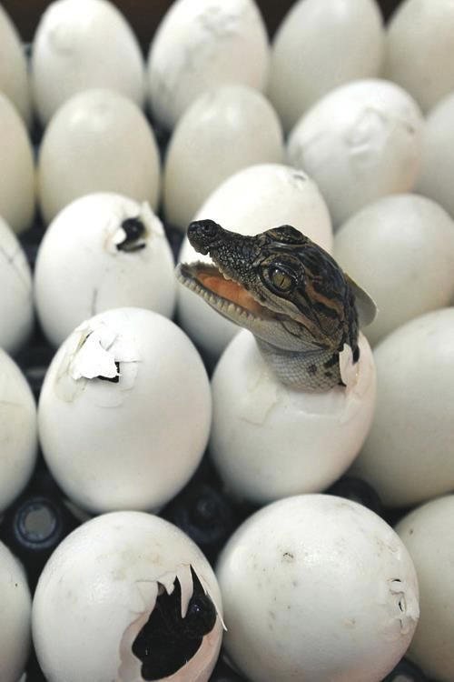
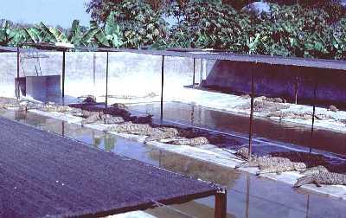

Slide 30
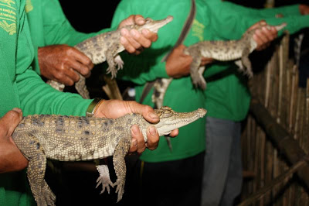
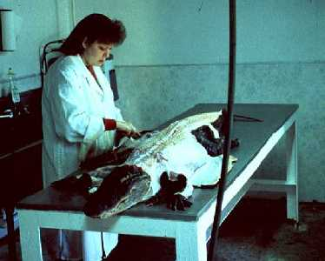

Slide 31
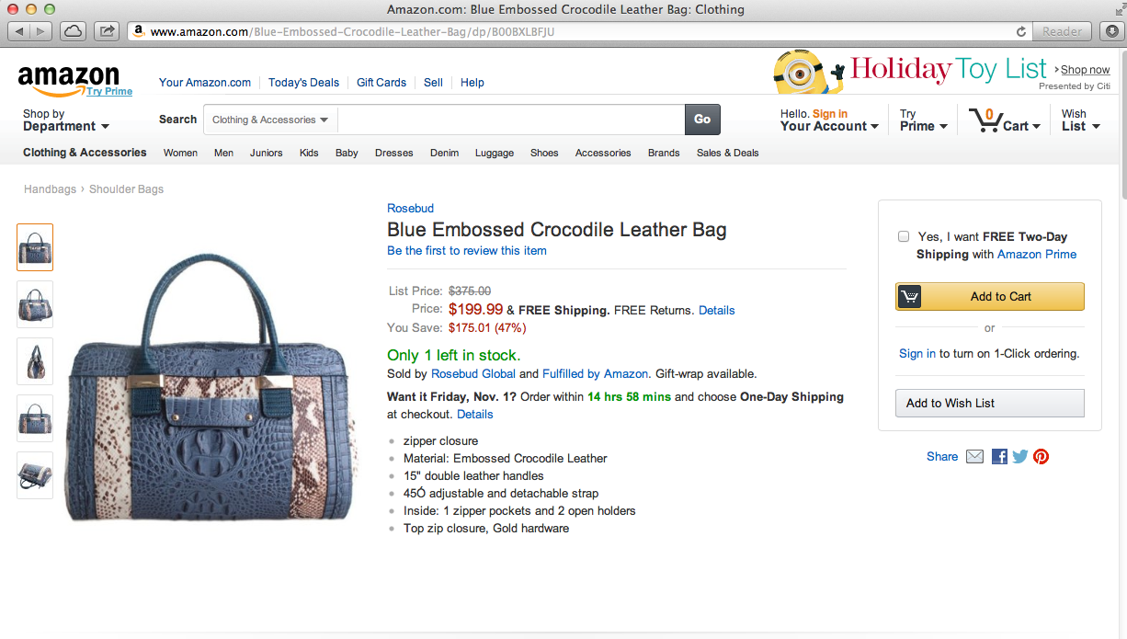
Crocodylian conservation: A success story?
1971: all 23 species considered endangered
2004/2017: 7 species endangered; controlled hunting allowed for
8 of 16 nonendangered.

Slide 32
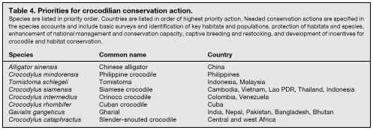

Slide 33
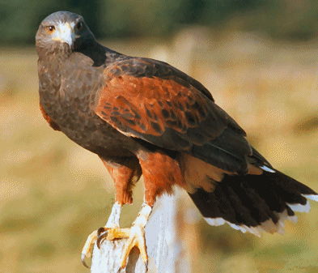
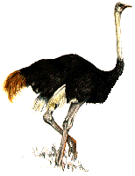
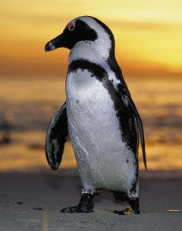
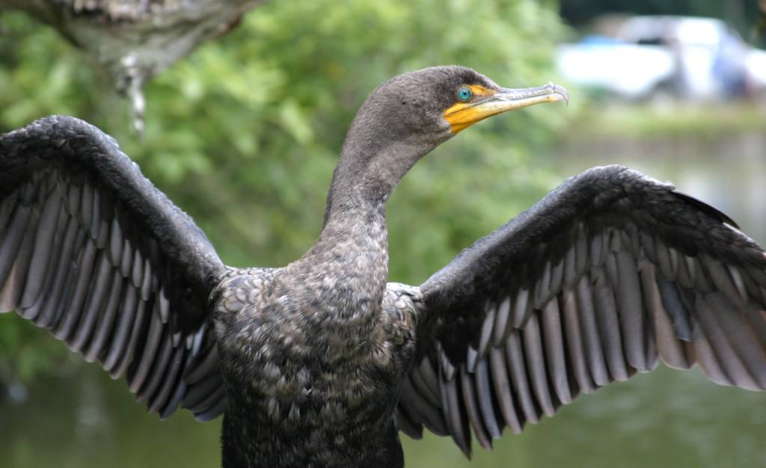
Archsauria: Aves

Slide 34
Synapomorphies of Aves (most shared with theropods)
Powered flight
Feathers
Respiratory system with air sacs
Furcula
Elongate, mobile neck
Fused sternum with keel
Hollow limb bones
Pygostyle
Endothermy
Beak, loss of teeth

Slide 35
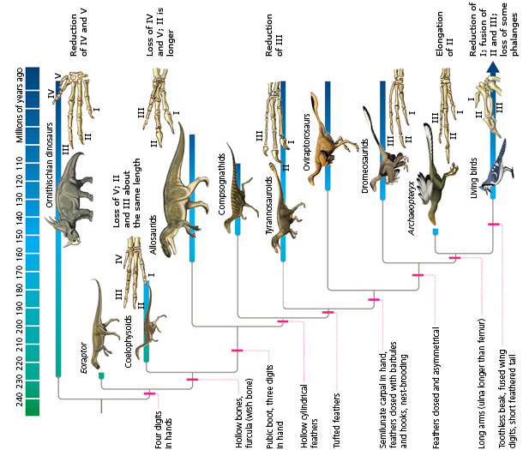
Archaeopteryx lithographica

Slide 36
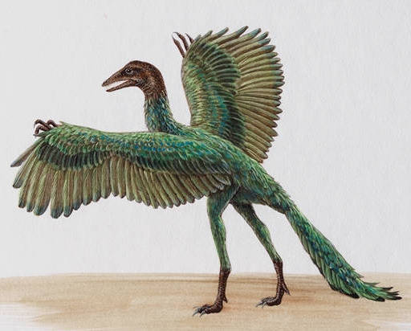
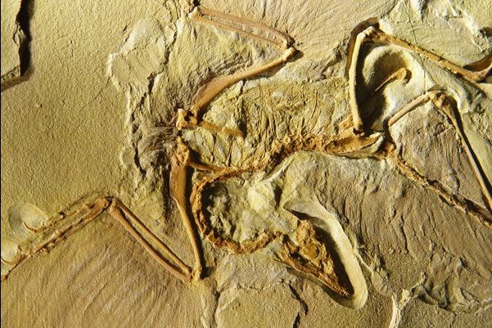
Archaeopteryx lithographica

Slide 37
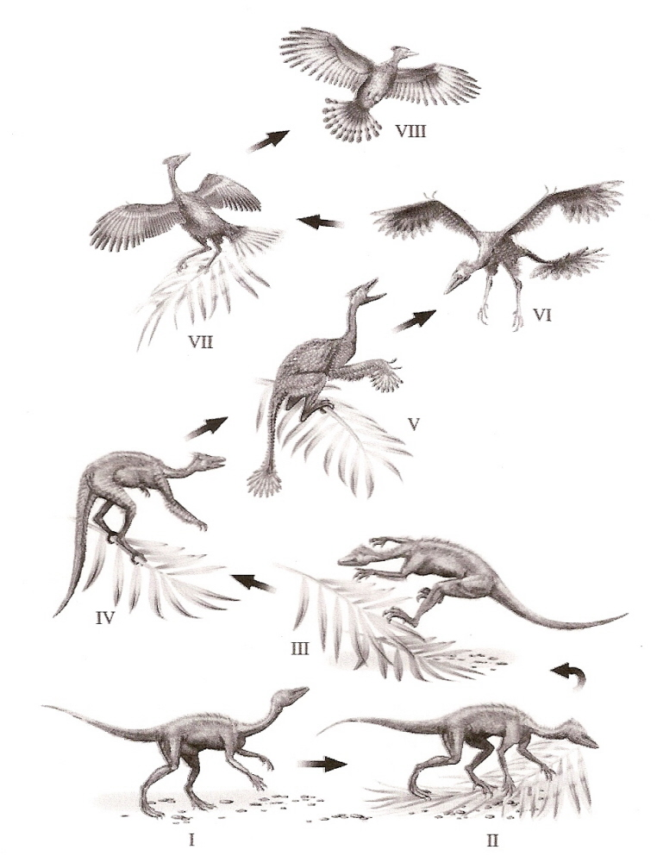
Origin of flight: terrestrial vs. arboreal

Slide 39
vaned down
remiges
rectrices

