Slide 2
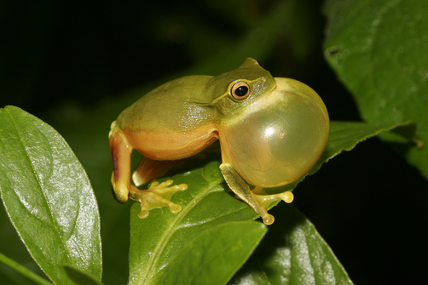
Frog vocalization

Slide 3
Frog vocalization

Slide 5
Amplexus

Slide 6
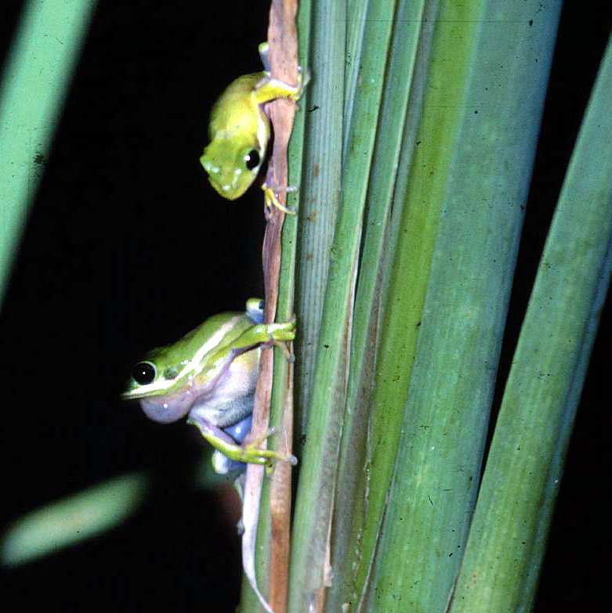
Alternative mating strategies in frogs
satellite males

Slide 7
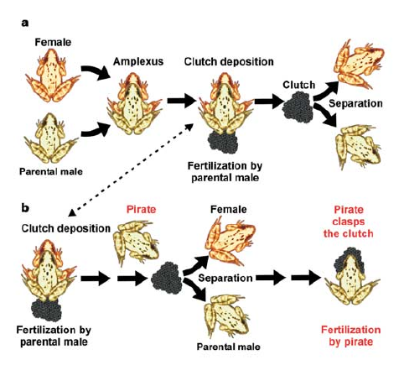
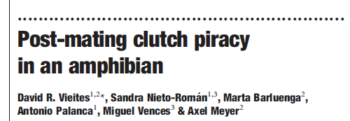
Alternative mating strategies in frogs
satellite males
clutch piracy

Slide 8
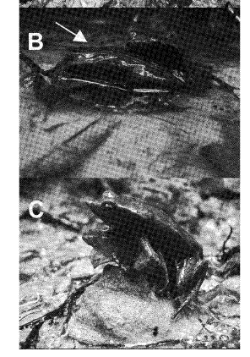
Alternative mating strategies in frogs
satellite males
clutch piracy
functional necrophilia

Slide 9
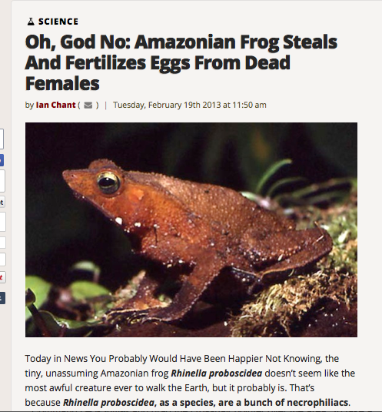

Slide 10
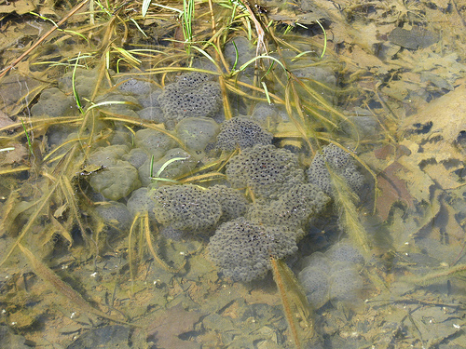
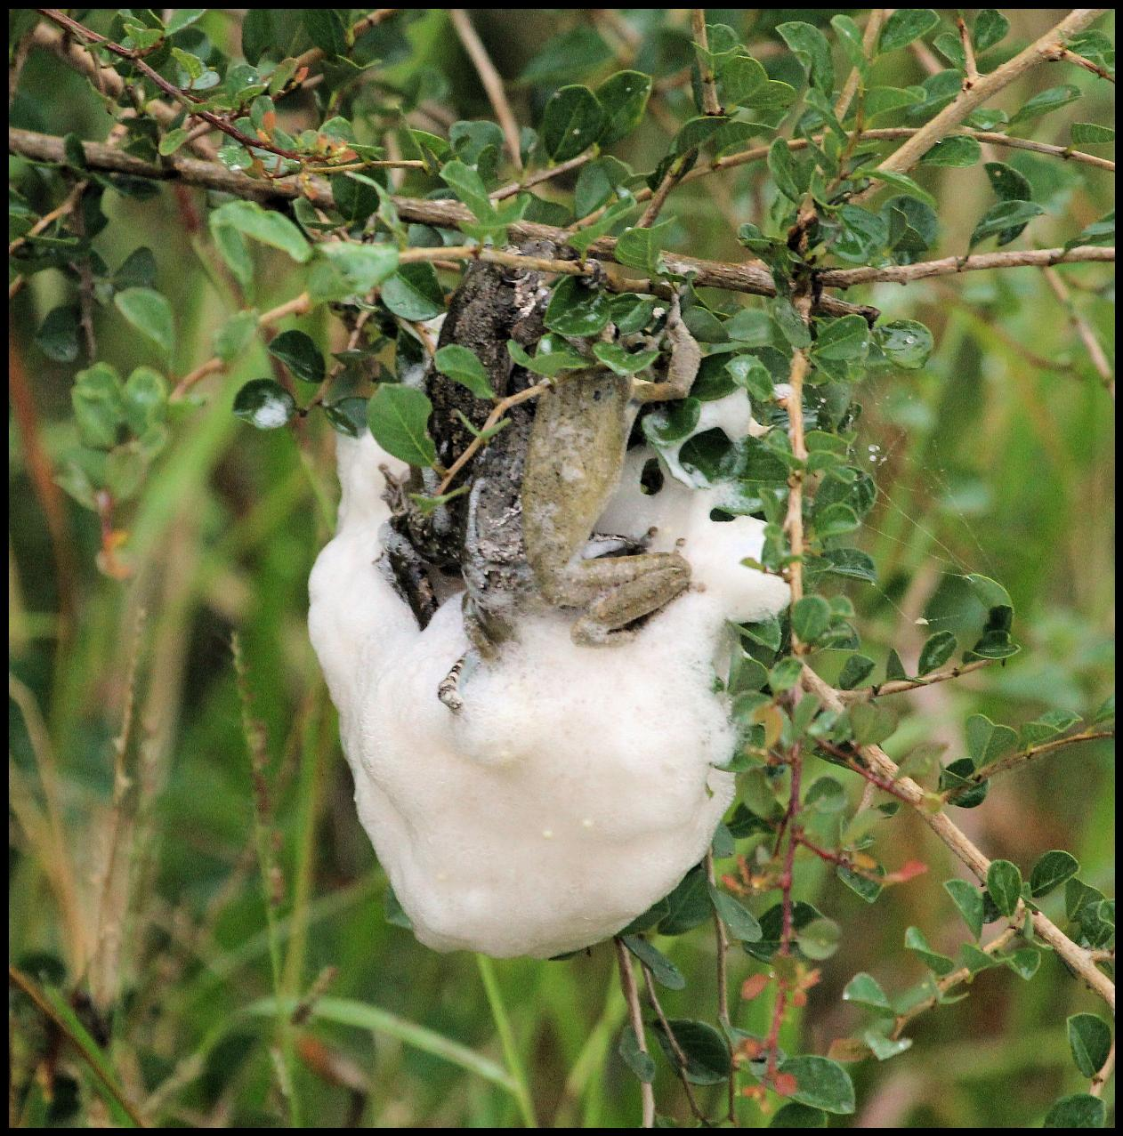
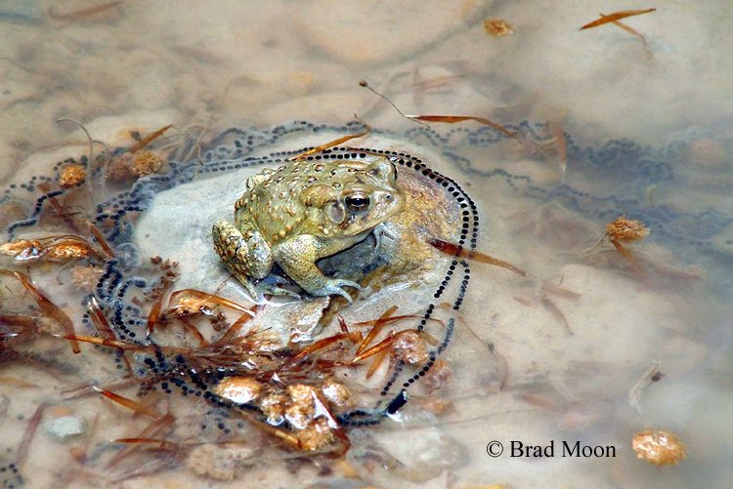
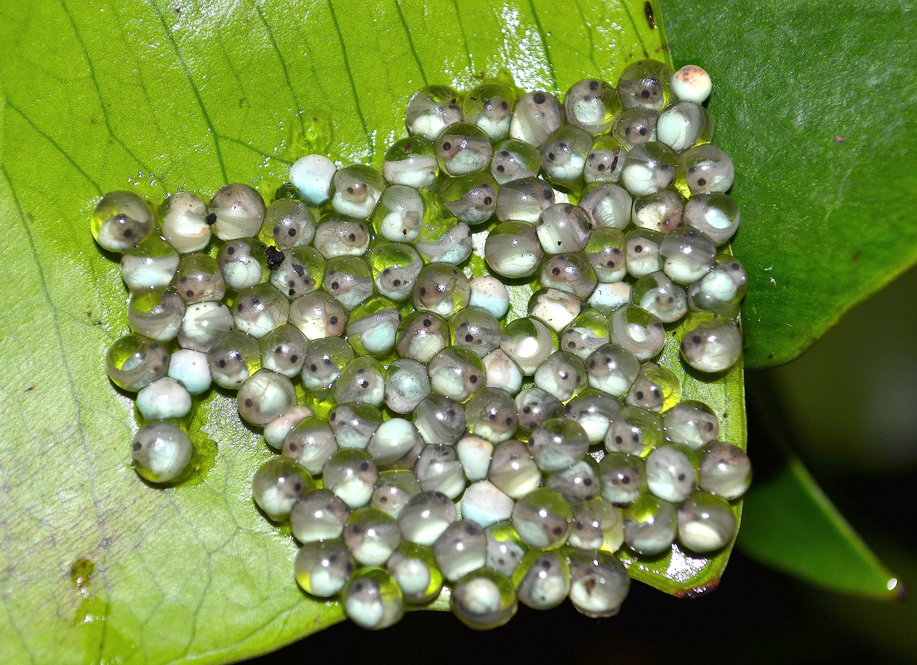

Slide 14
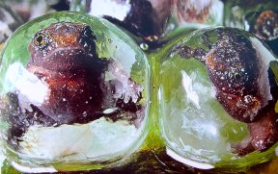

Slide 15
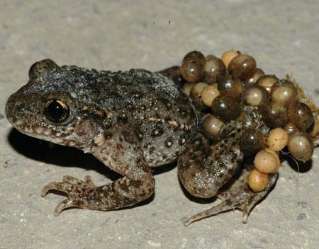
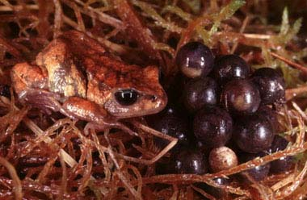
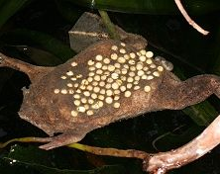
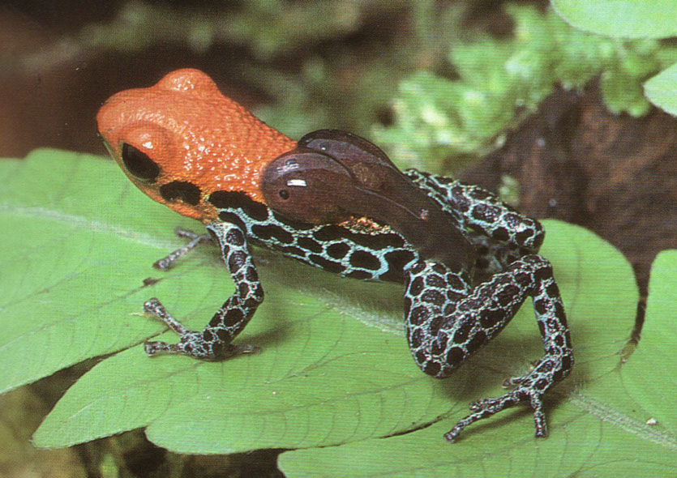
Parental care
Internal Brooding
(♀ → Gastric Brooders)

Slide 16
Parental care: Dendrobates

Slide 17
Parental care: Pipa

Slide 18
Parental care: Rhinoderma

Slide 19
