Slide 1
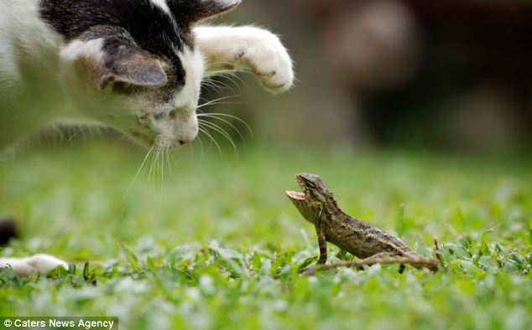

Slide 2
Species definitions
Phenetic species concept: A species is a set of organisms that look similar to each other and distinct from other sets (Sokal and Crovello 1970).

Slide 3
Species definitions
Phenetic species concept: A species is a set of organisms that look similar to each other and distinct from other sets (Sokal and Crovello 1970).
Ecological species concept: A species is a set of organisms exploiting (or adapted to) a single niche (Van Valen 1976).

Slide 4
Species definitions
Phenetic species concept: A species is a set of organisms that look similar to each other and distinct from other sets (Sokal and Crovello 1970).
Ecological species concept: A species is a set of organisms exploiting (or adapted to) a single niche (Van Valen 1976).
Biological species concept: Species are groups of actually or potentially interbreeding natural populations, which are reproductively isolated from other such groups (Mayr 1942).

Slide 5
Species definitions
Phenetic species concept: A species is a set of organisms that look similar to each other and distinct from other sets (Sokal and Crovello 1970).
Ecological species concept: A species is a set of organisms exploiting (or adapted to) a single niche (Van Valen 1976).
Biological species concept: Species are groups of actually or potentially interbreeding natural populations, which are reproductively isolated from other such groups (Mayr 1942).
Phylogenetic species concept: A species is the smallest diagnosable cluster of individual organisms within which there is a parental pattern of ancestry and descent (Cracraft 1983).

Slide 6
Species definitions
Phenetic species concept: A species is a set of organisms that look similar to each other and distinct from other sets (Sokal and Crovello 1970).
Ecological species concept: A species is a set of organisms exploiting (or adapted to) a single niche (Van Valen 1976).
Biological species concept: Species are groups of actually or potentially interbreeding natural populations, which are reproductively isolated from other such groups (Mayr 1942).
Phylogenetic species concept: A species is the smallest diagnosable cluster of individual organisms within which there is a parental pattern of ancestry and descent (Cracraft 1983).
Evolutionary species concept: A species is a single lineage of ancestor-descendant populations which maintain its identity from other such lineages and which has its own evolutionary tendencies and historical fate (Wiley 1981).

Slide 8
Species (Frost and Kluge 1994)
Species concept: What is a species?
an evolutionary lineage of populations (Evolutionary Species Concept)
Species criterion: How can we tell whether two groups of individuals are separate species?
Can they interbreed? (Biological Species Concept)
Do they occupy different niches? (Ecological Species Concept)
Do they look different (Phenetic Species Concept)
Does a phylogenetic analysis indicate they are distinguishable by synapomorphies? (Phylogenetic Species Concept)

Slide 9
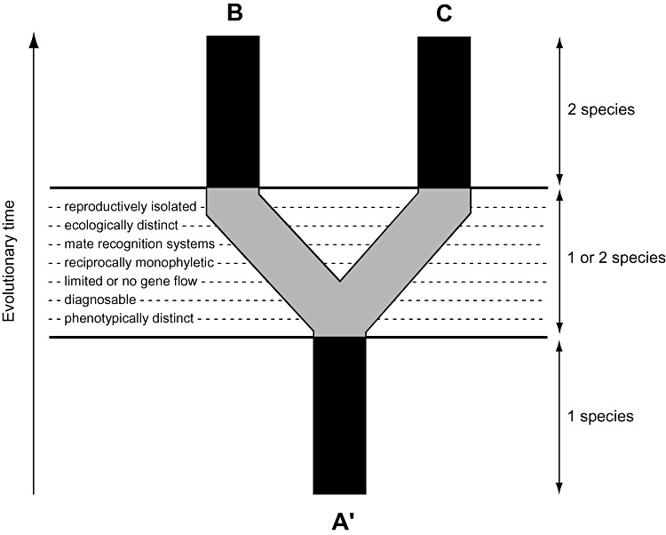

Slide 10
Species concepts: History
Pre-1942
Typology
Key reading: Aristotle
1940s-1990s
Key reading: Mayr 1942. Systematics and the origin of species from the viewpoint of a zoologist.
Interbreeding
Lots of philosophical work (Hull, Ghiselin, Hey)
1990s-now
Species = evolutionary lineages (Simpson)
Operational/conceptual distinction
Key reading: Wiley 1981, Frost and Kluge 1994, de Queiroz 1998

Slide 12
Speciation
Wiens, JJ. 2004. What is speciation and how should we study it?

Slide 13
Speciation
Lineage splitting
dispersal
vicariance

Slide 14
Speciation
Lineage splitting
dispersal
vicariance
Lineage divergence
natural selection
drift

Slide 15
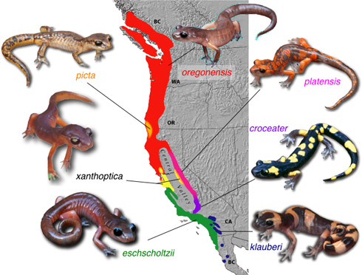
Speciation in action: a ring species

Slide 16
Summary/important aspects of species and speciation
Species are independent evolutionary lineages of populations (EVSC); most species "concepts" (BSC, PHYSC, ECSC, PHENSC) capture operational elements of this

Slide 17
Summary/important aspects of species and speciation
Species are independent evolutionary lineages of populations (EVSC); most species "concepts" (BSC, PHYSC, ECSC, PHENSC) capture operational elements of this
Species are "natural" entities, not human constructs
Subspecies are operational pattern classes

Slide 18
Summary/important aspects of species and speciation
Species are independent evolutionary lineages of populations (EVSC); most species "concepts" (BSC, PHYSC, ECSC, PHENSC) capture operational elements of this
Species are "natural" entities, not human constructs
Subspecies are operational pattern classes
Reproduction is (very) important, but it is just one aspect of species and speciation

Slide 19
Summary/important aspects of species and speciation
Species are independent evolutionary lineages of populations (EVSC); most species "concepts" (BSC, PHYSC, ECSC, PHENSC) capture operational elements of this
Species are "natural" entities, not human constructs
Subspecies are operational pattern classes
Reproduction is (very) important, but it is just one aspect of species and speciation
Speciation involves two steps: lineage splitting and lineage divergence

Slide 20
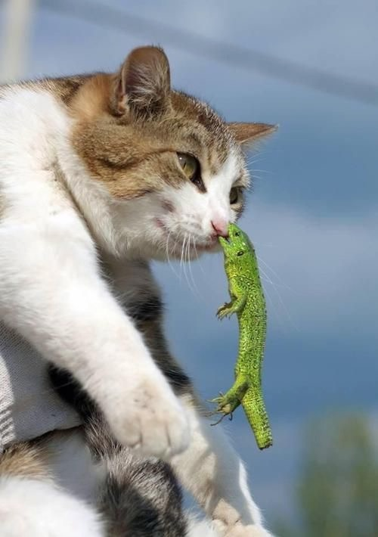

Slide 21
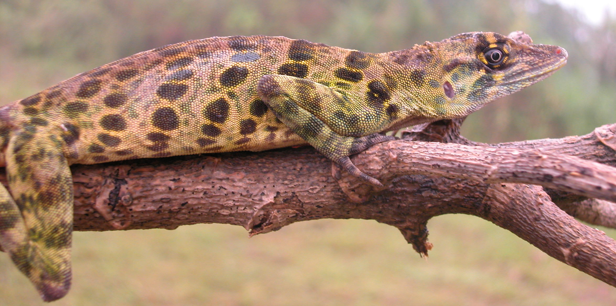
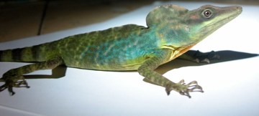
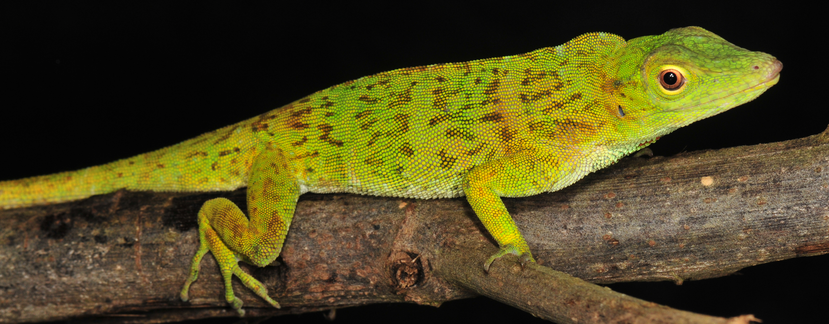
Species discovery
Phenetic
Find an individual or population in nature that appears different from other known populations
Compare individuals of purported new species to individuals of known species; search for diagnostic differences

Slide 22
Species discovery
Phenetic
Find an individual or population in nature that appears different from other known populations
Compare individuals of purported new species to individuals of known species; search for diagnostic differences
Phylogenetic
Obtain DNA sequences for multiple individuals from throughout the range of a species
Perform phylogentic analysis
Recognize separate clades with some degree of genetic divergence as separate species

Slide 23
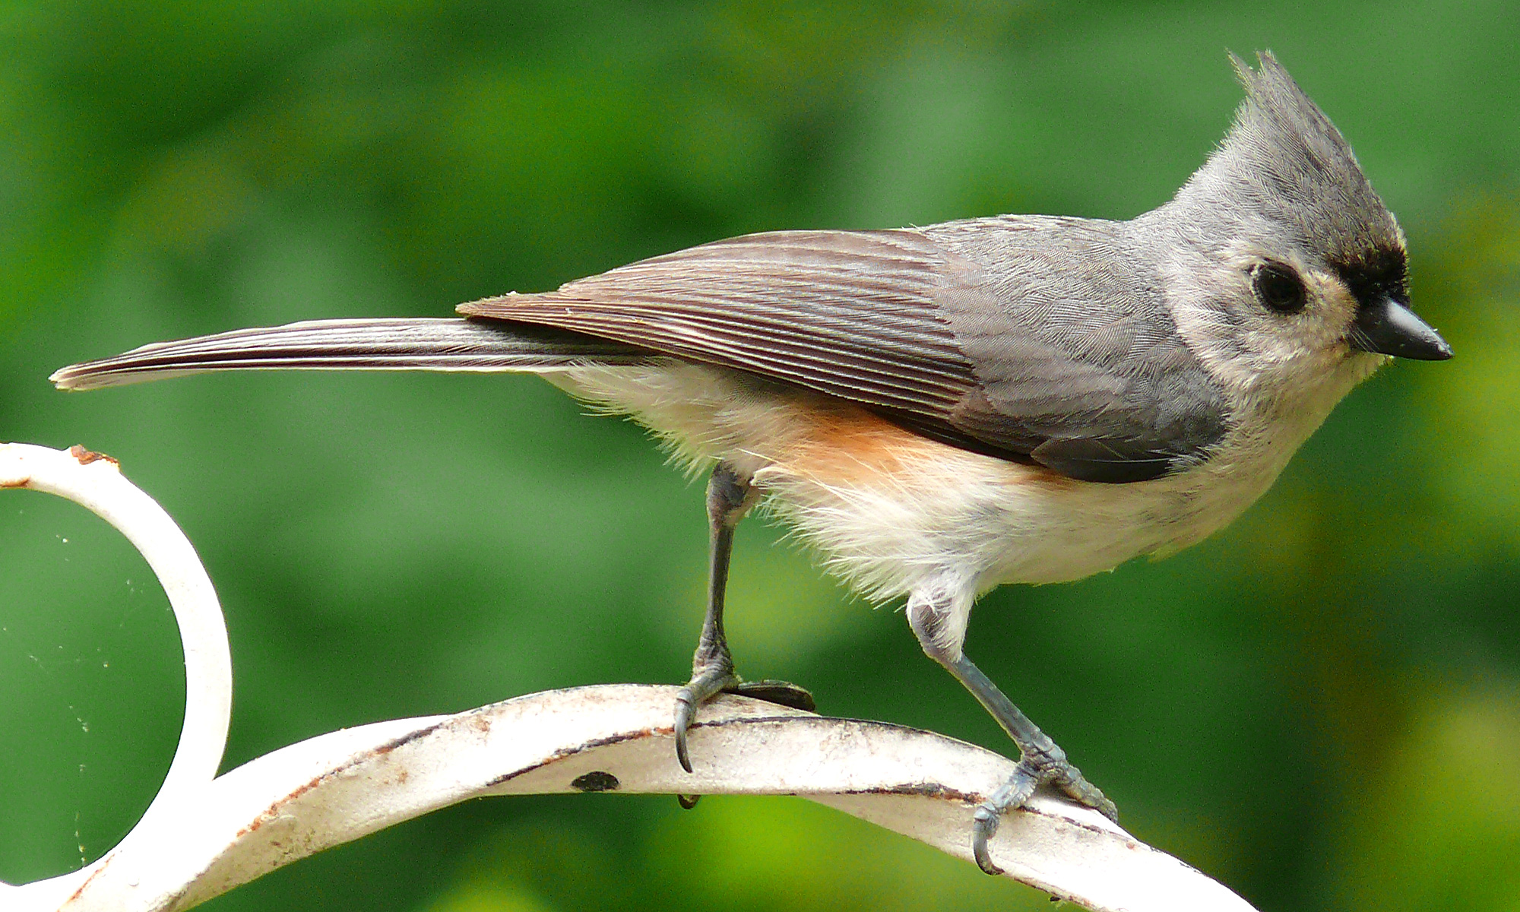
Species discovery

Slide 24
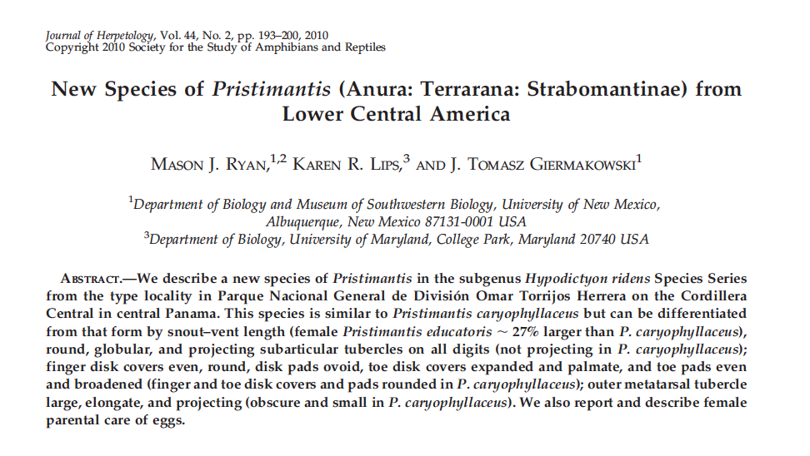
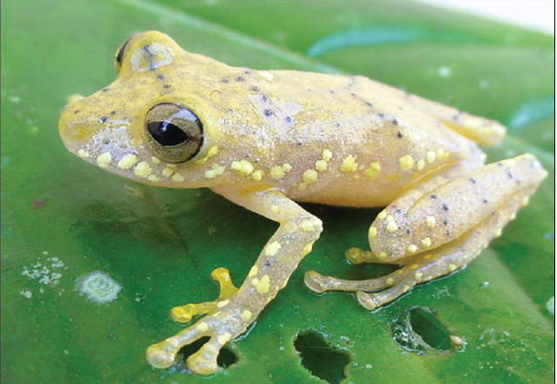
Species description
Designate a Holotype
Diagnose the species
Describe the Holotype and variation among paratypes
Other data
illustrations, range map, ecology, phylogeny

