Slide 1
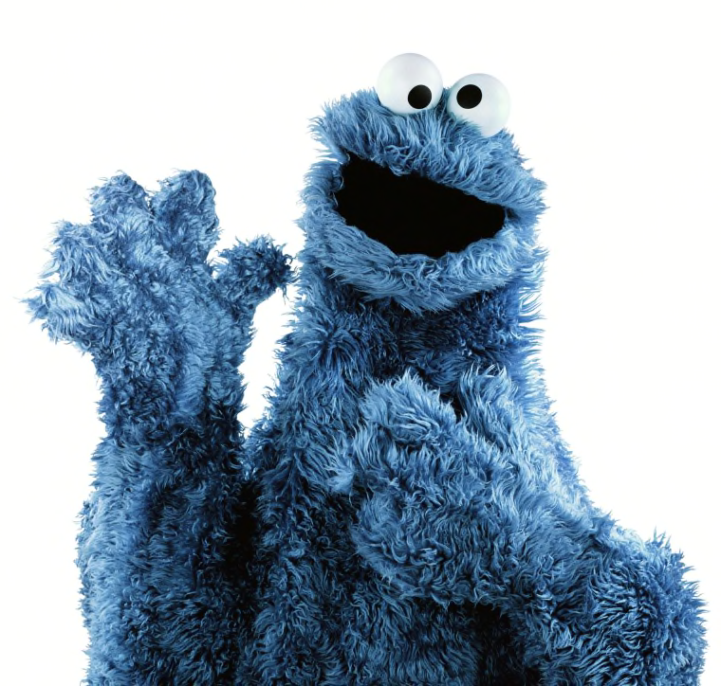
GVZ 2023 23 Feb
Amniota
Lepidosauria
Phylogeny
Traits
Diversity

Slide 2
crocodilians
turtles
mammals
birds

Slide 4
Testudines
Aves
Crocodylia
Lepidosauria
Mammalia
Amphibia
Archosauria
Reptilia
"the most recent common ancestor of extant mammals and reptiles, and all its descendants" (Gauthier et al., 1988)
Amniota
Tetrapoda

Slide 5
Testudines
Aves
Crocodylia
Lepidosauria
Mammalia
Amphibia
Archosauria
"The most recent common ancestor of extant turtles and saurians, and all its descendants."
(Gauthier et al. 1988)
Reptilia
Amniota
Tetrapoda

Slide 6
Testudines
Aves
Crocodylia
Lepidosauria
Mammalia
Amphibia
Archosauria
Reptilia
Amniota
Amniotic egg
Tetrapoda

Slide 7
Testudines
Aves
Crocodylia
Lepidosauria
Mammalia
Amphibia
Archosauria
Reptilia
Amniota
Tetrapoda

Slide 8
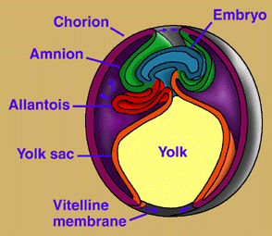

Slide 9
"lizards"
Serpentes
"lizards"
"lizards"
Sphenodon
Other Reptilia
Squamata
shed skin completely
transverse cloacal slit
notched tongue
caudal autotomy
Lepidosauria
Reptilia

Slide 10
"lizards"
Serpentes
"lizards"
"lizards"
Sphenodon
Other Reptilia
Squamata
hemipenes
kinetic skull
Lepidosauria
Reptilia

Slide 11
"lizards"
Serpentes
"lizards"
"lizards"
Sphenodon
Other Reptilia
Squamata
Lepidosauria
Reptilia

Slide 12
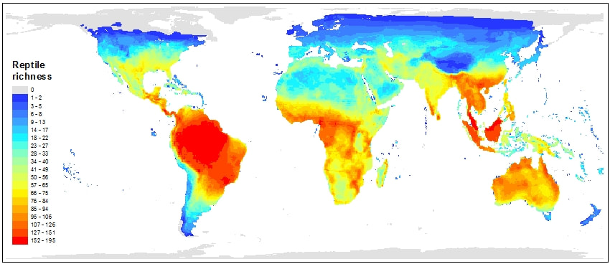
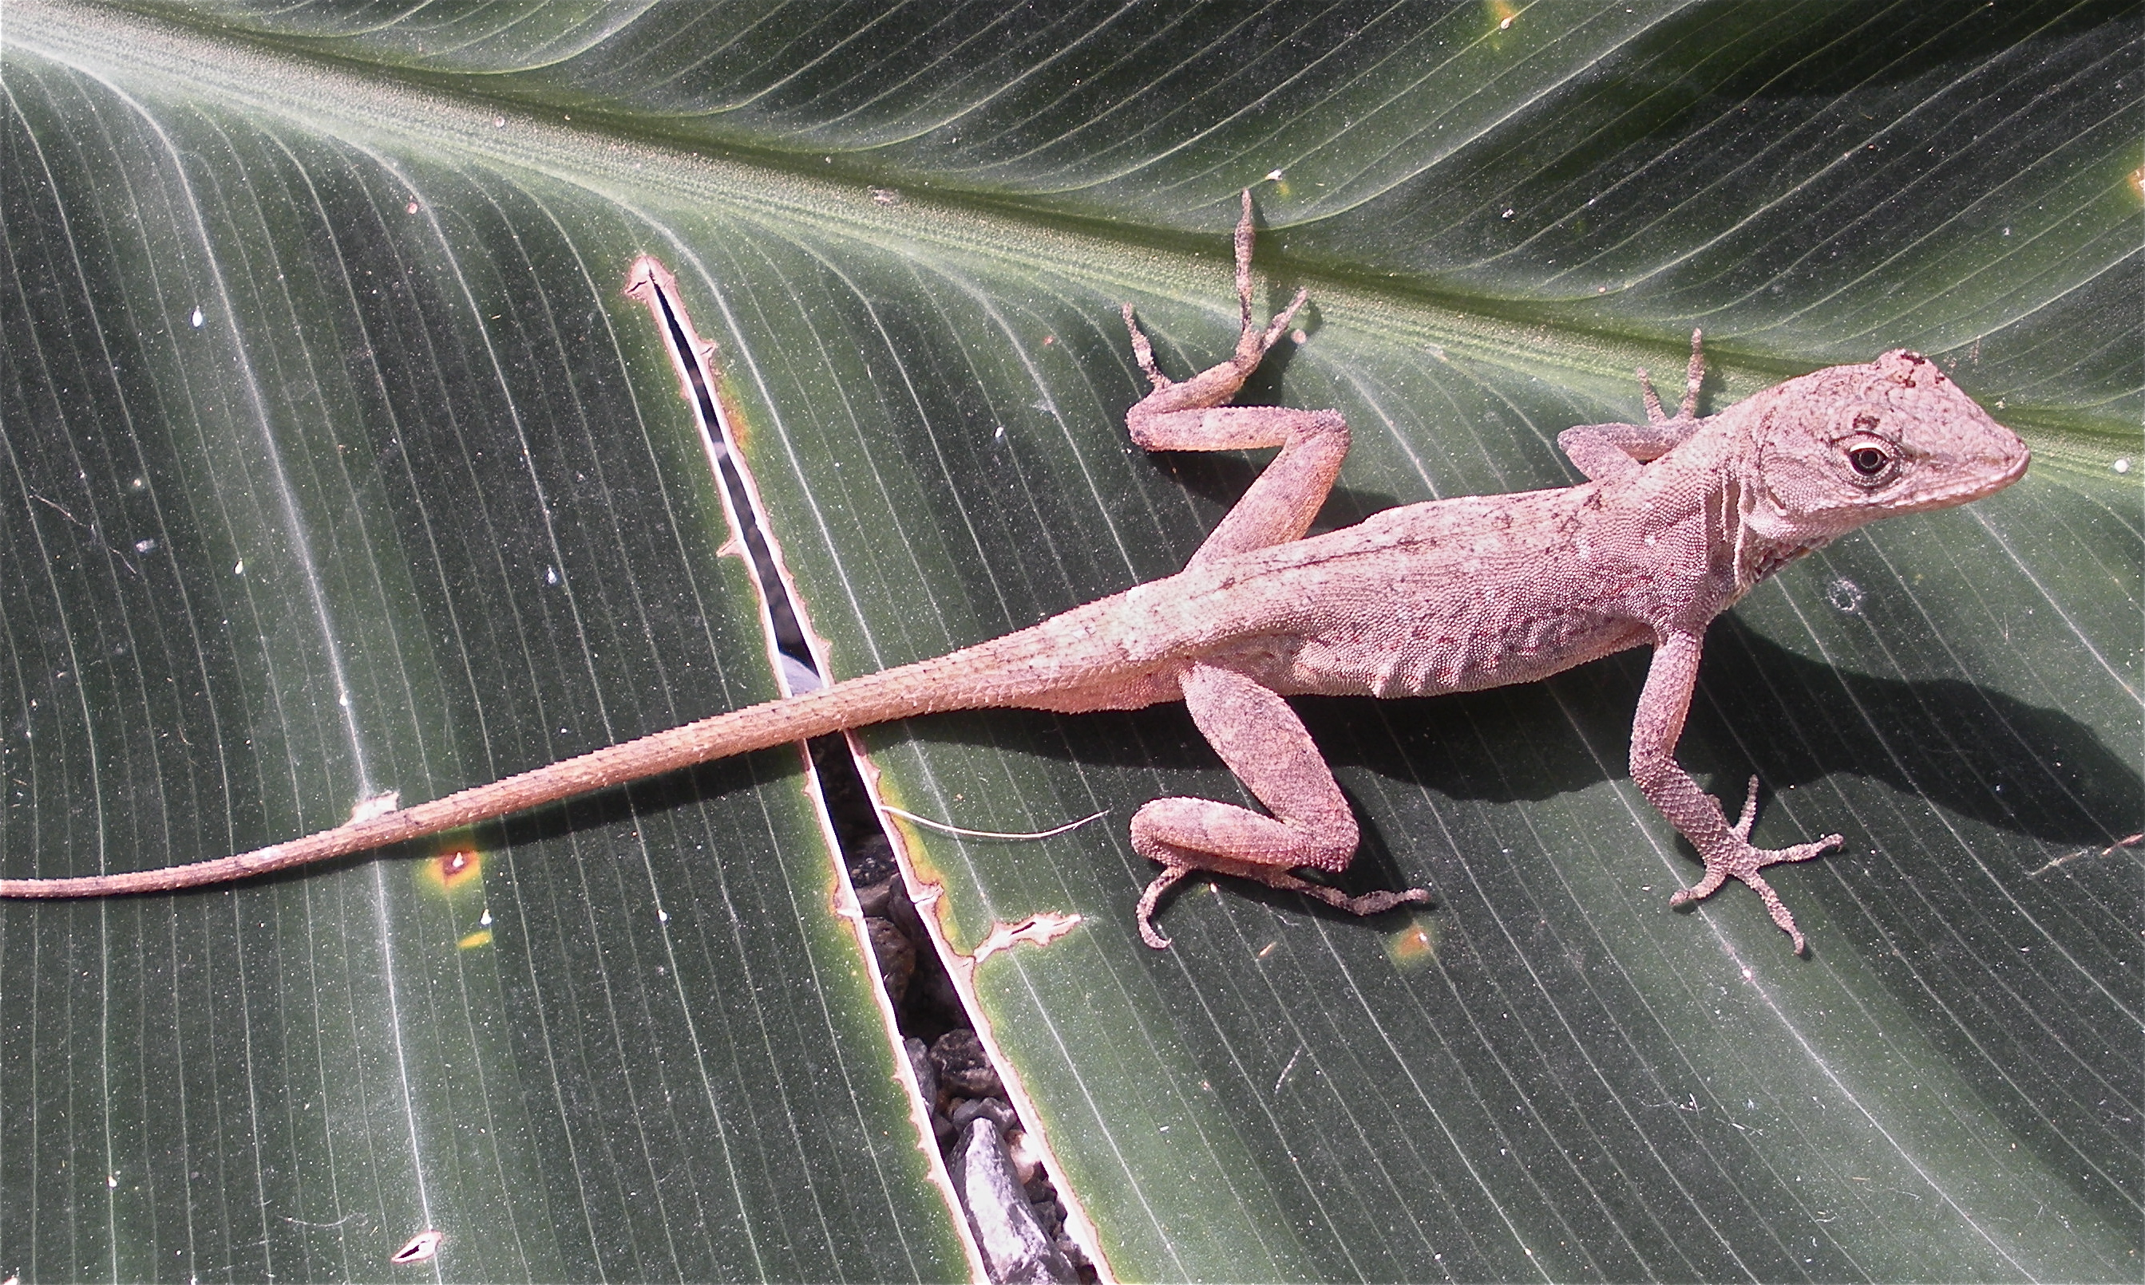
Lepidosauria

Slide 13
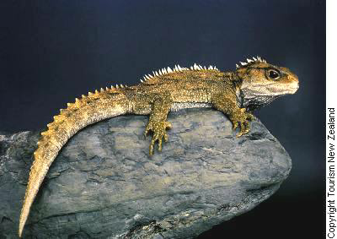
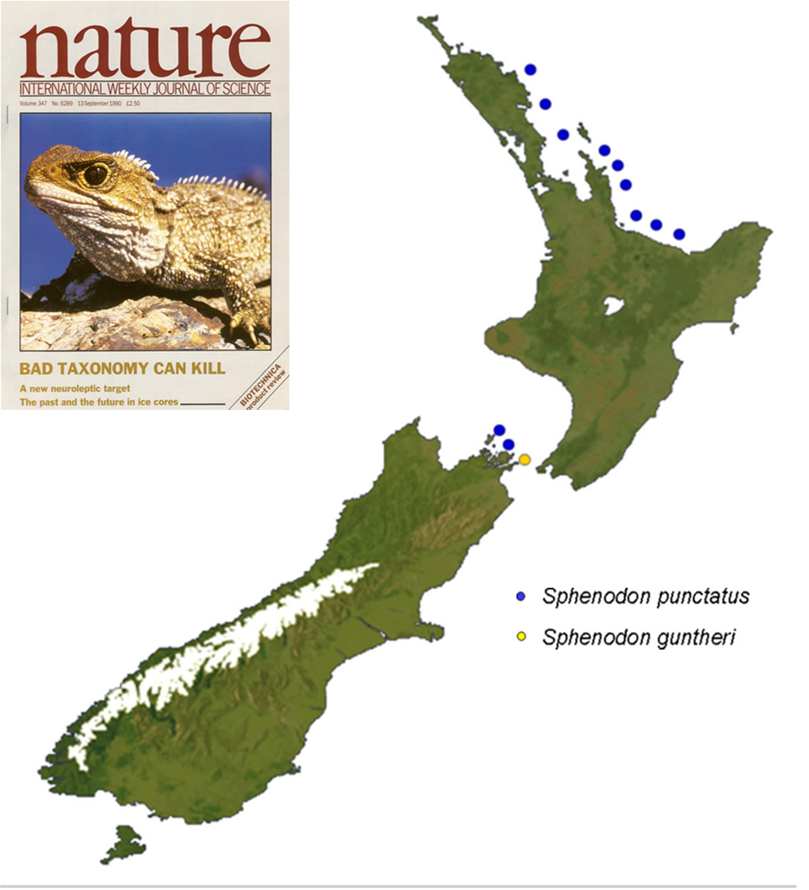
Rhynchocephalia: Spenodon punctatus

Slide 14
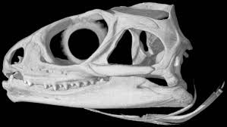
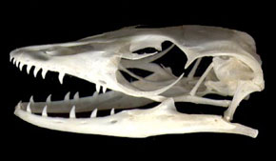
Sphenodon punctatus:
Rhyncocephalia
Diapsid skull
Varanus sp:
Squamata
Modified diapsid skull

Slide 15
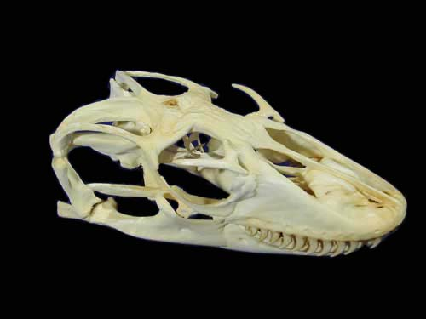
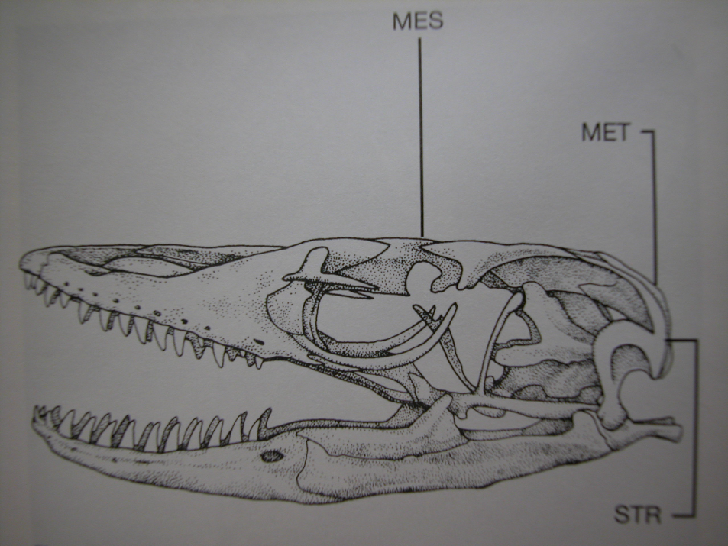
Cranial kinesis in lizard skulls:
Streptostylic, mesokinetic, metakinetic
quadrate

Slide 16
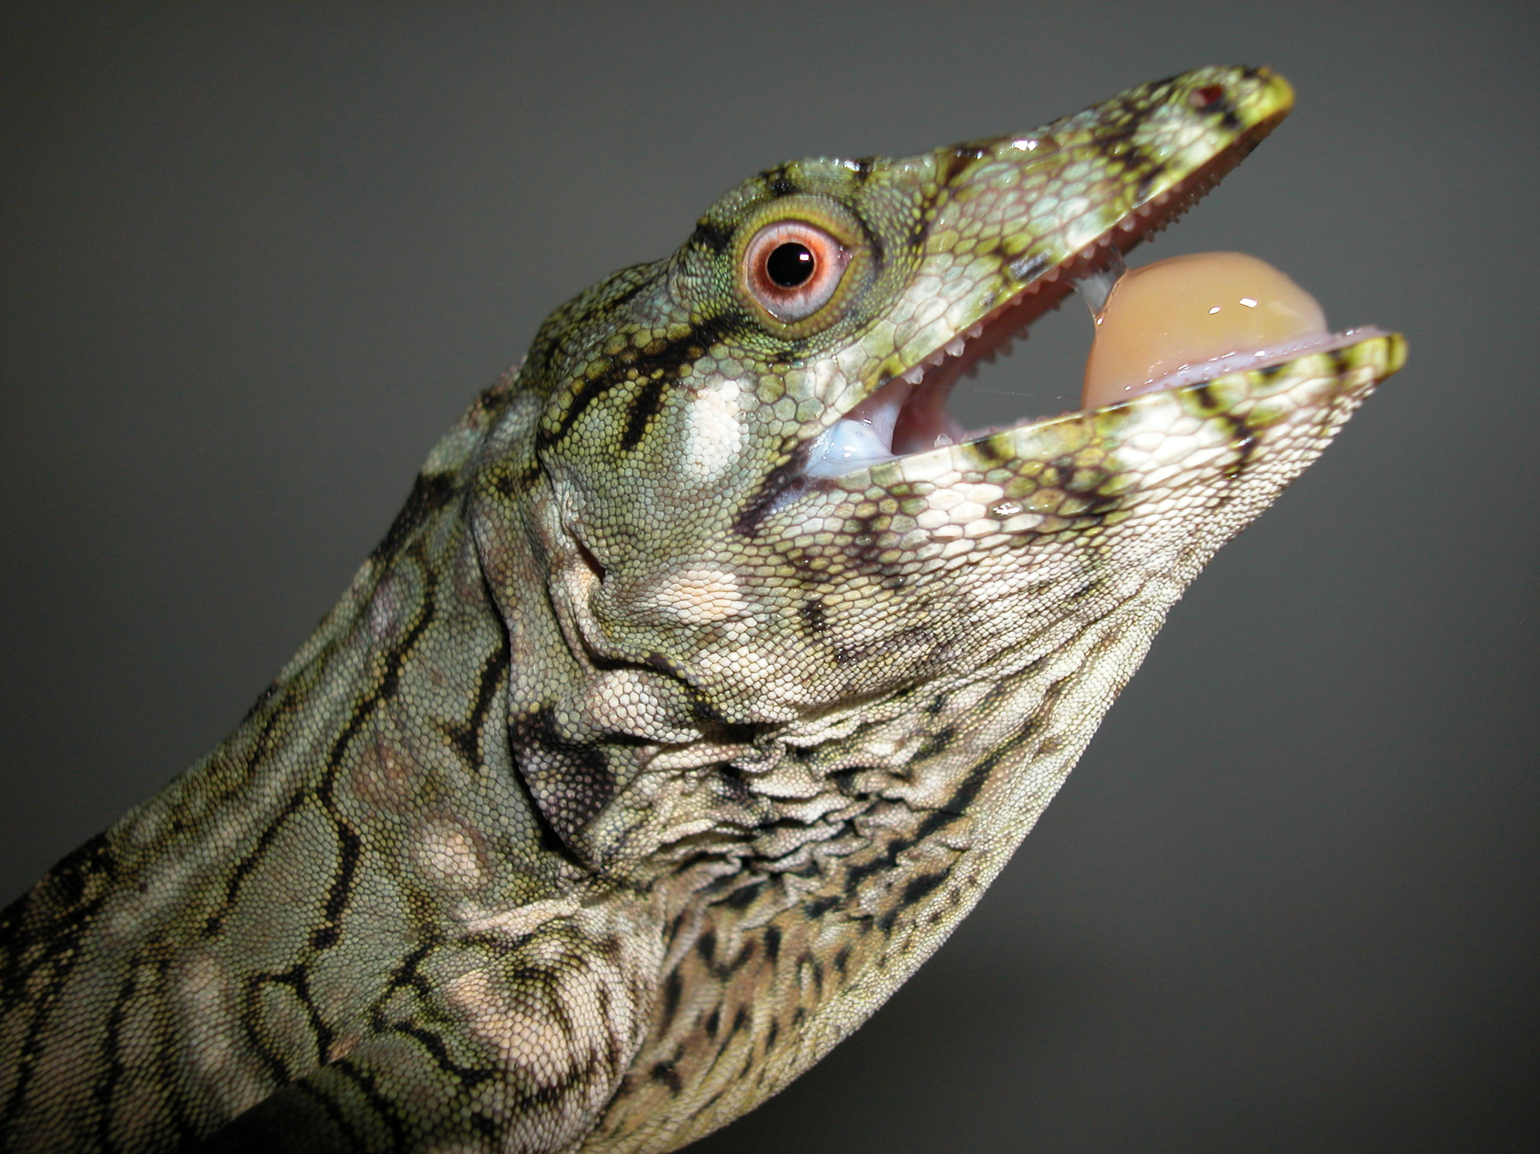
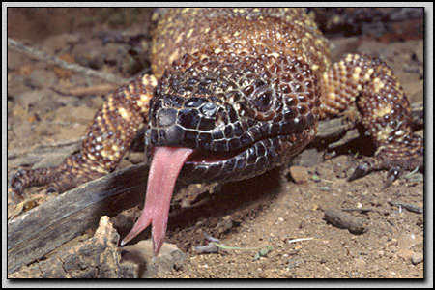
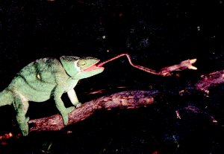
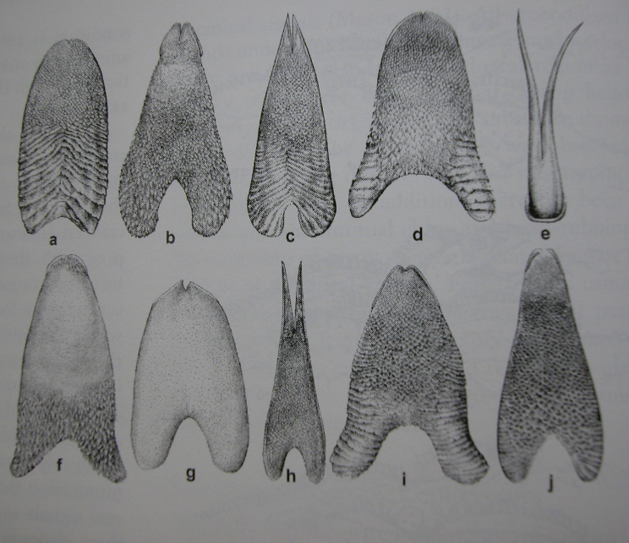
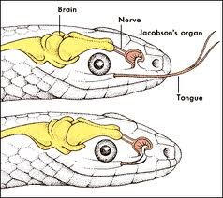
Lizard tongues

Slide 17
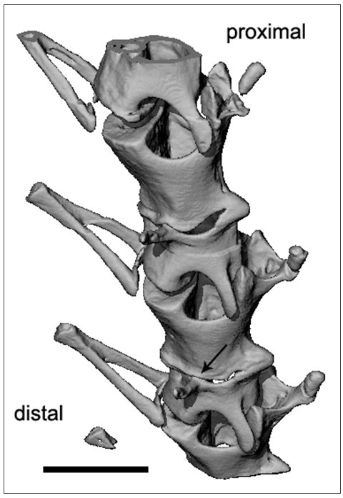
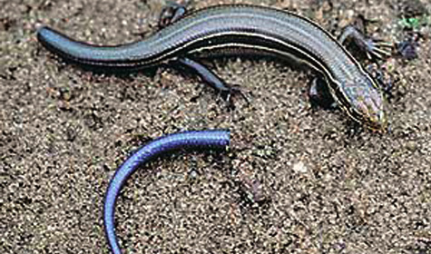
Caudal autotomy

Slide 18
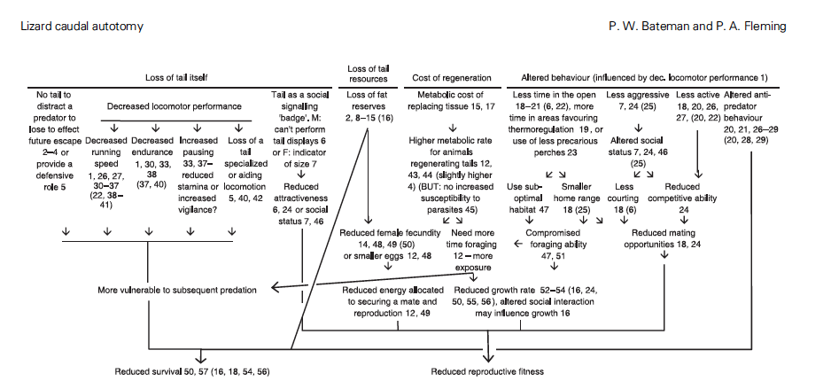
Caudal autotomy

Slide 19
Reproduction in squamates
Oviparous or viviparous
Usually sexual, some parthenogenetic
GSD or TSD
Some parental care
Territorial

Slide 20
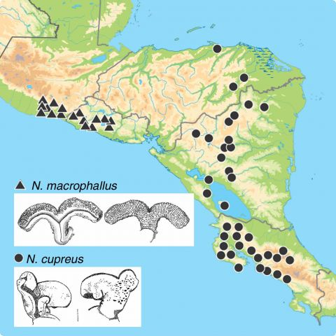
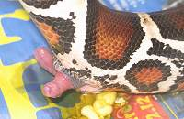
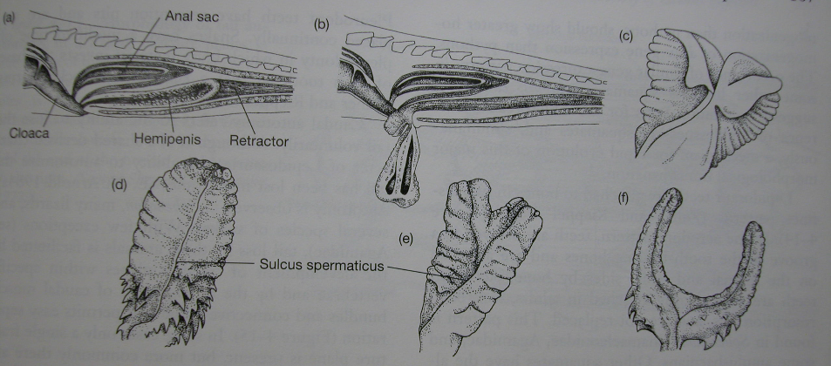
A. macrophallus
Hemipenes diversity in Squamates
A. cupreus

Slide 21
Temperature-dependent sex determination
Sex determined by temperature during critical period of development
All crocodylians, Sphenodon, most turtles, some lizards
Small range of temperatures (1-2C) at which both sexes produced
Differences in sex ratios within nests, between nests, between seasons

Slide 22
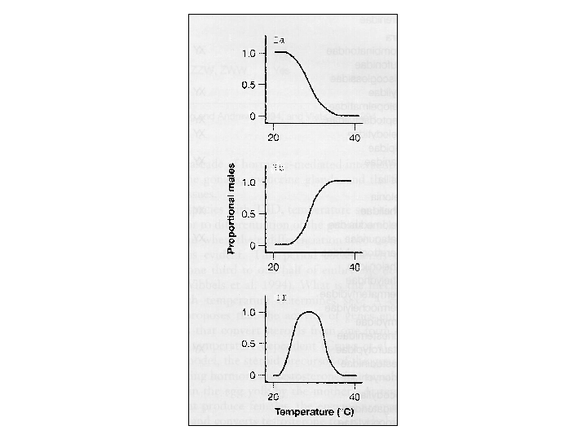
Three patterns of TSD
Most turtles
Many lizards
All crocs, some
lizards, few turtles
Proportion of males

Slide 23
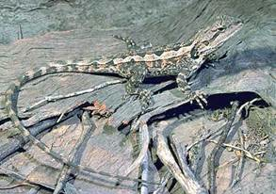
Why would TSD evolve?
Charnov and Bull (1987): TSD favored when different temperature environments confer different fitness advantages for each sex.

Slide 24
Why would TSD evolve?
Charnov and Bull (1987): TSD favored when different temperature environments confer different fitness advantages for each sex.
"if an individual finds itself in an environment where it can become a below average female or an above average male, selection will favor its becoming male because it can pass on more of its genes than if it were female"

Slide 25
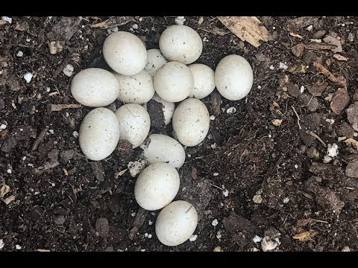
NATURE
WARM
COLD
FEMALES
MALES
FEMALES

Slide 26
NATURE
WARM
COLD
FEMALES
MALES
FEMALES
hormones
EXPERIMENT
WARM
COLD
FEMALES
AND MALES
FEMALES
AND MALES
FEMALES
AND MALES

Slide 27
Test of the Charnov-Bull hypothesis (Warner and Shine 2008)

Slide 28
Test of the Charnov-Bull hypothesis (Warner and Shine 2008)

Slide 29
TSD: conservation implications
Many conservation programs for TSD species involve collecting eggs, incubating them in the lab, and releasing juveniles back to the wild
Egg collection and incubation could screw up the sex ratio in nature (e.g., too many males)
(expensive) studies needed to
Discern details of TSD (which pattern? what temperatures?)
Determine sex ratios in nature
Global warming

Slide 30
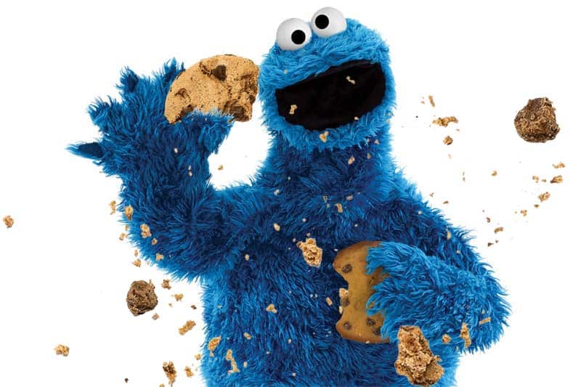
GVZ 2023 23 Feb
Lizard diversity

Slide 31
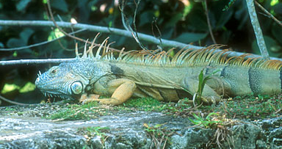
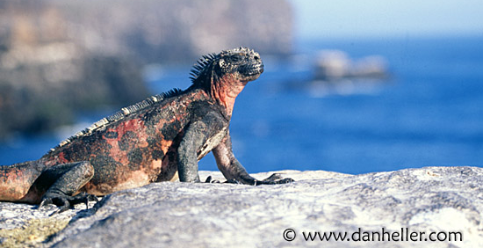
Iguaninae: Iguana iguana
Iguaninae: Amblyrhynchus cristatus

Slide 32
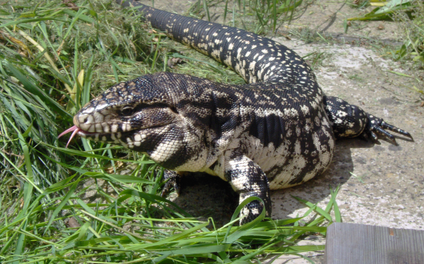
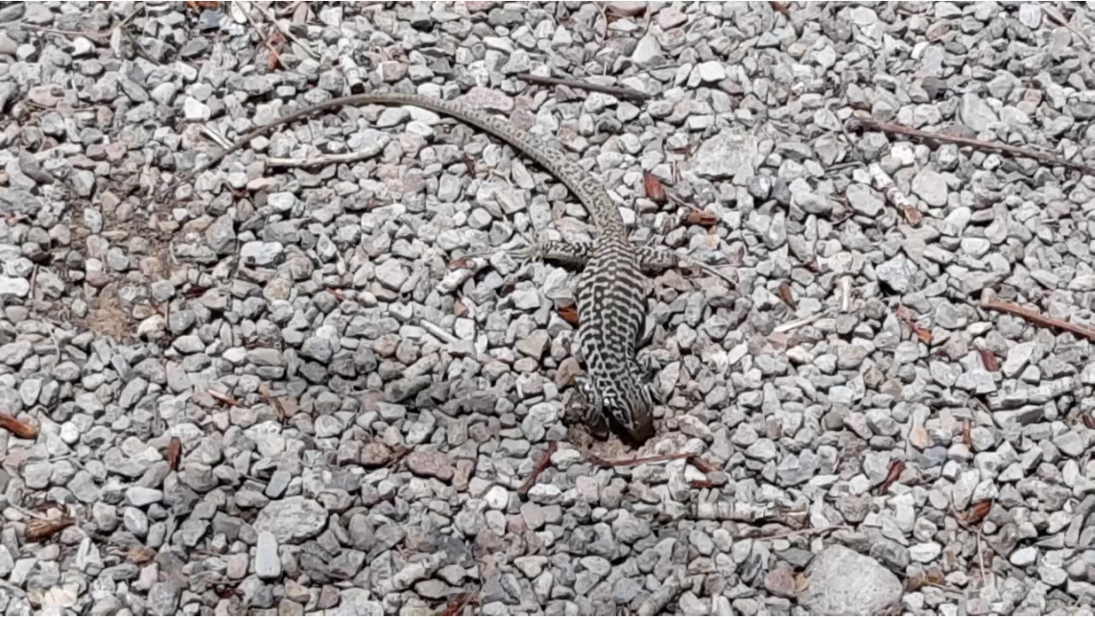
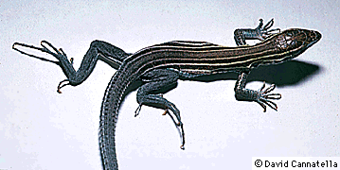
Teiidae:
Tupinambis merianae
Teiidae:
Aspidoscelis tigris

Slide 33
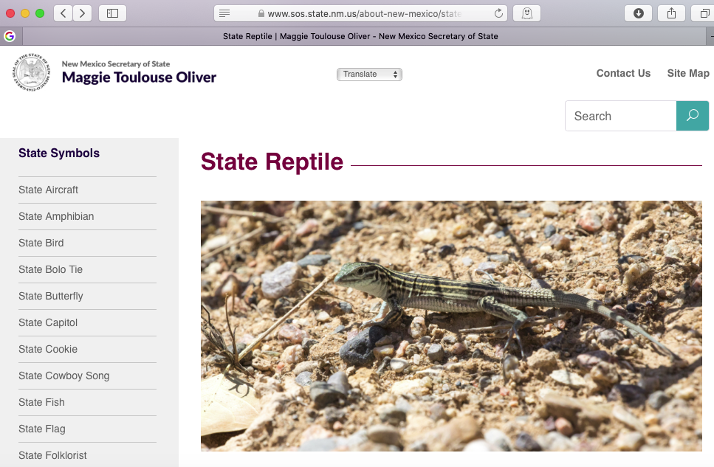
https://www.youtube.com/watch?v=mQE0LQFFn3s

Slide 34
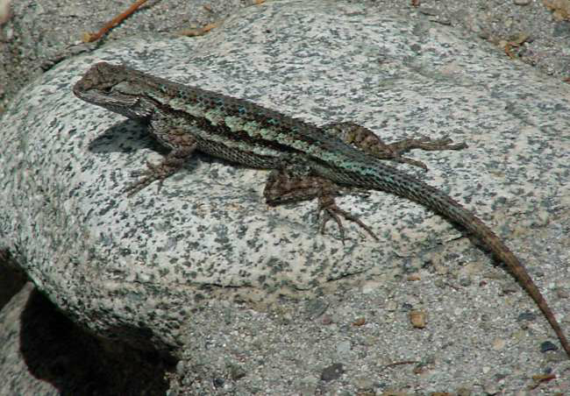
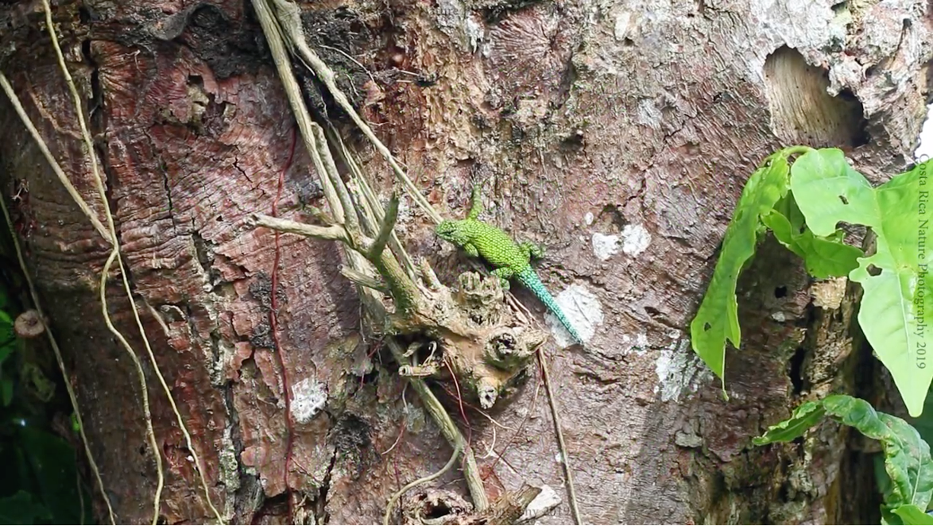
Phyrnosomatinae: Sceloporus magister
Phyrnosomatinae: Sceloporus malachiticus

Slide 35
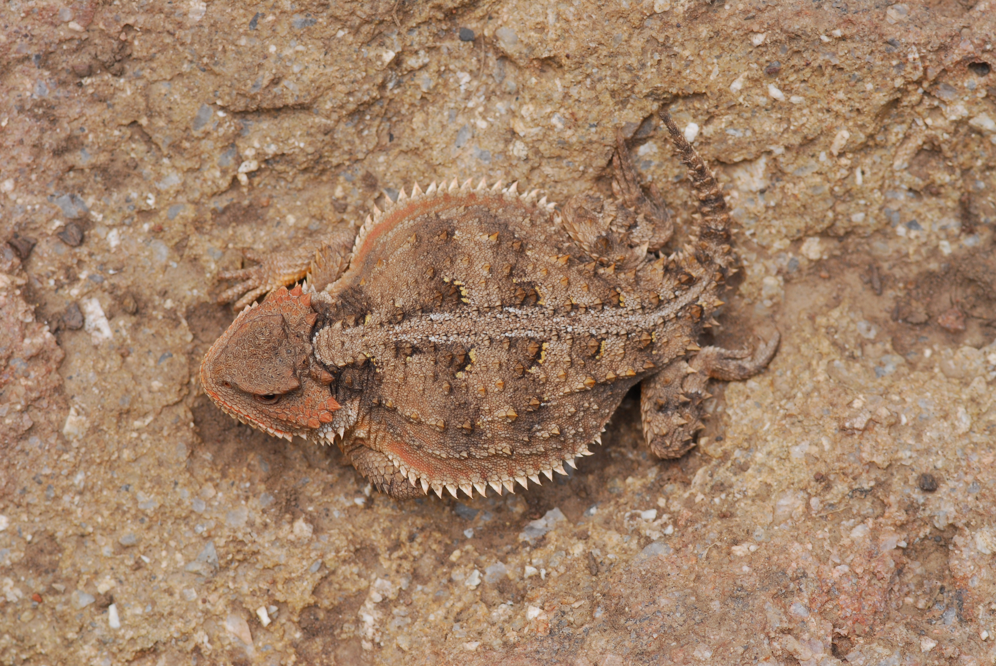
Phrynosomatinae: Phrynosoma douglasi

Slide 36
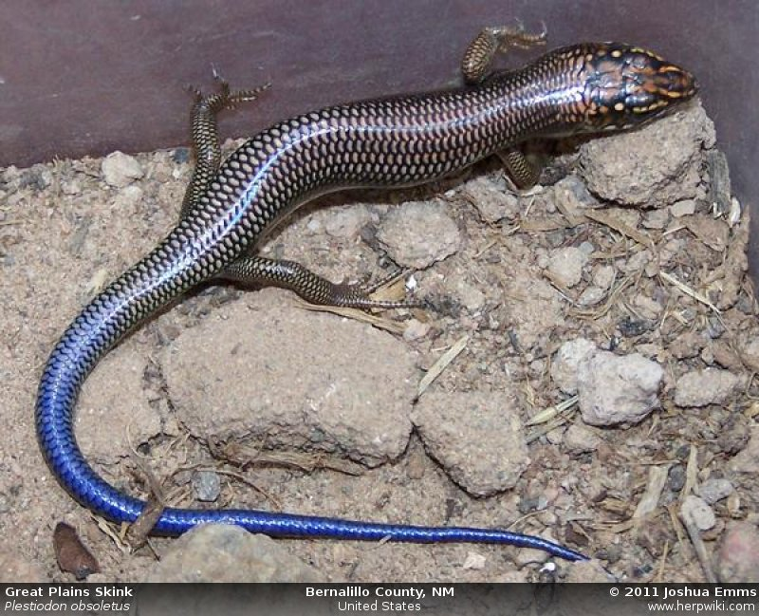
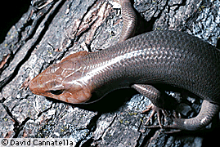
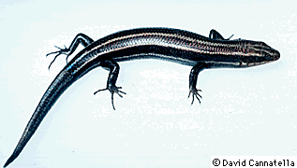
Scincidae
Plestiodon laticeps
Plestiodon obsoletus
Plestiodon fasciatus

Slide 37
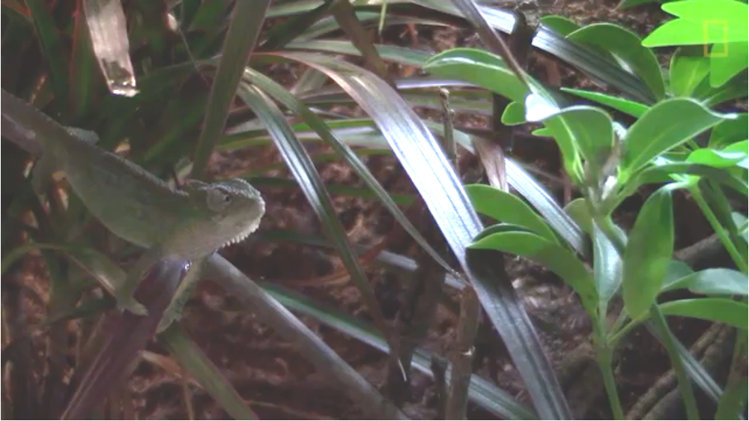
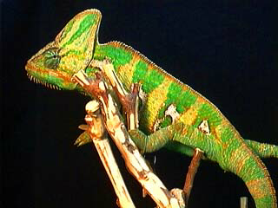
Chamaeleonidae

Slide 38
Chamaeleonidae

