Slide 1
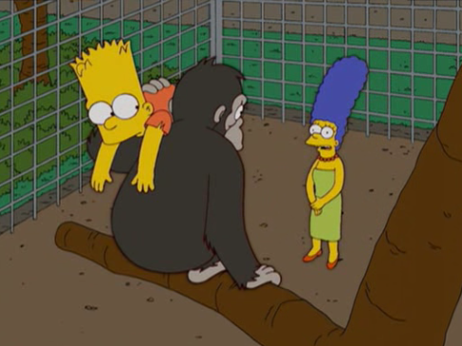

Slide 2
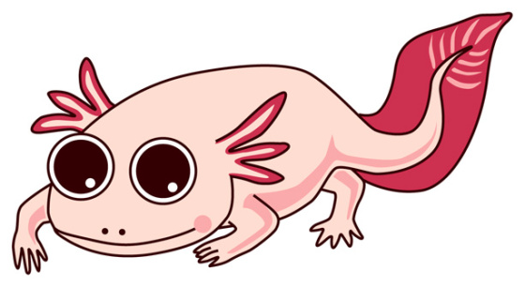
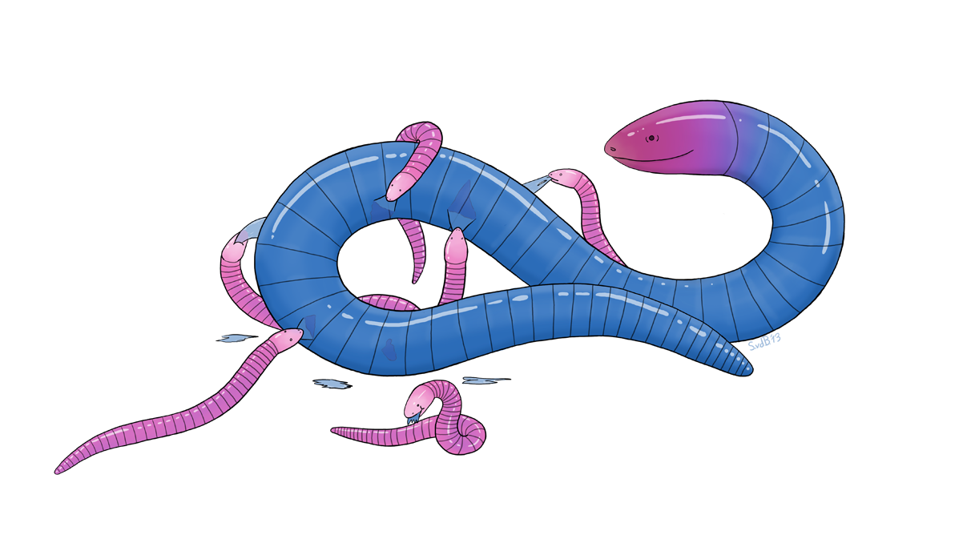
Amniota
Amphibia
Tetrapoda

Slide 4
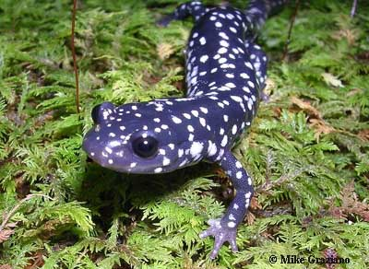
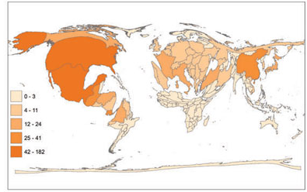
Caudata: node-based name for salamanders
Urodela: stem-based name for salamanders
10 families, 710species

Slide 5
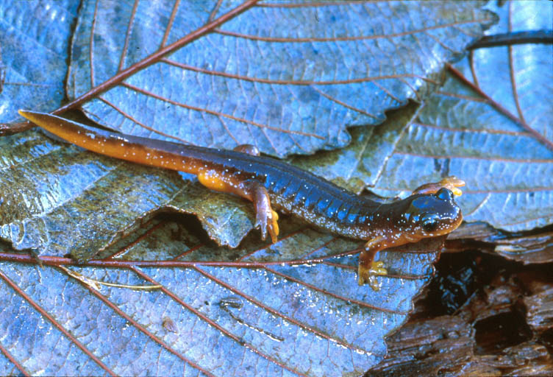
Salamander characteristics
Tailed, most with four limbs of approximately equal length, four digits on front limbs, five digits on hindlimbs
Aquatic, terrestrial/fossorial, arboreal
Breathe through lungs, gills, and/or skin
Sprawling gait
Large genome
14-120 Gb (humans: 3 Gb)
Limited variation in life cycles,
reproductive modes
Limb regeneration

Slide 6
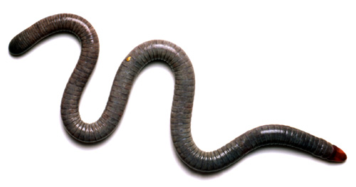
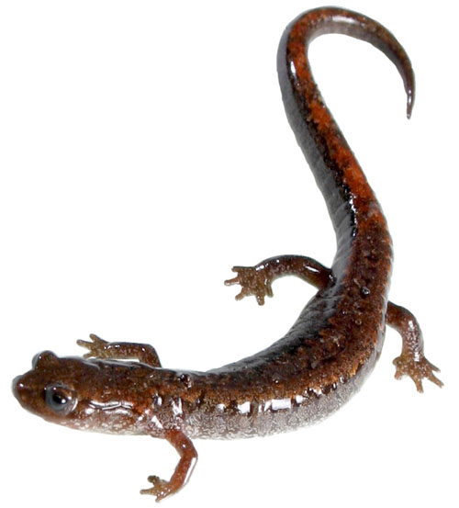
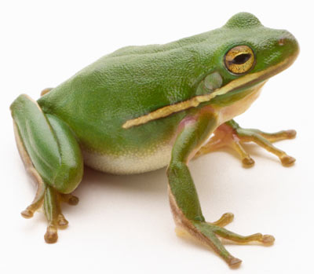
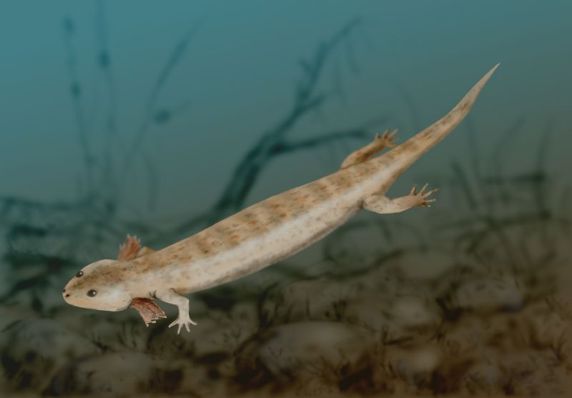

Slide 7
Loss of limbs
Tail reduced
Cylindrical body
Sprawling gait
Long tail
Hindlimbs = forelimbs
Upright posture
Loss of tail
Hindlimbs > forelimbs
Sprawling gait
Long tail
Hindlimbs = forelimbs

Slide 8
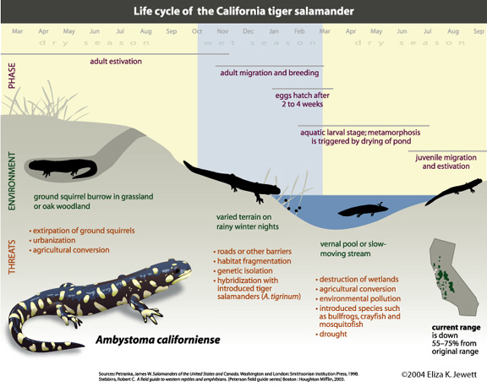

Slide 9
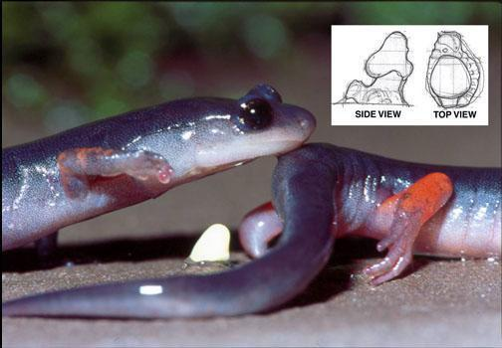
Salamander reproduction
Internal (spermatophore) or external fertilization
Most oviparous
Most breed, lay eggs in water
Most have larval stage
(tadpole)
Few have parental care
Complex courtship,
pheromones
spermatophore

Slide 10
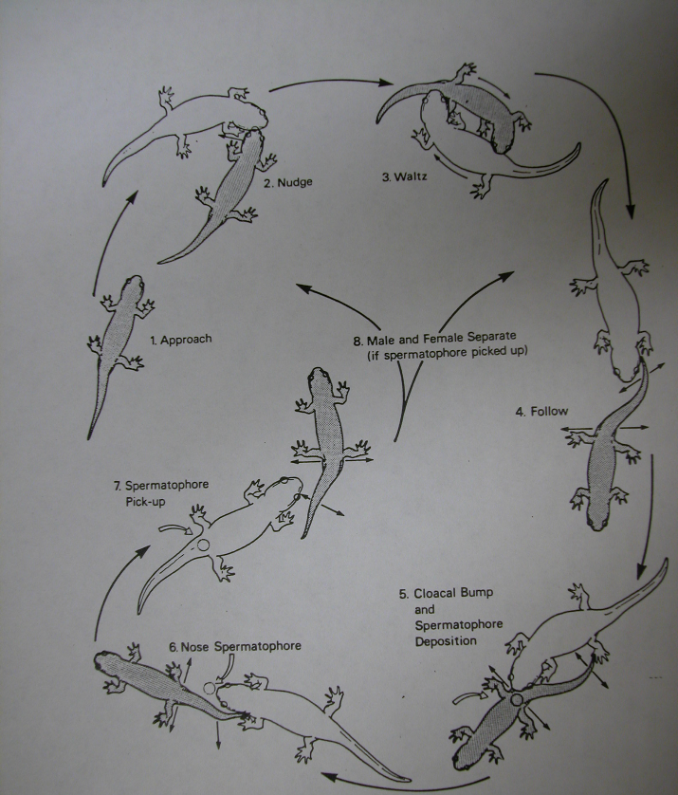
Courtship in Ambystoma talpoideum

Slide 12
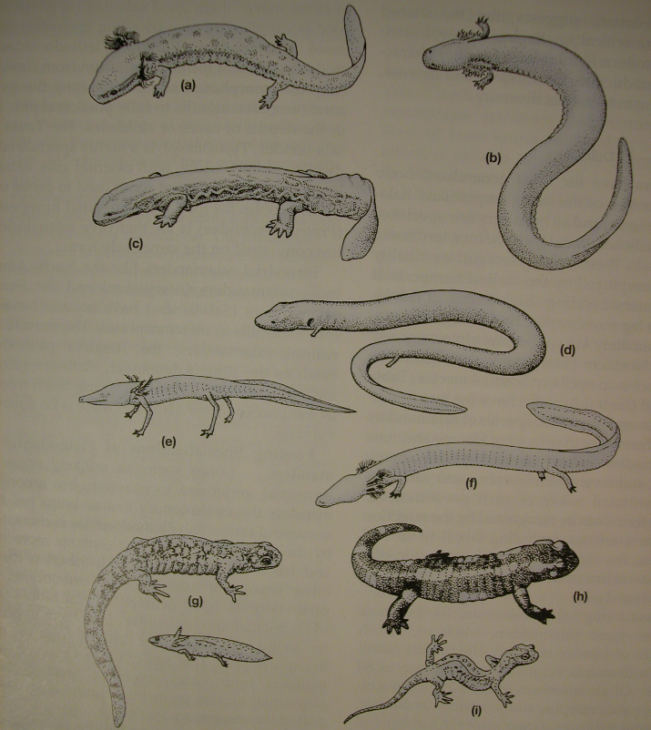
Salamander
diversity

Slide 13
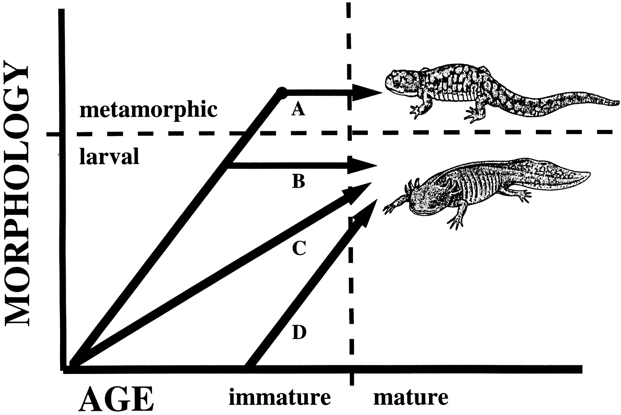
Sirenidae
two genera, 4 species
SE USA
elongate, paedomorphic
external gills, lack eyelids
nonpedicellate teeth
lack pelvic girdle, hindimbs
aquatic
external fertilization

Slide 14
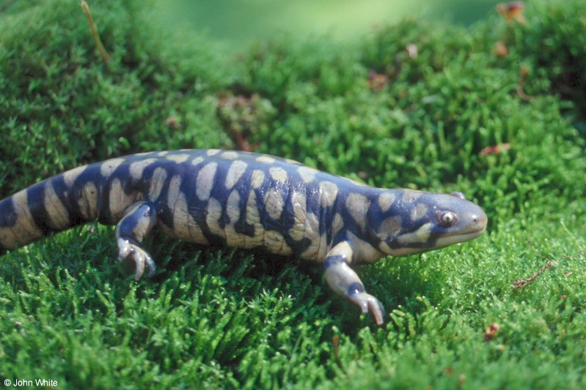
Ambystomatidae: Ambystoma tigrinum

Slide 15
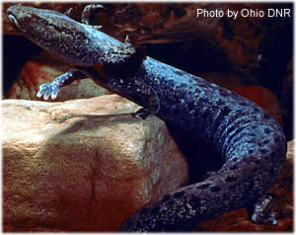
Proteidae: Necturus maculosus

Slide 16
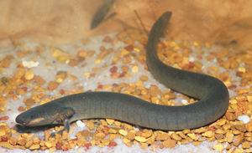
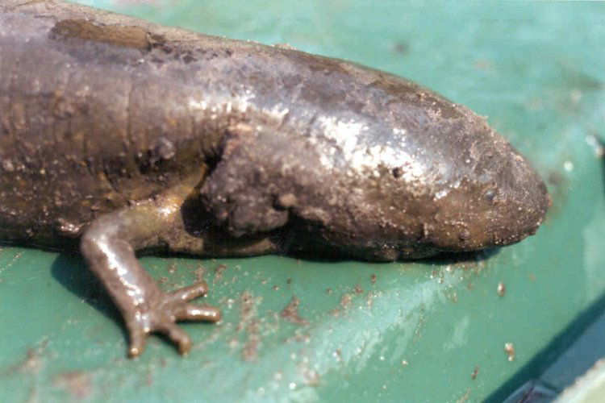
Sirenidae: Siren lacertina

Slide 17
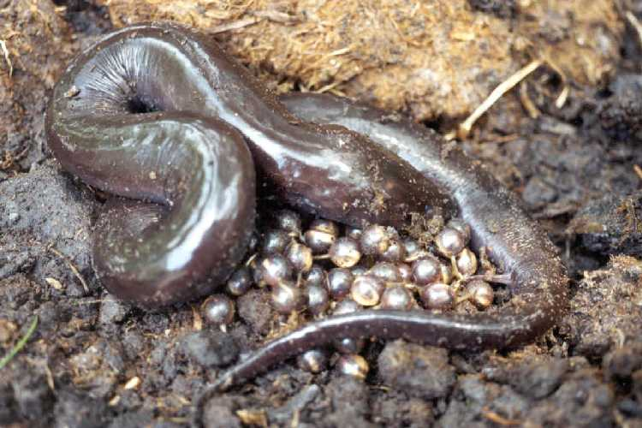
Amphiumidae: Amphiuma means

Slide 18
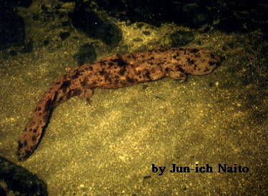
Cryptobranchidae: Andrias japonicus

Slide 19
Cryptobranchidae: Andrias japonicus

Slide 20
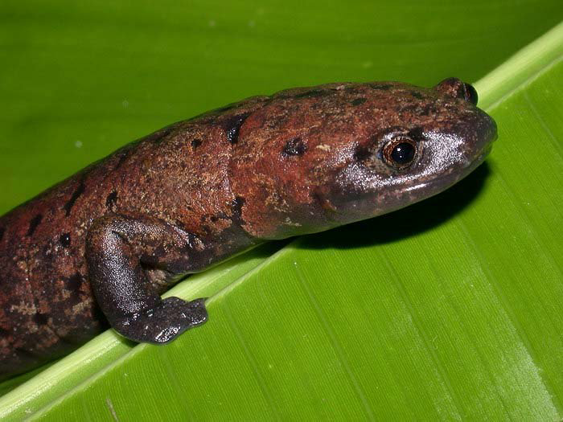
Plethodontidae: Bolitoglossa dofleini

Slide 21
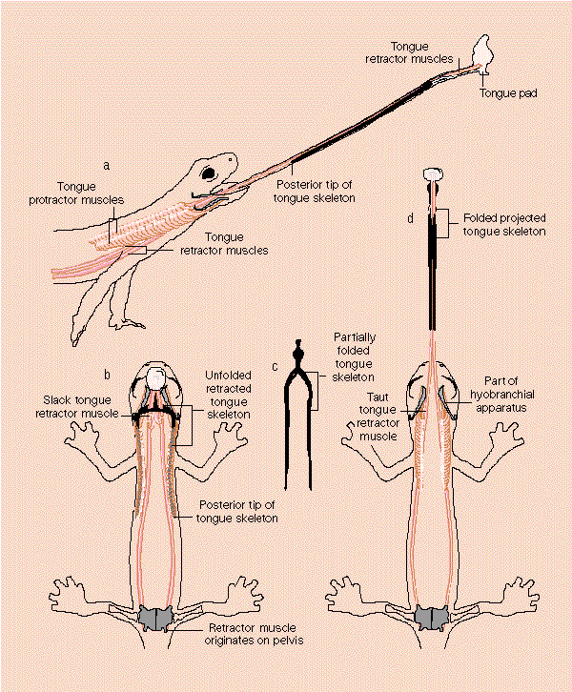
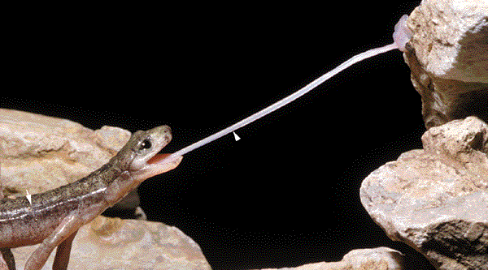
Tongue projection in Plethodontid salamanders
Hydromantes

Slide 22
Tongue projection in Plethodontid salamanders

Slide 23
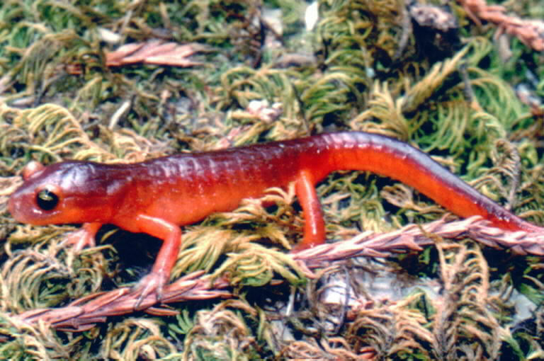
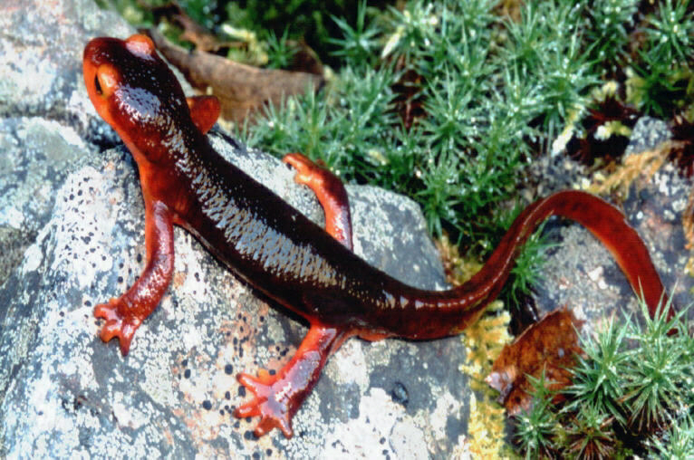
Plethodontidae: Ensatina escholtzi
Aposematism and
Batesian mimicry
Salamandridae: Taricha torosa

Slide 24
Place clay models in a forest
where both Ensatina and Taricha
are found
two model colors (brown, orange)
454 models
Leave for three weeks
Count number damaged by predators

Slide 25
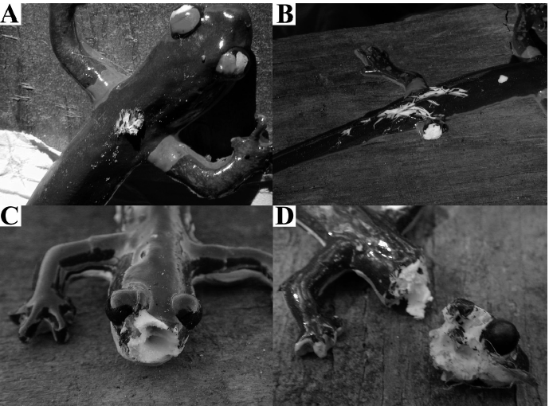
Place clay models in a forest
where both Ensatina and Taricha
are found
two model colors (brown, orange)
454 models
Leave for three weeks
Count number damaged by predators
46 brown models attacked, 25 orange
P = 0.007

Slide 26
Amniota
Amphibia
Tetrapoda

Slide 27
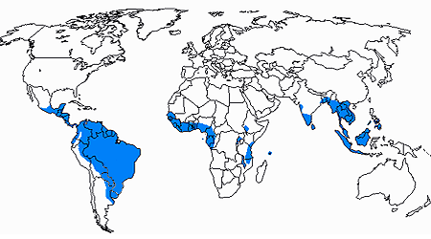
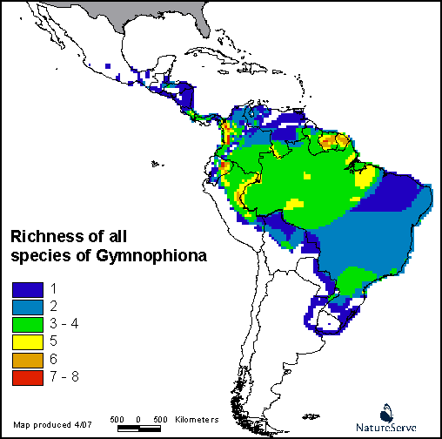
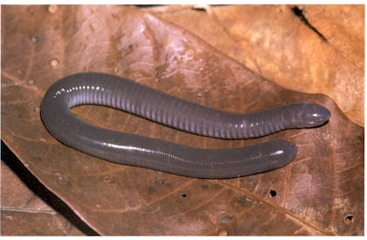
Gymnophiona
(caecilians; Apoda)
10 families, 33 genera, 207 species

Slide 28
Caecilian synapomorphies
No limbs, girdles
Annuli
Siphonops annulatus

Slide 29
Caecilian synapomorphies
No limbs, girdles
Annuli
Solidified skull with
Eyes reduced/absent
Fusion of bones
Roofed, reduced fossa

Slide 30
Caecilian synapomorphies
No limbs, girdles
Annuli
Solidified skull with
Eyes reduced/absent
Fusion of bones
Roofed, few/no fossa
Tentacle

Slide 31
Caecilian synapomorphies
No limbs, girdles
Annuli
Solidified skull with
Eyes reduced/absent
Fusion of bones
Roofed, few/no fossa
Tentacle
Phallodeum

Slide 32
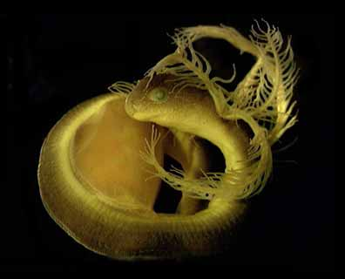
Caecilian reproduction
Internal fertilization
Oviparity or viviparity
Eggs aquatic or terrestrial
Larvae or direct development
Parental care
Notes:
32

Slide 33
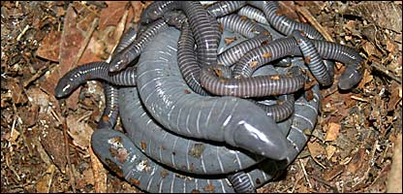
Notes:
33

Slide 34
Notes:
34

Slide 35
Variability between caecilian species
Position of tentacle
Position of mouth
Primary, secondary, tertiary annuli
Skull
Zygokrotaphic
Stegokrotaphic
Presence/absence of tail
Aquatic/fossorial

Slide 36
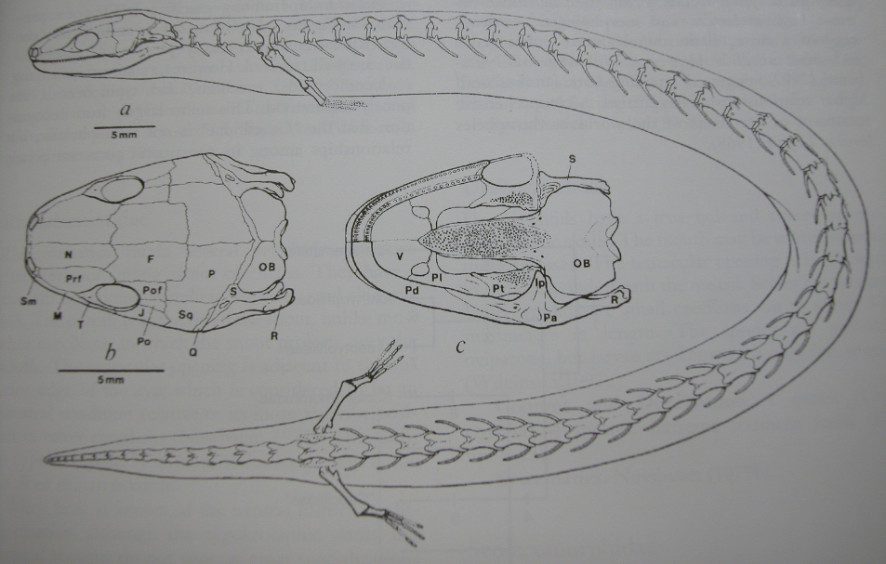
Eocaecilia micropodia

Slide 37
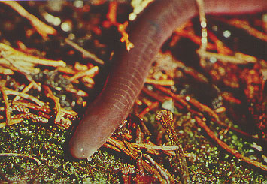
Gymnophiona: Scolecomorphidae: Scolecomorphus kirkii
Scolecomorphus kirkii

Slide 38
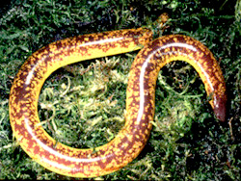
Rhinatrematidae: Epicrionops

Slide 39
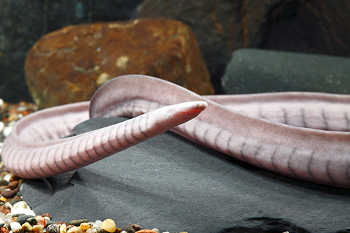
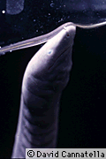
Typhlonectidae: Typhlonectes natans
Typhlonectes natans

Slide 40
Amniota
Amphibia
Tetrapoda

Slide 41
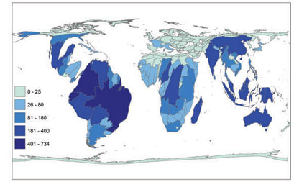
Anura (Salientia): Frogs
6893 species

Slide 42
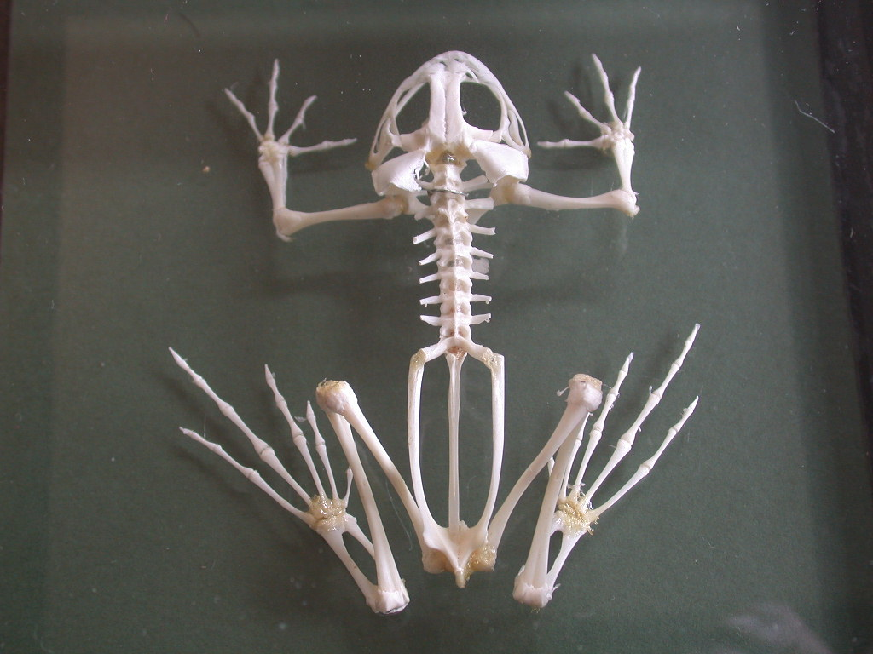
Synapomorphies of Anura
urostyle
lack tail
fused tibia and fibula
fused ulna and radius
hindlimbs > forelimbs

Slide 43
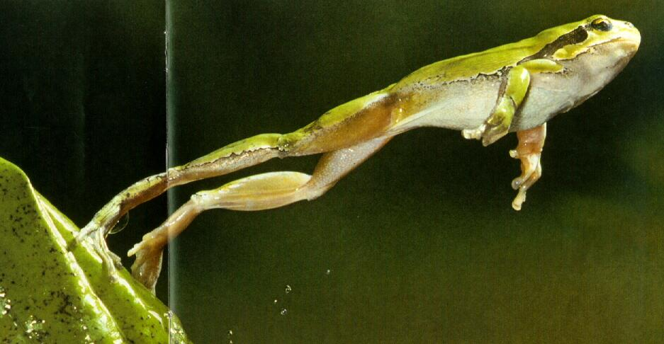
Synapomorphies of Anura
urostyle
lack tail
fused tibia and fibula
fused ulna and radius
hindlimbs > forelimbs

Slide 44
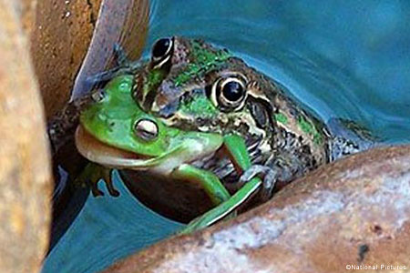
Frog feeding
Bite
Suction feeding
Protrusible tongue

Slide 45
Frog feeding

Slide 47
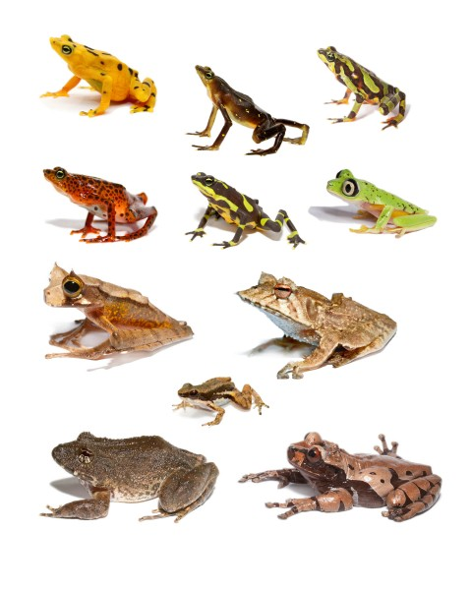
Frog diversity

Slide 49
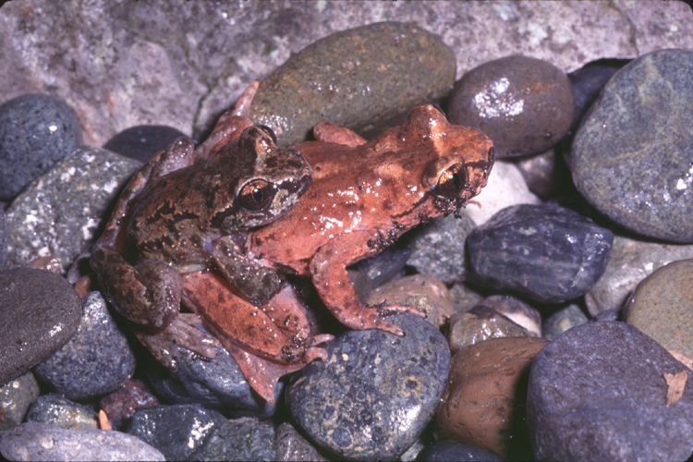
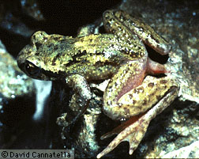
Ascaphidae: Ascaphus truei

Slide 50
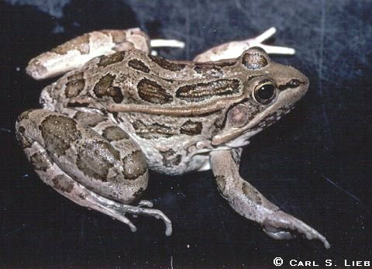
Rana berlandieri

Slide 51
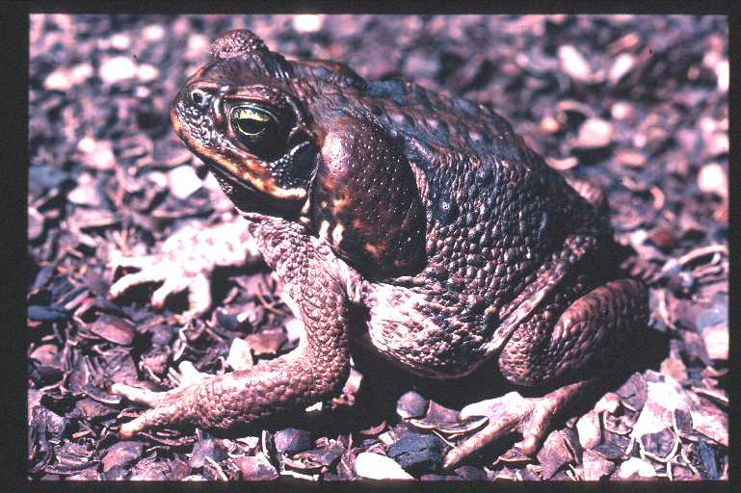
Rhinella marina

Slide 52
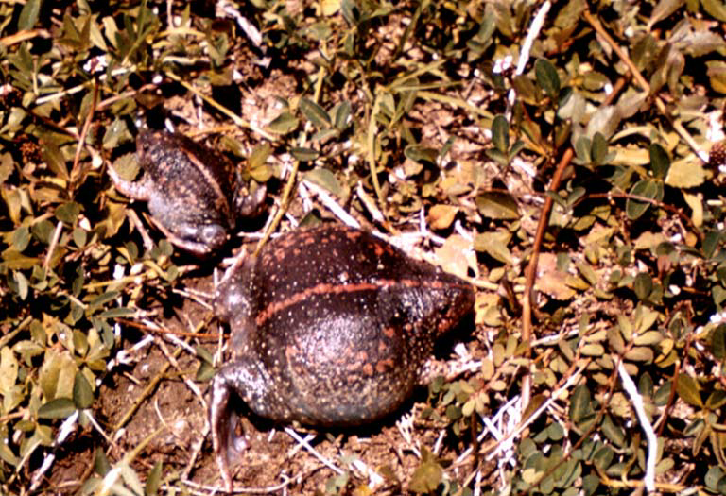
Rhinophrynus dorsalis

Slide 53
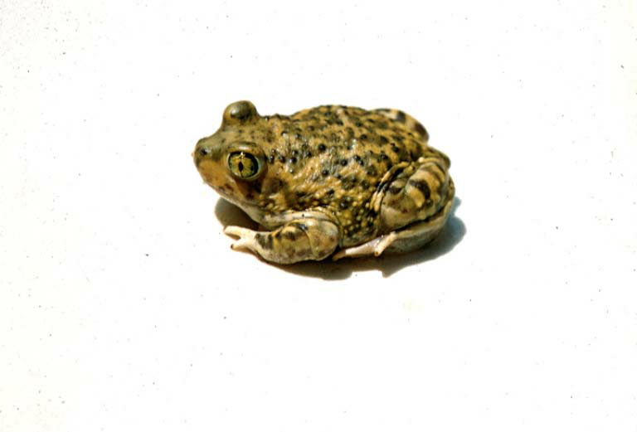
Scaphiopus couchii

Slide 54
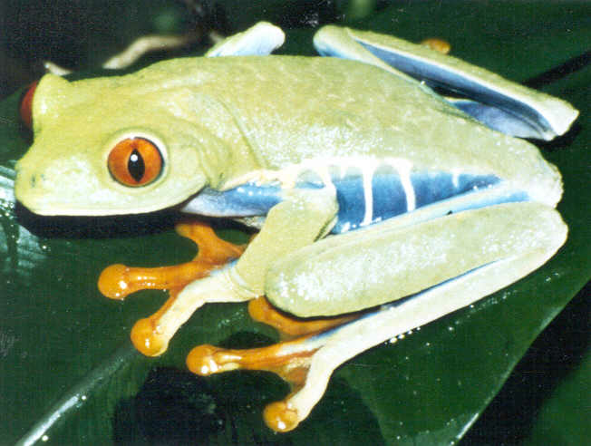
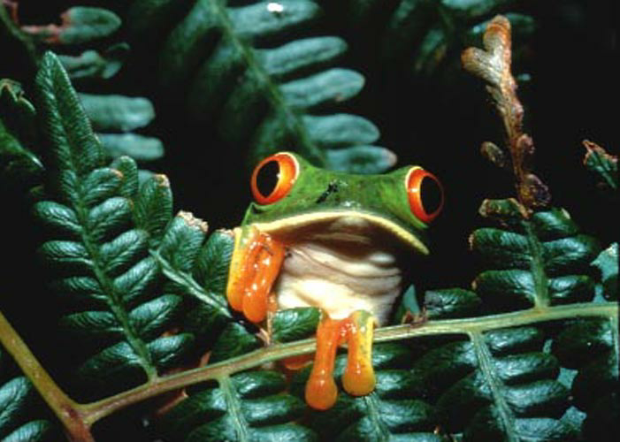
Agalychnis callidryas

Slide 55
Xenopus laevis

Slide 56
Dendrobatidae

Slide 57
Centrolenella prosoblepon

Slide 58
Reproduction in frogs

Slide 59
Frog reproduction
Most are sexual
XY, ZW

Slide 60
Frog reproduction
Most are sexual
XY, ZW
Clonal
hybridogenesis:
Pelophylax (Rana) esculenta

Slide 61
Frog reproduction
Temperate
seasonal
rainfall, temperature triggers
ponds and lakes
explosive breeding

Slide 62
Explosive/ephemeral seasonal breeding

Slide 63
Frog reproduction
Tropical
breeding throughout the year
rainfall may trigger
diversity of reproductive strategies, breeding sites

Slide 64
Tropical frog reproduction
Tropical

Slide 65
Frog vocalization

