Slide 2
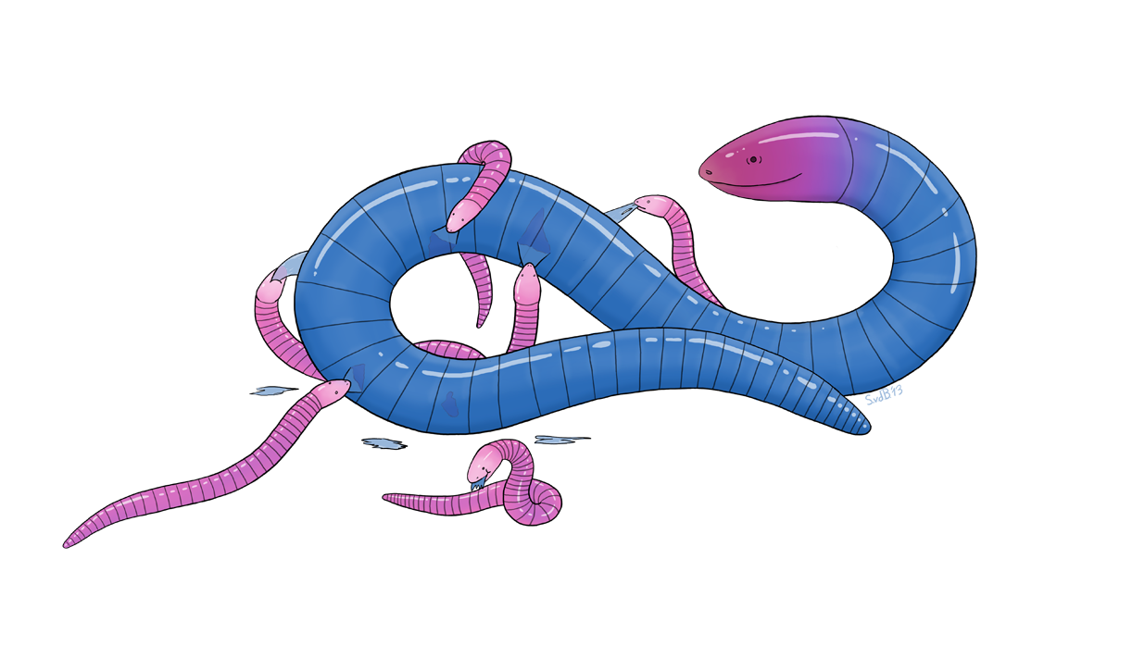
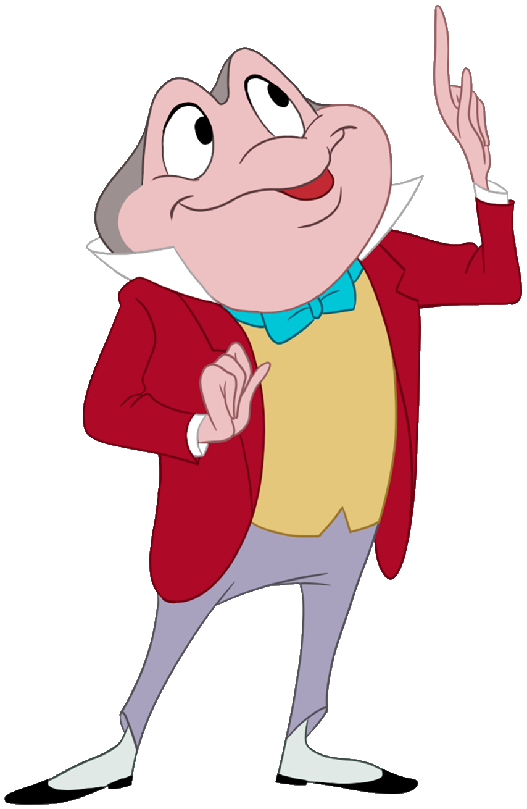
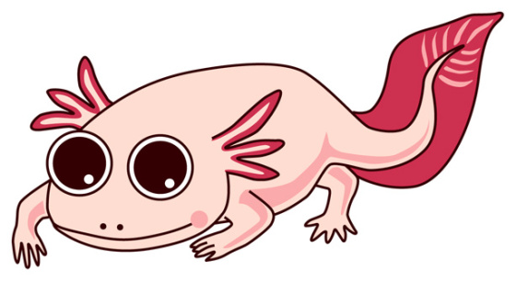
GVZ 2023 Lecture 10
Amniota
Amphibia
Tetrapoda

Slide 3
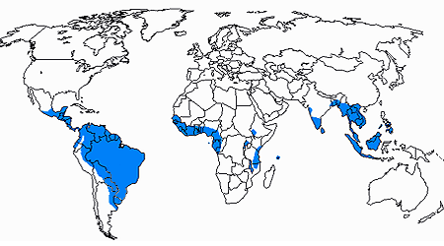
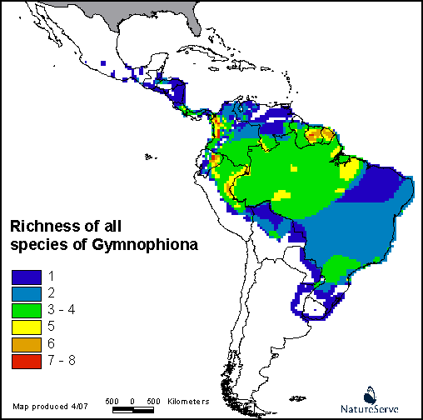
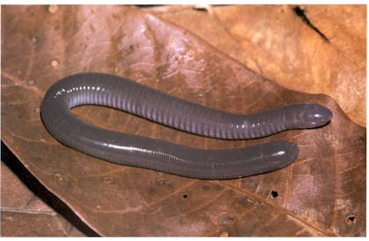
Gymnophiona
(caecilians; Apoda)
10 Families, 33 Genera,
215 species

Slide 4
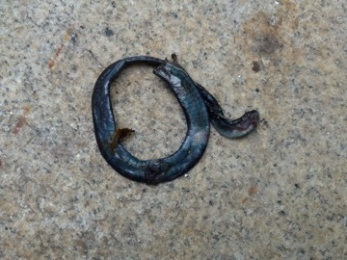
Gymnophiona
(caecilians; Apoda)
10 Families, 33 Genera,
215 species

Slide 5
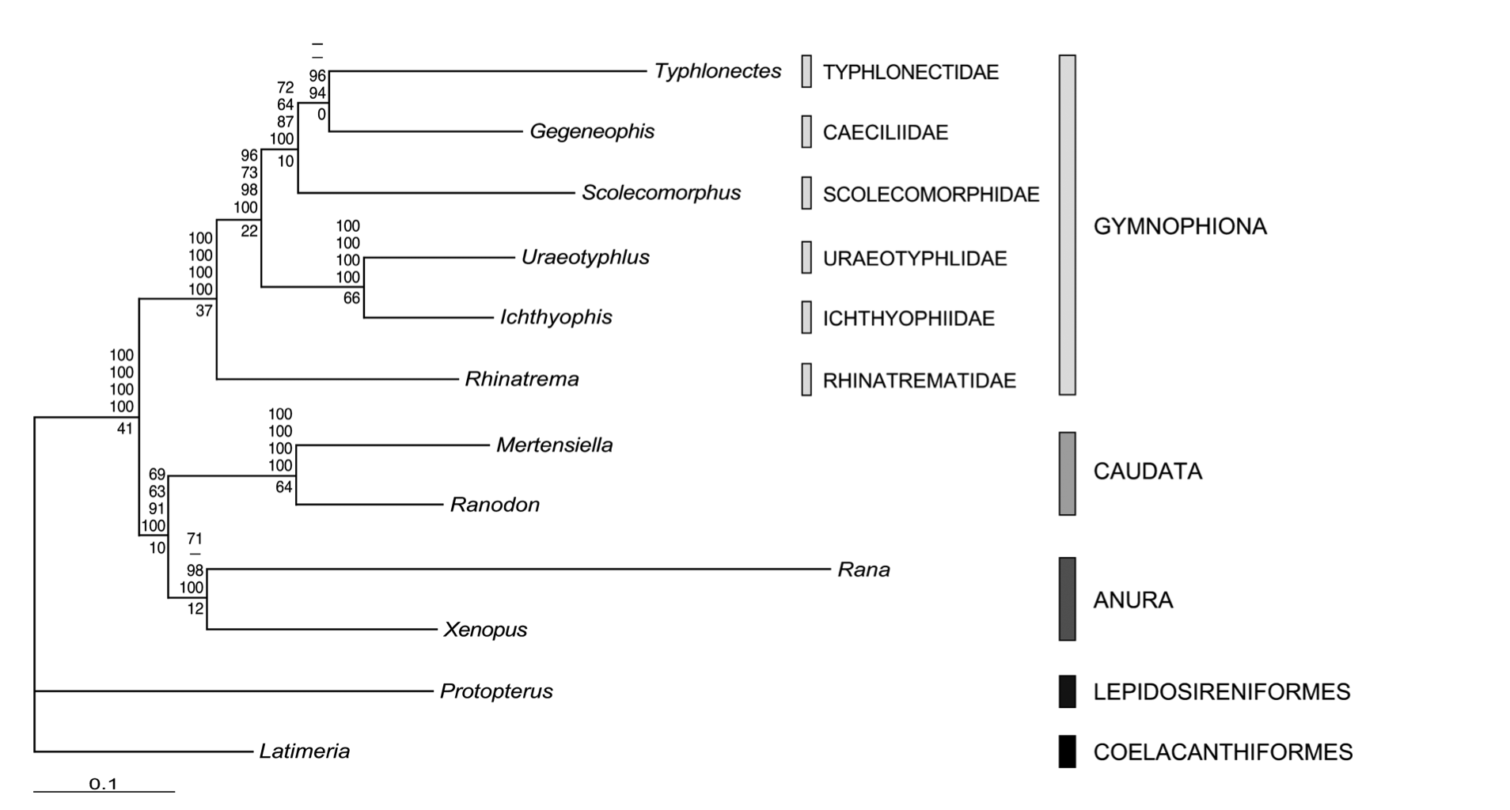
Gymnophiona (node-based, minimum clade) = The most recent common ancestor of Rhinatrema and Typhlonectes and all its descendants.

Slide 6
Gymnophiona (node-based, minimum clade) = The most recent common ancestor of Rhinatrema and Ichythyophis and all its descendants.

Slide 7
Gymnophiona (node-based, minimum clade) = The most recent common ancestor of Typhlonectes and Ichythyophis and all its descendants.

Slide 8
Gymnophiona (node-based, minimum clade) = The most recent common ancestor of Typhlonectes and Ichythyophis and all its descendants.

Slide 9
Gymnophiona (node-based, minimum clade) = The smallest clade including both Rhinatrema and Ichythyophis.

Slide 10
Apoda (stem-based, maximum clade) = All species more closely related to Typhlonectes than to Rana.

Slide 11
Apoda (stem-based, maximum clade) = All species more closely related to Rhinatrema than to Ranodon.

Slide 12
Apoda (stem-based, maximum clade) = The largest clade including Typhlonectes but not Rana.

Slide 13
Caecilian synapomorphies
No limbs, girdles
Annuli

Slide 14
Caecilian synapomorphies
No limbs, girdles
Annuli
Solidified skull with
Eyes reduced
Fusion of bones
Roofed, reduced fossa

Slide 15
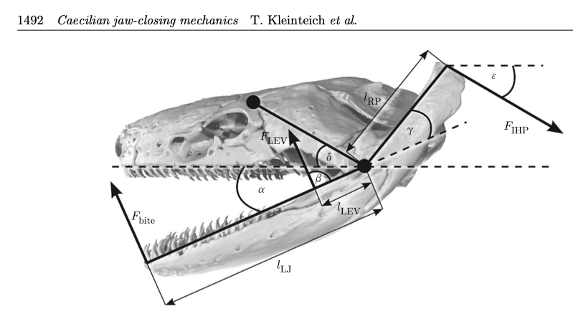
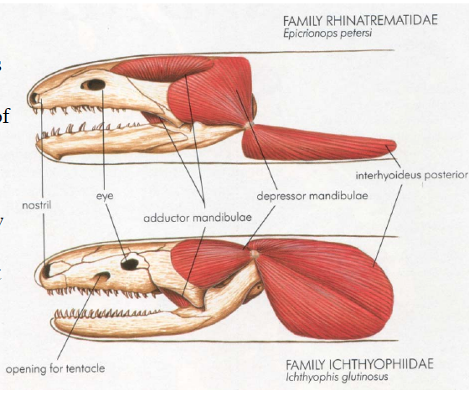
Caecilian synapomorphies
No limbs, girdles
Annuli
Solidified skull with
Eyes reduced
Fusion of bones
Roofed, reduced fossa
Two jaw-closing systems

Slide 16
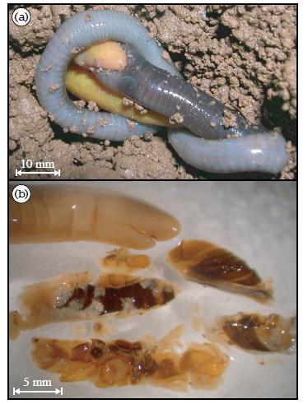
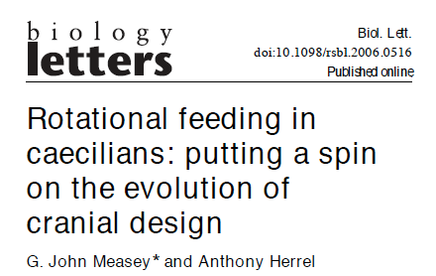
Rotational feeding

Slide 17
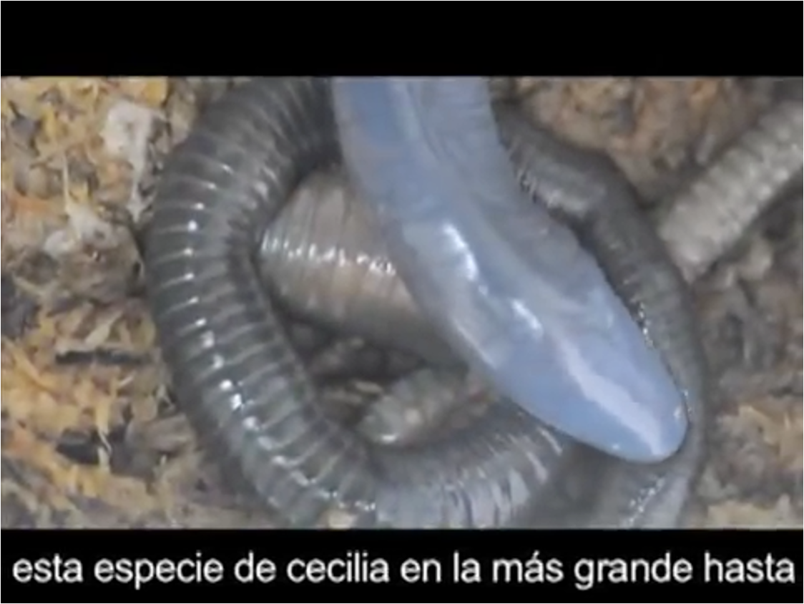
Rotational feeding

Slide 18
Caecilian synapomorphies
No limbs, girdles
Annuli
Solidified skull with
Eyes reduced/absent
Fusion of bones
Roofed, few/no fossa
Two jaw-closing systems
Tentacle

Slide 19
O'Reilly, J. C., Nussbaum, R. A., and Boone, D. 1996. Vertebrate with protrusible eyes. Nature 382:33.
Notes:
19

Slide 20
Caecilian synapomorphies
No limbs, girdles
Annuli
Solidified skull with
Eyes reduced/absent
Fusion of bones
Roofed, few/no fossa
Two jaw-closing systems
Tentacle
Phallodeum

Slide 21
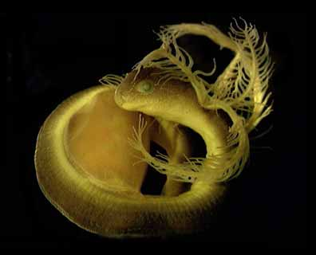
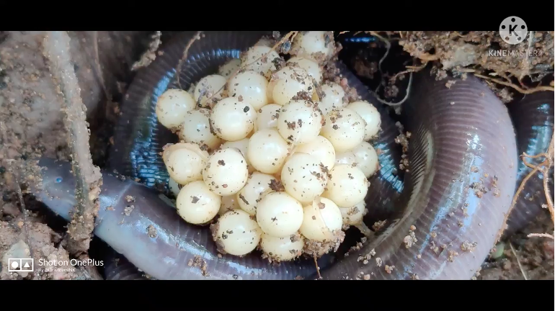
Caecilian reproduction
Internal fertilization
Oviparity or viviparity
Eggs aquatic or terrestrial
Larvae or direct development
Parental care
Notes:
21

Slide 22
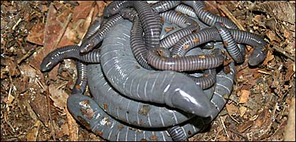
Notes:
22

Slide 23
Notes:
23

Slide 24
Variability between caecilian species
Position of tentacle
Position of mouth
Primary, secondary, tertiary annuli
Skull
Zygokrotaphic
Stegokrotaphic
Presence/absence of tail
Aquatic/fossorial

Slide 25
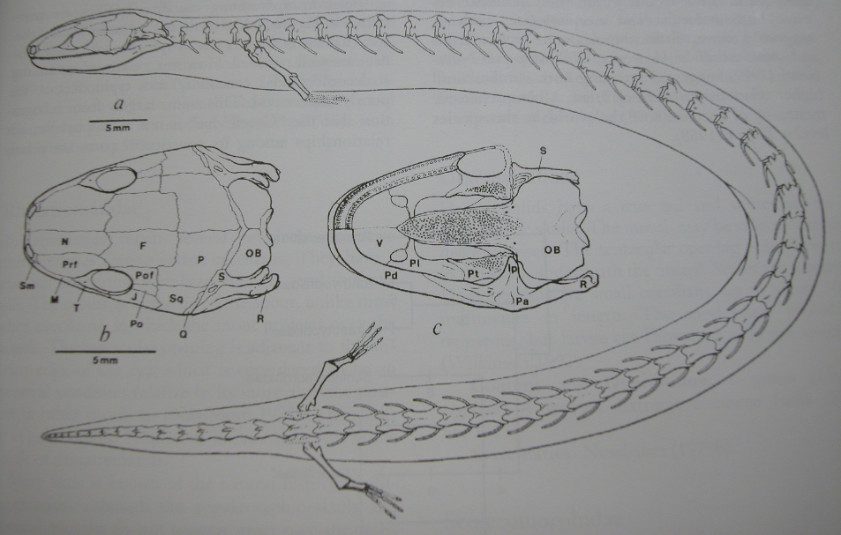
Eocaecilia micropodia

Slide 26
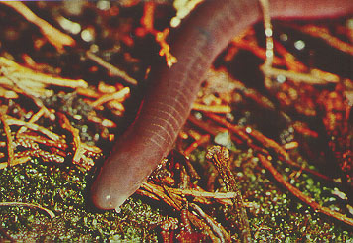
Gymnophiona: Scolecomorphidae: Scolecomorphus kirkii
Scolecomorphus kirkii

Slide 27
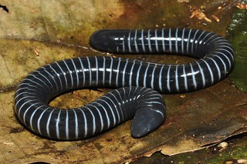
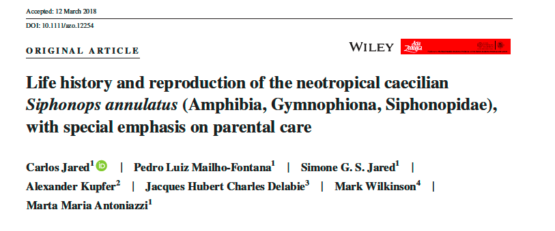
Gymnophiona: Siphonopidae: Siphonops annulatus

Slide 28
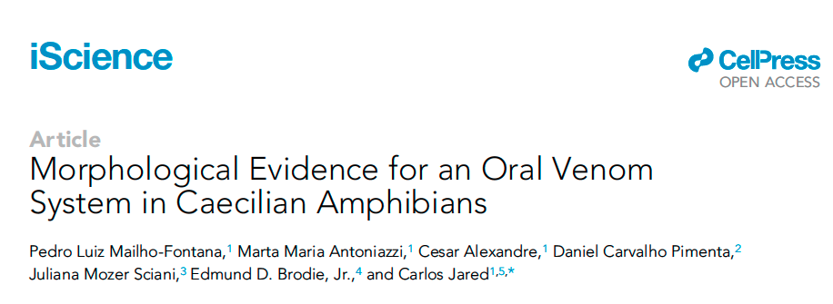
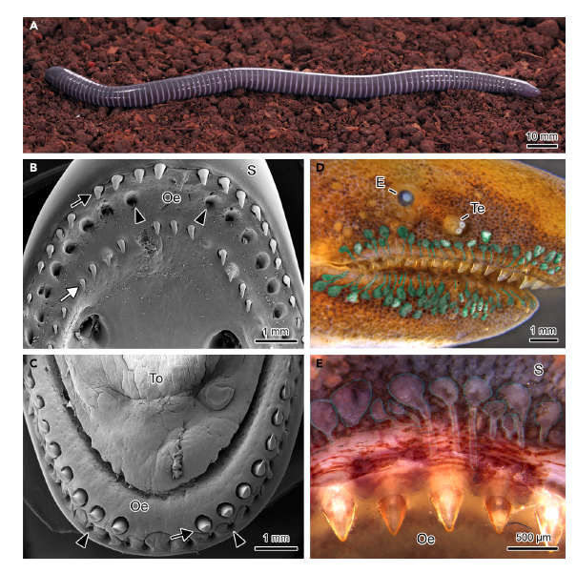
Gymnophiona: Siphonopidae: Siphonops annulatus

Slide 29
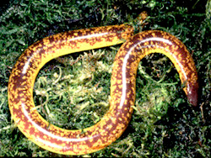
Rhinatrematidae: Epicrionops

Slide 30
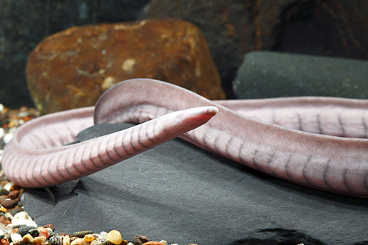
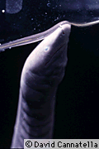
Typhlonectidae: Typhlonectes natans
Typhlonectes natans

Slide 31
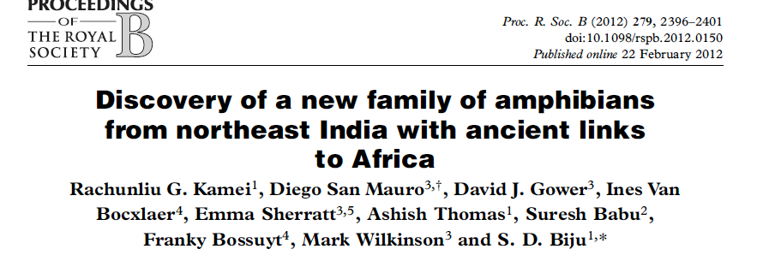
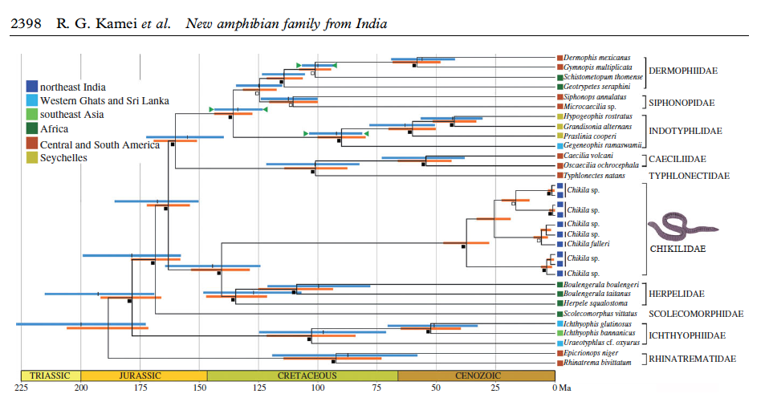
Chikilidae

Slide 32
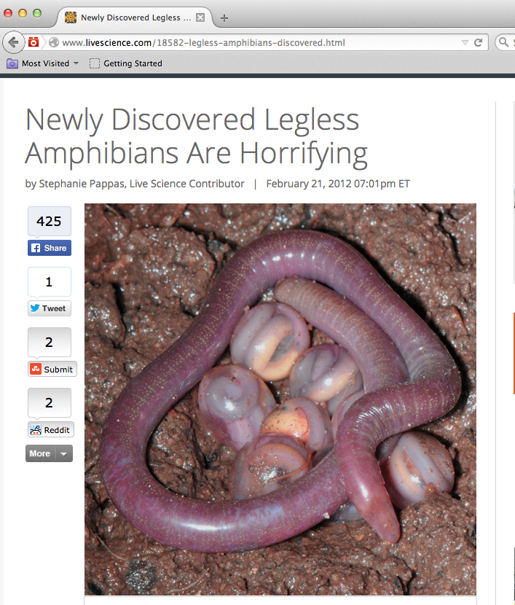
Chikilidae

Slide 33
Amniota
Amphibia
Tetrapoda

Slide 34
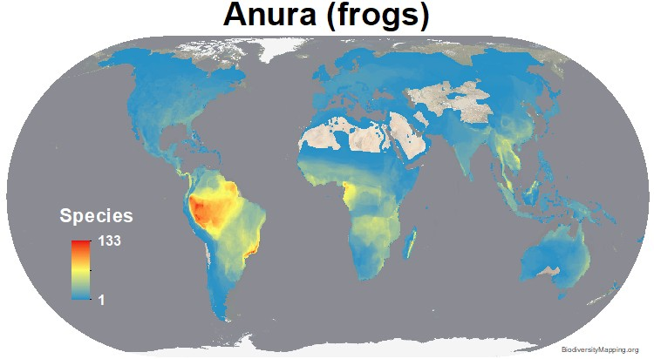
Anura (Salientia): Frogs
7566 species

Slide 35
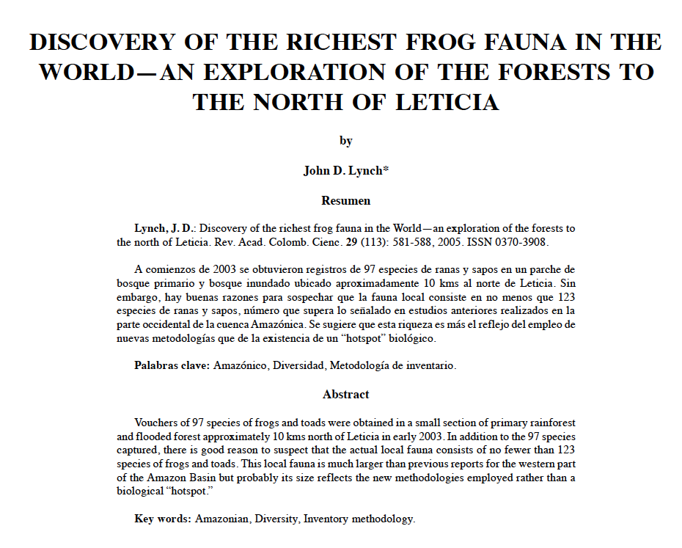

Slide 36
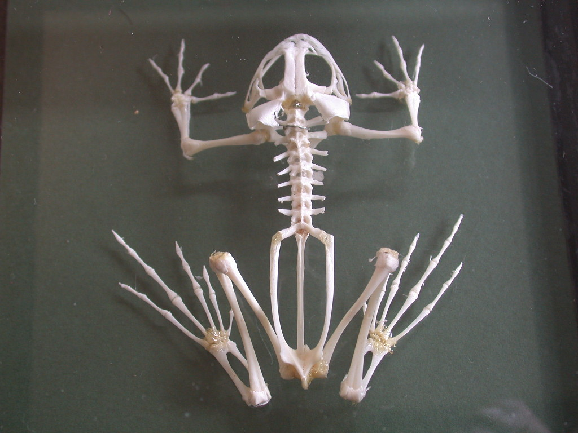
Synapomorphies of Anura
urostyle
lack tail
fused tibia and fibula
fused ulna and radius
hindlimbs > forelimbs
Tongue protrusion

Slide 37
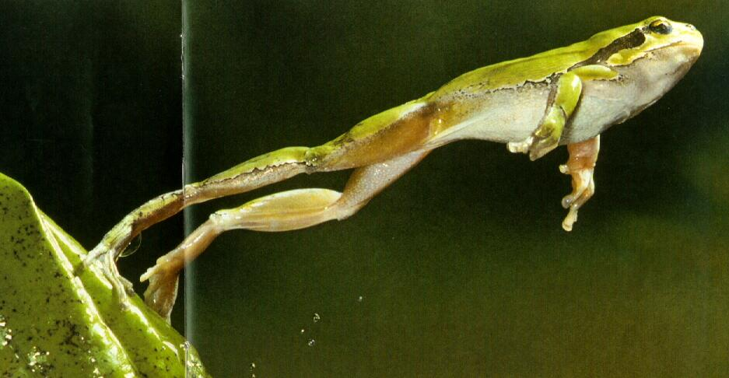
Synapomorphies of Anura
urostyle
lack tail
fused tibia and fibula
fused ulna and radius
hindlimbs > forelimbs
Tongue protrusion

Slide 38
Frog feeding
Suction feeding
Bite
Protrusible tongue

Slide 39
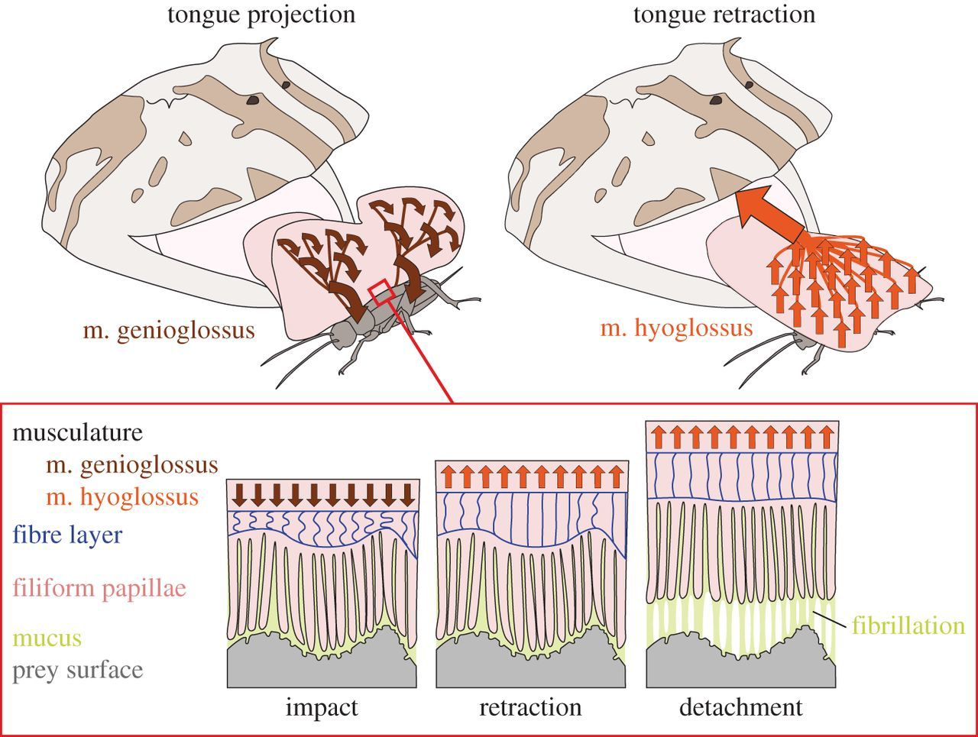

Slide 41
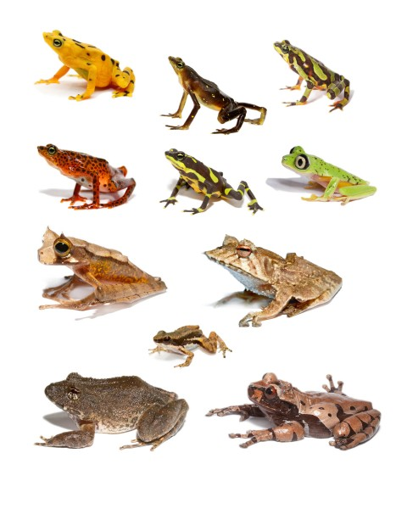
Frog diversity

Slide 43
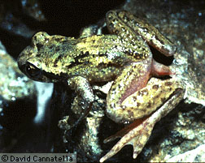
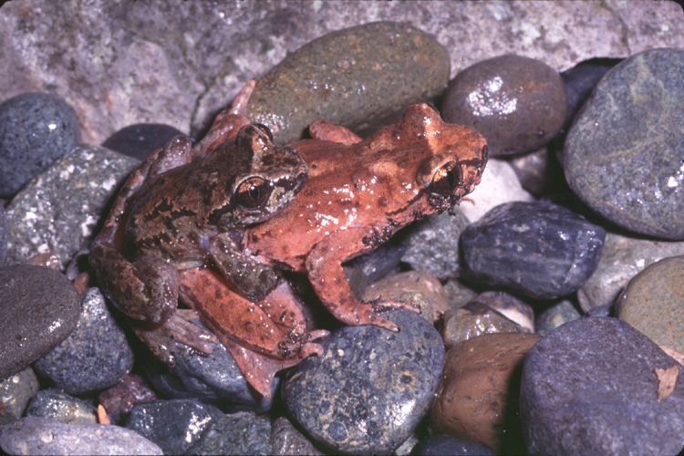
Ascaphidae: Ascaphus truei
Ascaphus truei

Slide 44
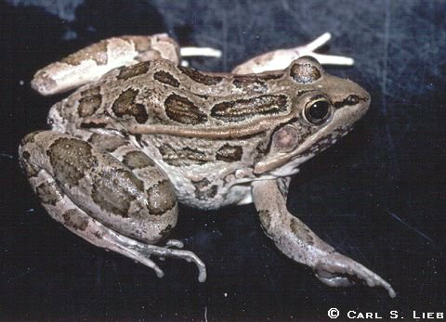
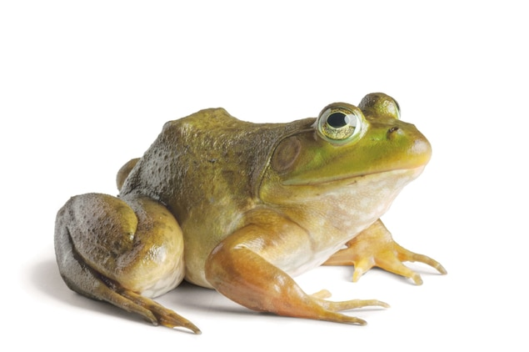
Rana berlandieri
Rana catesbeiana

Slide 45
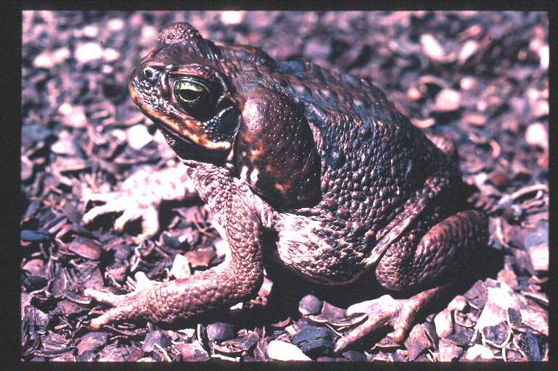
Bufonidae: Rhinella marina

Slide 46
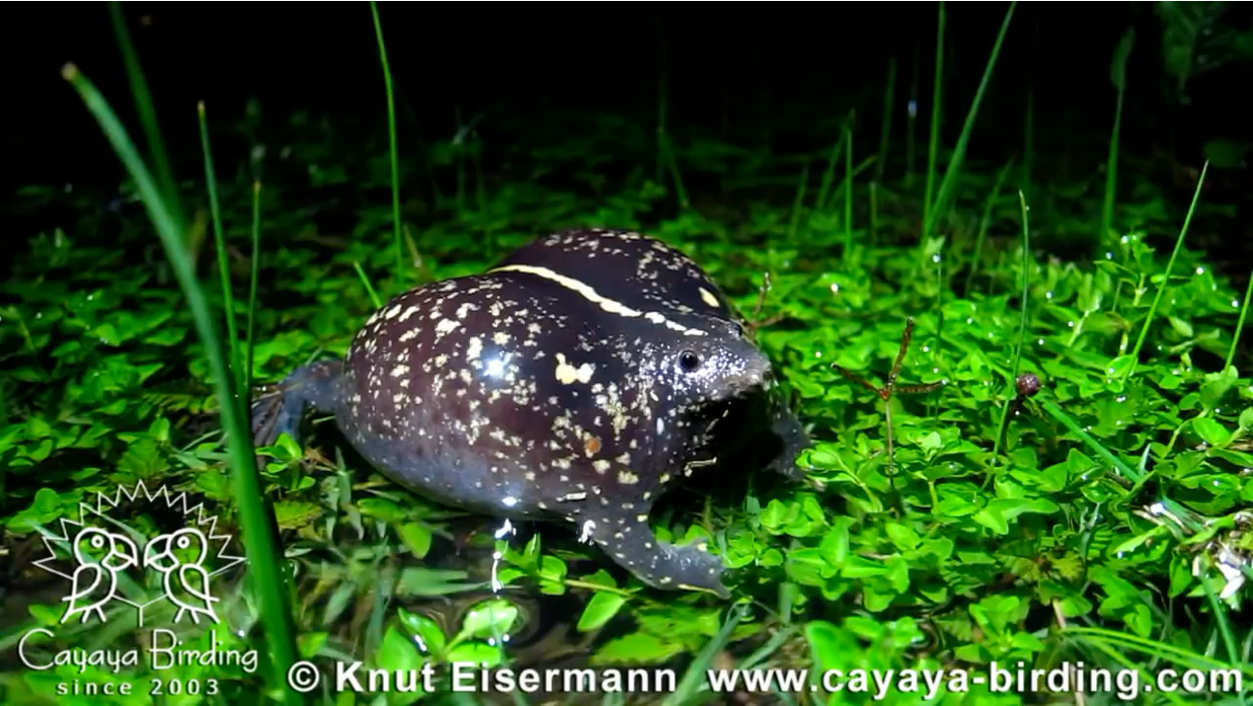
Rhinophrynidae: Rhinophrynus dorsalis

Slide 47
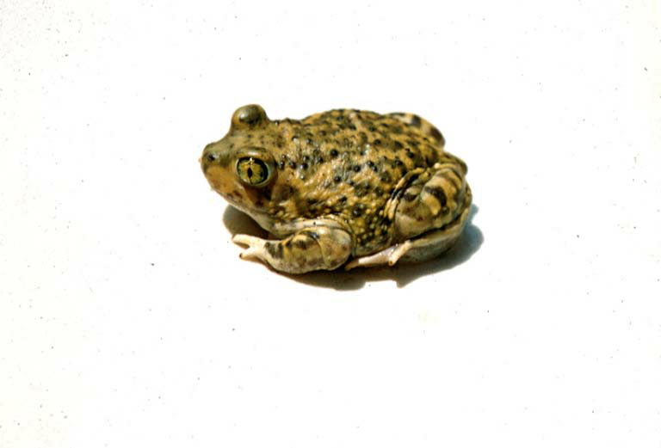
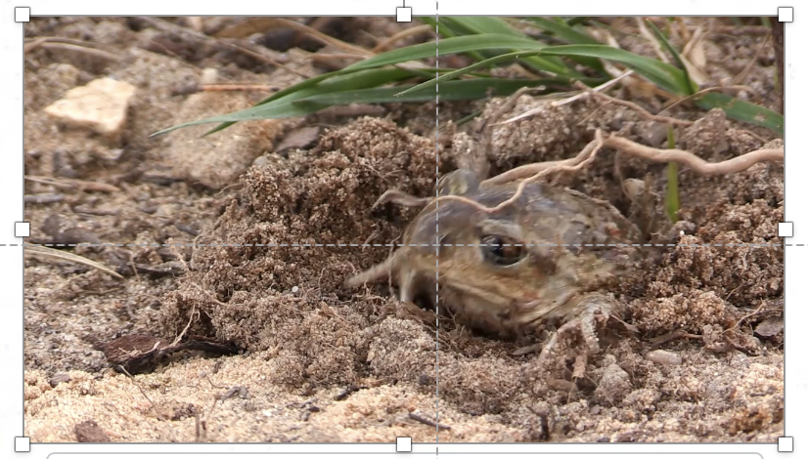
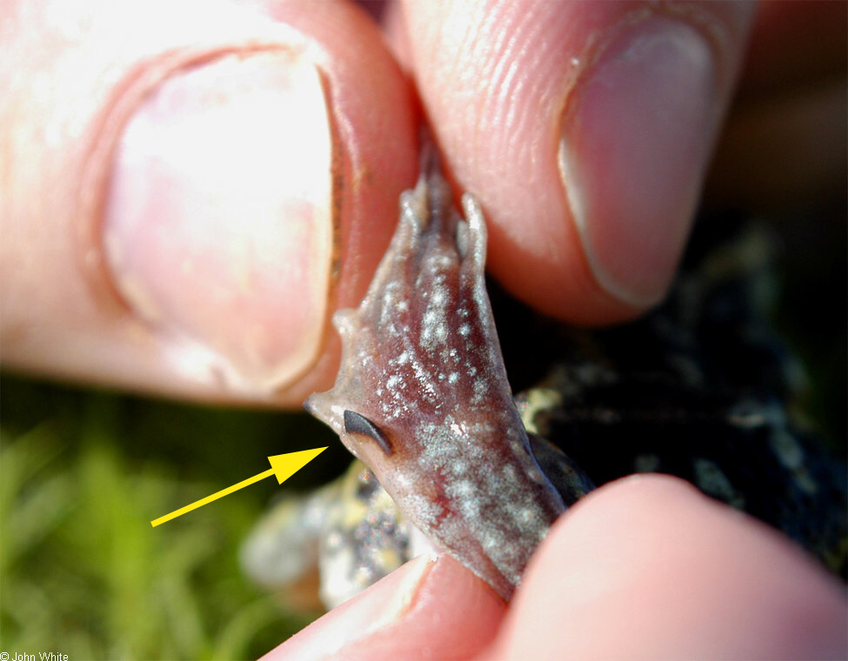
Pelobatidae: Pelobates fuscus

Slide 48
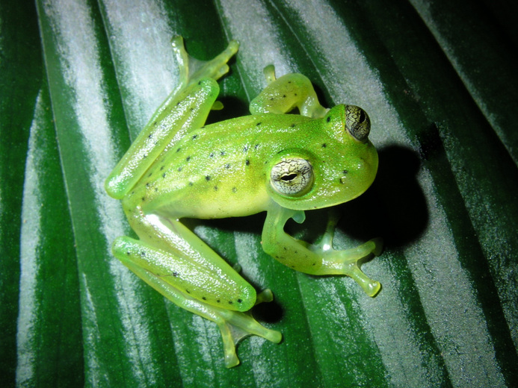
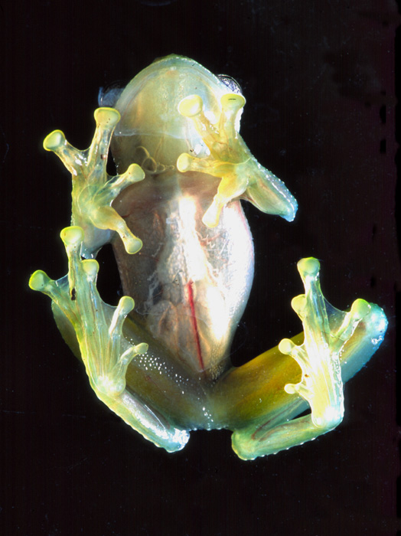
Centrolenidae: Centrolenella prosoblepon

Slide 49
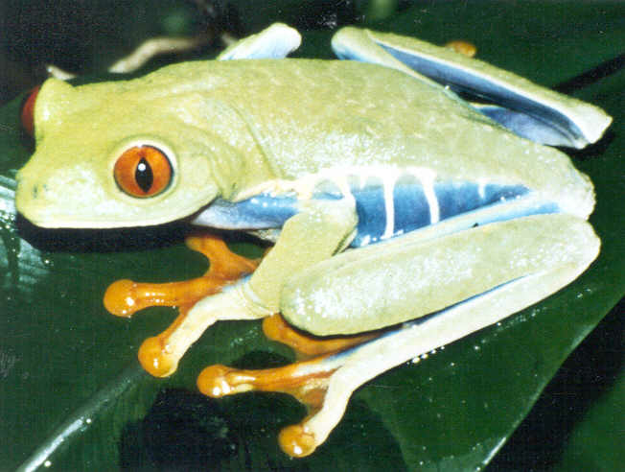
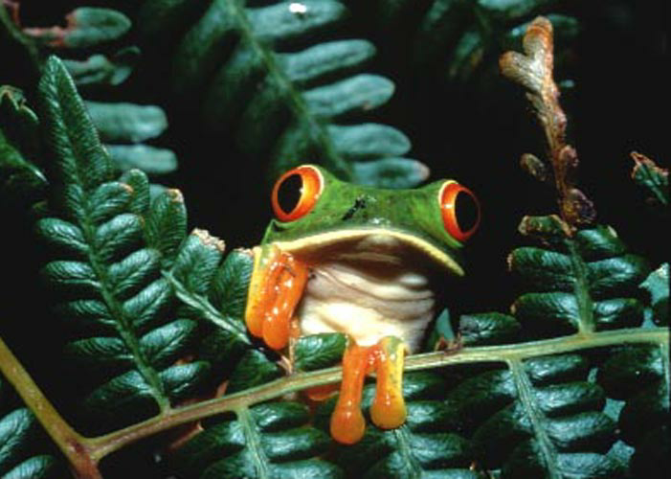
Agalychnis callidryas

Slide 50
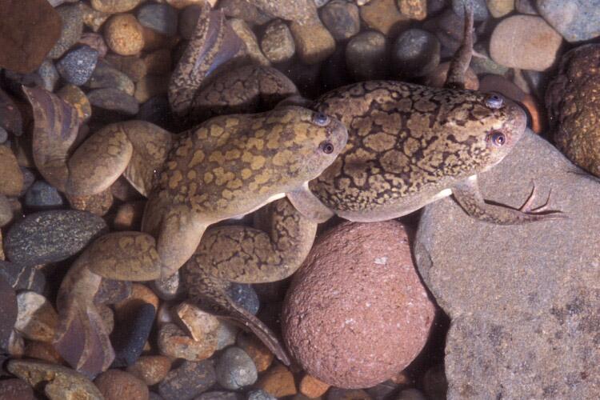
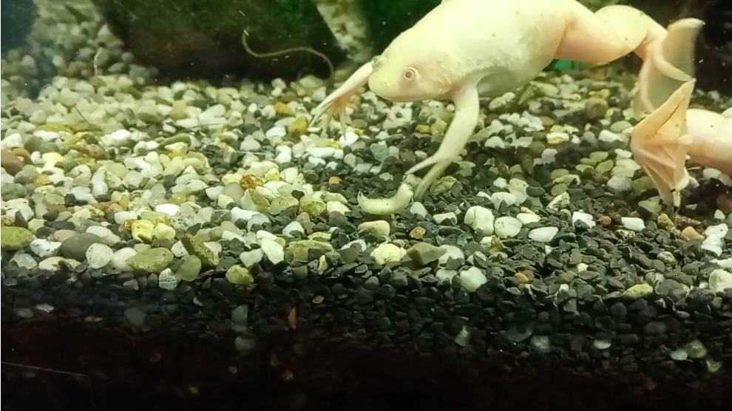
Pipidae: Xenopus laevis

Slide 51
Reading
Amphibiaweb
peruse
"Primer"
Kuchta 2006
Lynch 2005
Jared et al. 2018

Slide 52
