Slide 1
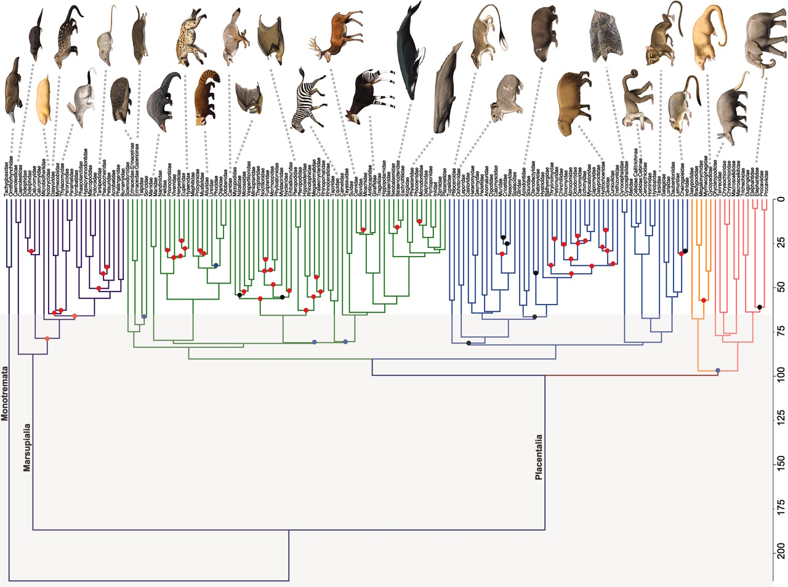
Robert W. Meredith et al. Science 2011;334:521-524
Notes:
Phylogenetic time tree of mammalian families (13) created on the basis of an analysis of the amino acid matrix (autocorrelated rates and hard-bounded constraints) of 164 mammals, rooted with five vertebrate outgroups (chicken, zebrafinch, green anole, frog, and zebrafish; see SOM for trees with outgroups). All nodes were strongly supported (BS ≥ 90%, BPP ≥ 0.95) in amino acid and DNA analyses except for nodes that are denoted by solid blue circles (conflict between DNA and amino acid trees) or solid black circles (DNA and amino acid trees agree, but with BS < 90%). Strongly supported nodes that disagree with Bininda-Emonds et al. (8) are indicated with solid red circles. Several nodes that remain difficult to resolve (e.g., placental root) have variable support between studies of rare genomic changes (29, 30), as well as genome-scale data sets (31–33), which suggest that diversification was not fully bifurcating or occurred in such rapid succession that phylogenetic signal tracking true species relations may not be recoverable with current methods. The KPg boundary is denoted by the transition from gray background (Mesozoic) to white background (Cenozoic). Color-coded branches in Placentalia correspond to Laurasiatheria (green), Euarchontoglires (blue), Xenarthra (orange), and Afrotheria (pink). See table S11 for ordinal affiliations of mammalian families. [Mammal paintings are by Carl Buell]

Slide 2
Eutheria: Carnivora
Worldwide except Australia (until recently)
11 families, 271 species
Feliformia: cats, mongooses, hyenas, civets
Caniformia: dogs, bears, weasels, racoons
Pinnipeds: walrus, seals, sea-lions
Meat eating anatomy
Small to very large

Slide 3
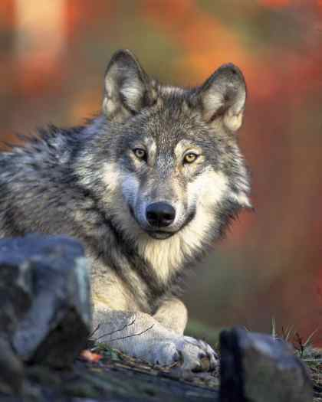
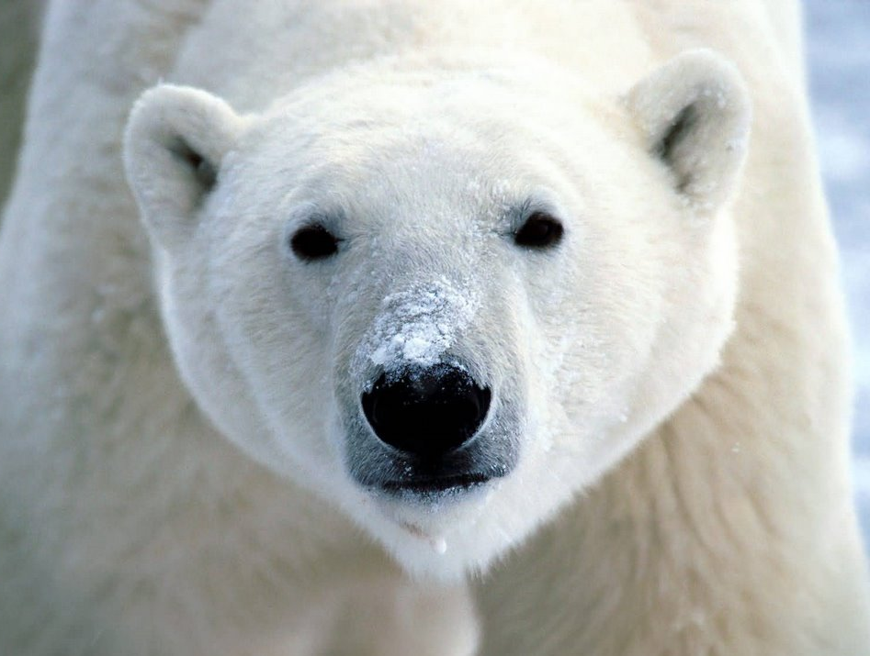
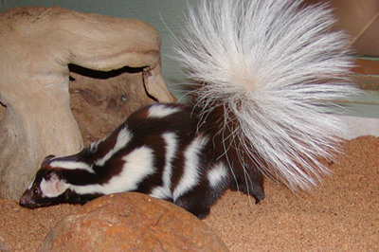
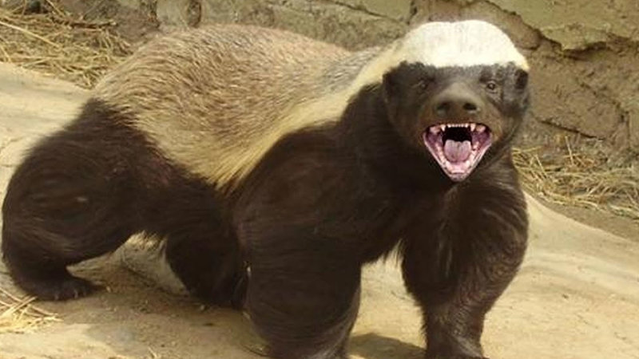

Slide 4
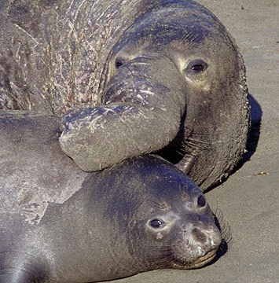
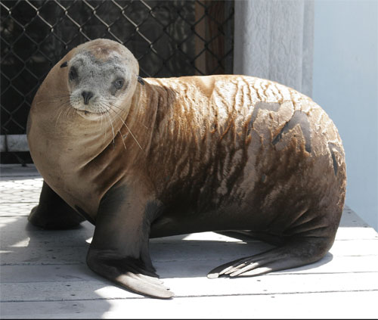
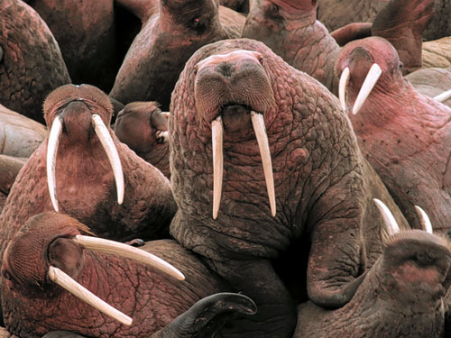

Slide 5
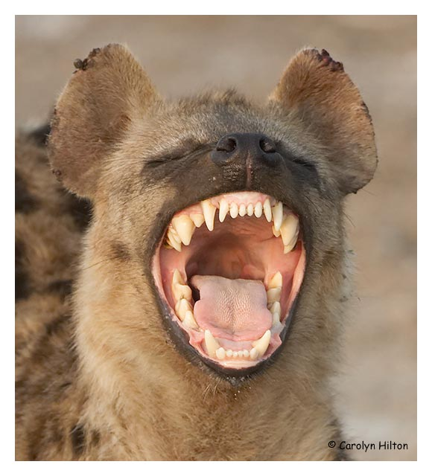
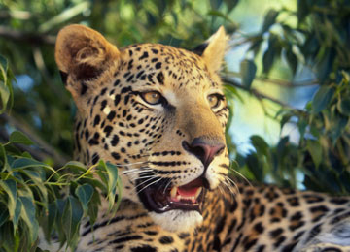
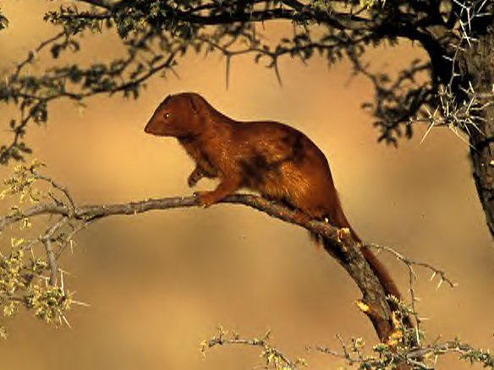

Slide 7
Eutheria: Cetartiodactyla: Cetacea
Worldwide oceans and some rivers
Mysticeti: baleen whales (11 species)
Baleen plates for filter feeding
Odontoceti: toothed whales (67 species)
Homodont and monophyodont
echolocation
Many secondary aquatic traits
Very large size

Slide 8
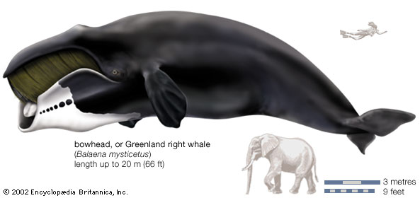
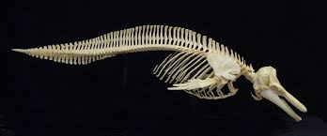
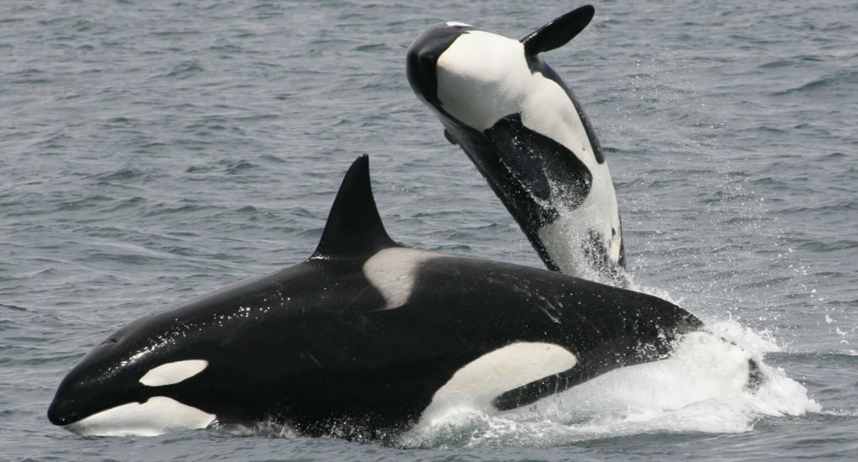
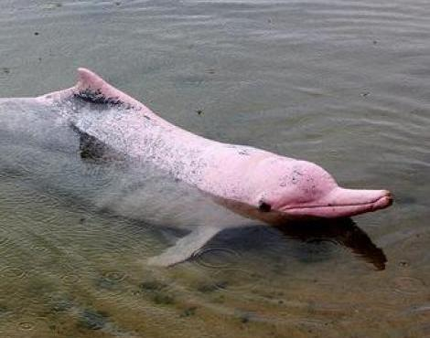

Slide 10
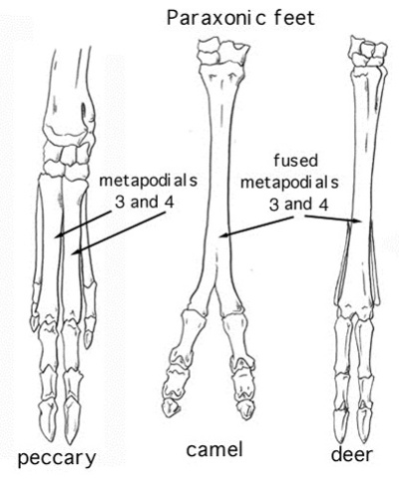
Eutheria: Cetartiodactyla: "Artiodactyla"
Worldwide except Antarctica
Very diverse: 10 families, 220 species
Suborder: Suiformes: pigs, hippos, peccaries
Suborder: Tylopoda: camels
Suborder: Ruminantia: deer, giraffe, pronghorn, antelope, bison, goats, sheep
Microbial digestion in multiple stomachs
Even-toed ungulates, cursorial
Have horns or antlers

Slide 11
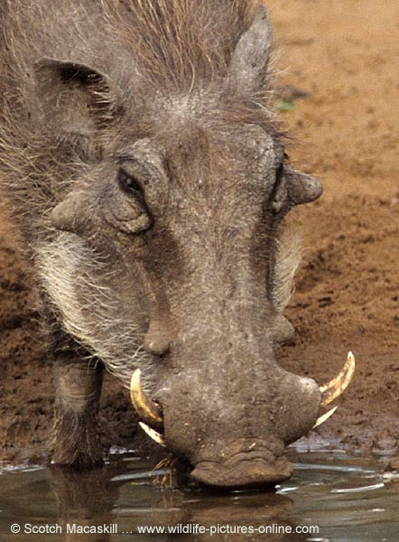
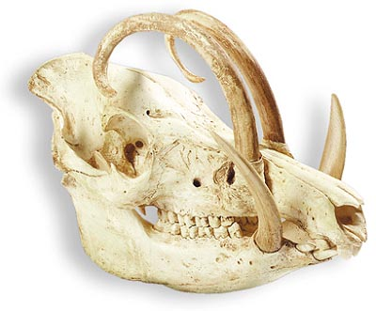
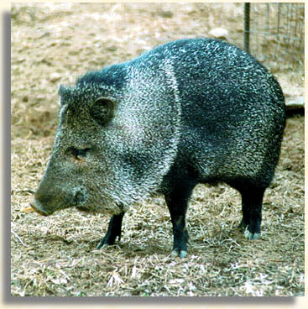
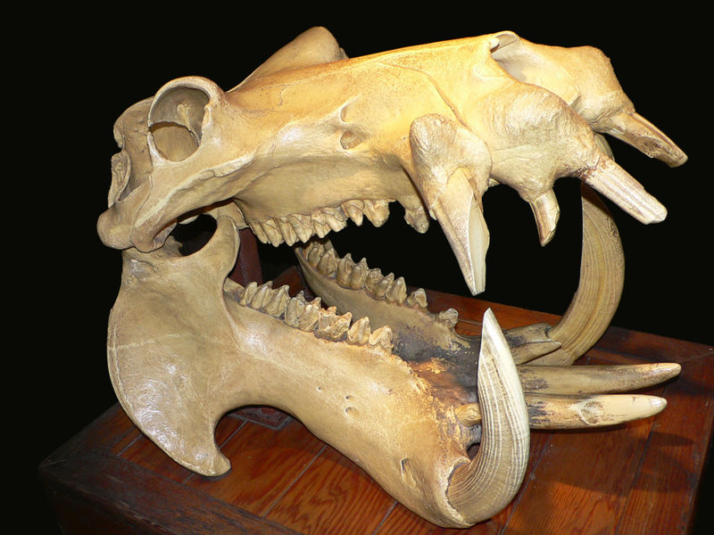

Slide 12
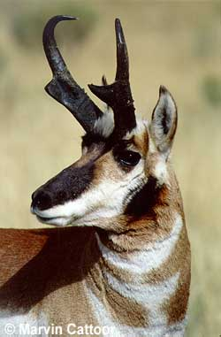
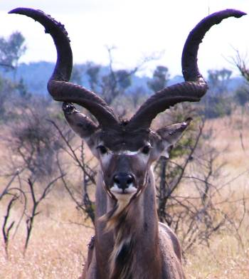
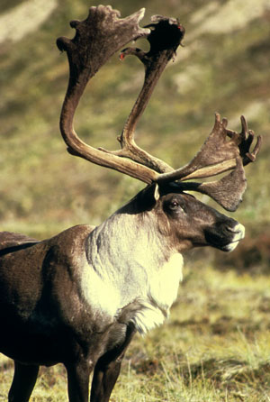
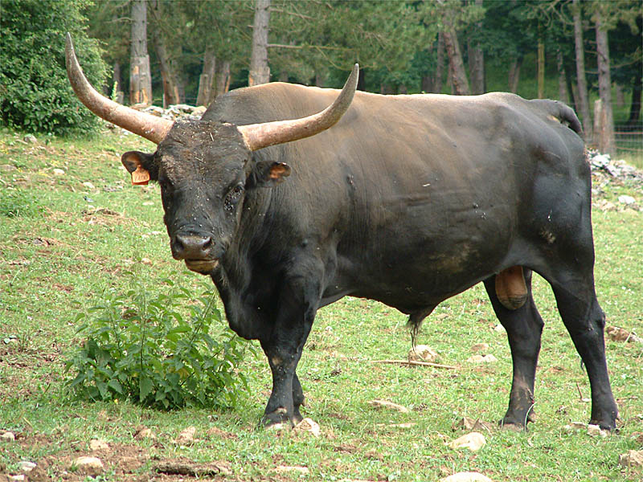
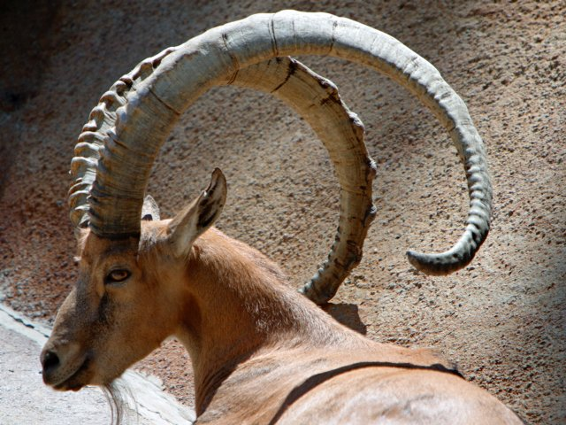

Slide 13
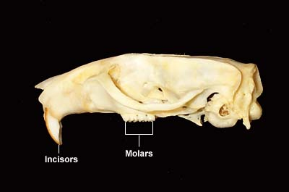
Eutheria: Rodentia
Worldwide except Antarctica and islands
Largest mammal order (43% of all mammals)
28 families, 2000+ species
Diverse habitats
Arboreal, gliding, fossorial, terrestrial, semi-aquatic
Single pair of upper and lower incisors
Ever-growing
Mostly small, generally nocturnal
Generally herbivorous or granivorous

Slide 14
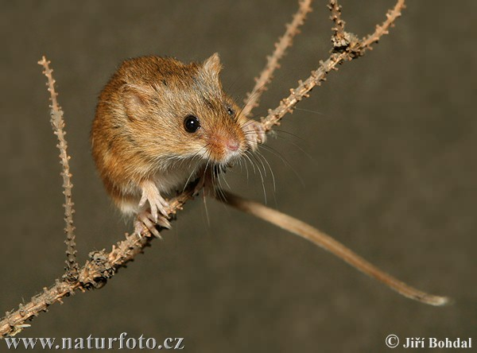
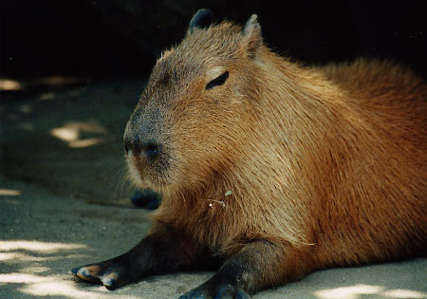
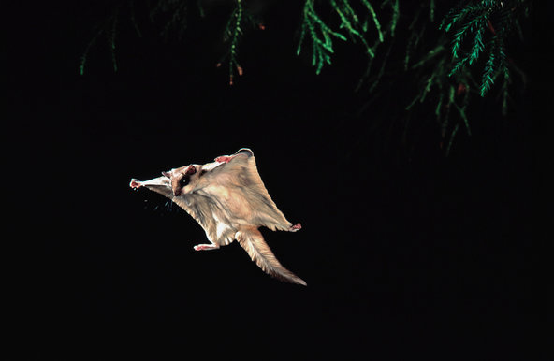
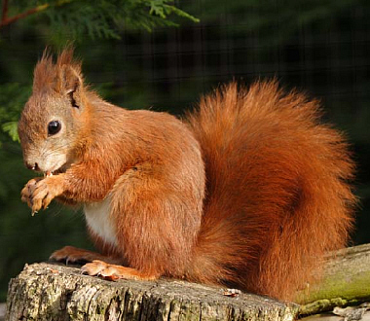
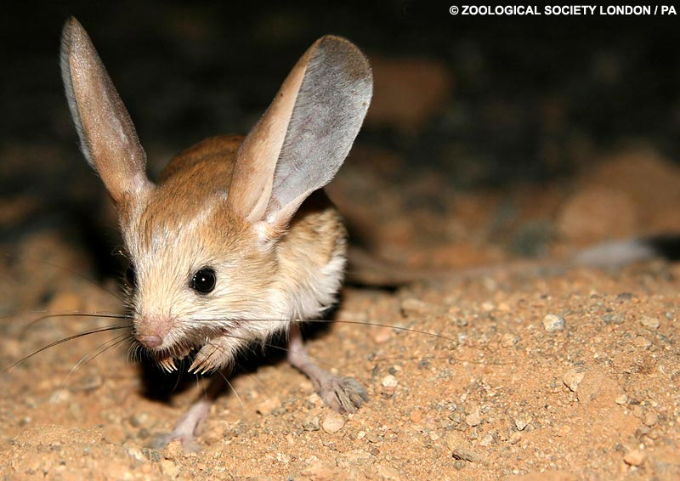

Slide 15
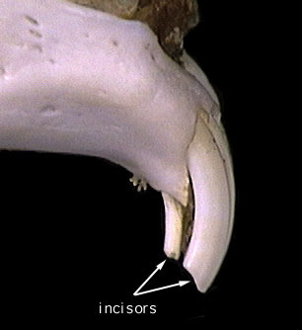
Eutheria: Lagomorpha
Worldwide except Australia, New Zealand
2 families, 80 species
2 pairs of upper incisors
Terrestrial and herbivorous
Practice coprophagy
Small to medium size

Slide 16
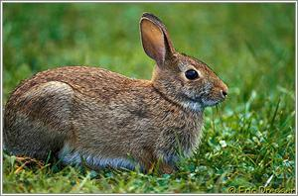
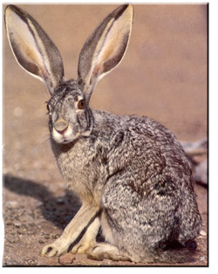

Slide 17
Eutheria: Proboscidea
Africa, southeast Asia
Family: Elephantidae
African and Asian elephants
Largest land mammals (11 feet, 13K lbs)
Occupy various terrestrial habitats
Long lived and gregarious
Arid climate

Slide 18
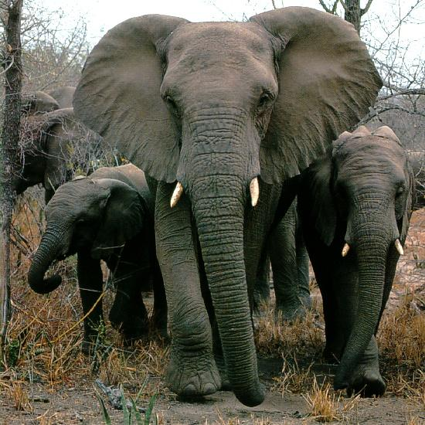
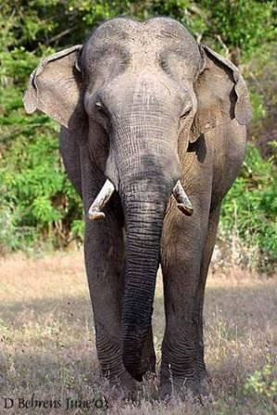

Slide 21
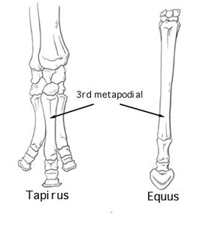
Eutheria: Perissodactyla
Worldwide except Antarctica
3 families, 17 species
Horses, rhinos, tapirs
Odd-toed ungulates, cursorial
Stand on middle digit
Very diverse in fossil record
Large
Generalist herbivores

Slide 22
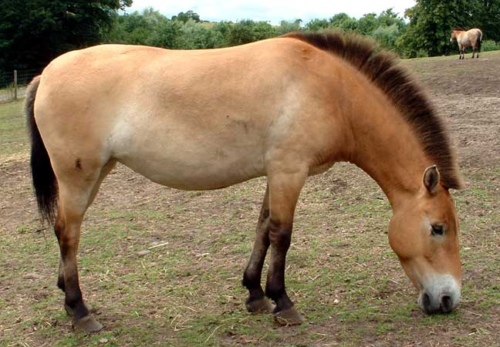
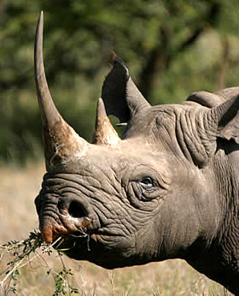
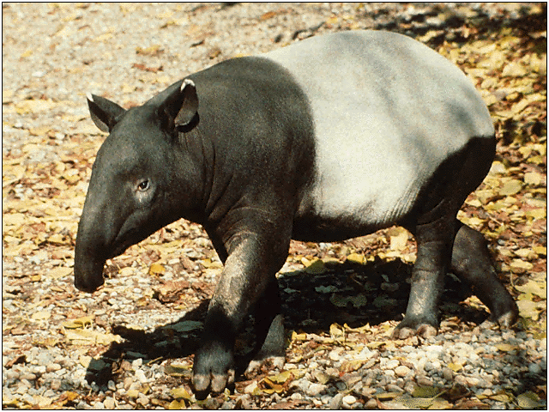
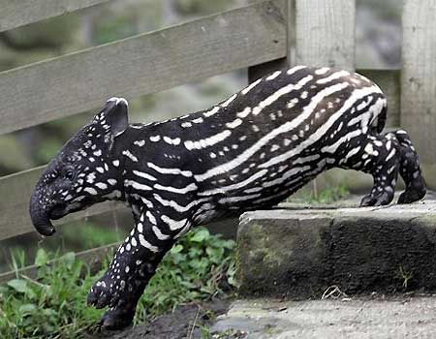

Slide 23
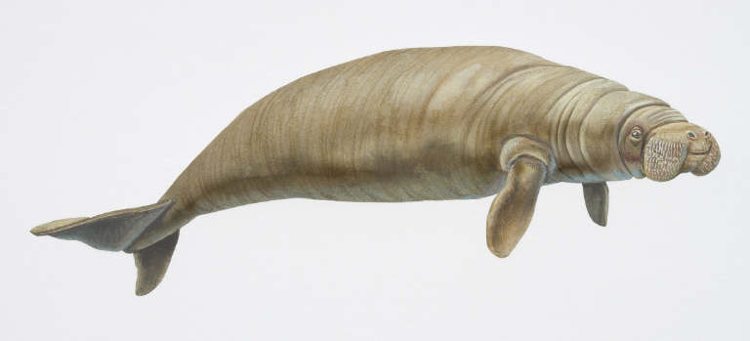
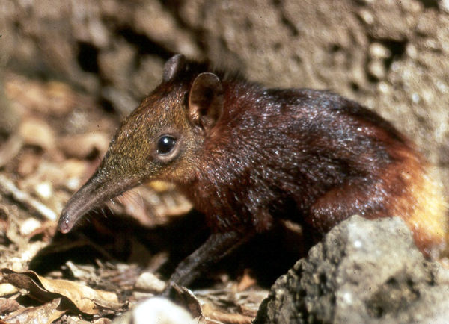
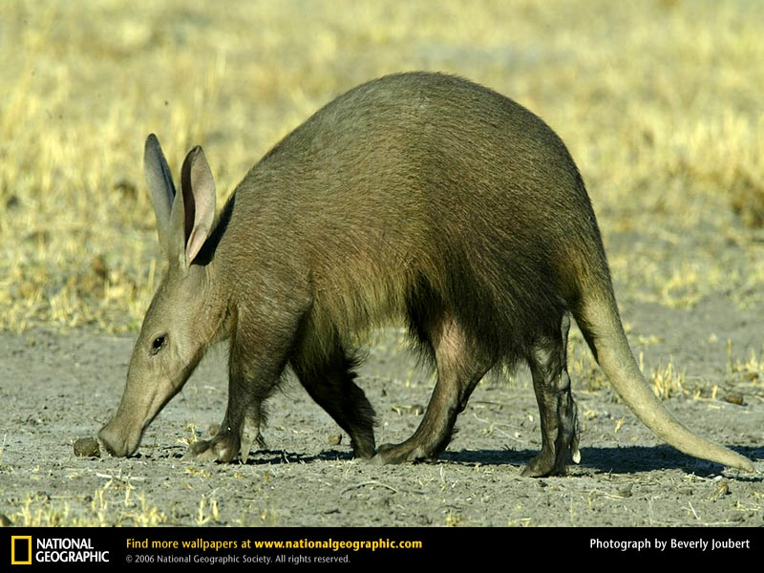
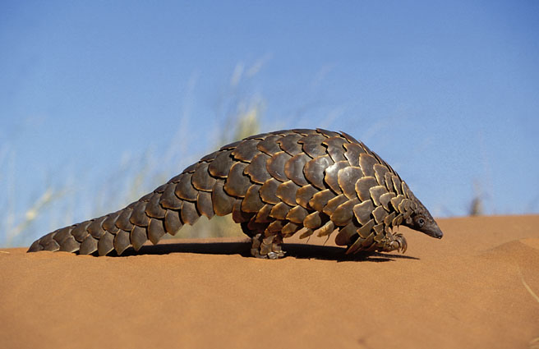
Eutheria
Sirenia (manatees, dugong; disjunct worldwide)
Pholidota (pangolins; Asia, Africa)
Tubulidentata (aardvark; Africa)
Macroscelidea (elephant shrews; Africa)
Scandentia (tree shrews; Southeast Asia)
Hyracoidea (hyraxes; Africa)

Slide 25
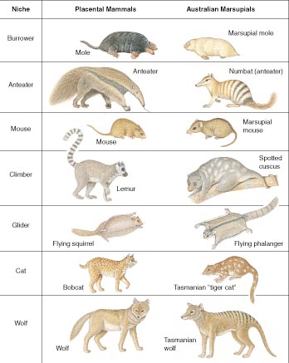

Slide 26
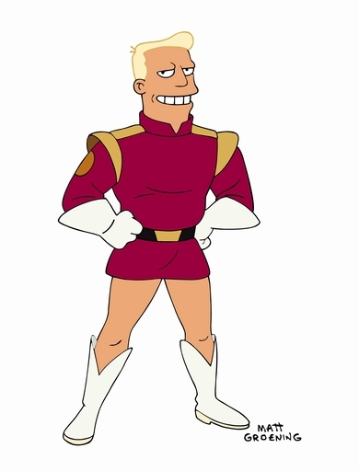
Eutheria: Primates
Worldwide tropics except
Australia
13 families, 233 species
30 g to 200 kg

Slide 27
Primate synapomorphies
Free moving shoulder and elbow joints
Arboreal locomotion
Hindlimb-dominated locomotion
Five functional digits on hands/feet
Opposable thumb and big toe
Claws modified into nails
Reduced olfactory, increased vision
Smaller snout
Large orbits
Binocular vision
Large brain
Small litter, long gestation, long period of parental care

Slide 28
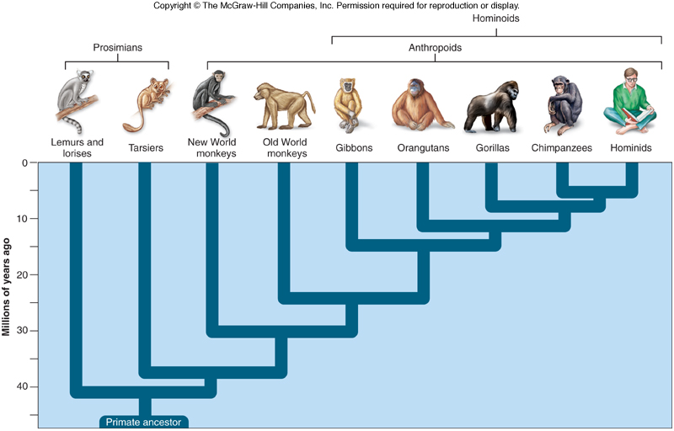
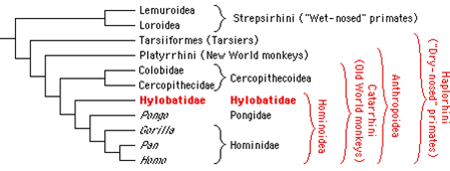
Lemurs, pottos, lorises: Strepsirrhini
Anthropoids, tarsiers: Haplorhini

Slide 29
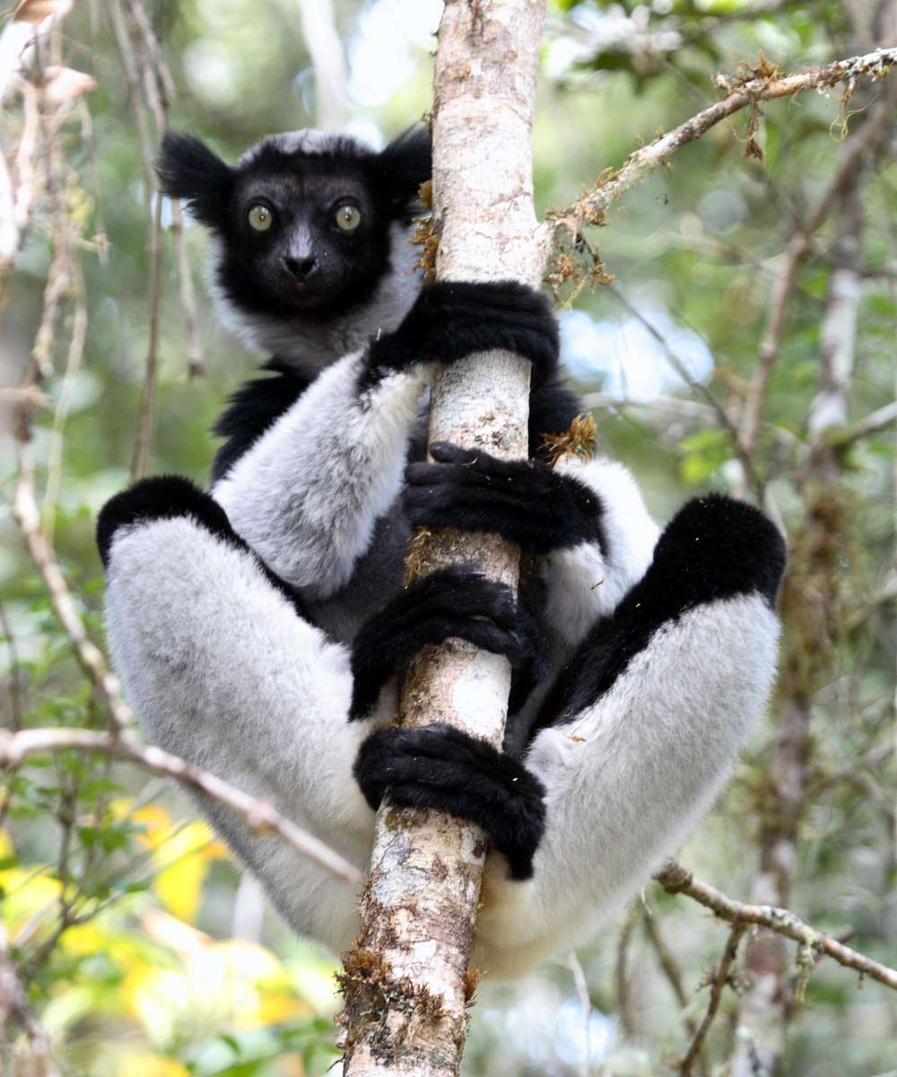
Strepsirrhini
Lemurs: Madagascar
Lorises: SE Asia, India
Potto, Galagos: Africa
Small, arboreal, diurnal (lemurs) or nocturnal (others)

Slide 30
Tarsiiformes
Part of Haplorhini
Southeast Asia islands
Small, nocturnal, arboreal, carnivorous
Elongate fingers, hindlimbs (tarsus)
Large eyes

Slide 31
Simiiformes (Anthropoidea)
Larger size
Body size and brain size increased
Change of diet
Insectivorous to
frugivorous/folivorous
Change in activity
Nocturnal to diurnal
Locomotion
From leaping and clinging to running and brachiating
Includes monkeys and Hominoids

Slide 32
Platyrrhini
New World monkeys
flat face, lateral nostrils
prehensile tail (some)
frequent monogamy, male parental care
3 premolars
structure of digits
Cercopithecoidea (part of Catarrhini)
Old world monkeys
downward nose, nostrils
polygamous
2 premolars
structure of digits

Slide 34
Hominoidea

Slide 35
Hominoidea: Gibbons
18 species
Monogamous social system
Brachiation

Slide 36
Hominoidea: Orangutans
Pongo pygmaeus, P. abelii, P. tapanuliensis
Sophisticated tool use
Solitary
Sexual dimorphism
Arboreal but heavy

Slide 37
Hominoidea: Gorillas
Gorilla gorilla, G. beringei
Highly social and sexually dimorphic
Polygynous (harems)
Terrestrial

Slide 38
Hominoidea: Gorillas

Slide 39
Hominoidea: Chimpanzees
Highly social but polygamous
Africa
Terrestrial
Omnivorous
Pan troglodytes (common chimp), P. paniscus (bonobo)

Slide 40
Hominoidea:
Human evolution

Slide 41
Humans (Homo)
Diverged from other great apes ~6-13 Mya
Three synapomorphies
Bipedal stance
S-shaped curvature of vertebrae
Pelvic modifications
Lengthening and placement
of leg bones
Flattened feet,
unopposable big toe
Large brains
Linked to locomotion and hand manipulation
Speech and Language
larynx shifted back, use of tongue

Slide 42
DNA comparison
95-98%
similar
86%
similar

Slide 43
Great moments in the study of human evolution: Texts
GL LeClerq 1749 Histoire Naturelle
discusses (but rejects) human-ape link
Others suggested relationship (Chambers, Lamarck) or classified humans as primates (Linnaeus)
TH Huxley 1863 Evidence as to Man's Place in Nature
Compelling anatomical arguments
C Darwin 1871
The Descent of Man
Focus on sexual selection

Slide 44
Huxley 1863
"Without question... [man's] early stages of development... far nearer the apes, than apes are to the dog"
"Is man so different from any of these apes that he must form an order by himself?"
"It is quite certain that the ape which most nearly approaches man is either the Chimpanzee, or the Gorilla..."
"Thus, whatever system of organs be studied, the comparison of their modifications in the ape series leads to one and the same result—that the structural differences which separate Man from the Gorilla and the Chimpanzee are not so great as those which separate the Gorilla from the lower apes…But if man be separated by no greater structural barrier from the brutes than they are from each other—then it seems to follow that... there would be no rational ground for doubting that man might have originated... by the gradual modification of a man-like ape"
"At the present moment there is but one hypothesis which has any scientific existence—that propounded by Mr. Darwin"

Slide 45
Great moments in the study of human evolution: Discoveries
1856 Homo neanderthalensis
1891 Homo erectus
1925 Australopithecus africanus
1938 Paranthropus robustus
1974 Australopithecus afarensis
1992/2009 Ardipithecus ramidus

Slide 47
Timeline of human species

Slide 48
Hypotheses of Human Evolution
Multiregional (Milford Wolpoff 1988)
Origin in Africa
Homo dispersal to other continents 2 mya
Worldwide species evolves to modern Homo sapiens
H. erectus = H. sapiens = H. neanderthalensis

Slide 49
Hypotheses of human evolution
"Out of Africa"/Recent African Origin
Origin in Africa
H. erectus (1.9 mya) and H. neanderthalensis (400K ya) migrate to Europe, Asia
H. sapiens leaves Africa 60K ya, colonizes world, outcompetes other forms

