Slide 1
Mammals

Slide 2
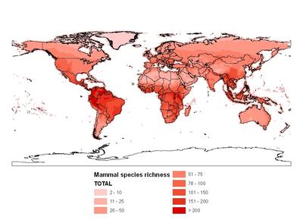

Slide 3
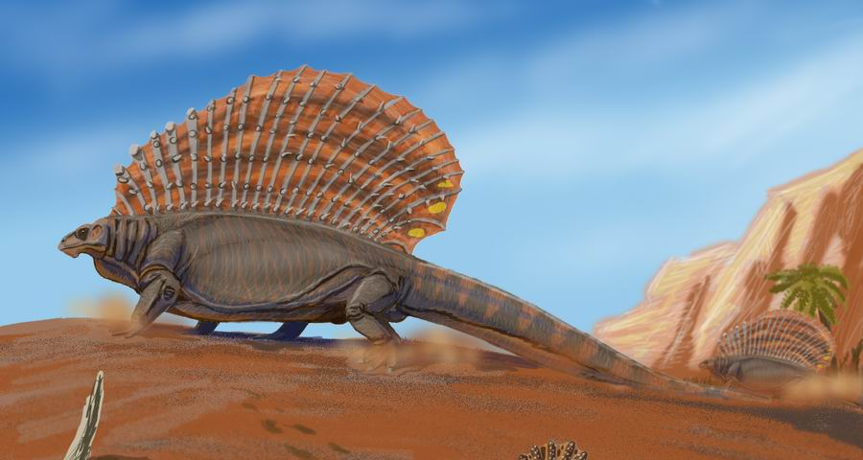
Synapsida
Includes extinct sister groups of Mammalia ("non-mammalian synapsids," "stem mammals," "mammal-like reptiles") and mammals
A single lateral temporal fenestra
Review: Anapsida = turtles; Diapsida = birds, snakes, lizards (and Anapsida)
A stem-based name: All species more closely related to Mammalia than to Reptilia

Slide 4
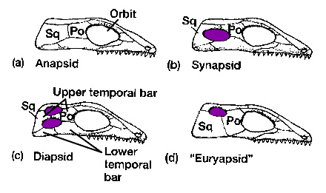
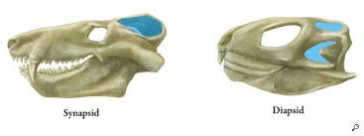
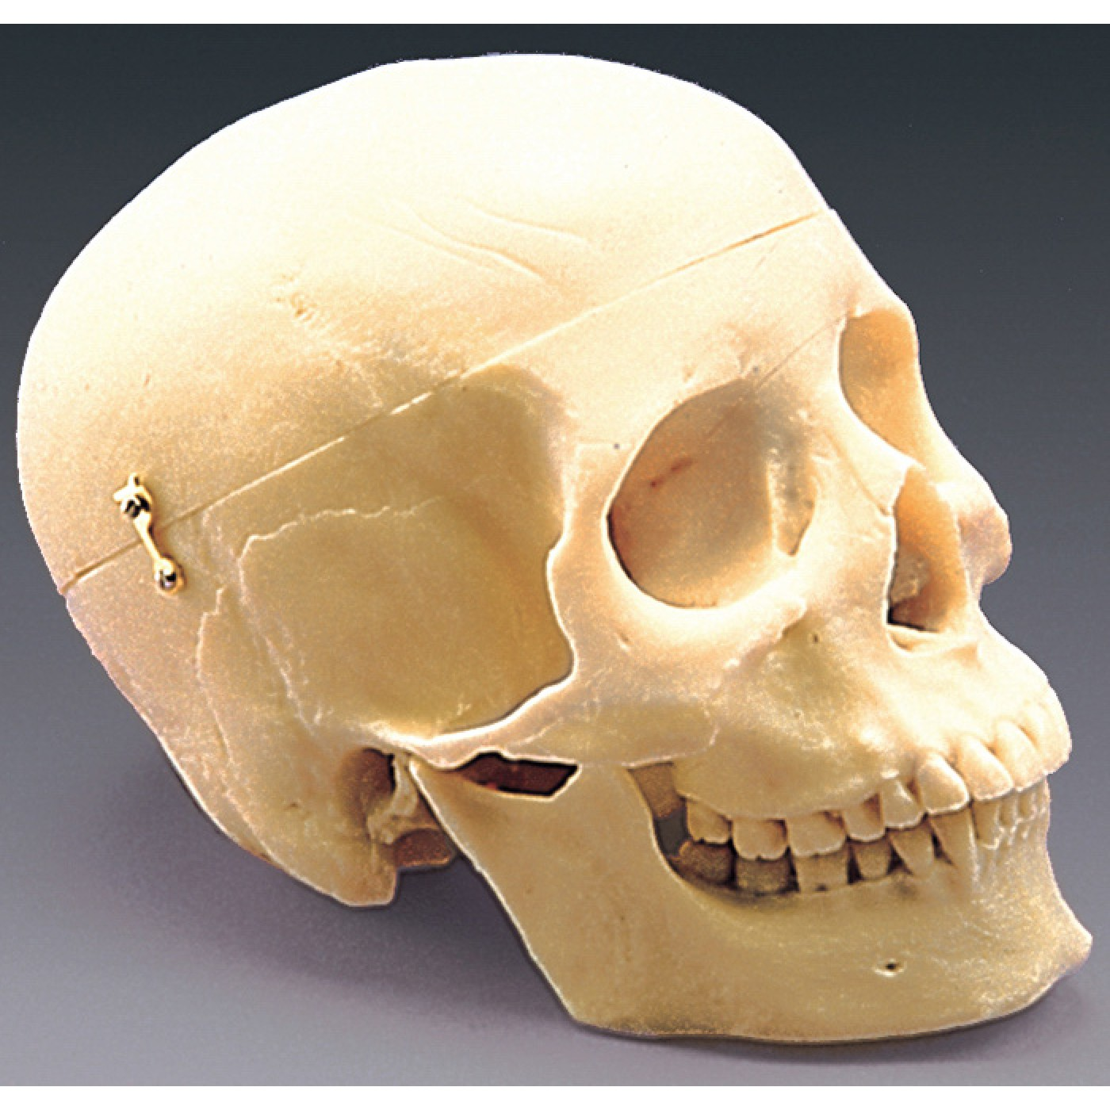

Slide 5
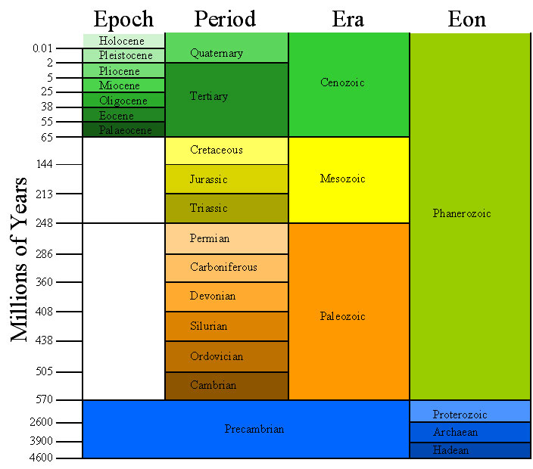

Slide 6
Synapsida
First group of amniotes to radiate in a terrestrial environment
Most abundant terrestrial vertebrates in Late Carboniferous and Permian (300-250 mya)
Top carnivores from Early Permian to Triassic (300-250 mya)
Medium to large size (10-200kg) until the Late Triassic
2 mass extinctions
Permian-Triassic: 250 mya (archosaurs become dominant)
Cretaceous-Tertiary 65 mya (mammals radiated extensively post-extinction)

Slide 7
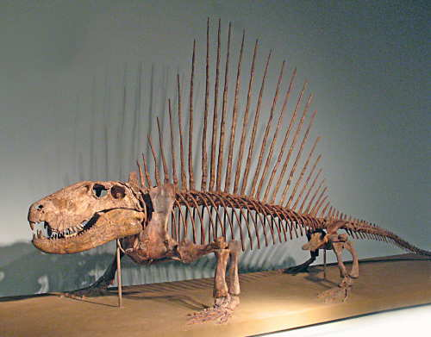
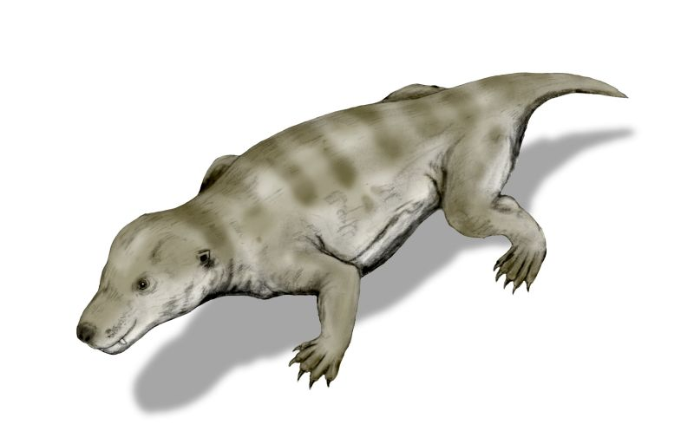
Non-Mammalian Synapsids
2 major groups
'Pelycosaurs'
Early Permian
"Sailbacks"
Generalized carnivores with large teeth
Elongated neural spines
'Therapsids'
Dicynodonts, Cynodonts
Closer to Mammalia
Heavy-bodied, large-headed
Late Permian to Early Cretaceous
Dentition differentiated

Slide 8
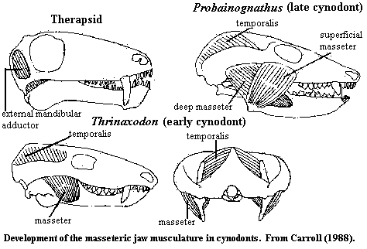
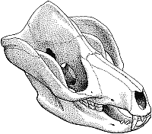
Synapsids to Mammalia: Musculoskeletal evolution in the head
Size of temporal fenestra
Larger = more jaw muscle
Loss of postorbital bar
Zygomatic arch
Adductor mandibulae
Temporalis
Masseter
Deep
Superficial
Tritylodon
(Cynodont)

Slide 9
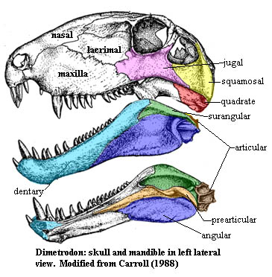
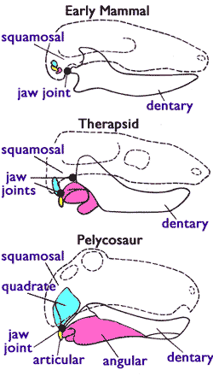
Evolution of mammalian jaw
Derived Condition (cynodonts and mammals)
Dentary bone enlarged
Postdentary bones become middle ear bones
Quadrate = Incus; Angular = tympanic; Articular = Malleus; (Columella = stapes)
Condylar process of dentary articulates with squamosal of skull
Dentary-squamosal jaw joint

Slide 10
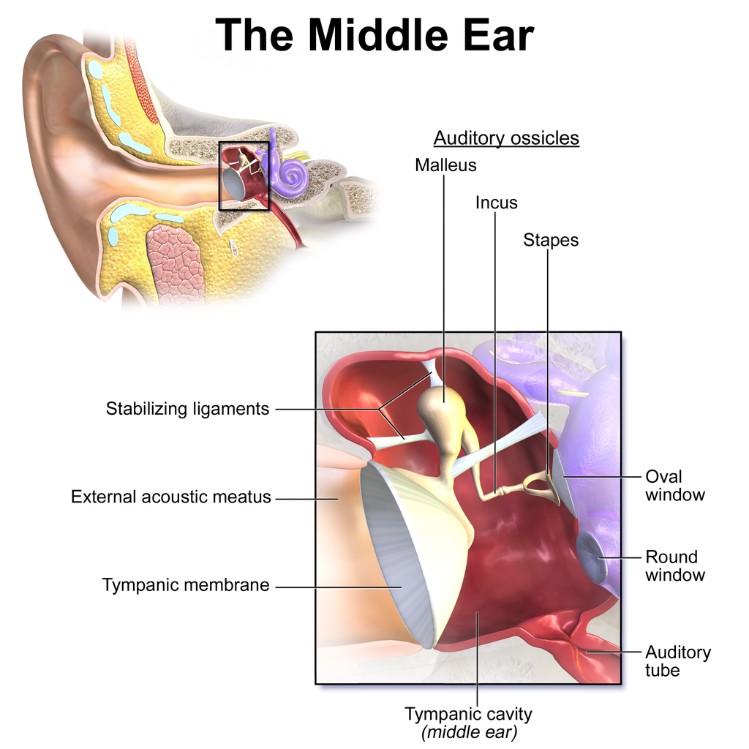
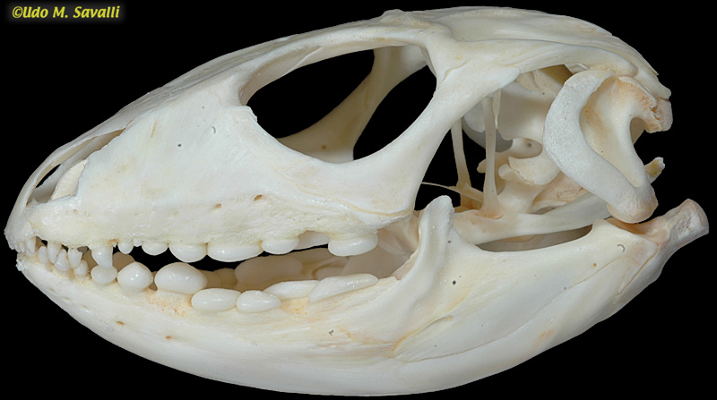
Evolution of mammalian jaw
quadrate

Slide 11
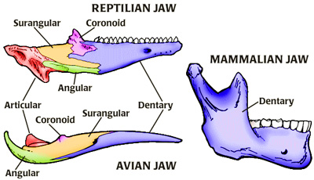
Evolution of mammalian jaw

Slide 12
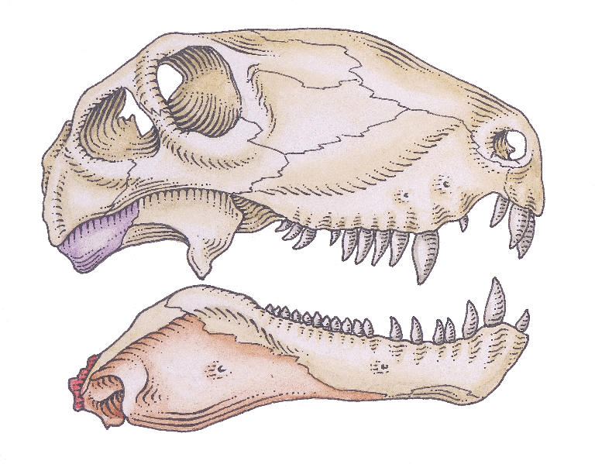
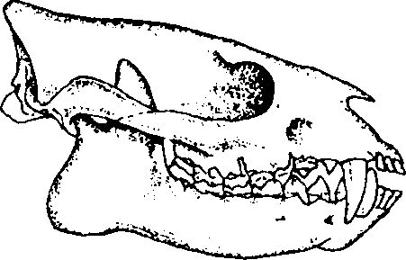
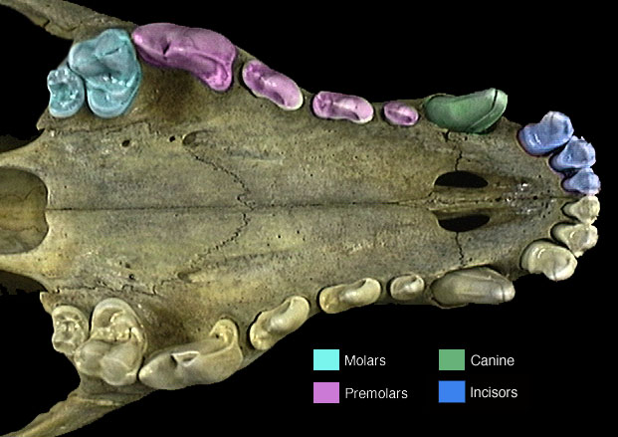
Synapsids to Mammalia: Skeletal evolution of the head
Teeth
Greater specialization
Heterodont instead of homodont dentition
Regionalization of function
Diphyodont (only two sets of teeth)
Secondary palate

Slide 13
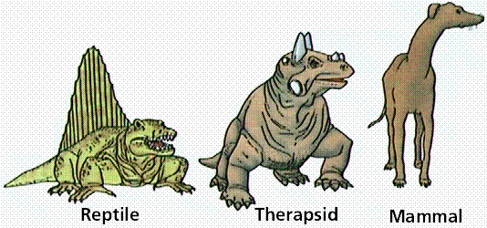
Synapsids to Mammalia: Skeletal evolution
Position of limbs and limb girdles
Limbs underneath body
"Carrier's constraint"
Upright posture
Higher level of activity
Girdles reduced
More weight supported by limbs
Less cumbersome
http://microlnx.com/dinosaurs/images/Synaps5.gif

Slide 14
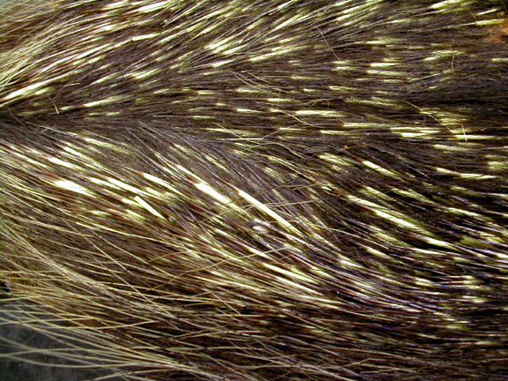
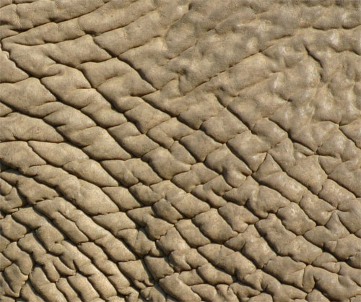
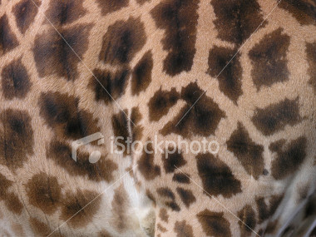
Integument
Diversity of skin
Glands
Eccrine, apocrine, sebaceous, mammary
Nails, claws, hoofs, horns, antlers
Locomotion, predation, defense, display
Hair/Fur
Camouflage, communication, sensation, protection, insulation
Molting

Slide 15
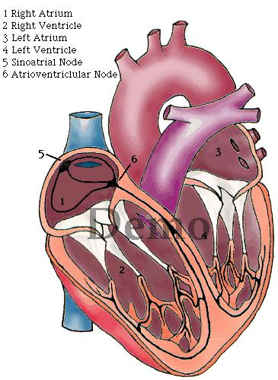
Internal Anatomy
Adipose tissue
Insulation, metabolic processes, brown fat for heat generation
Cardiovascular system
Complete ventricular septum, anucleate erythrocytes
Respiratory system
Developed lungs, diaphragm
Urogenital System
lack of cloaca (except monotremes)

Slide 16
Mammal reproduction
Genetic sex determination (XY)
Internal fertilization
Oviparity (Monotremata) or viviparity (other lineages)
Variation in structure of reproductive tract and penis, gestation time, cloaca, parental care
lactation

Slide 17
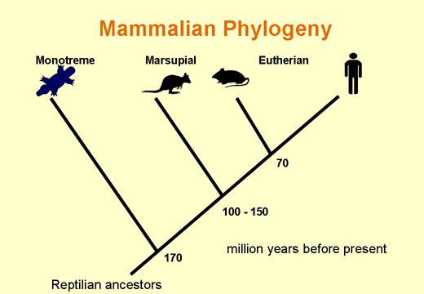
Mammalian Lineages
Monotremata
Theria
Metatheria (Marsupialia)
Eutheria (Placentalia)

Slide 18
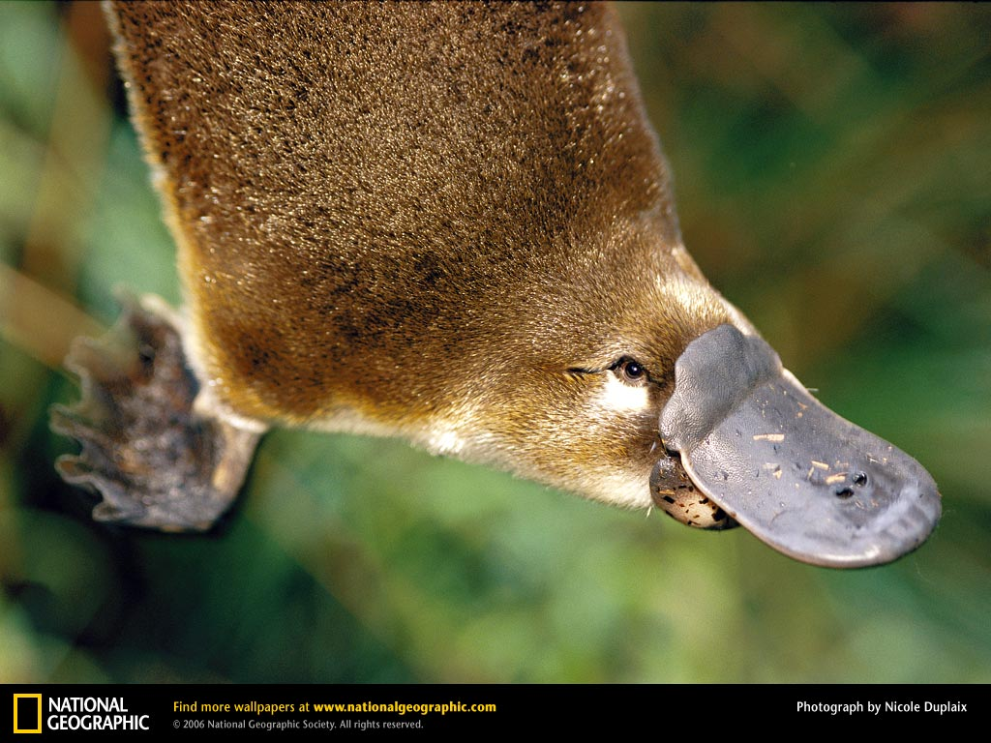
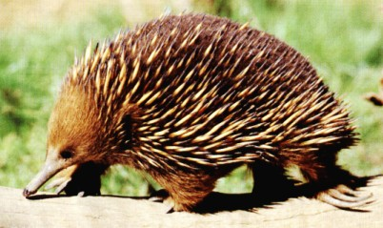
Prototheria: Monotremata
Plesiomorphic conditions:
lay eggs
lack pinnae
lack nipples
robust pectoral girdle
more sprawling gait
cloaca
Monotreme synapomorphies:
loss of teeth
leathery "beak" with electromagnetic sensors
poison spines
3-5 extant species
Platypus
Echidnas
Australia, New Guinea

Slide 19
Prototheria: Monotremata

Slide 20
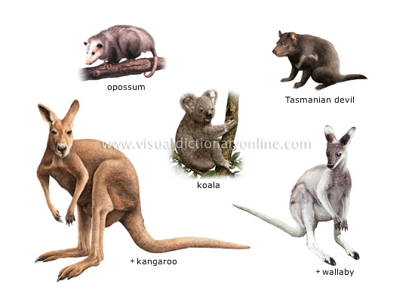
Metatheria/Marsupialia
7 Extant Orders, 18 Families, 275 Species
Mostly South American and Australasian

Slide 21
Marsupial Reproduction
Split vagina
Meets anteriorly then diverges into two vaginas/uteri
Birth through middle pseudovaginal canal
Transient shell
Evidence of oviparous ancestry
Embryonic development extreme
Neonates with well developed forelimbs
Lungs well developed
Jaws, palate, face muscles, tongue developed

Slide 22
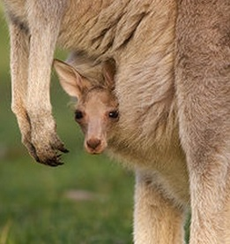
Marsupial Reproduction
Pouch
Neonates climb into pouch to nipples
Milk composition variable
Watery and protein rich
Thicker and fat rich
Nipples independent of each other

Slide 24
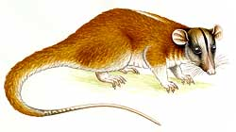
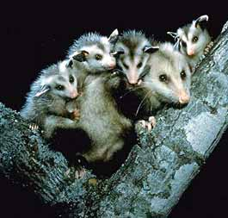
Marsupialia: Didelphimorphia
South and North America
Family: Didelphidae
New World opossums

Slide 25
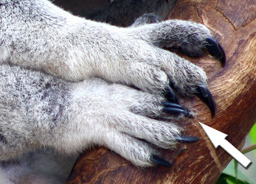
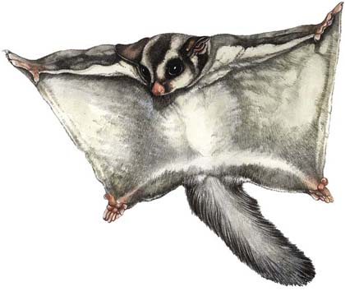
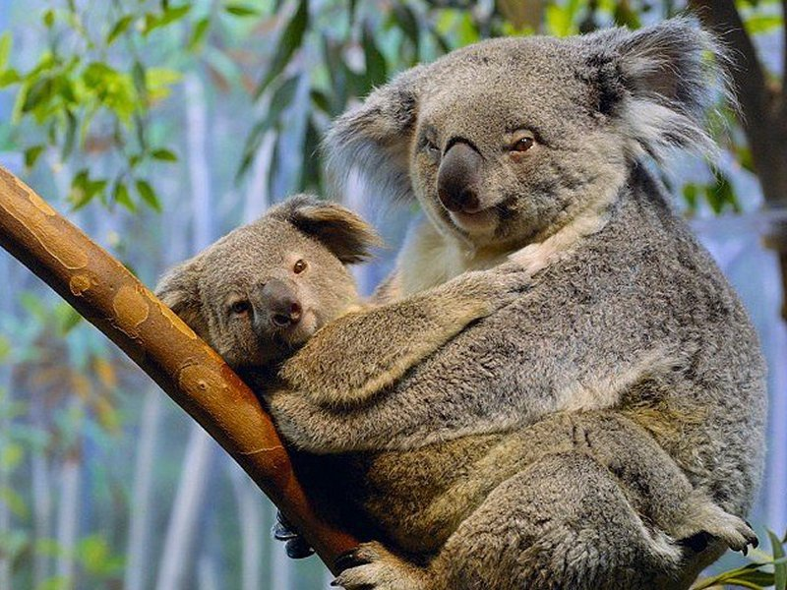
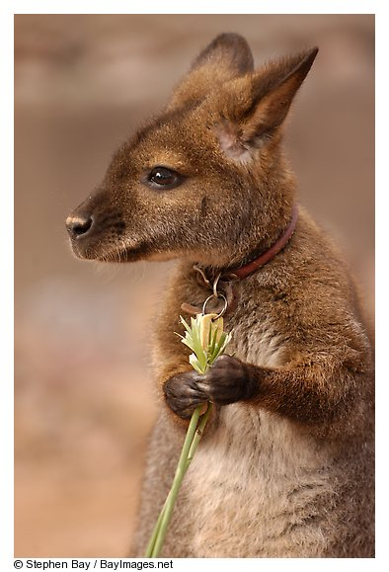
Marsupialia: Diprotodontia
Australasia
8 families, 120 species
Kangaroos, koalas, wombats, gliders etc.
Diprotodont and syndactylous

Slide 27
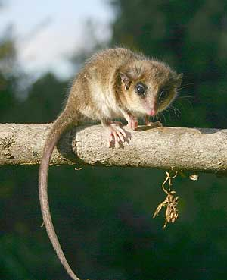
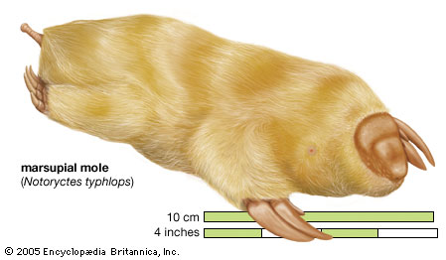
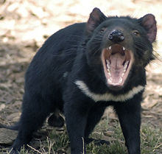
Marsupialia
Paucituberculata (shrew-, rat-opossums) South America
Microbiotheria (monito del monte) South America
Dasyuromorphia (carnivorous marsupials) Australasia
Peramelemorphia (bandicoots, bilbies) Australasia
Notoryctomorphia (marsupial moles) Australasia

Slide 28
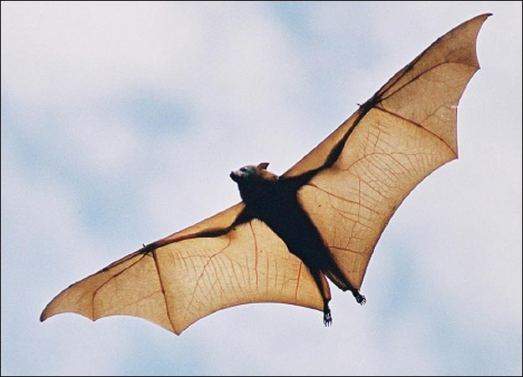
Eutheria
18 Orders, 89 Families, ~4000 species
Worldwide in distribution
High metabolism and activity
Distinguished from non-Eutherian mammals
Limbs, jaws, teeth
auditory bullae
loss of epipubic bones
reproduction

Slide 29
Eutherian Reproduction
Single vagina but bipartite uterus (in most)
Prolonged gestation
Complex well developed placenta
Choriovitelline and Chorioallantoic placentas
Neonates either altricial or precocial
Lactation necessary but duration shorter than gestation

Slide 30
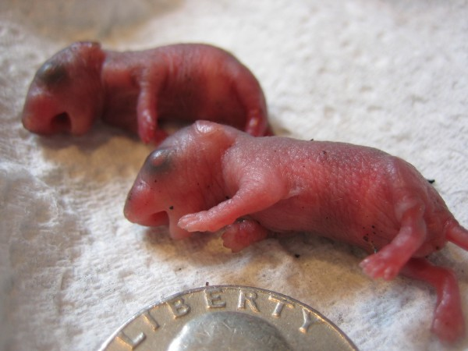
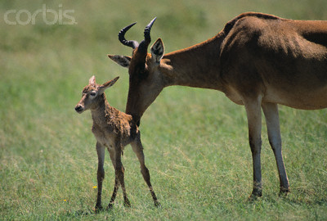

Slide 31
Eutheria: Eulipotyphla
All continents except Australia, SA and Antarctica
2 g to 1 kg
Diverse
6 families, 350 spp, including shrews, moles, hedgehogs
Fossorial, semi-fossorial, terrestrial
Pinnae and eyes absent or reduced

Slide 32
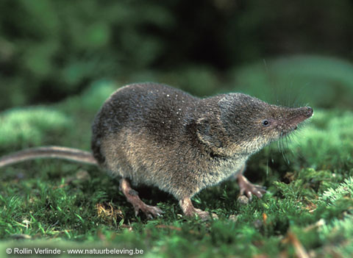
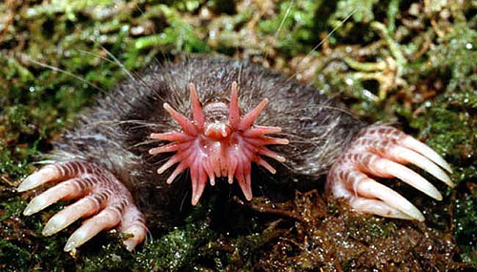
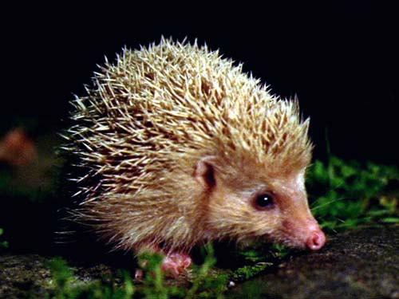

Slide 33
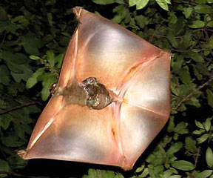
Eutheria: Dermoptera
Colugos, "flying lemurs"
Family: Cynocephalidae (“skin-winged”)
Indonesia
Arboreal folivores
Patagium for gliding
To .5 m, 2 kg

Slide 34
Eutheria: Dermoptera

Slide 35
Eutheria: Chiroptera
Worldwide except Antarctica
Powered flight – key innovation
Megachiroptera (Old World fruit bats)
Family: Pteropodidae (166 species)
Fruit eaters, large size, no echolocation
Microchiroptera
16 families, ~ 760 species
Diverse ecologies and life histories
Eat insects, vertebrates, blood
Echolocation
Yinpterochiroptera (megabats+), Yangochiroptera

Slide 36
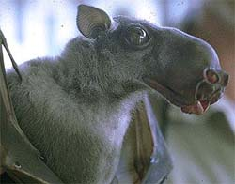
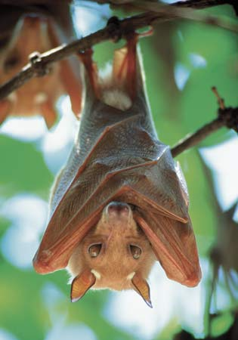
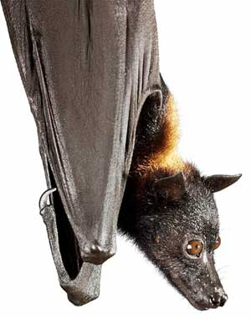

Slide 37
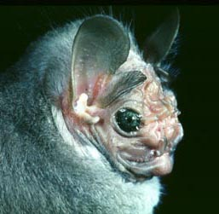
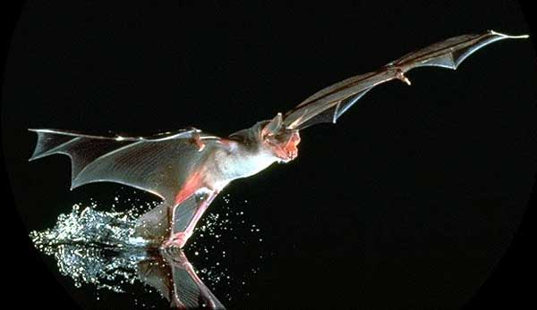
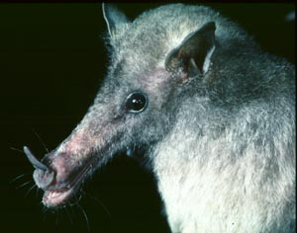

Slide 39
Eutheria: Xenarthra
North and South America
4 families including sloths, anteaters, armadillos
Teeth reduced or absent
Morphologically diverse both fossils and extant
Low metabolic rates, low body temp.
Limited to warm regions
Robust, heavily clawed hands and feet

