Slide 1
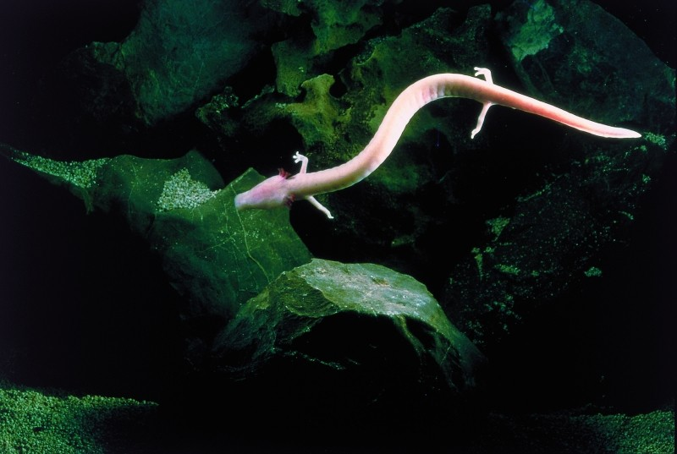

Slide 2
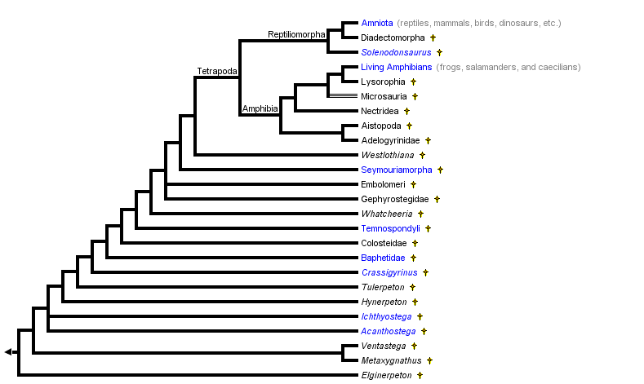

Slide 3
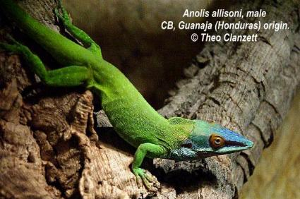
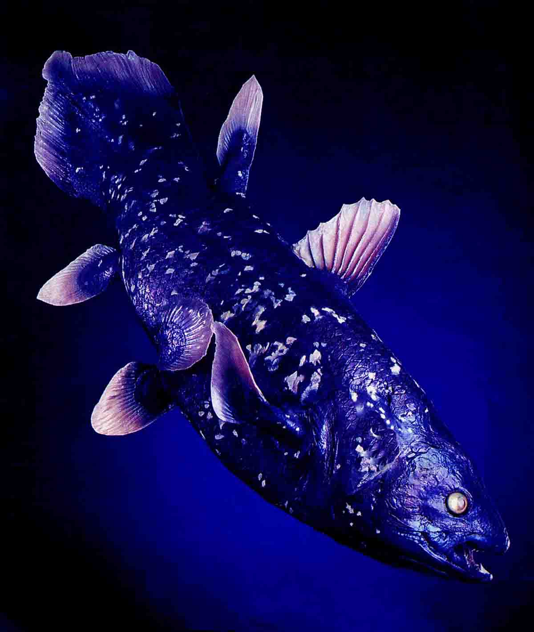
Coelecanths
Lungfishes
Acanthostega
Ichthyostega
Seymouria
Transition to land
Aquatic
Terrestrial or aquatic
Tetrapoda
Transition to terrestrial
Locomotion/support
Respiration
Temperature
Reproduction

Slide 4
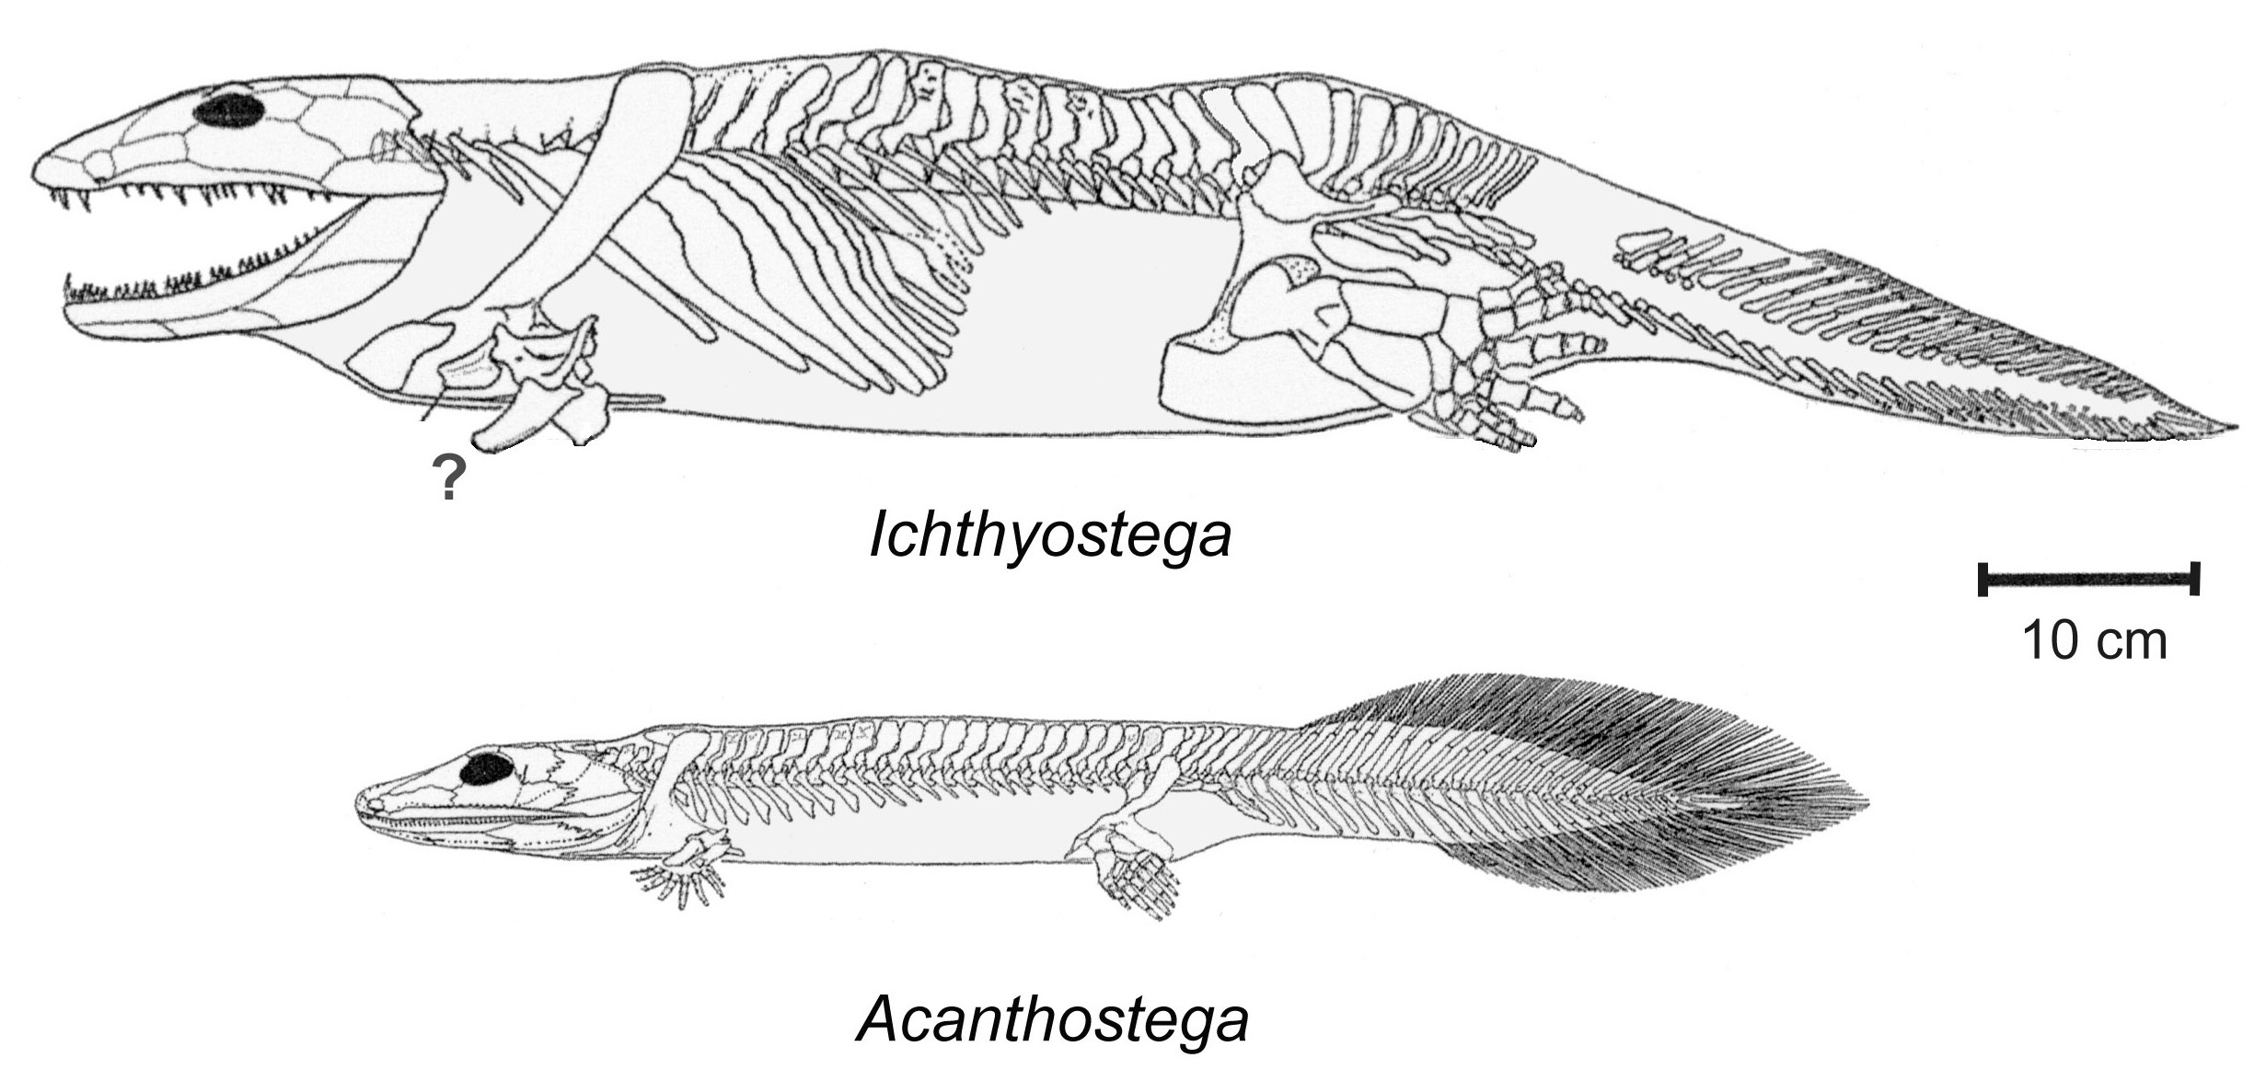
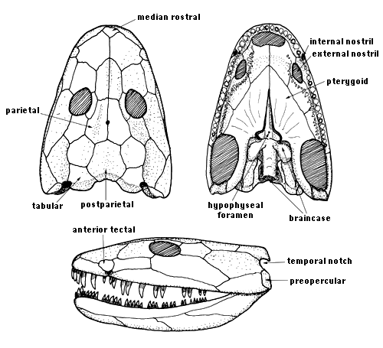

Slide 5
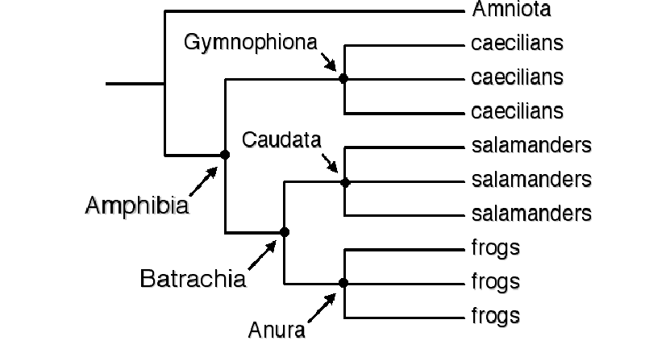
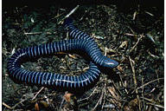
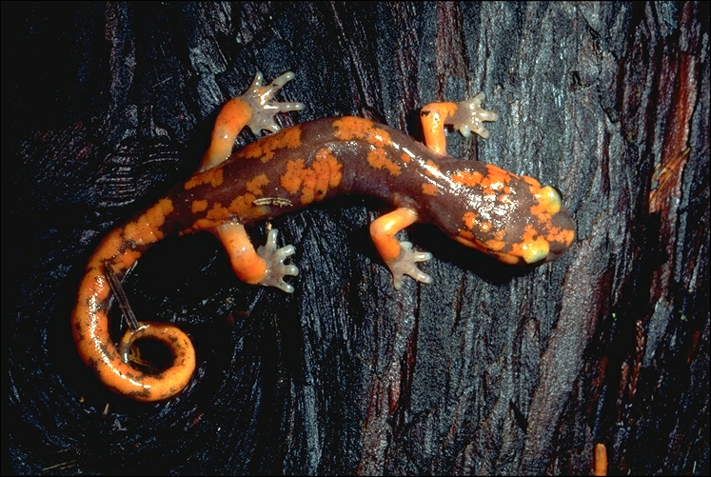
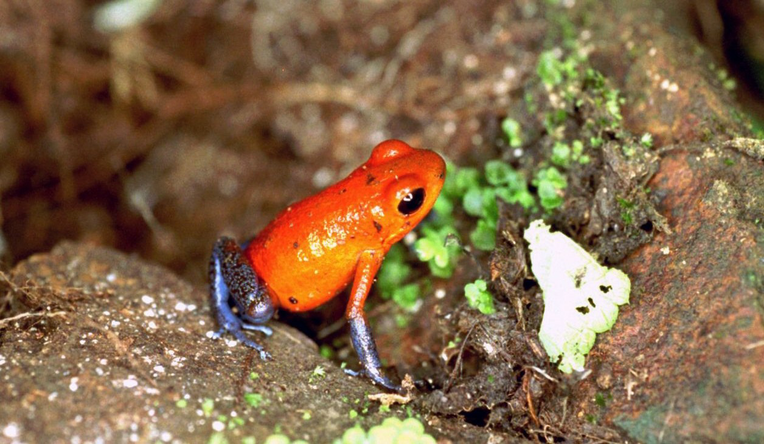
Amphibia

Slide 6
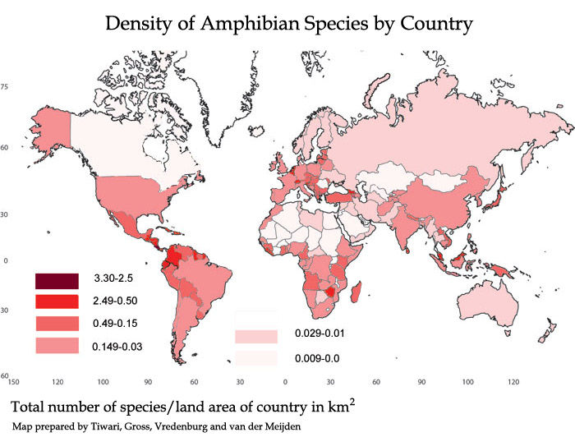

Slide 7
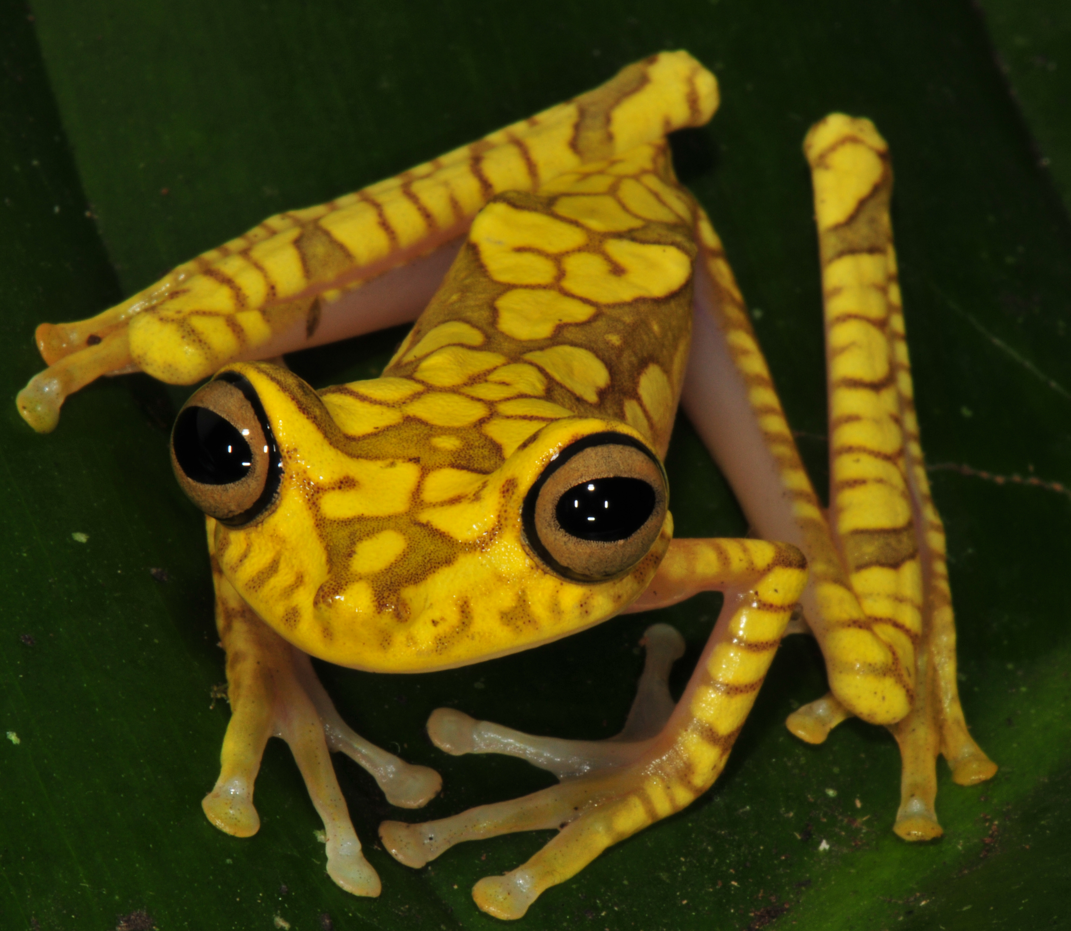
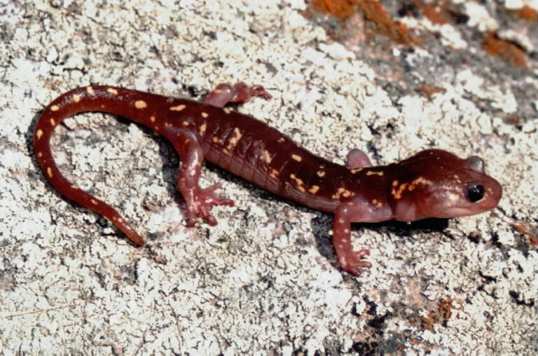
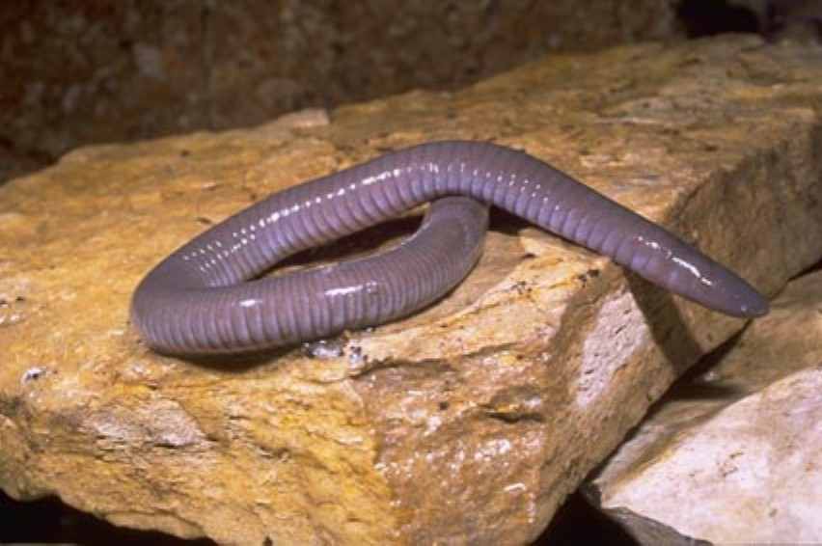
Amphibian synapomorphies
Lungfish
Amniota
Amphibia
Tetrapoda

Slide 8
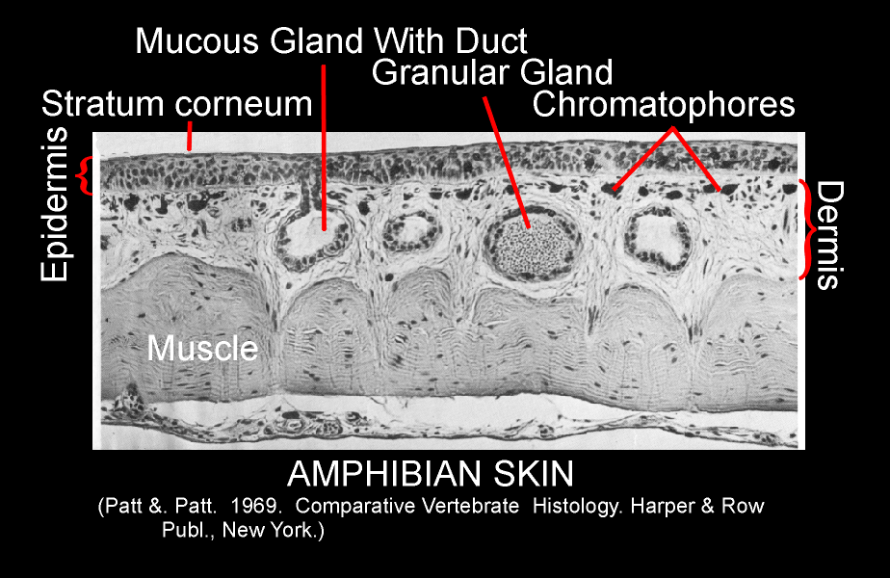
Amphibian synapomorphies
Skin
respiration
mucous glands
poison glands

Slide 9
Amphibian synapomorphies
Skin
respiration
mucous glands
poison glands
pedicellate teeth

Slide 10
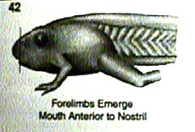
Amphibian synapomorphies
Skin
respiration
mucous glands
poison glands
pedicellate teeth
biphasic lifestyle

Slide 11
Amphibian synapomorphies
Skin
respiration
mucous glands
poison glands
pedicellate teeth
biphasic lifestyle
second hearing system

Slide 12
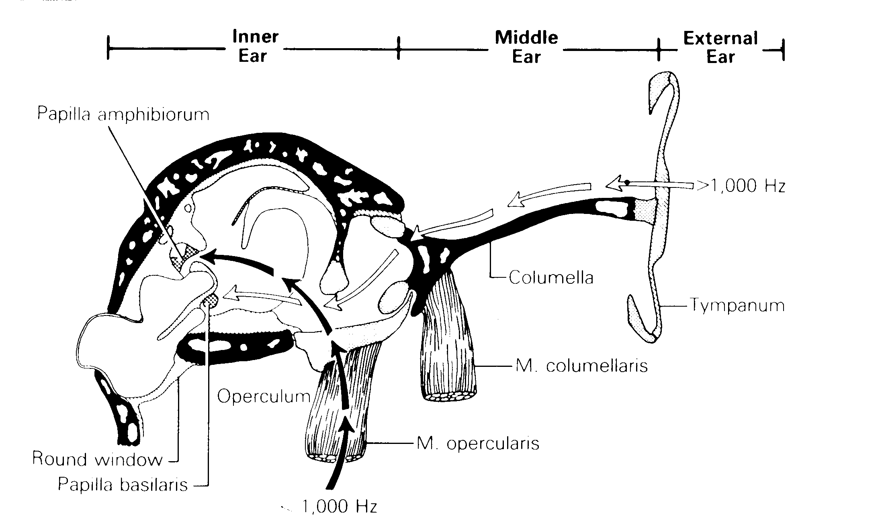

Slide 13
Amphibian synapomorphies
Skin
respiration
mucous glands
poison glands
pedicellate teeth
biphasic lifestyle
second hearing system
unique retinal cells
Green rod
Red rod

Slide 14
Amphibian synapomorphies
Skin
respiration
mucous glands
poison glands
pedicellate teeth
biphasic lifestyle
second hearing system
unique retinal cells
skull
paired occipital condyles
reduction/loss of bones
paired occipital condyles

Slide 15
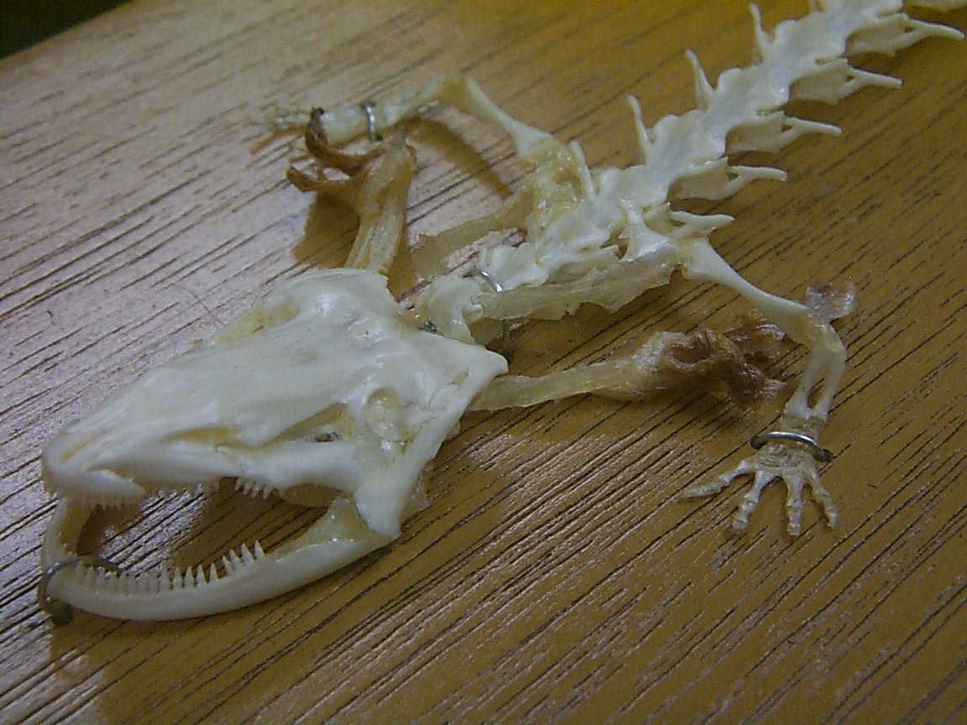
Amphibian synapomorphies
Skin
respiration
mucous glands
poison glands
pedicellate teeth
biphasic lifestyle
second hearing system
unique retinal cells
skull
paired occipital condyles
reduction/loss of bones
orientation of stapes
short ribs
four digits on hand

Slide 16
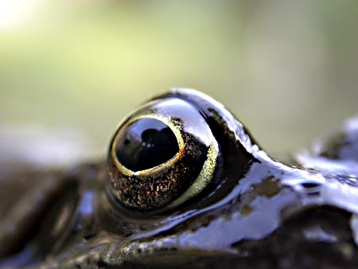
Amphibian synapomorphies
Skin
respiration
mucous glands
poison glands
pedicellate teeth
biphasic lifestyle
second hearing system
unique retinal cells
skull
paired occipital condyles
reduction/loss of bones
orientation of stapes
short ribs
four digits on hand
levator bulbi muscle

Slide 17
Relationships of the amphibian clades
Anura
Caudata
Gymnophiona
Caudata
Anura
Gymnophiona
Gymnophiona
Caudata
Anura
Morphology
(e.g., Duellman and
Trueb, 1986)

Slide 18
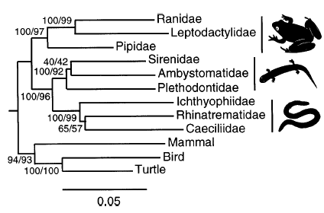
Molecular evidence shakes up the amphibian tree
Hay et al. 1995
1995
One mtDNA gene
850 bp
28 of 40 Families sampled
Parsimony and distance analyses
Feller and Hedges 1998
1998
Four mtDNA genes
2700 bp
Parsimony, distance (neighbor joiningj), and Bayesian analyses

Slide 19
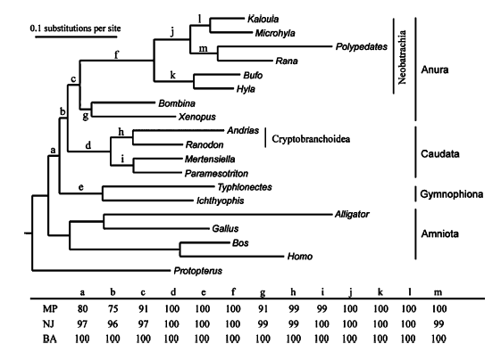
Full mitochondrial genomes
(~15000 bp)
Parsimony, distance (nj), and Bayesian analyses
2005

Slide 20
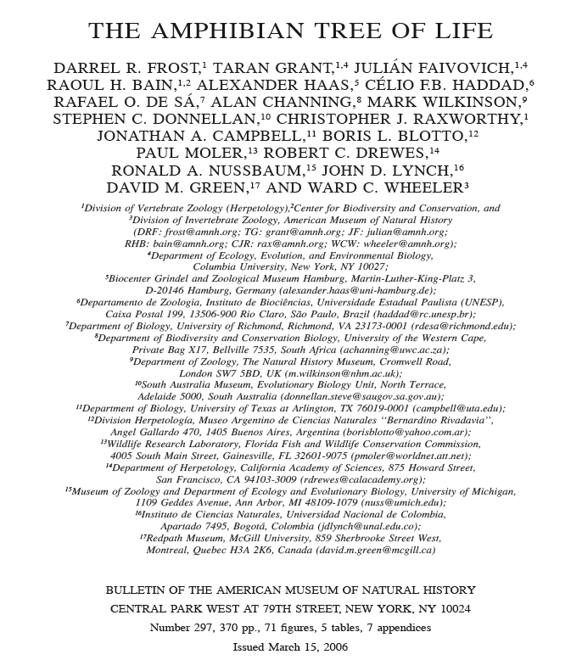
522 species
2400 bp mtDNA
2300 bp nDNA
156 morph characters
Parsimony analysis
Gymnophiona
Caudata
Anura

Slide 21
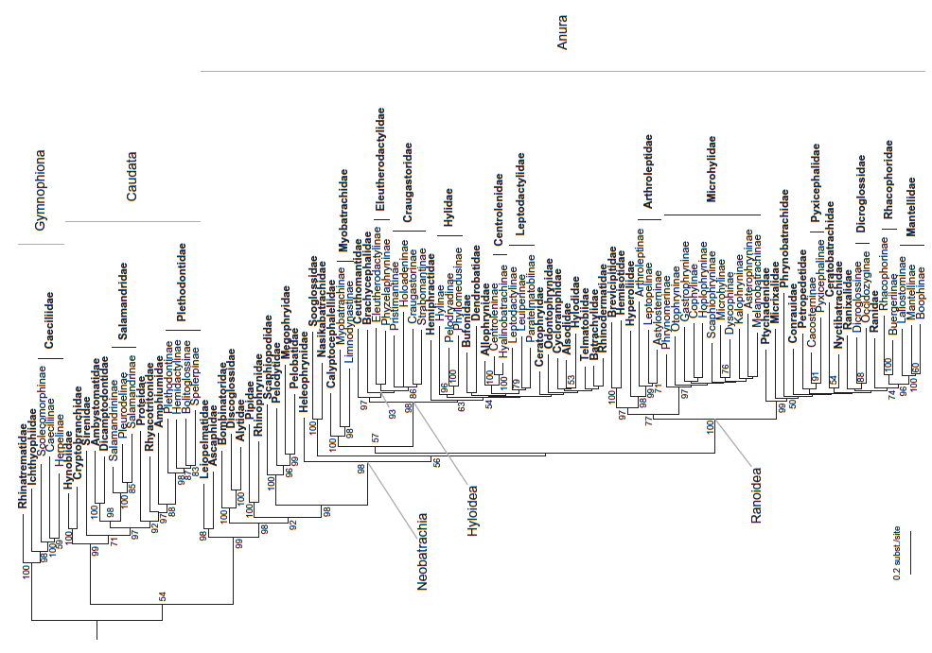
3 genes mtDNA
9 genes nDNA
likelihood

Slide 22
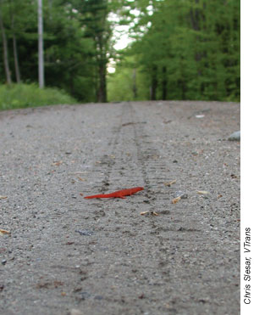

Slide 23
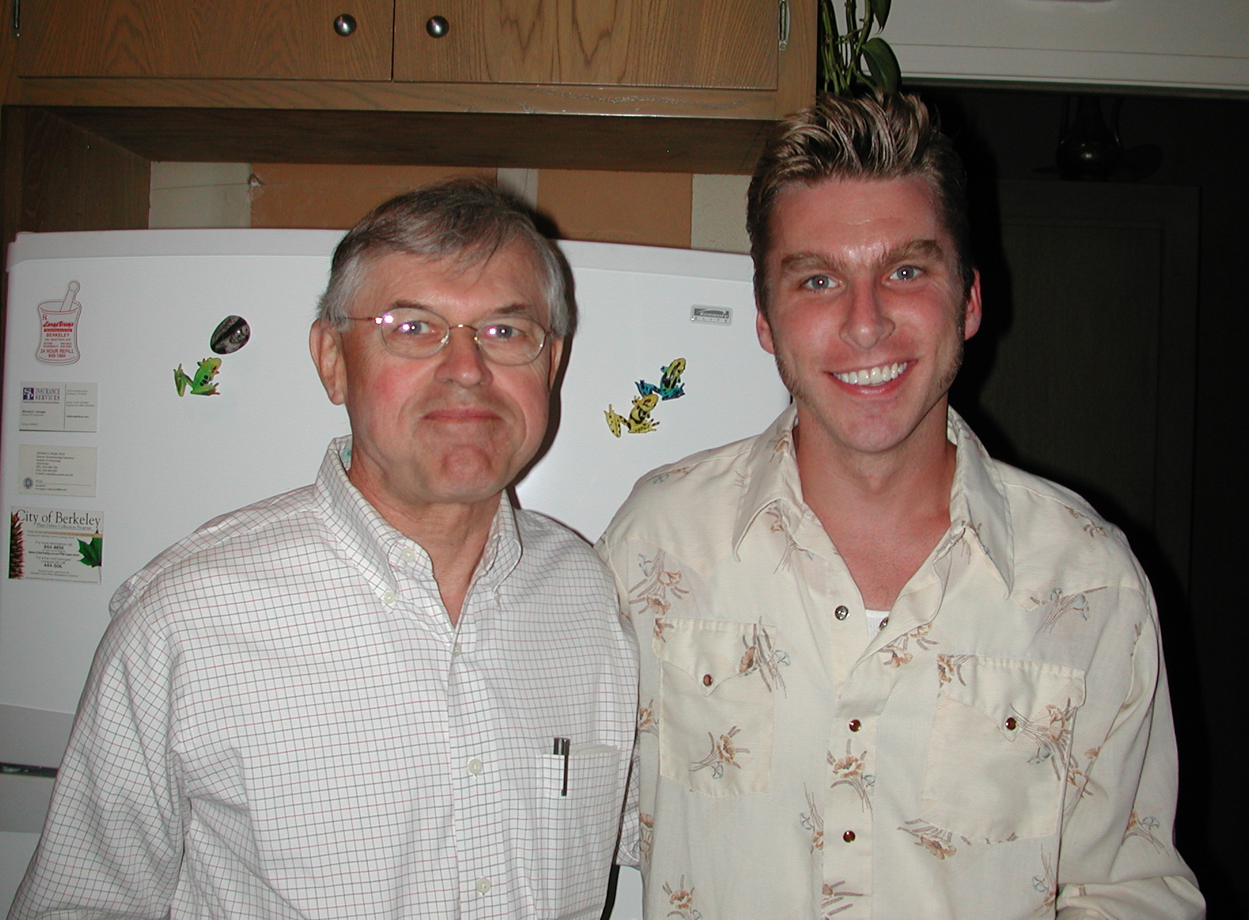
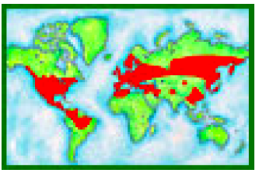
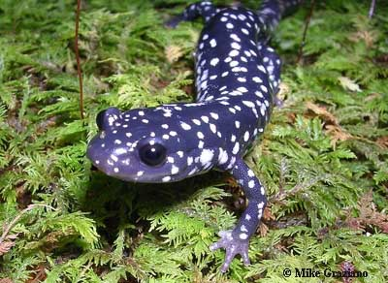
Caudata: node-based name for salamanders
Urodela: stem-based name for salamanders
10 families, 675 species

Slide 24
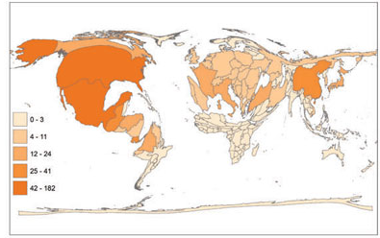

Slide 25
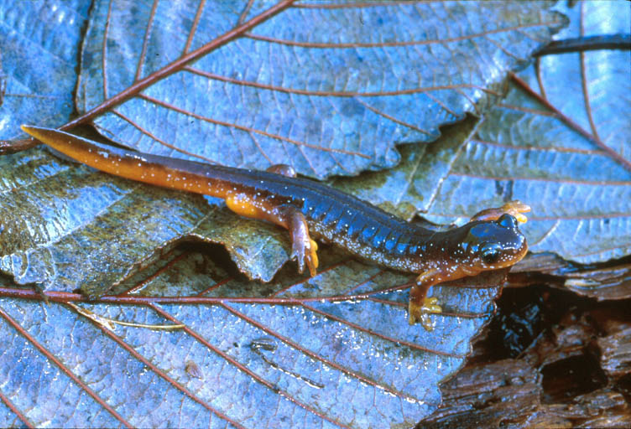
Salamander characteristics
Tailed, most with four limbs of approximately equal length, four digits on front limbs, five digits on hindlimbs
Aquatic, terrestrial/fossorial, arboreal
Breathe through lungs, gills, and/or skin
Sprawling gait
Large genome
15-90 pg (humans: 3pg)
Diverse life cycles,
reproductive modes
Skull: absence of postorbital,
supratemporal, jugal, supraoccipital,
basioccipital, ectopterygoid

Slide 26
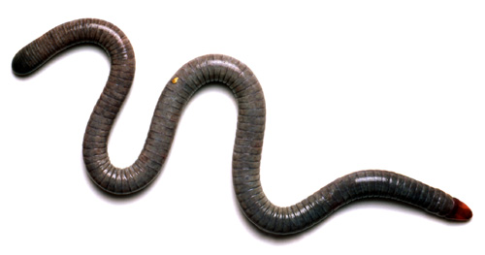
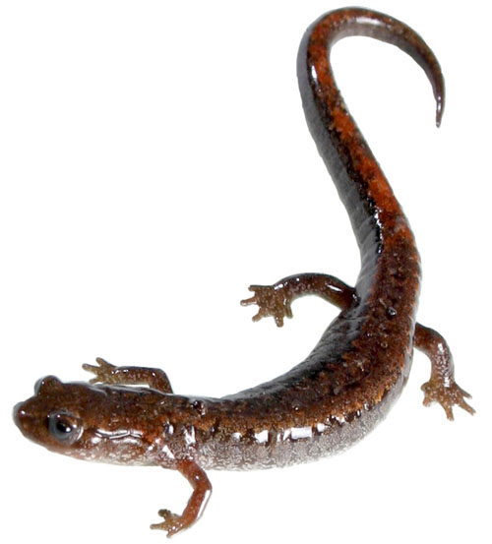
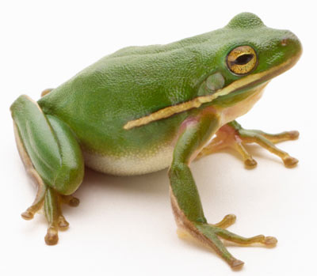
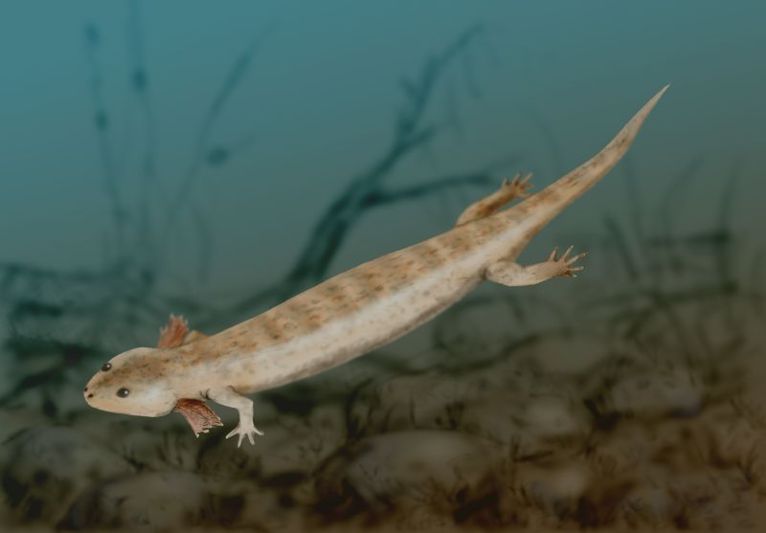

Slide 27
Loss of limbs
Tail reduced
Cylindrical body
Sprawling gait
Long tail
Hindlimbs = forelimbs
Upright posture
Loss of tail
Hindlimbs > forelimbs
Sprawling gait
Long tail
Hindlimbs = forelimbs

Slide 28
