Slide 1
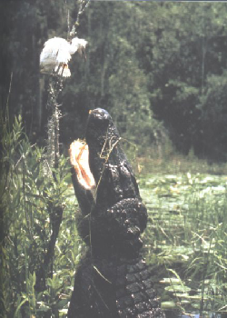
Crocodylians

Slide 2
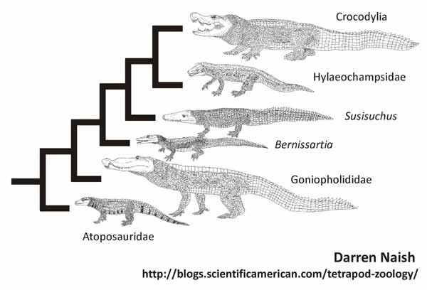

Slide 3
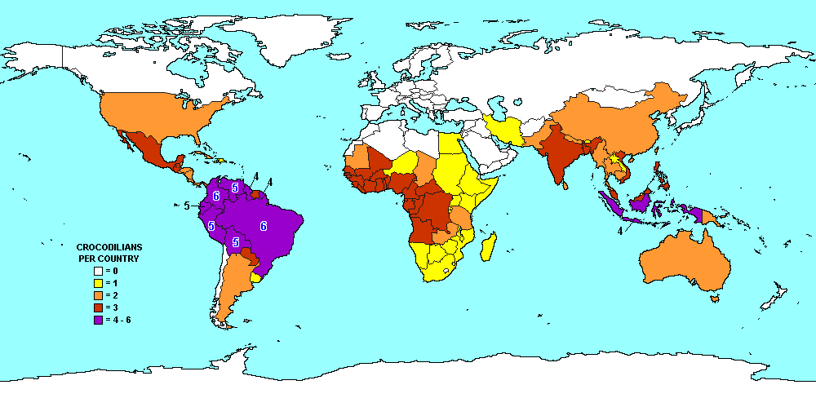

Slide 4
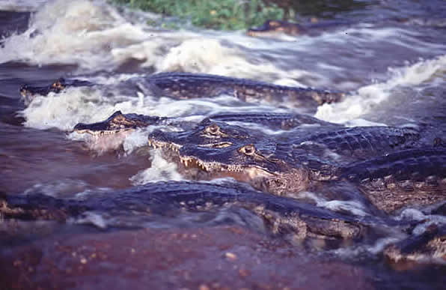
Crocodylian characteristics
Large body size
Semiaquatic
Laterally compressed tail, webbed feet
Dorsal scales heavily ossified
Share skeletal/behavioral characteristics with birds, dinosaurs (Archosauria)
Apex predators, Keystone species
Complex social behaviors
Locomotion: belly crawl, high walk, gallop, swim, leap

Slide 5
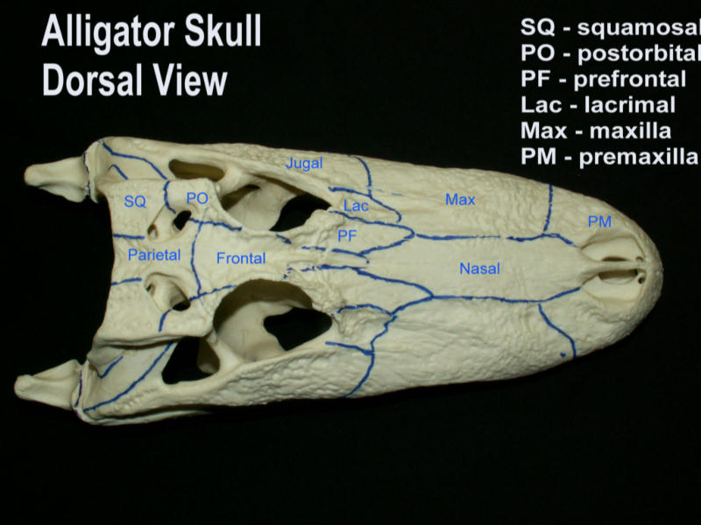
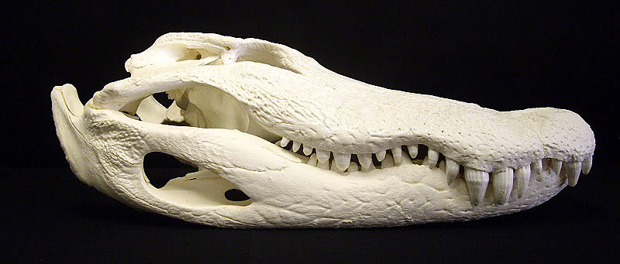
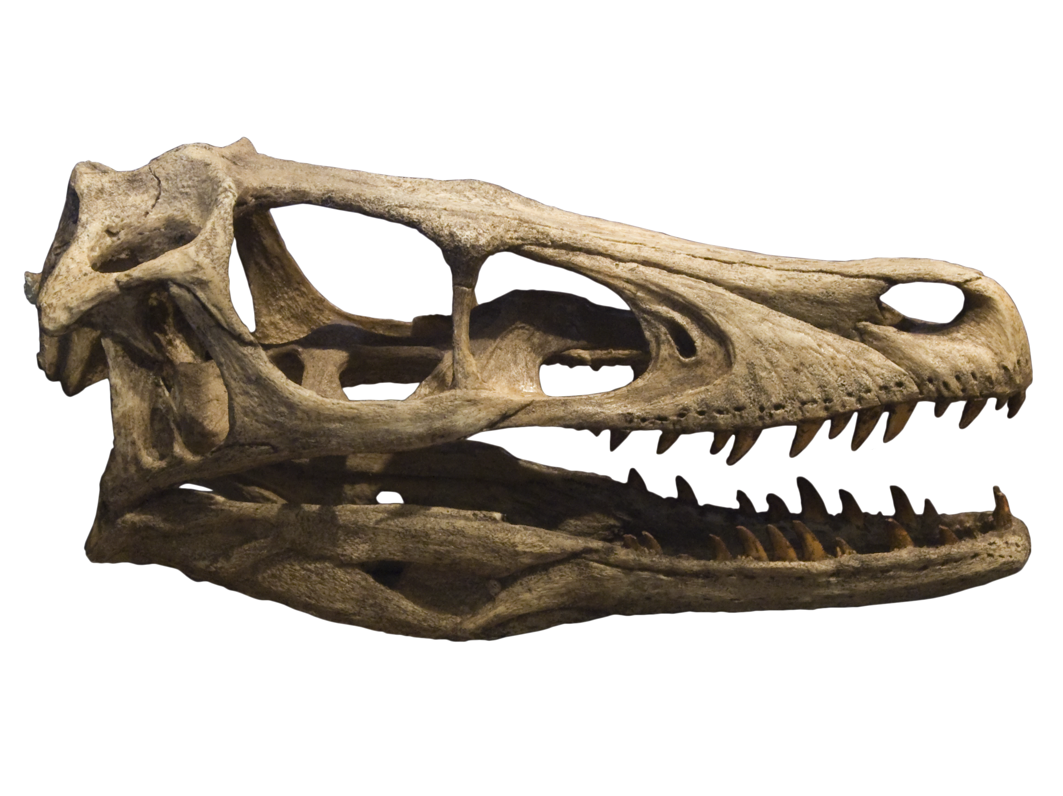
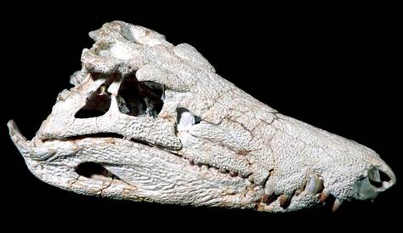

Slide 6
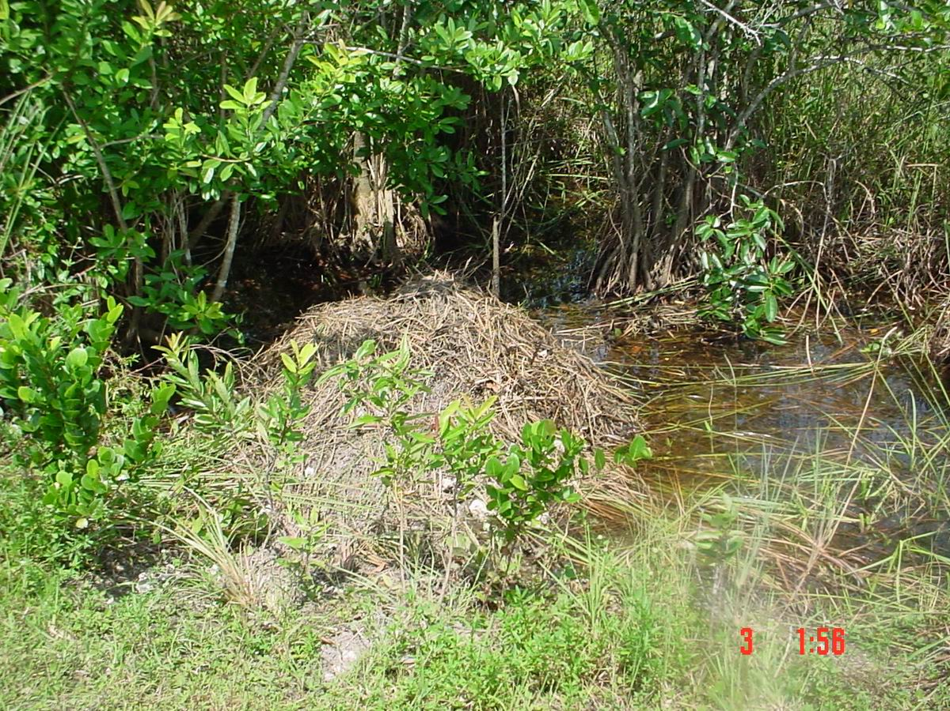
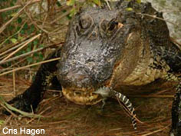
Crocodylian reproduction
Internal fertilization
Oviparous
Temperature dependent sex determination
Nest building
Parental care

Slide 7
Variation within Crocodylia
Body size
Head shape
Nuchal scales
Teeth pattern
Aquatic habitat
Dirt/veg nest
Structure of parental care

Slide 8
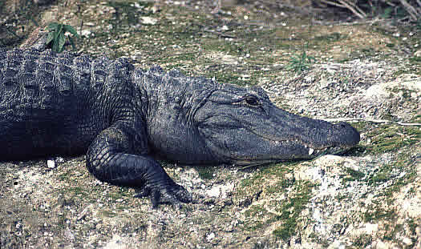
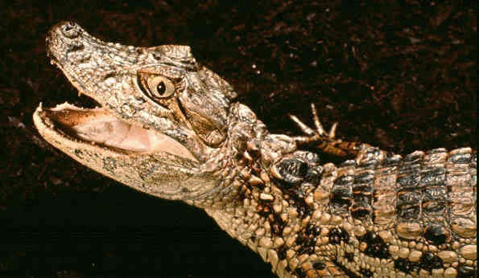
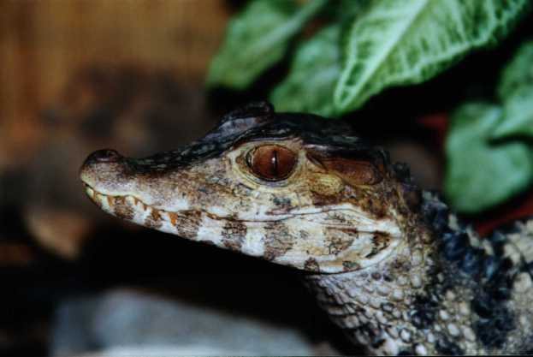
Crocodylia
Alligatoridae
Alligator (2 sp), Caiman (4 sp; including Melanosuchus), Paleosuchus (2 sp)
Alligator mississippiensis
Caiman latirostris
Paleosuchus palpebrosus

Slide 9
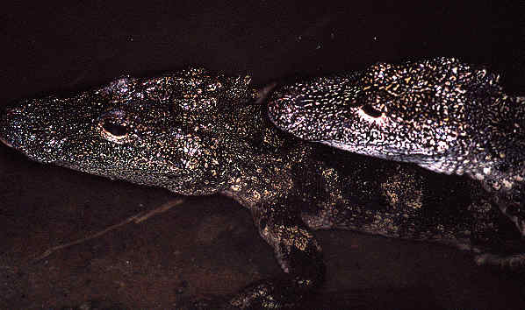
Alligator sinensis

Slide 10
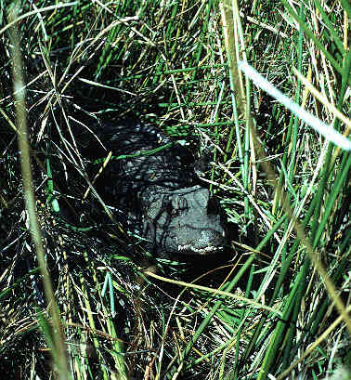
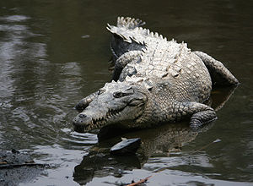
Crocodylia
Crocodylidae
Crocodylus (12 sp), Osteolaemus, Mecistops
Osteolaemus tetraspis
Crocodylus acutus

Slide 11
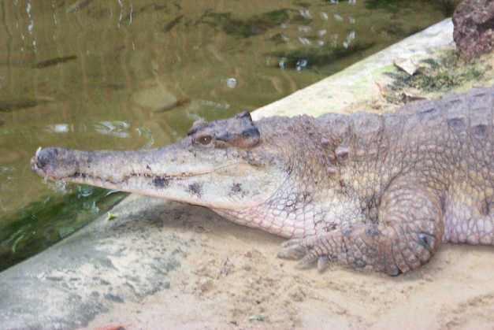
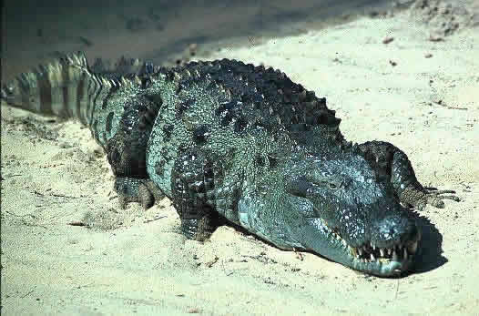
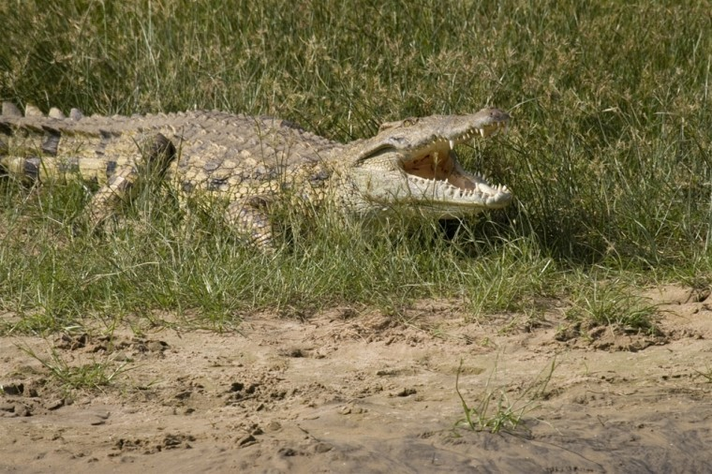
Crocodylus/Mecistops cataphractus
Crocodylus palustris
Crocodylus niloticus

Slide 12
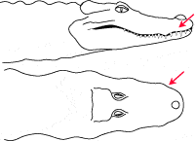
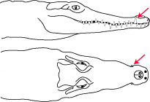
4th tooth visible

Slide 13
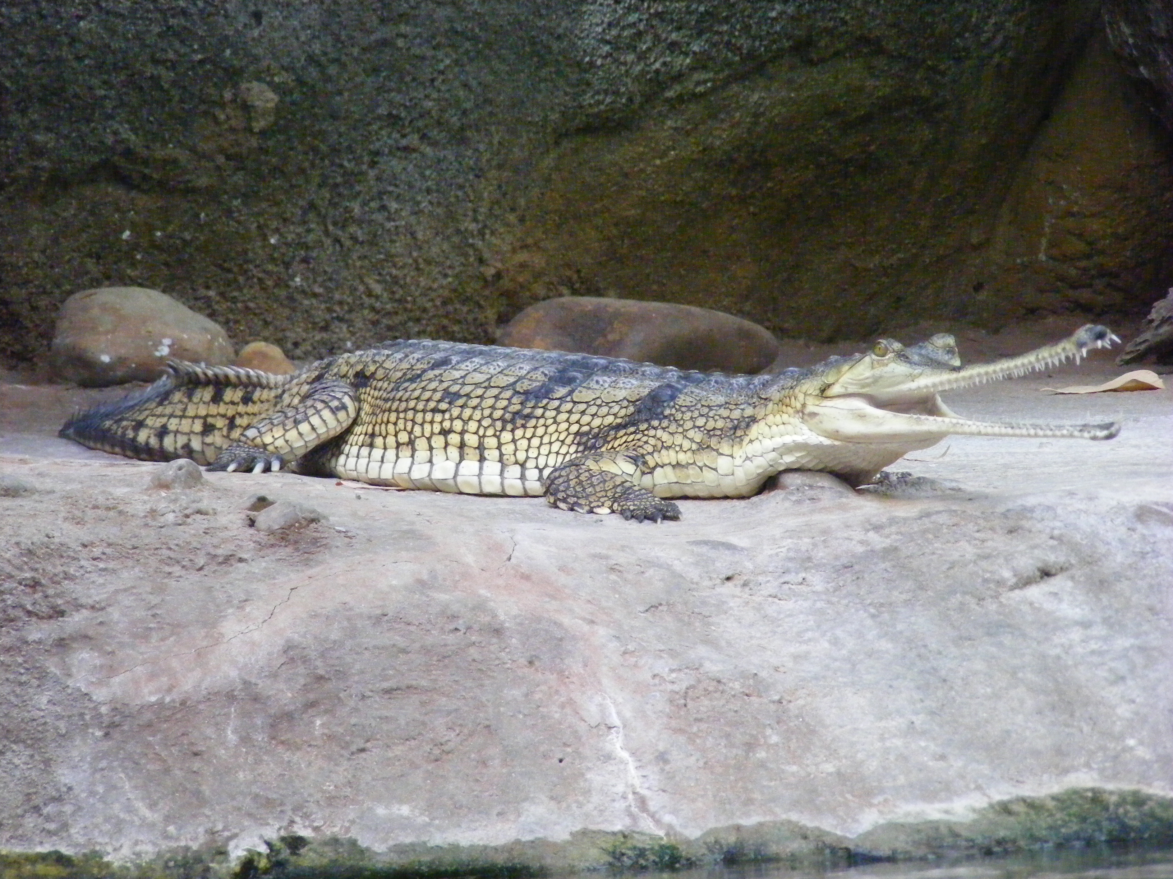
Crocodylia
Gavialis gangeticus

Slide 14
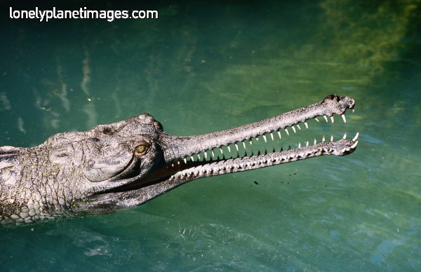
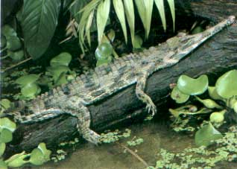
Crocodylia
Tomistoma schlegelii

Slide 15
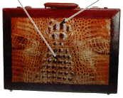
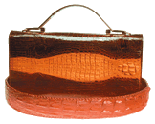
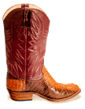
Crocodylian conservation: A success story?
1971: all 23 species considered endangered
today: 7 species endangered; 18 not endangered, including
8 where controlled hunting is allowed.

Slide 16
