Slide 1
Testing hypotheses with trees 1: character correlation

Slide 2
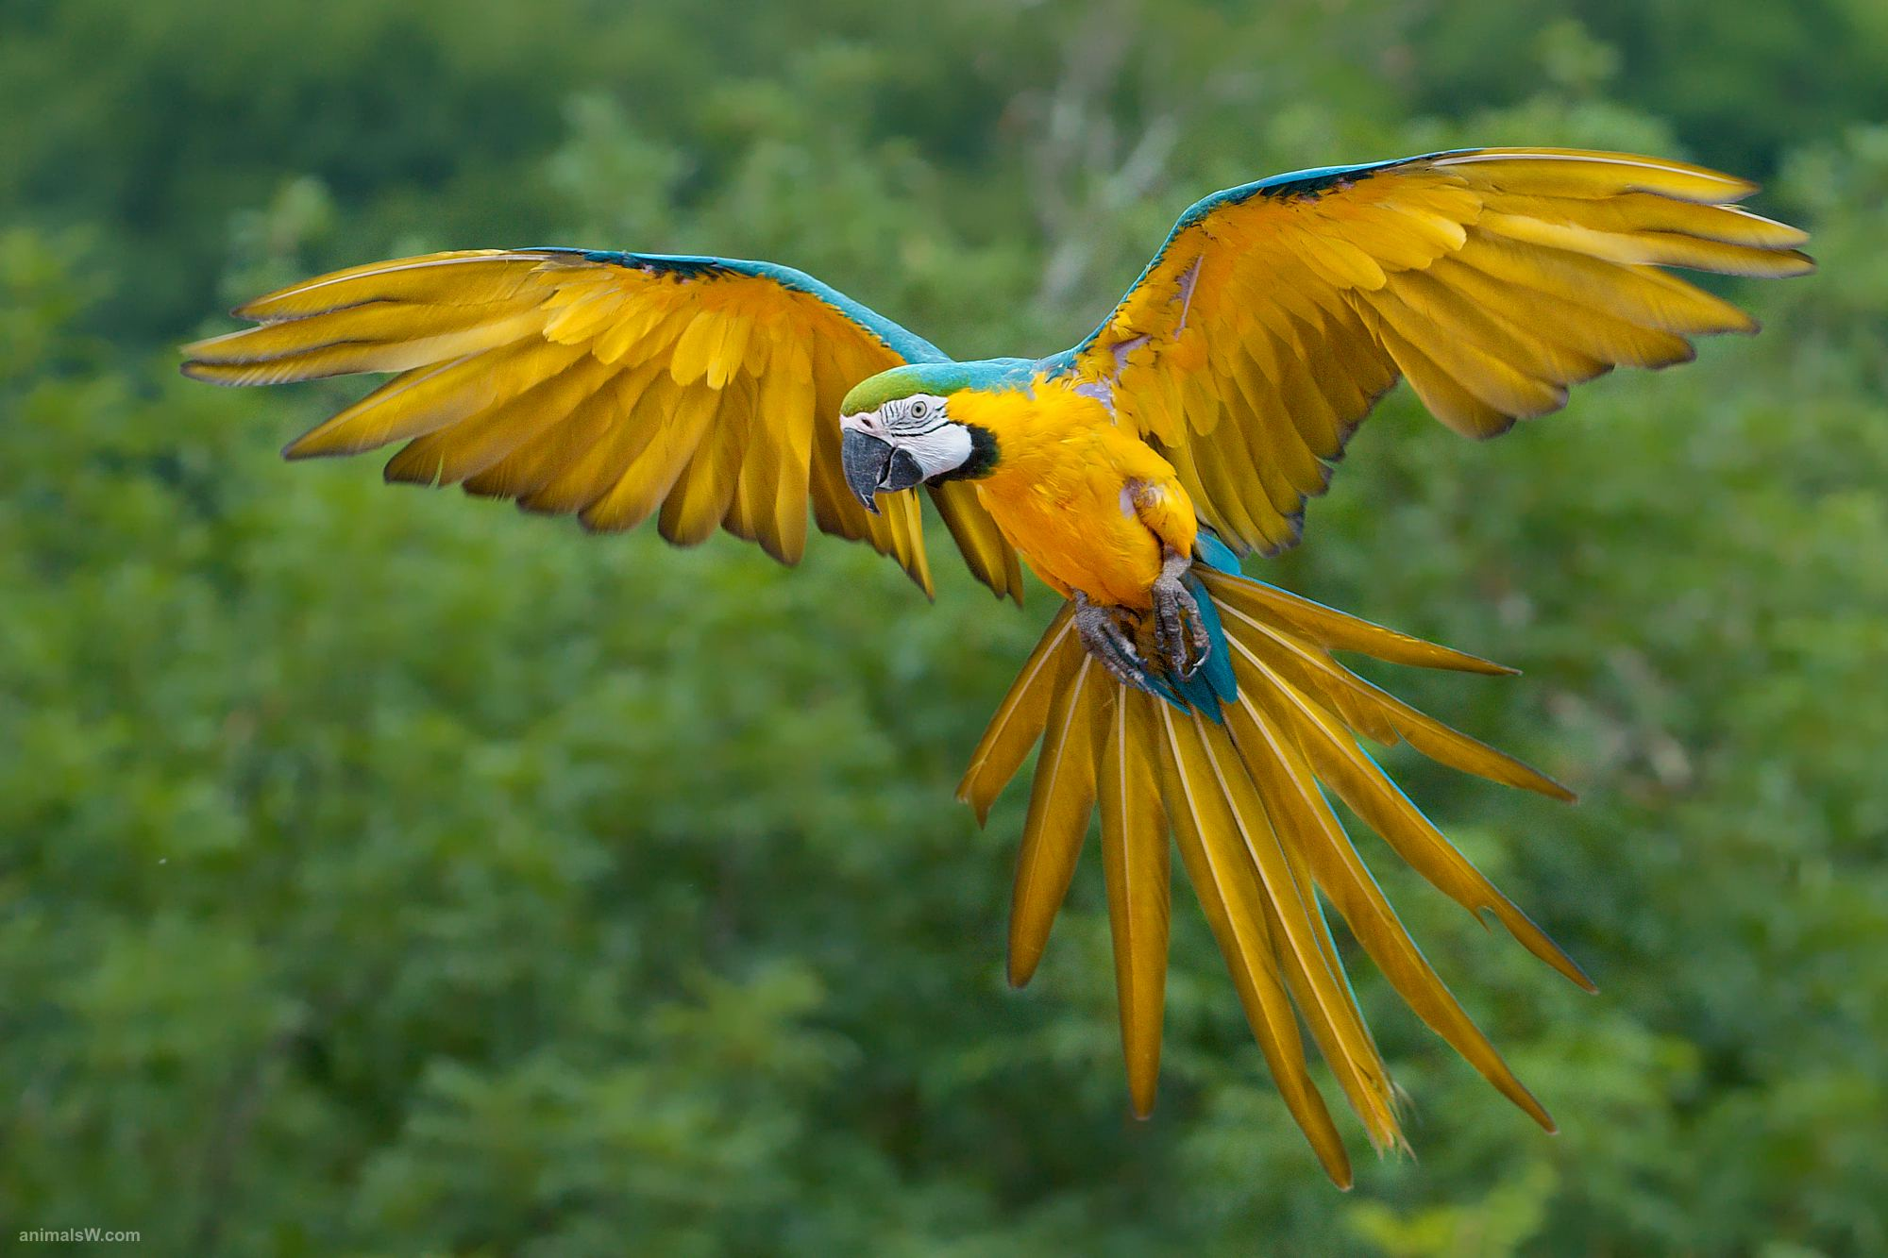
Testing hypotheses with trees 1: character correlation
Are feathers associated with powered flight in vertebrates?

Slide 3
Are feathers associated with powered flight?
Nonphylogenetic approach:
Count # of species of each: feathers + flight, feathers + no flight, no feathers + no flight, no feathers + flight
Test whether
observed feathers + flight >> expected feathers + flight
feathers no feathers
flight P < 0.0001
no flight strong association

Slide 4
Are feathers associated with powered flight?
Phylogenetic approach:
Get phylogenetic tree of vertebrates (e.g., DNA sequences, likelihood)
Note whether each species has feathers, and whether each species flies
Map evolutionary changes to flight, feathers
Test whether flight and feathers tend to evolve on the same branches

Slide 5
Are feathers associated with powered flight?
bats birds
flight
flight
feathers
mammals lizards turtles crocodylians
few data points
no association

Slide 6
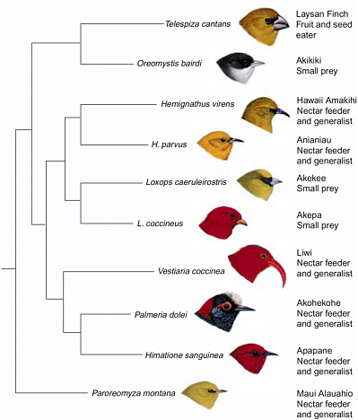
Testing hypotheses with trees 2: Adaptive Radiation

Slide 7
Adaptive Radiation
"Adaptive radiation refers to those evolutionary groups that have exhibited an exceptional extent of adaptive diversification into a variety of ecological niches, with such divergence often occurring extremely rapidly."
Gavrilets and Losos 2009

Slide 8
Adaptive Radiation
"Adaptive radiation refers to those evolutionary groups that have exhibited an exceptional extent of adaptive diversification into a variety of ecological niches, with such divergence often occurring extremely rapidly."
"Adaptive radiation has two components: the production of new species (speciation) and the adaptation of constituent species to a diversity of ecological niches."
Gavrilets and Losos 2009

Slide 9
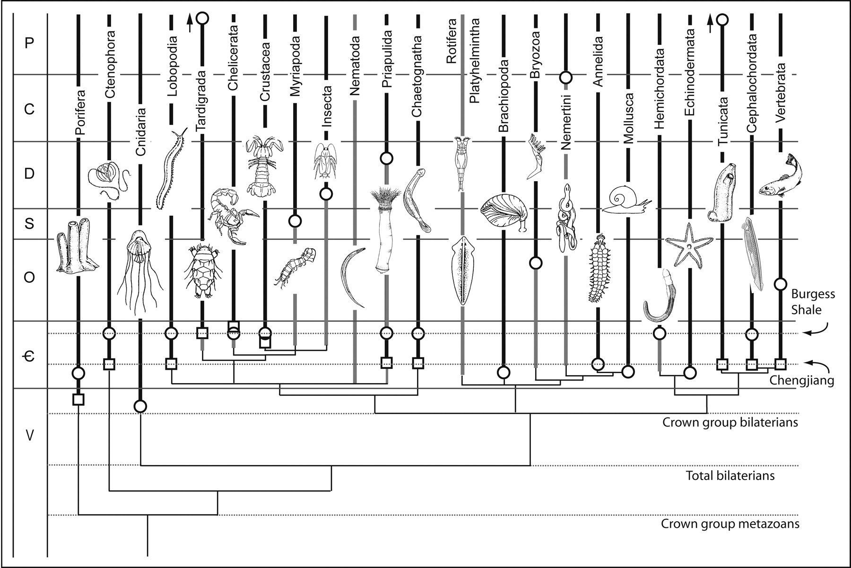
When does adaptive radiation occur?

Slide 10
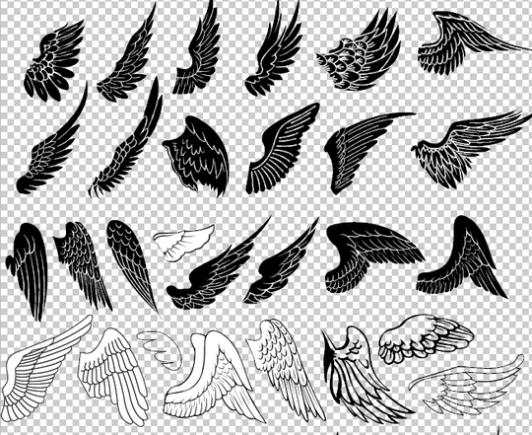
When does adaptive radiation occur?
Ecological opportunity: "an ancestral species finds itself in an environment in which resources are abundant and underutilized." (Schluter 2000)
Colonization of an underpopulated area (lakes, islands)
Extinction of previously
ecologically dominant groups
Key innovation

Slide 11
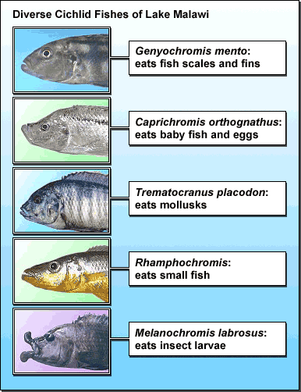
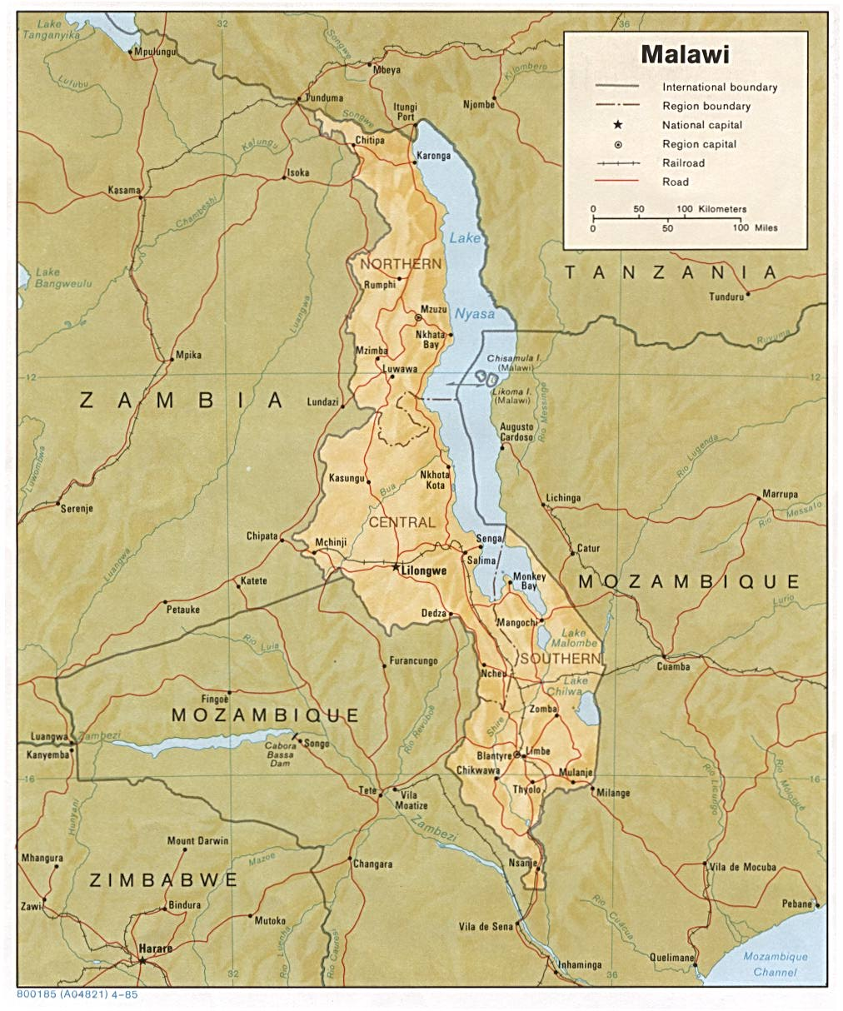
Adaptive Radiation: examples
African lake cichlids

Slide 12
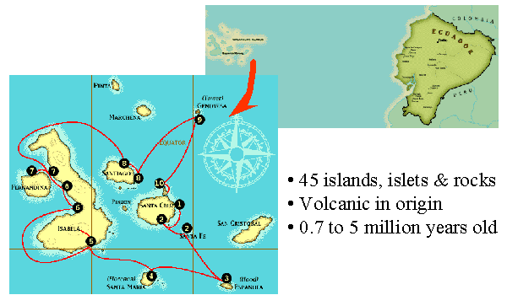
Adaptive Radiation: examples Galapagos finches
One species invaded the Galapagos from South America 2-3 million years ago
Radiation within and among the islands resulted in 14 recognized species
Diversity of beak structures, feeding modes, behaviors--comparable to seven families of South American birds
'Darwin's finches'

Slide 13
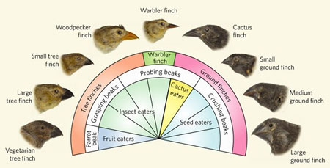

Slide 14
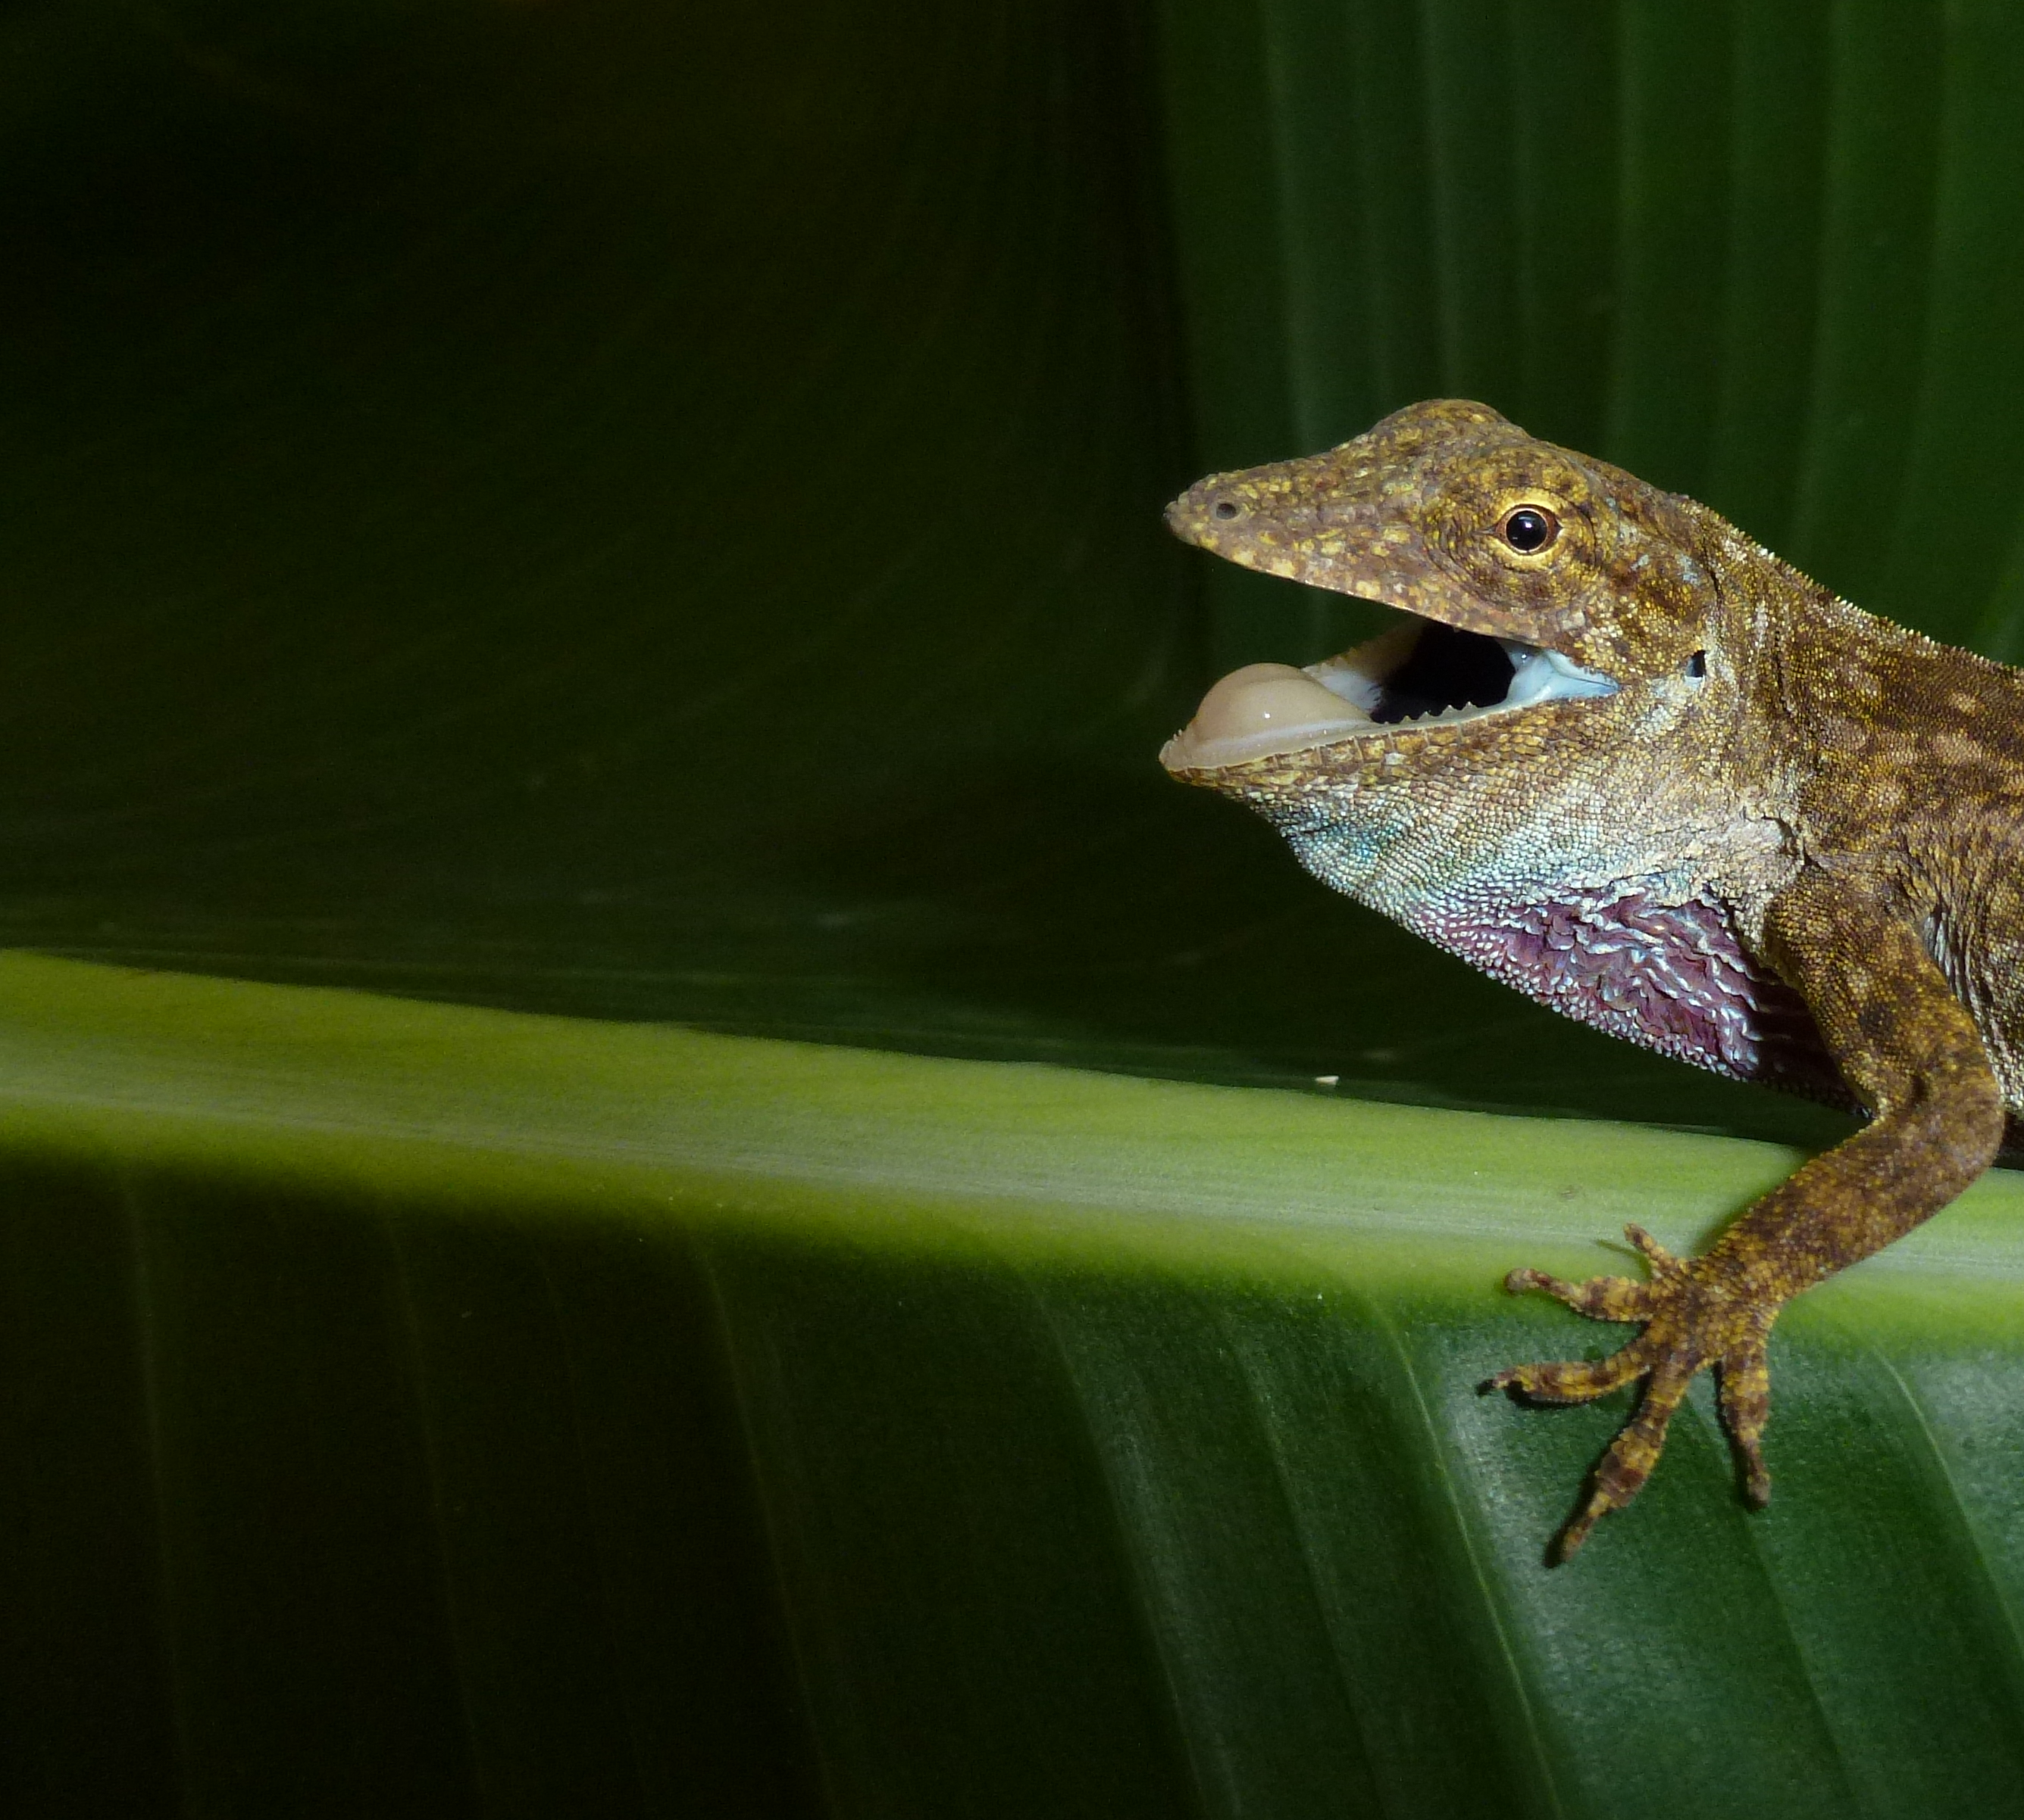
Anolis sympatry
Adaptive radiation:
examples
Greater Antillean Anolis
Notes:
14

Slide 15
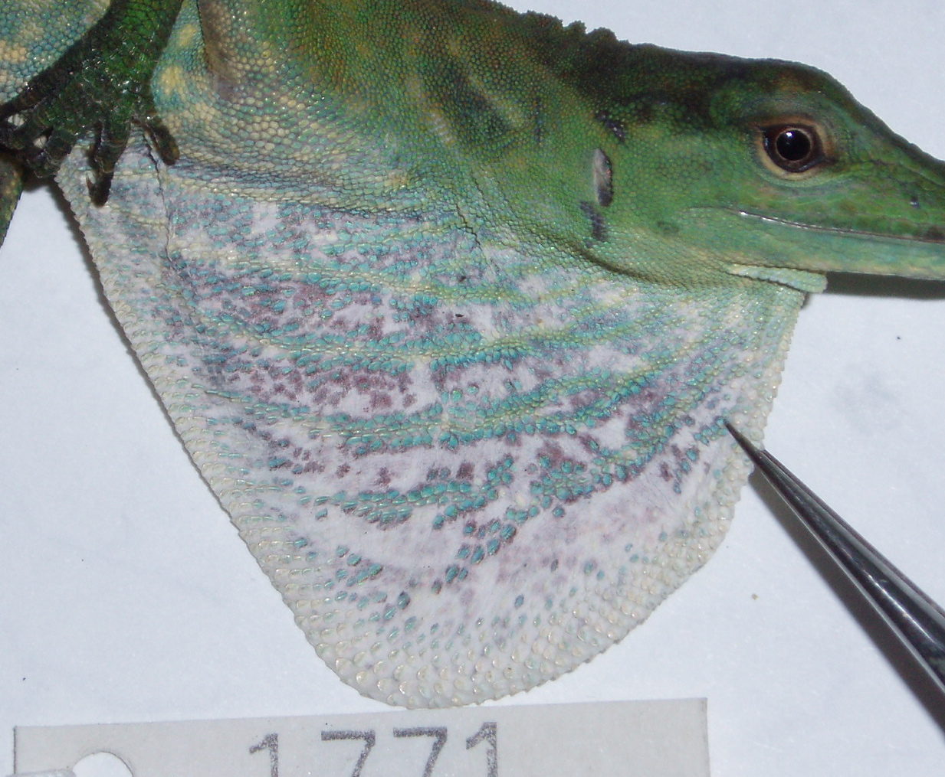
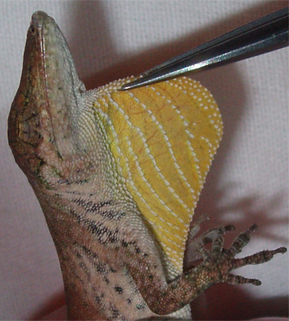
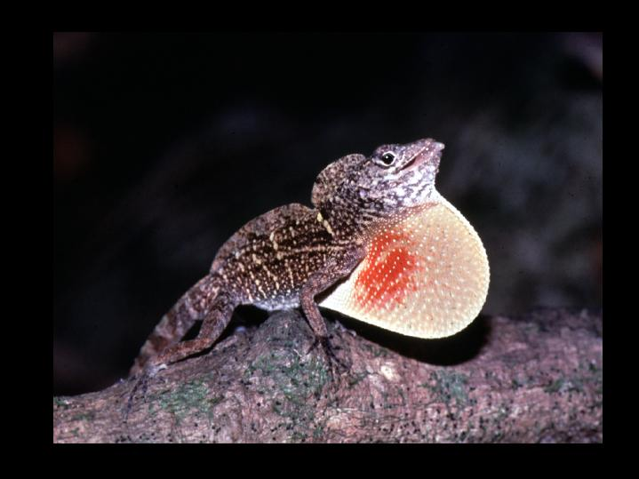
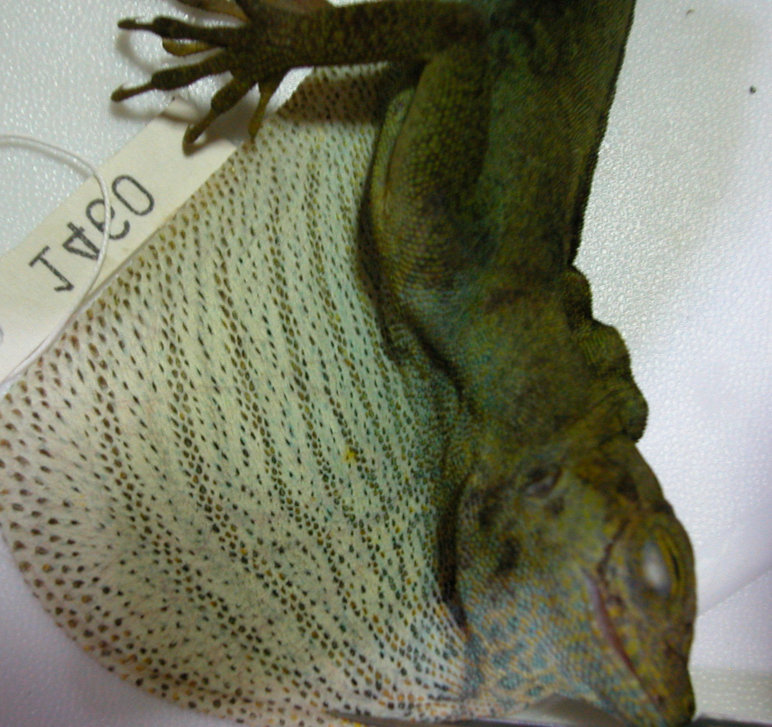
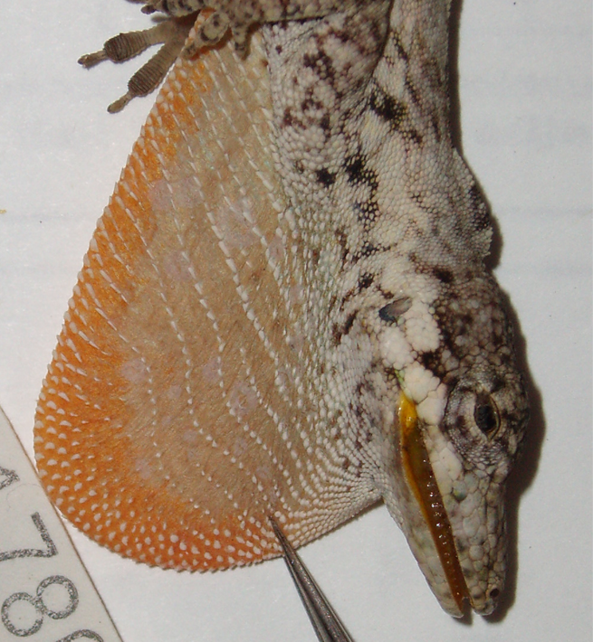
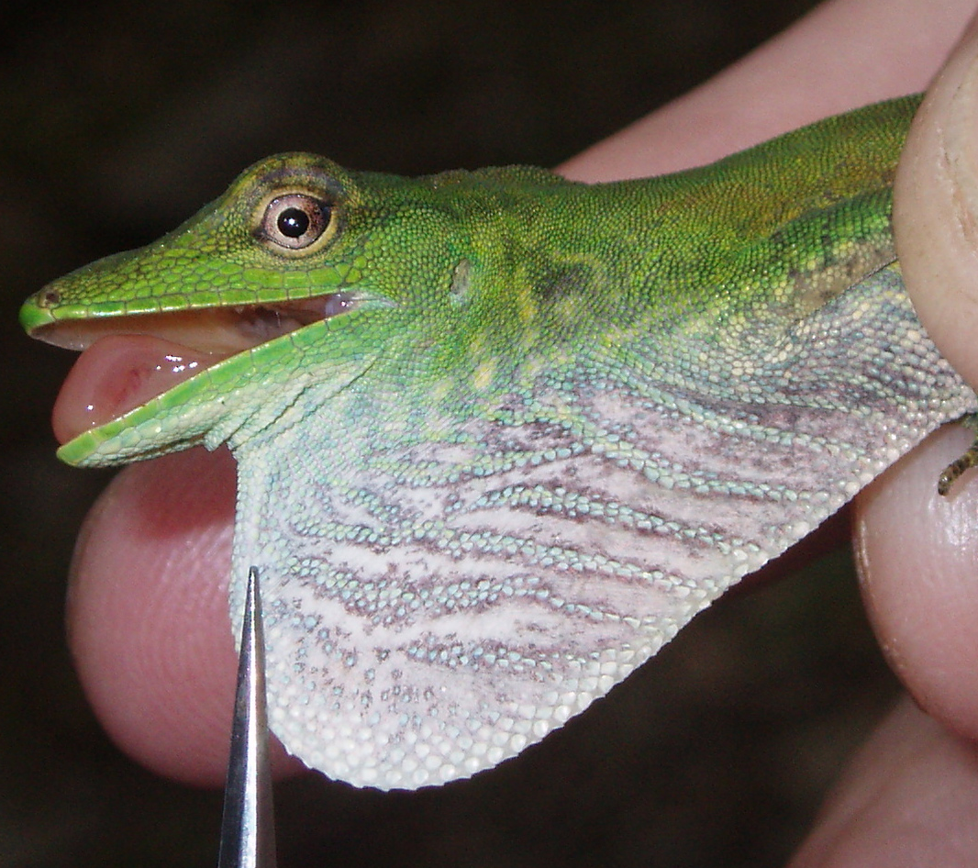
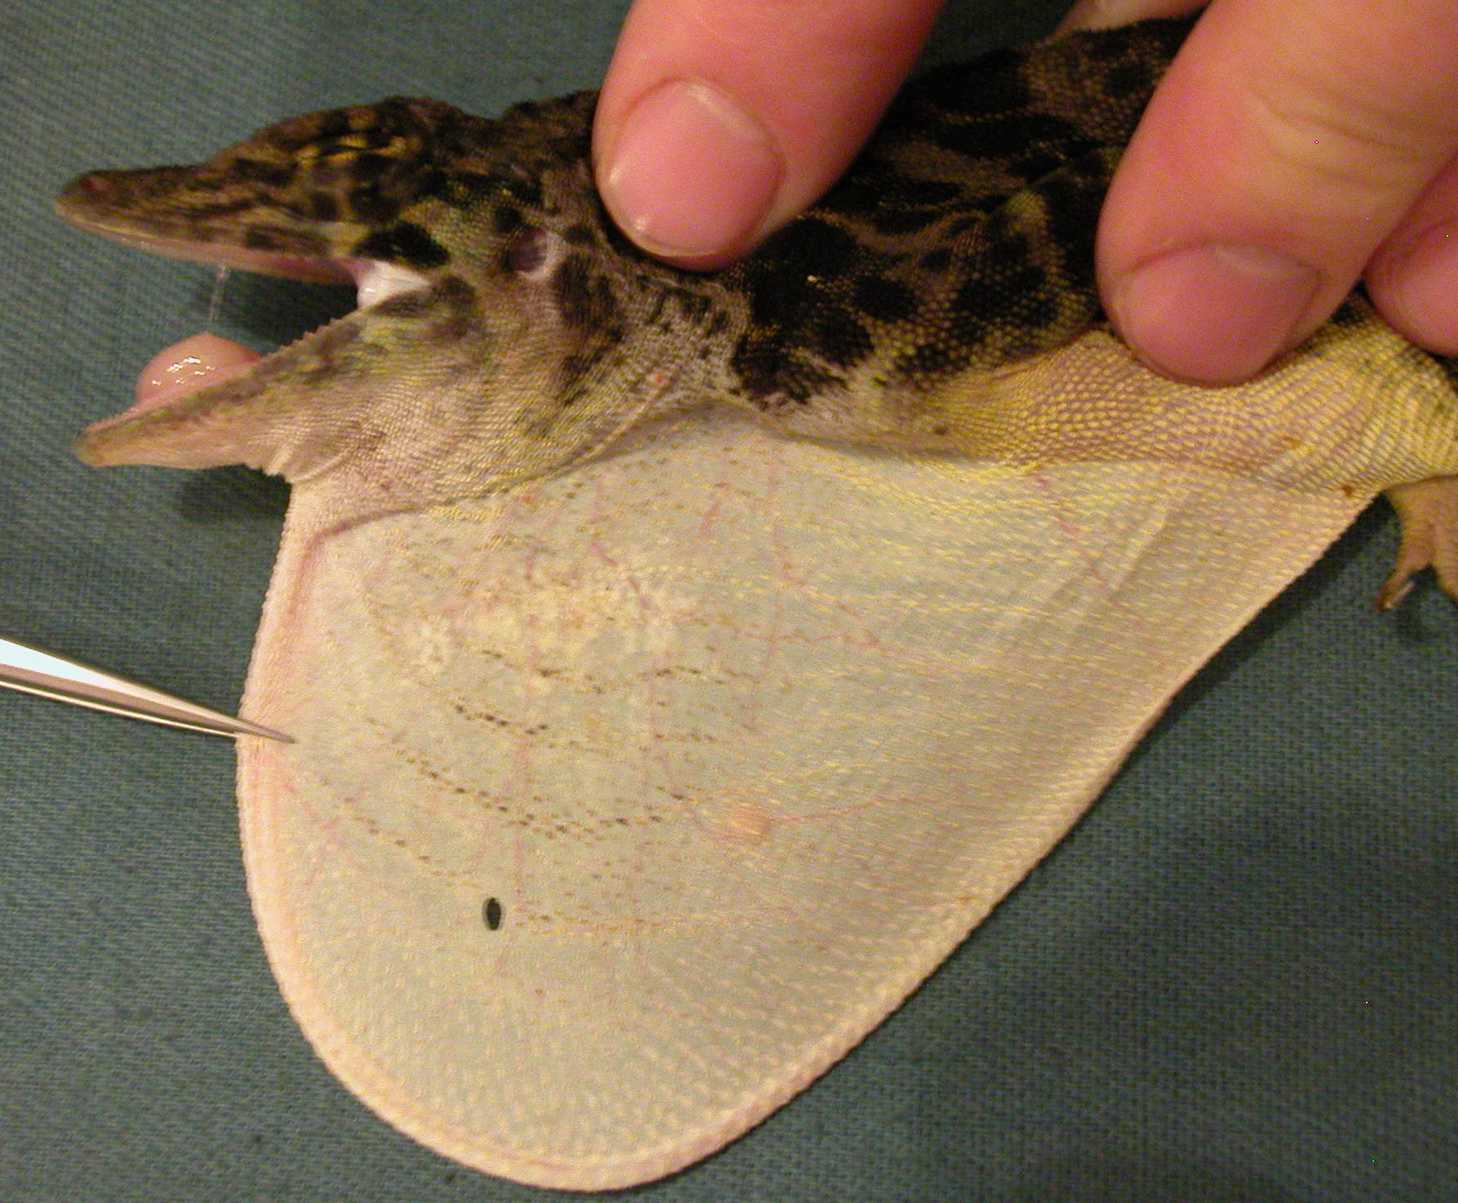
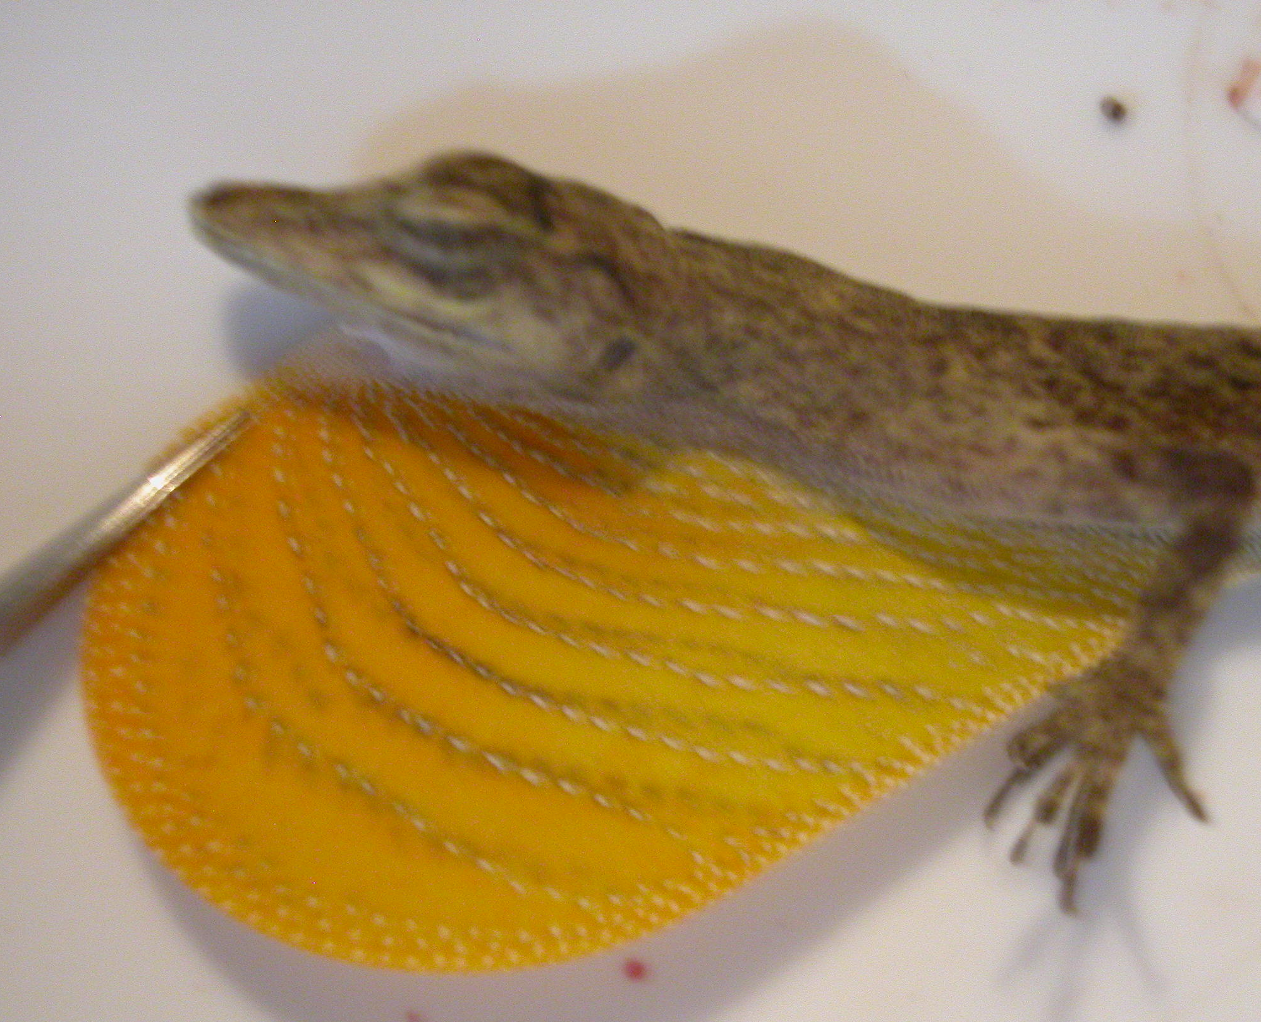
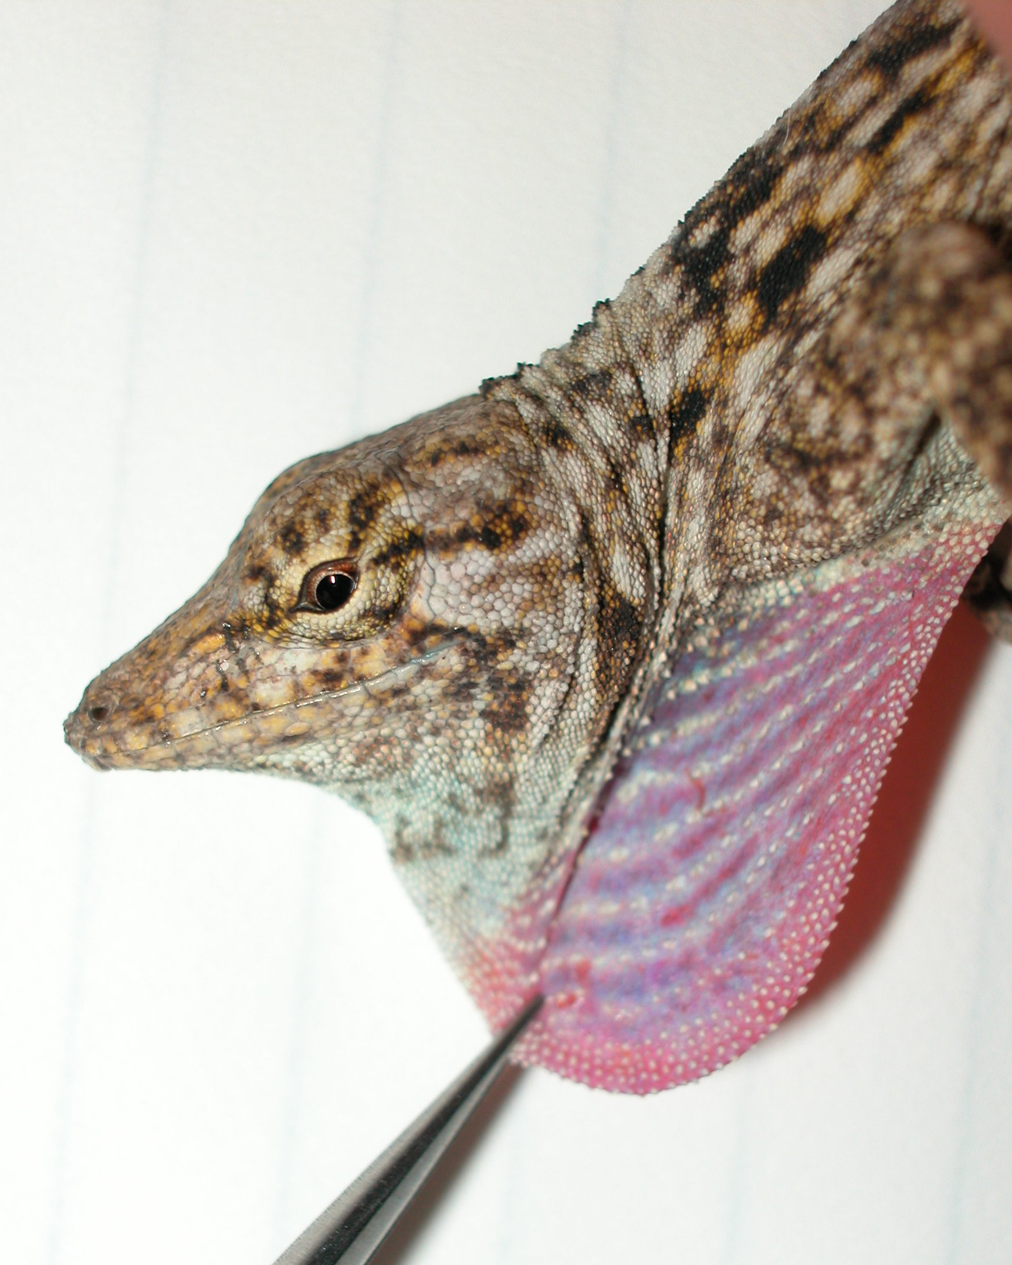
Anolis

Slide 16
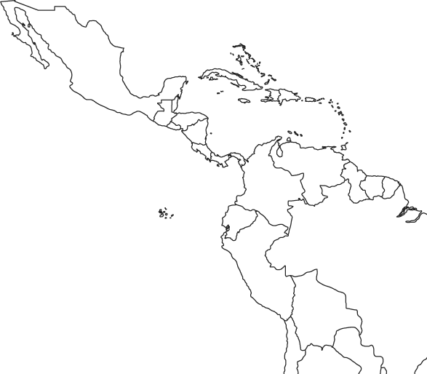
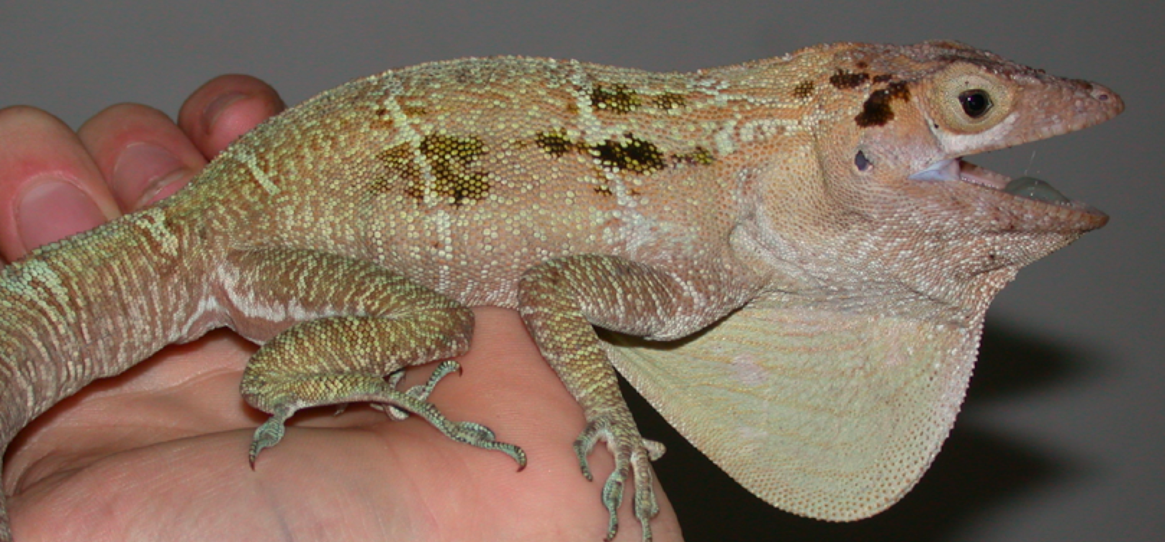
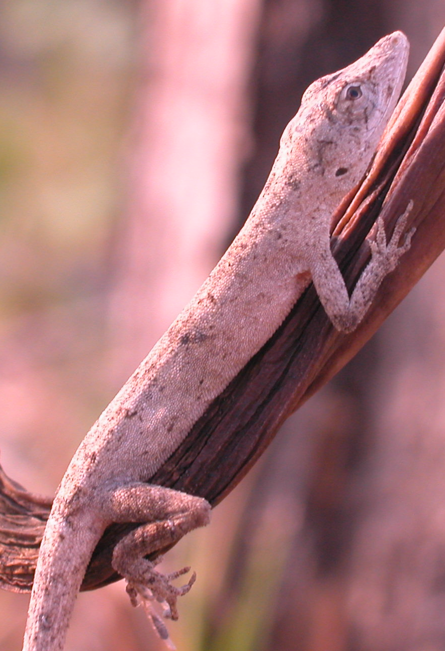
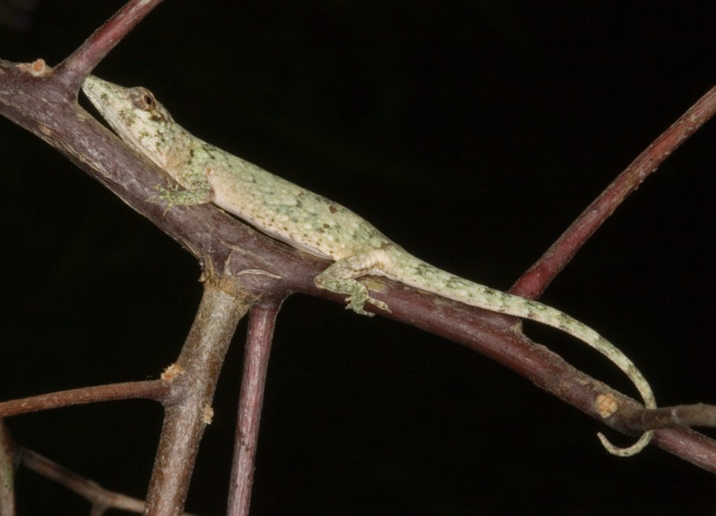
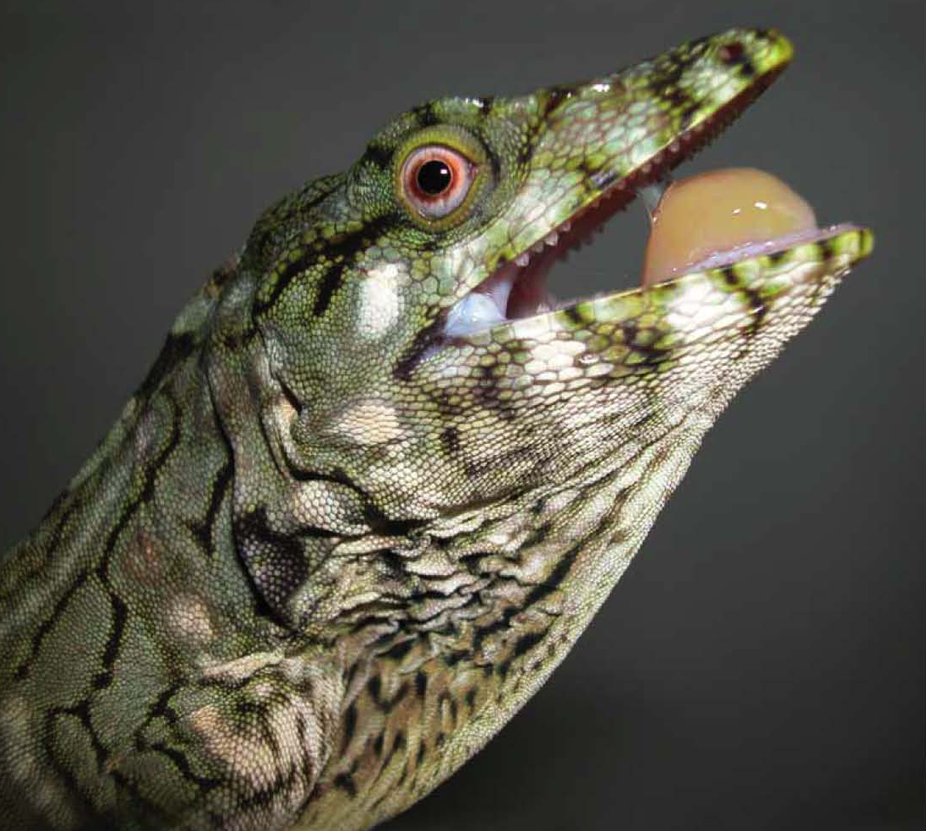
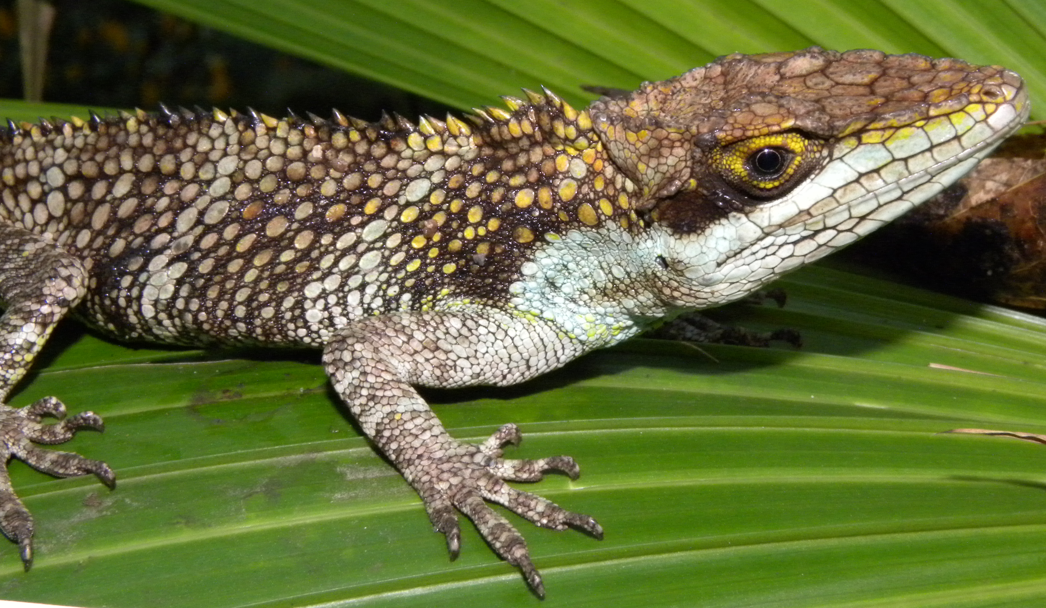
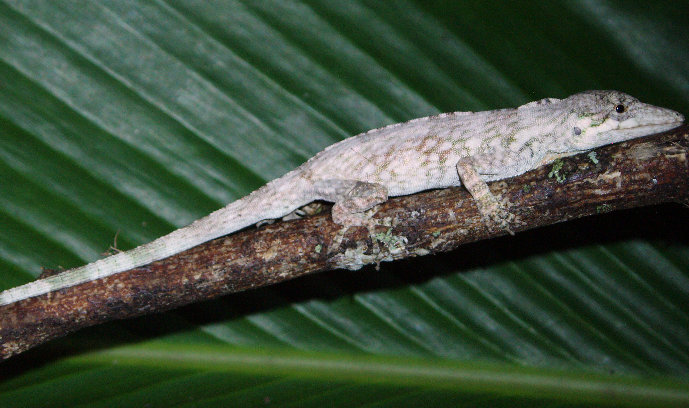
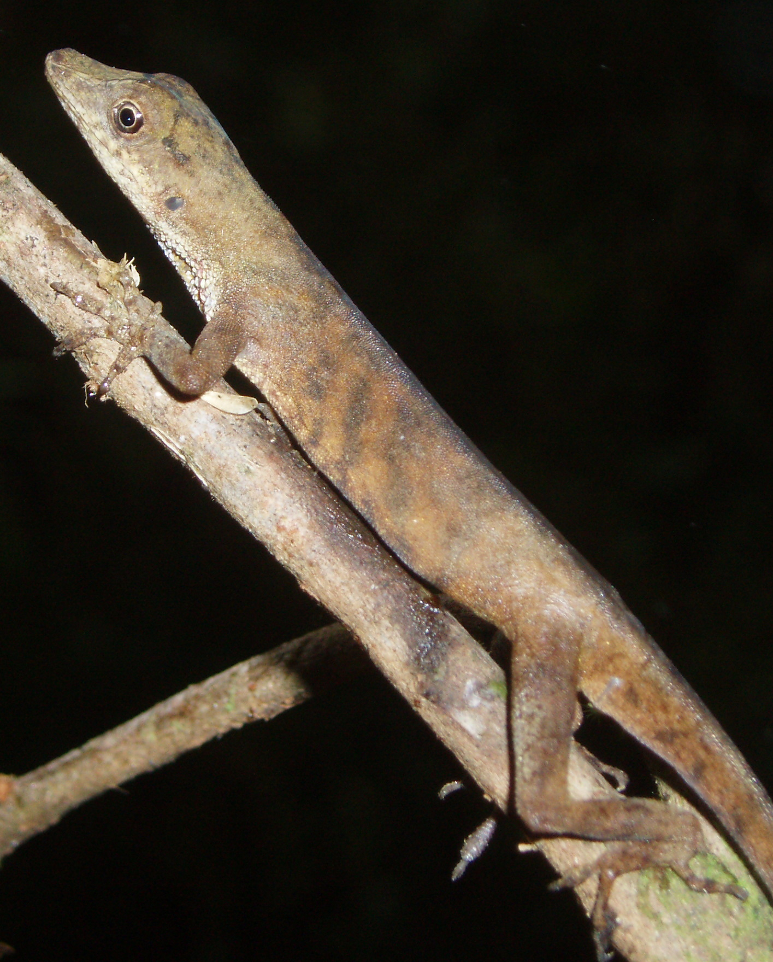

Slide 17
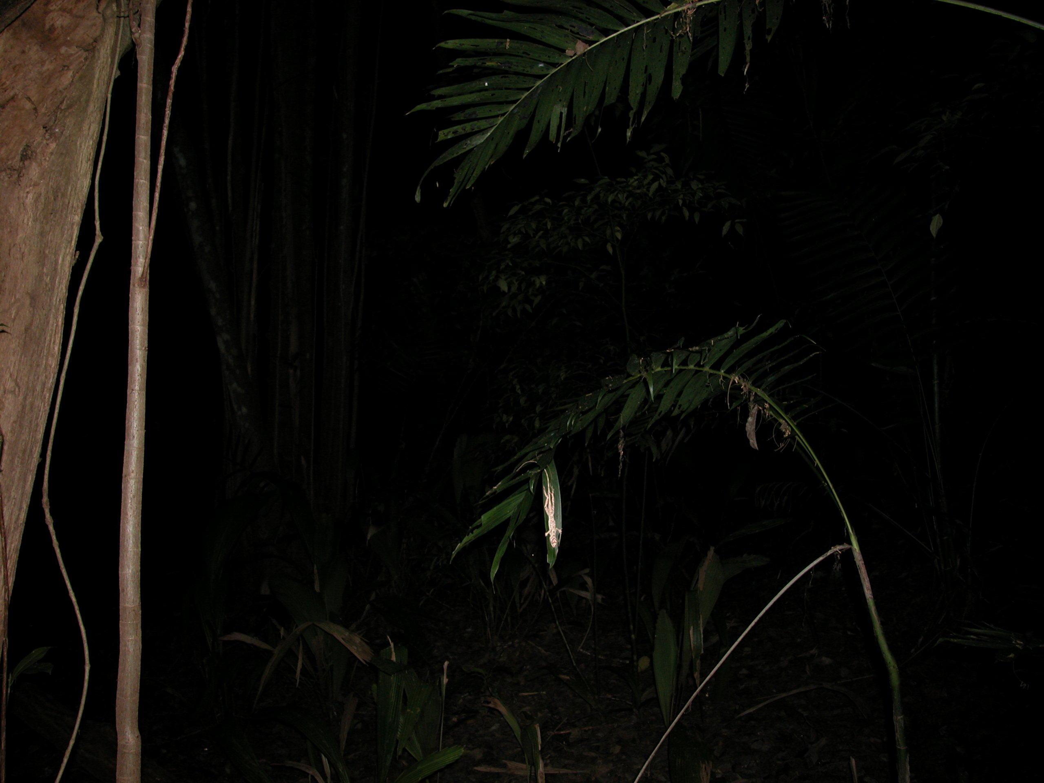

Slide 19
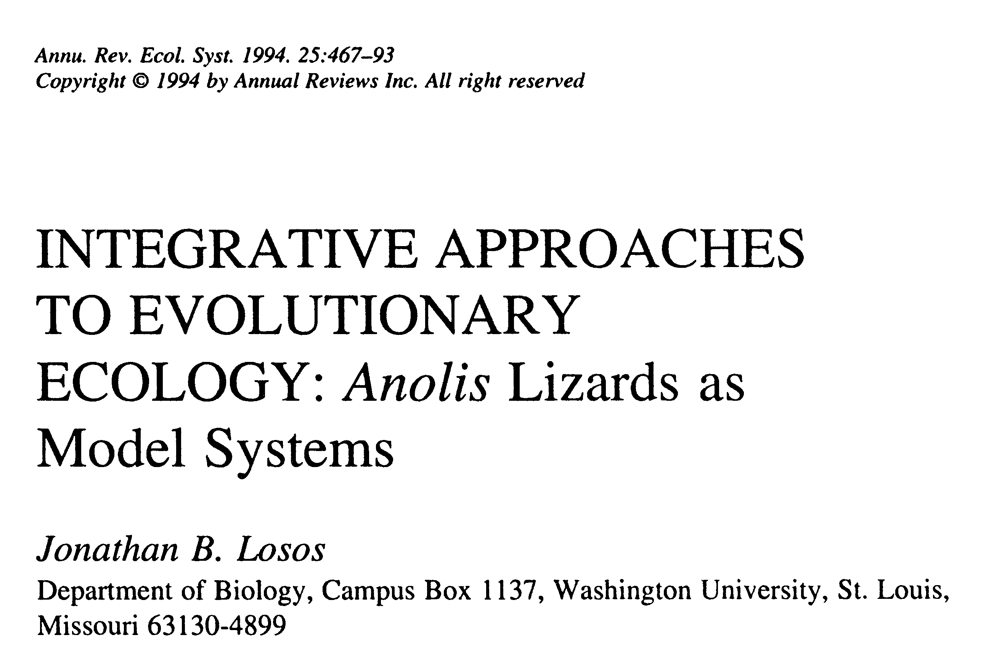
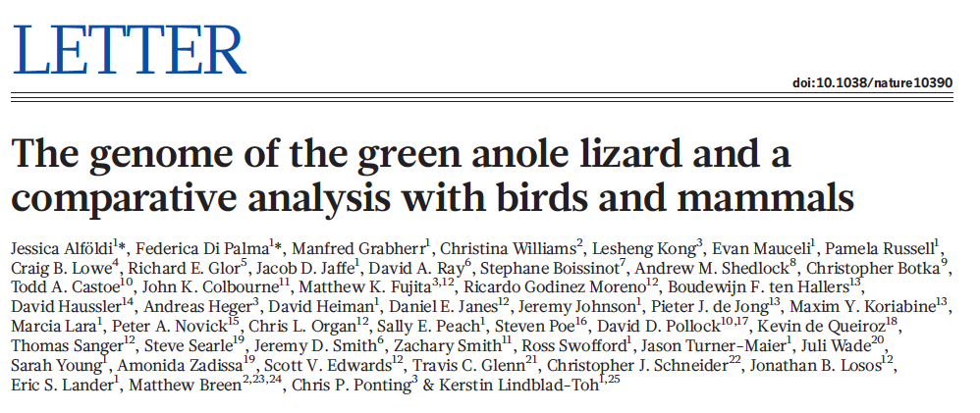
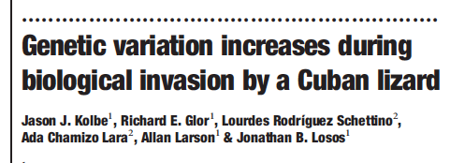

Slide 20
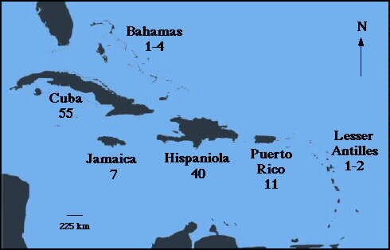
Adaptive Radiation example: Greater Antillean Anolis
One species invaded the Northern Caribbean from mainland America millions of years ago
This lineage evolved into several species, several ecological and morphological types

Slide 21
Ecomorph: Suite of ecological,
morphological, and behavioral
characteristics associated with
a particular niche.

Slide 22
Ecomorphs in Anolis lizards
Trunk-crown:
Cuba
Trunk-crown:
Hispaniola

Slide 23
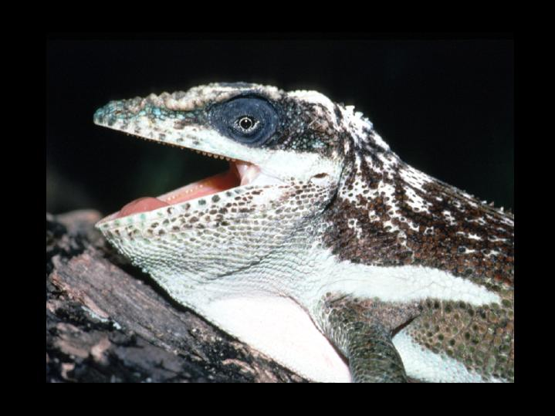
Crown-giant: Hispaniola
Crown-giant: Cuba

Slide 24
Trunk-ground:
Hispaniola
Trunk-ground:
Cuba

Slide 25
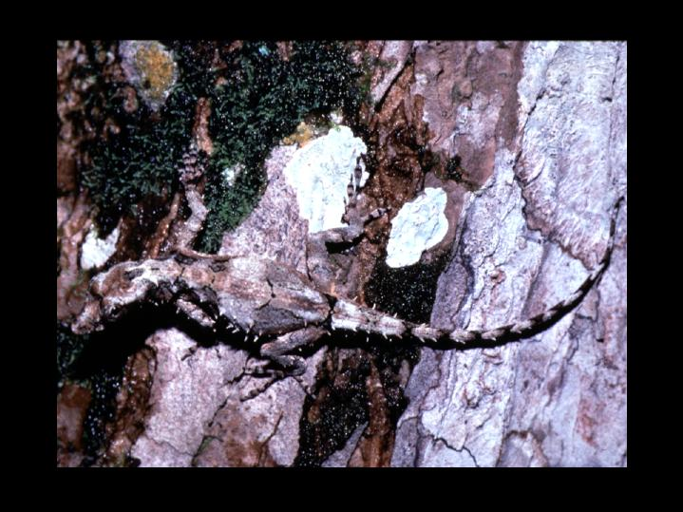
Trunk: Hispaniola
Trunk: Cuba

Slide 26
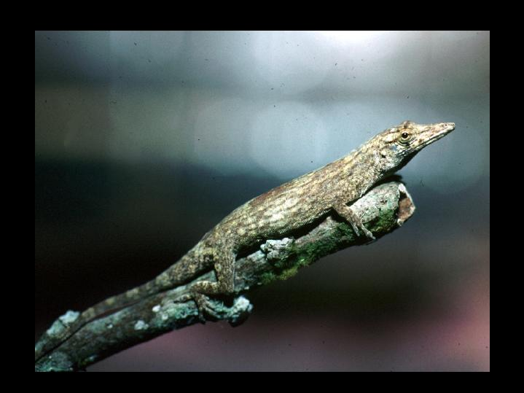
Twig: Hispaniola
Twig: Cuba

Slide 27
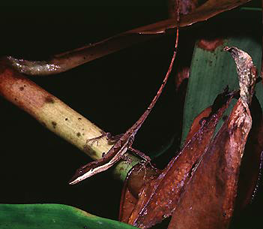
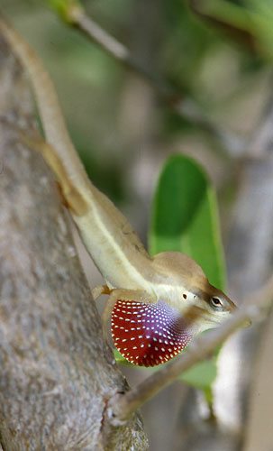
Grass: Puerto Rico
Grass: Hispaniola

Slide 28
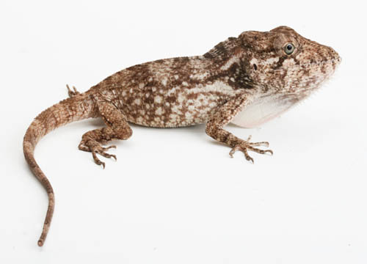
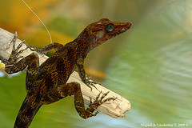
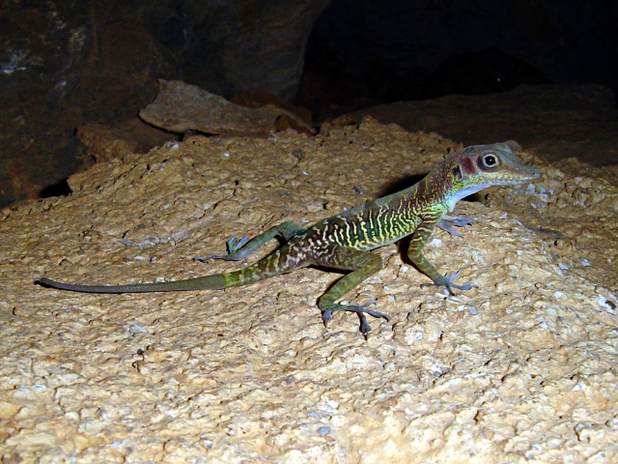
Greater Antillean
non ecomorphs
or
new ecomorphs

Slide 29
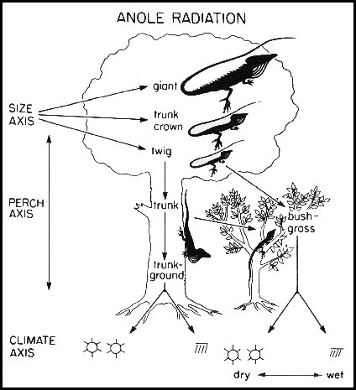

Slide 30
Question:
Did the ecomorphs (Em) evolve
independently as part of
monophyletic island lineages?
(adaptive radiation)
Or…
Did each ecomorph evolve
separately, then disperse to
each of the Greater Antilles?
(taxon/character assortment)
Island 1 island 2
Em 1 Em 2 Em 1 Em 2
Em 1 Em 2
Island 1 island 2 island 1 island 2

Slide 31
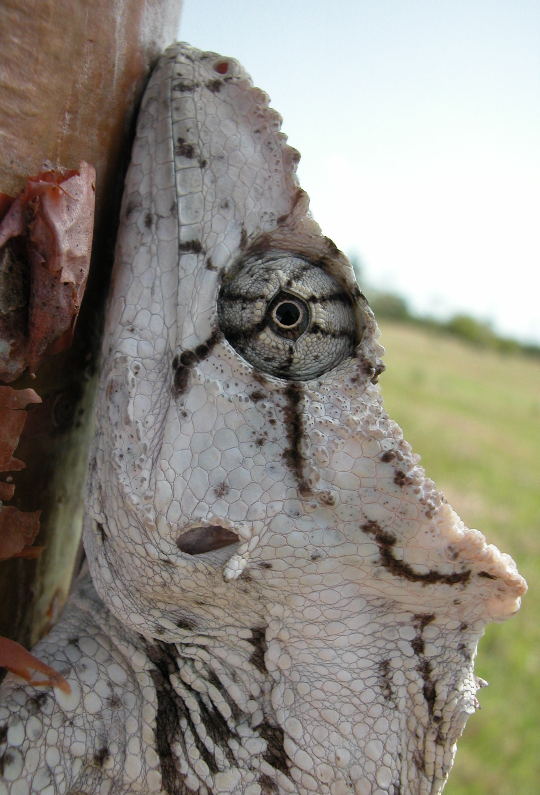
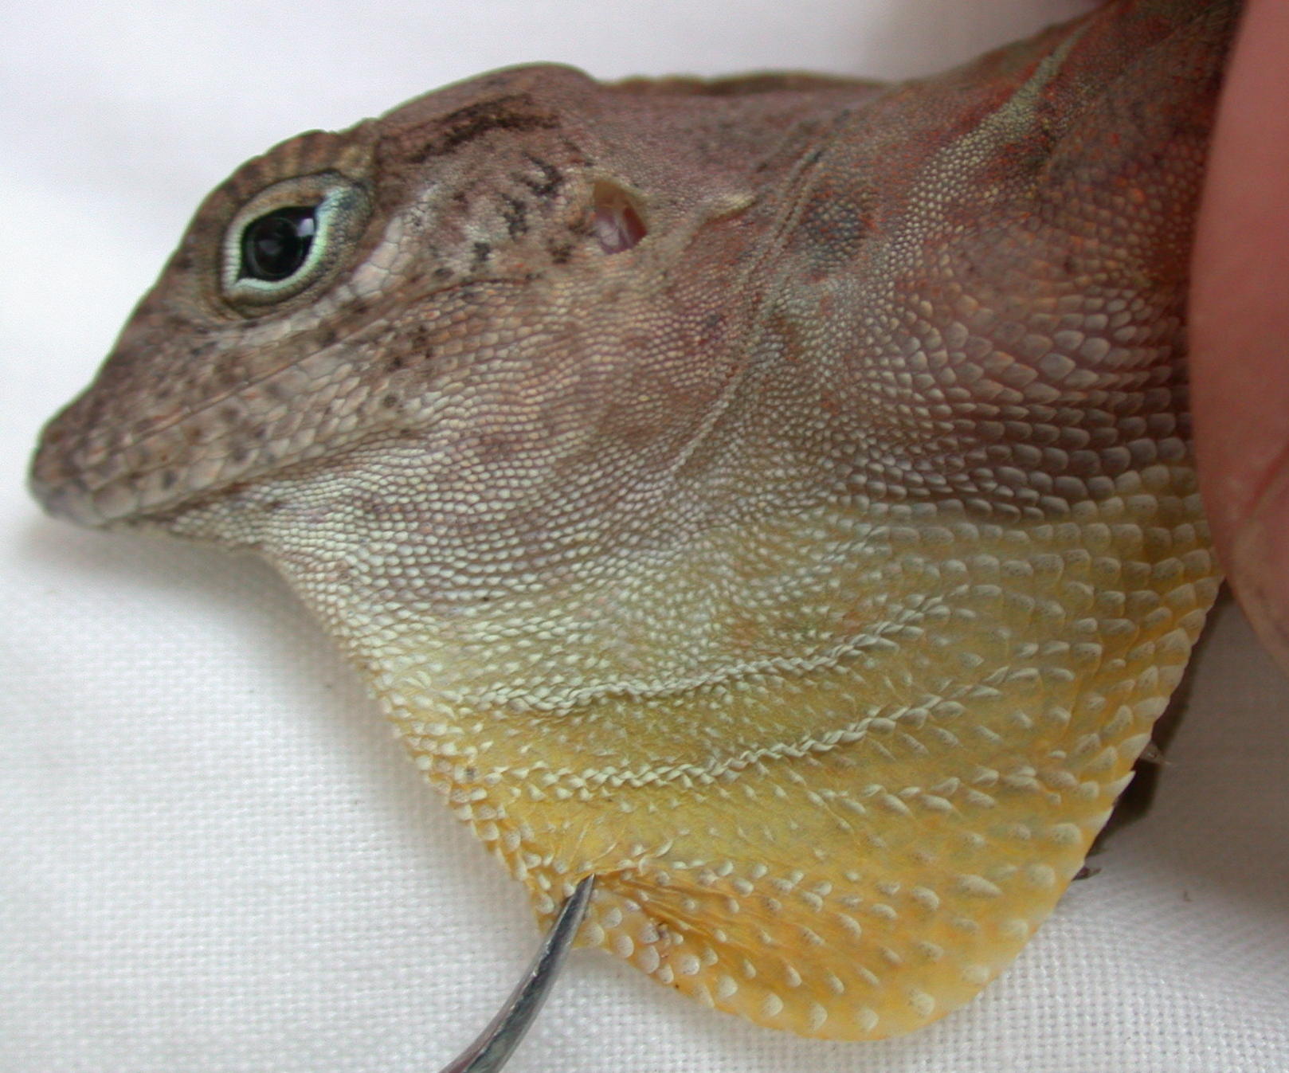
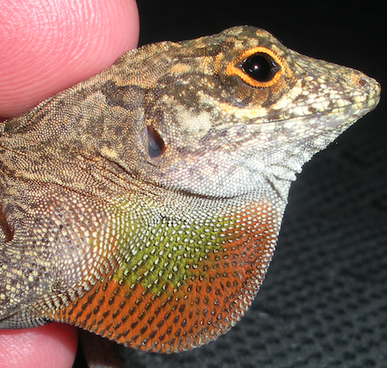
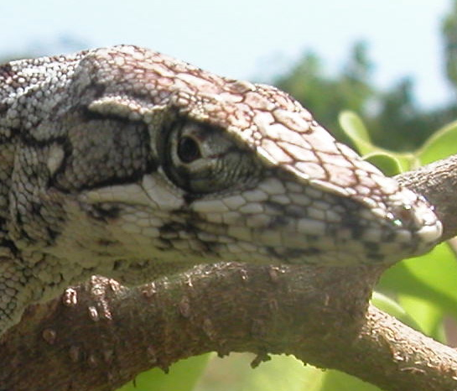
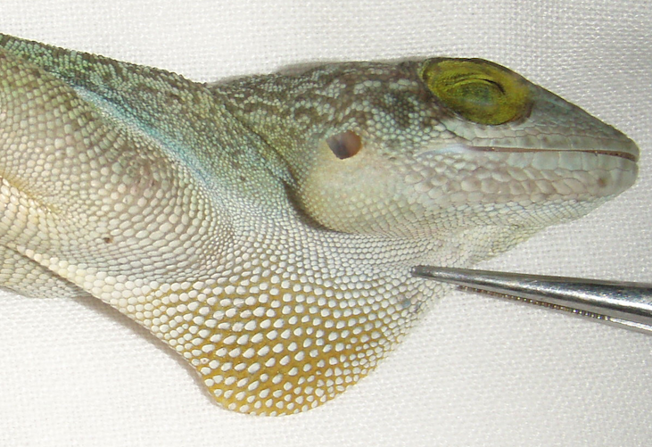
Test for adaptive radiation in Anolis (Losos et al. 1998)
1 Obtain phylogenetic estimate for Greater Antillean Anolis (mitochondrial DNA sequence data; parsimony, likelihood)

Slide 32
Test for adaptive radiation in Anolis (Losos et al. 1998)
1 Obtain phylogenetic estimate for Greater Antillean Anolis (parsimony, likelihood, etc.)
2 Note ecomorph type, island locality for each species

Slide 33
Test for adaptive radiation in Anolis (Losos et al. 1998)
1 Obtain phylogenetic estimate for Greater Antillean Anolis (parsimony, likelihood, etc.)
2 Note ecomorph type, island locality for each species
3 Map island locations, ecomorphs onto phylogenetic tree
islands monophyletic: Adaptive radiation
ecomorphs monophyletic: Taxon assortment

Slide 34
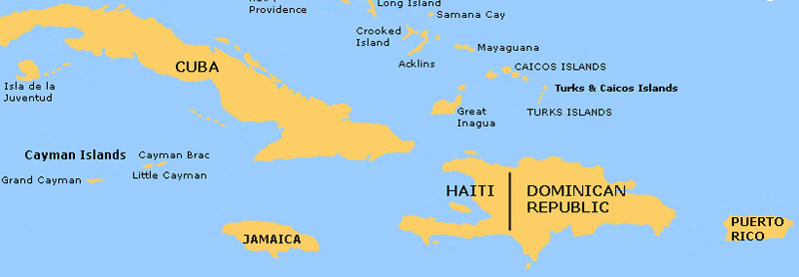
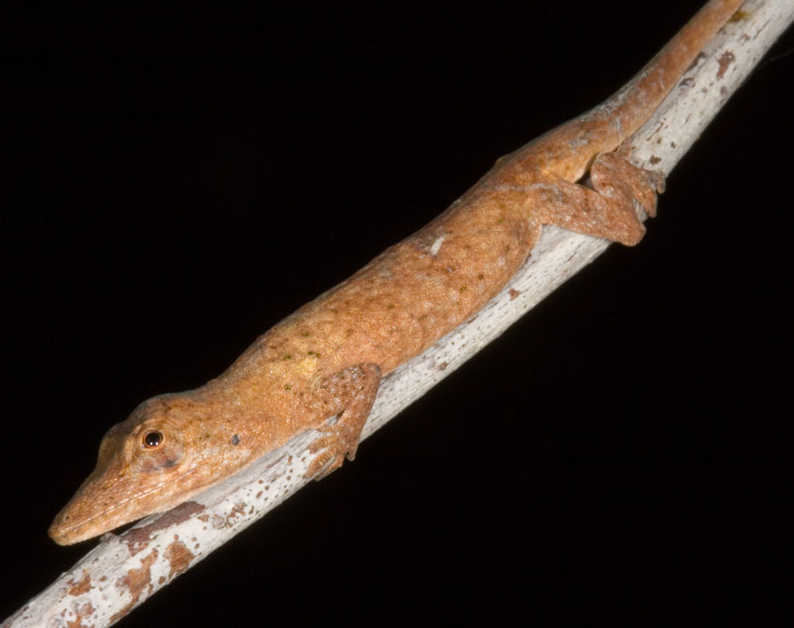
CG
to Hispaniola
TG
TC
to Jamaica
to Puerto Rico
to Cuba
TW

Slide 35
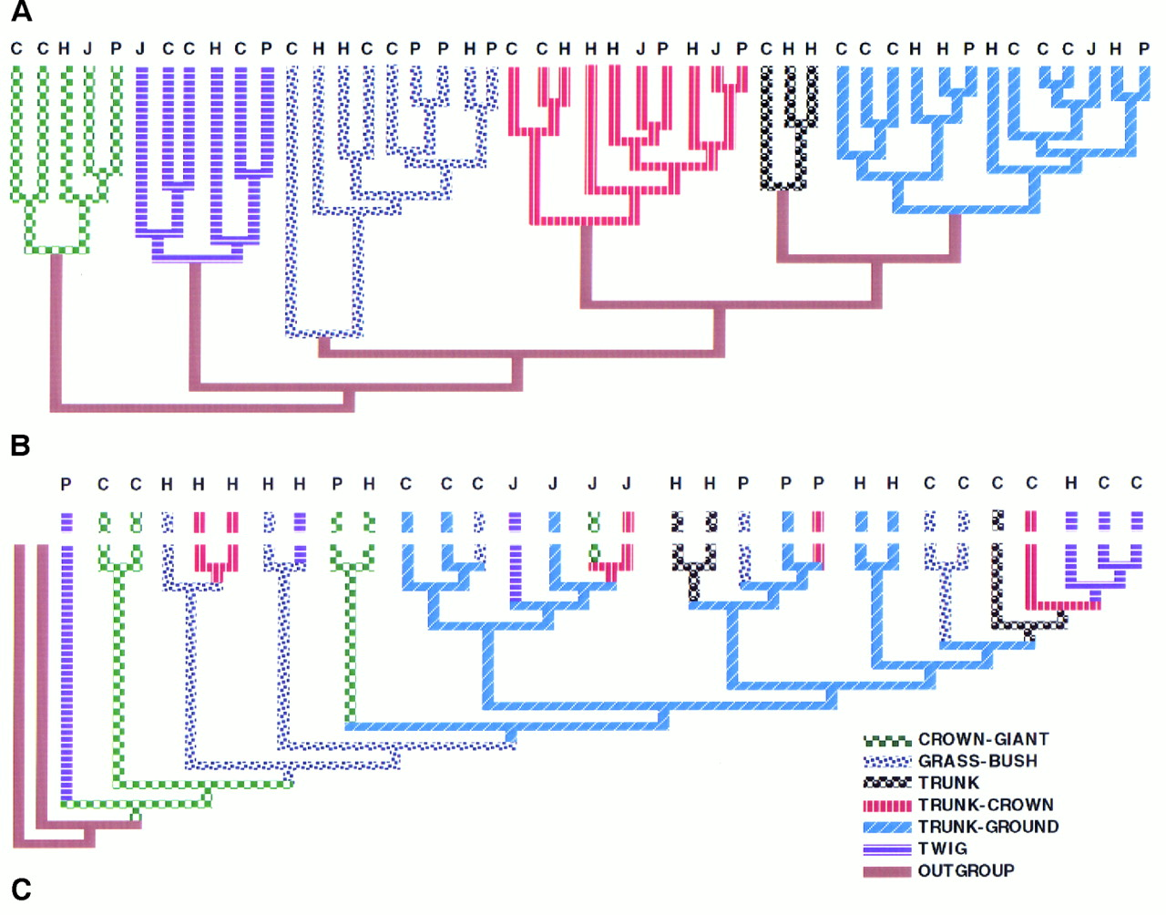
Notes:
(A) UPGMA phenogram showing that members of the same ecomorph class cluster in morphological space regardless of geographic affinities. Branch lengths are proportional to the distance separating species or clusters in morphological space. Letters indicate the island on which a species is found (C, Cuba; H, Hispaniola; J, Jamaica; P, Puerto Rico). The shading of the branches connecting the ecomorph classes has no significance. (B) The most parsimonious tree derived from the molecular data indicates frequent transitions among ecomorph classes. The lengths of the branches have no significance. (C) Topology of the four ecomorphs common to all islands, extracted for each island separately from the most parsimonious phylogeny.

Slide 37
Precambrian period origin of earth => 542 mya
Major events in evolution
Origin of life
Origin of photosynthesis
Origin of complex cells
Origin of sex
Origin of multicellular life

Slide 38
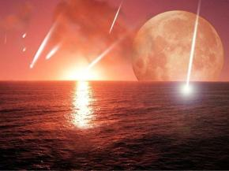
sex,
multicellularity
prokaryotes
(1st life)
eukaryotes
photosynthesis
Cambrian explosion
cyanobacteria
land plants
Notes:
Precambrian conditions:
Coalescense of the earth
Bombardment
Origin of continents
Moon close (tides of 1000ft)
No mountain building (little sediment)
Atmosphere
Originally lots of carbon dioxide, methane, ammonia
Later mainly nitrogen
Only later, oxygen Extensive, worldwide ice ages “Snowball Earth” Hostile to life

Slide 39
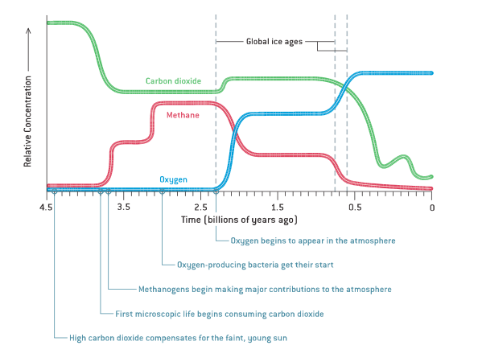
Earth was very different when life first evolved

Slide 40
1. Origin of life
~4000 Mya – Abiogenesis – life (metabolism, growth, reaction to stimuli, reproduction, evolution) from nonlife
Needed components
Organic molecules
Amino and nucleic acids
Macromolecules (proteins, peptide chains)
Membrane components (phospholipids)
Replication

Slide 41
Origin of life: what is needed?
Formation of amino acids (building blocks)
Linking of amino acids (complex structures)
Plasma membrane (cells)
Self-replicating (reproduction)
Need proteins and DNA
Or a self-replicating structural molecule (RNA world)

Slide 42
Origin of life: what is needed?
Formation of amino acids (building blocks) ✔ (Miller 1953)
Linking of amino acids (complex structures) ✔ (Fox and Harada 1958)
Plasma membrane (cells)
✔ (Dworkin et al. 2001)
Self-replicating (reproduction)
Need proteins and DNA
Or a self-replicating structural molecule (RNA world)

Slide 43
Formation of organic compounds
Simple amino and nucleic acids form naturally through non-life chemical reactions
Miller-Urey Experiment

Slide 44
Replication
"RNA world" hypothesis
RNA is both catalytic and (potentially) self replicating
Catalytic and can transmit information for future catalytic reactions
DNA later used for transmission of information
Enzymes later used for catalysis

Slide 45
First "life": Protobionts
Protobiont – aggregations of abiotically produced organic compounds in a lipid bilayer
Different internal chemical environment from surroundings (homeostasis)
Simple reproduction (e.g. fission), simple metabolism (e.g. simple biochemical cycles)
Competition
May have led to first single-celled organisms

Slide 46
Stromatolites
First known living things (from fossils)
Stromatolites – 2800-3500 Mya
Films of cyanobacteria that trap sediment

Slide 47
2. Photosynthesis
~2800 Mya
Cyanobacteria
H₂O as a source of electrons
Release of O₂ into atmosphere, first O₂
Oxygen is toxic to anaerobic organisms
Led to the "Oxygen Catastrophe" or "Great Oxygen Event" 2400 Mya

Slide 48
3. Origin of complex cells (eukaryotes)
Grypania
~2100 Mya – Eukaryotes
Fusion of two or more cells
Thought to have arisen once with subsequent incorporation of additional organelles

Slide 49
Modern organelles were Bacteria/Algae
Similar size and morphology
Double membrane
Outer from engulfing vesicle
Inner from bacterial plasma membrane
Similar enzymes and inner membrane transport systems
Similar division (i.e. by binary fission)
Circular DNA genome
Similar protein synthesis machinery including rRNA and tRNAs
Phylogenetic analyses suggests relationship with bacteria/algae

Slide 50
4. Origin of Sex
~1200 Mya – in red algae, Bangiomorpha pubescens
Probably originated a single time
Originated and persisted because of benefits of sexual reproduction
Helps spread advantageous alleles
Helps remove or “hide”
disadvantageous alleles
Recombination provides variability

Slide 51
5. Origin of multicellular life
~1200 Mya
Sex (Production of alternative gametes) may have led to origin of multicellular life (combination of gametes from different individuals)
Colonial Theory – Colonies of same species of unicellular life
Symbiotic Theory – Symbiosis of species of unicellular life
Cellularisation Theory – A single cell may have developed multiple nuclei and internal membranization
Arose multiple times (ancestors of plants, fungi, animals and others)

Slide 52
http://www.youtube.com/watch?v=U6QYDdgP9eg

